Slide 1
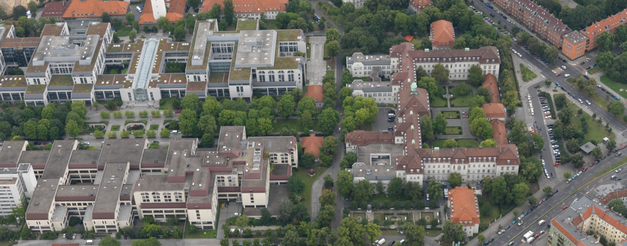
Topographical Anatomy of the Mitral Valve
EACTS Academy- Hannes Meyer Cardiothoracic Surgery Research & Training Symposium Bloemfontein, South Africa 3-5 June 2011
Charité Medical University Berlin
Deutsches Herzzentrum Berlin
Charles A. Yankah, MD, PhD
Deutsches Herzzentrum Berlin & Charité Medical University Berlin, Germany

Slide 2
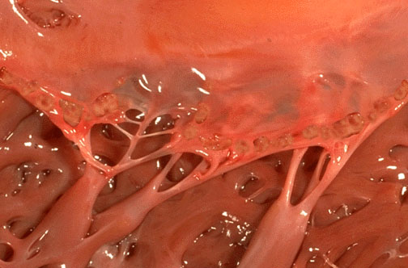
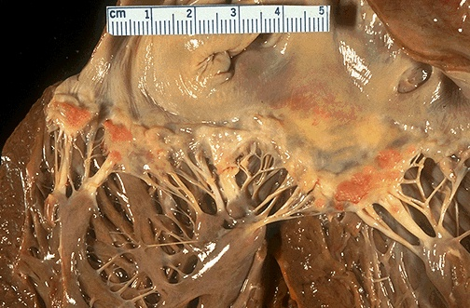
Burden of rheumatic heart disease:
Disease of poverty/socioeconomic status
Global impact
16 million worldwide affected
95% occurs in developing countries
500.000 new cases of ARF every year
Binotto et al. Images Paediatr Cardiol 2002;11:12-25
World Heart Federation 2011

Slide 3
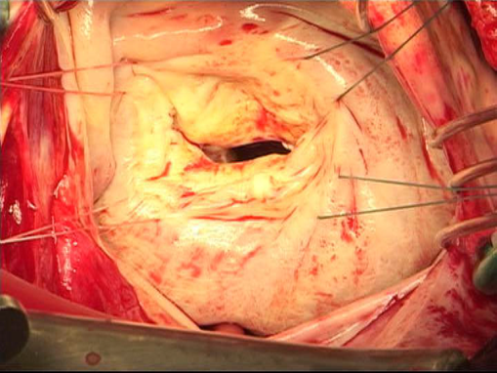
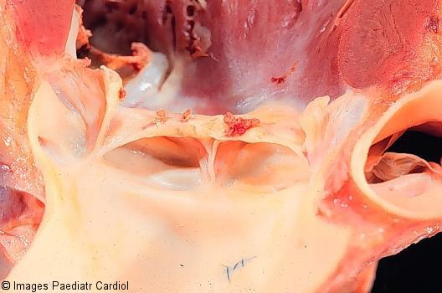
Burden of rheumatic heart disease:
Disease of poverty/socioeconomic status
300.000 wiil develop RHD
Hundreds of thousand with disabling heart disease
350.000 deaths/year from ARF and RHD
Most people are diagnosed late with advanced disease
Binotto et al. Images Paediatr Cardiol 2002;11:12-25
World Heart Federation 2011

Slide 4
Burden of rheumatic heart disease:
Disease of poverty/socioeconomic status
Treatment of RF and RHD and annual cost in Brazil
(Datusus – Health System 2007)
Clinical treatment US$ 30.000.000
Cardiac surgery US$ 50.000.000
Can Africa afford it?

Slide 5
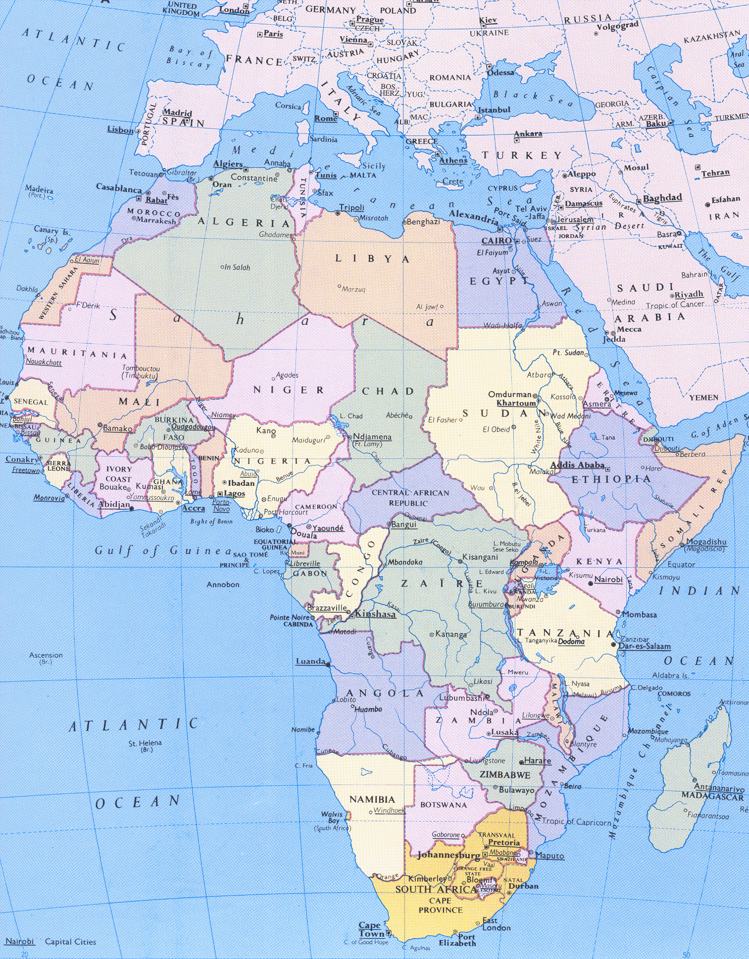
African Countries with Cardiac Centres
N= 25
Population: 1.03 billion
*
*
High volume centres:
Egypt, South Africa, Sudan
*
*
*
*
*
*
*
*
*
*
*
*
*
*
*
*
*
*
*
*
*
*
Source: Prof. Ogola, Kenya 2011

Slide 6
Centres which do not host visiting teams
330 Cardiac surgeons, 1 Surgeon/3.12 million population,
1Cardiac centre/41.2 million population
South Africa* 8.000 (+16000**)
Egypt* 12.000
Sudan * 2000
*Do not host visiting teams (missions)
** Interventions

Slide 7
South Africa
47 million citizens
Decrease in rheumatic fever/RHD
27 open heart facilities
8000 open heart ohs./yr.
16000 interventions/yr.
4 transplant units
1 artificial heart program

Slide 8
Cardiac surgeons and centres in Africa
Population of Africa (2010) 1.03 billion
Cardiac centres 25
Cardiac surgeons 330
1Cardiac centre/41.2 million population
1 Surgeon/3.12 million population,

Slide 9
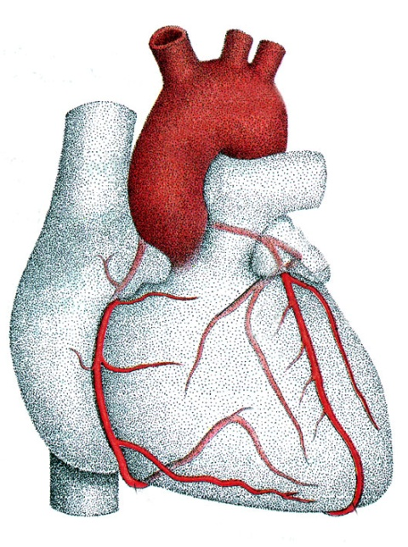
Topographical Anatomy of the Mitral Valve
The Heart

Slide 10
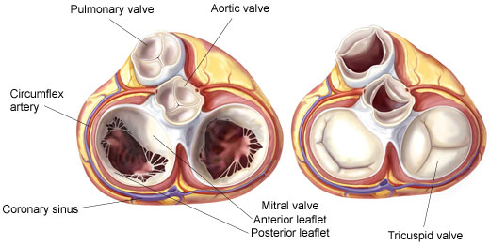
The mitral valve and ist neighbouring structures

Slide 11
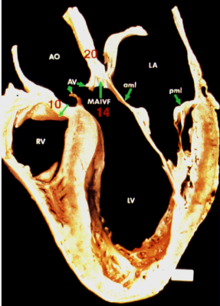
Longitudinal section of the heart demonstrating the heart structures and potential areas for expansion of aortic and mitral valve endocarditis

Slide 12
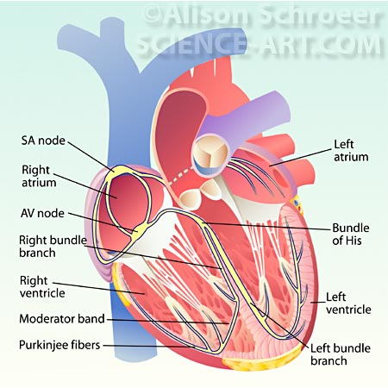
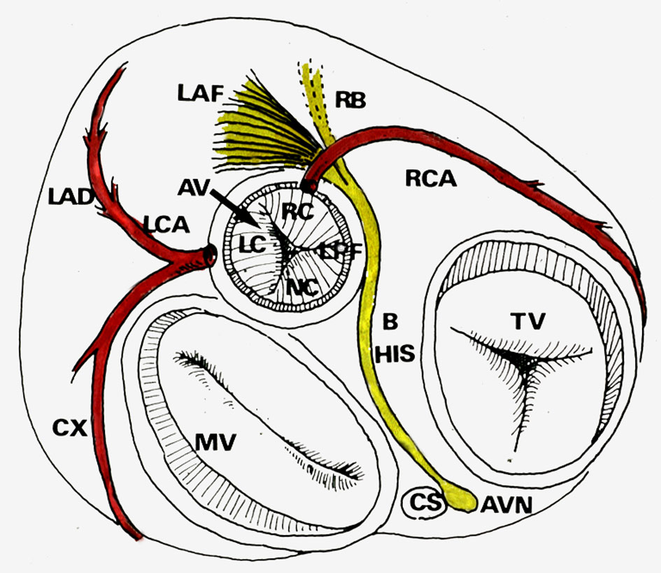
Anatomic relationship of cardiac valves and structures and the conducting system of the heart
Hutter et al. JAMA 1976

Slide 13
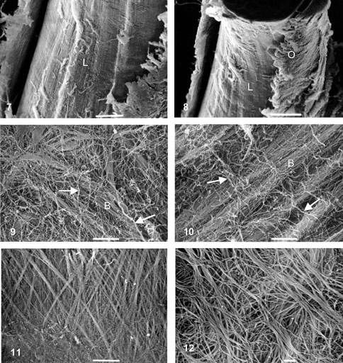
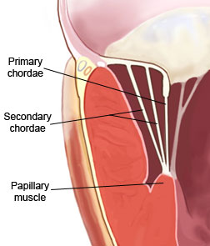
SEM of Chordae tendinae (Figs. 7, 8, 10)
Architecture in the papillary muscle insertion (Fig. 12)
Gusukuma et al. Int J Morphol 22(4):267, 2004.

Slide 14
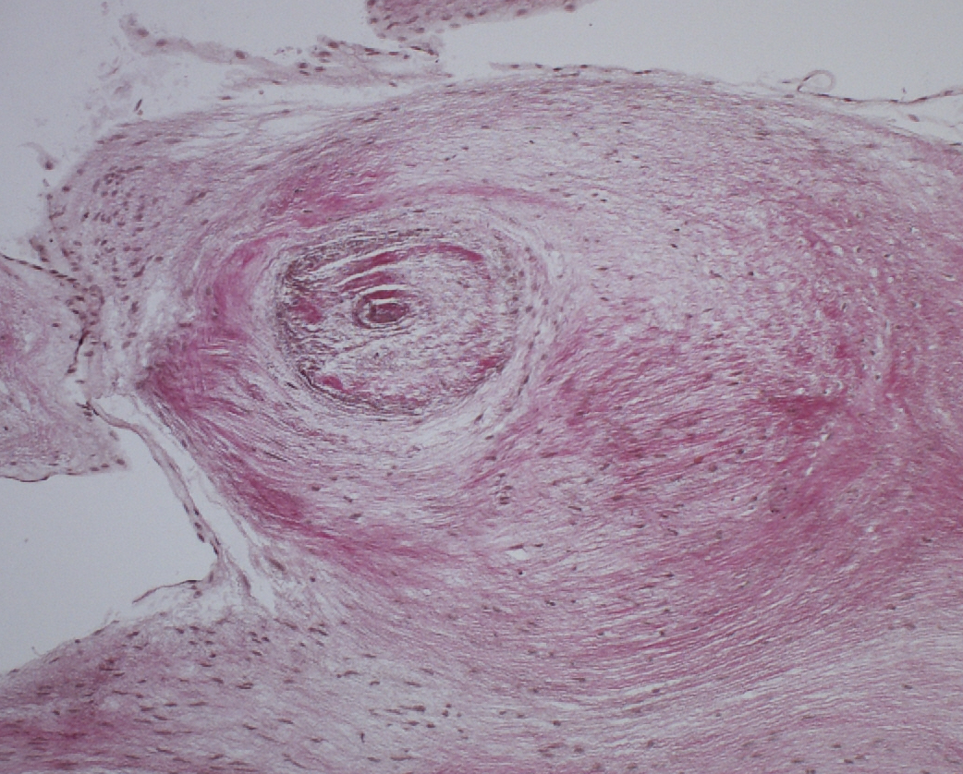
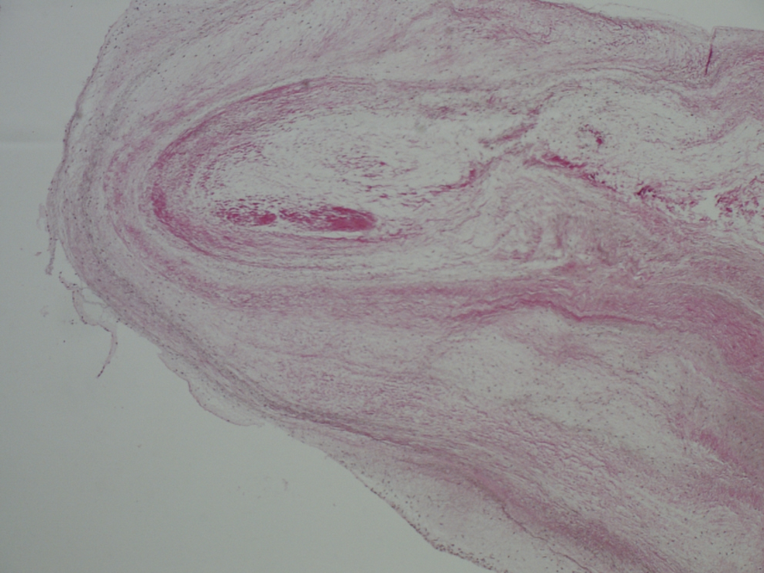
Microscopic view of a chorda tendinae of a rheumatic mitral valve
rf
cf
chorda tendinae
rf
cf
chorda tendinae
mc
mc
Cross sectional view, elastica van Gieson:
Collagen fibres (cf), residual fibrosa (rf),
mucoid changes (mc)
Dr. Dirsch, Cardiac Pathologist, DHZB
Oblique sectional view, elastica van Gieson:
Collagen fibres (red), residual fibrosa, mucoid
degeneration

Slide 15
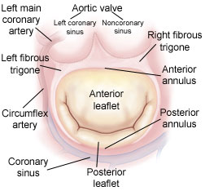
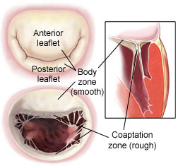
The mitral valve:The annulus and the zone of coaptation

Slide 16
Mitral valve diseases
Etiology:
• Mitral valve prolapse • Cardiomyopathy
• Degenerative/myxomatous • Ischemic
• Papillary muscle dysfunction • Dilated
• Ruptured chordae tendineae • Restrictive
• Rheumatic • Hypertrophic
• Endocarditis • Congenital
• Mitral annular calcification • Trauma

Slide 17
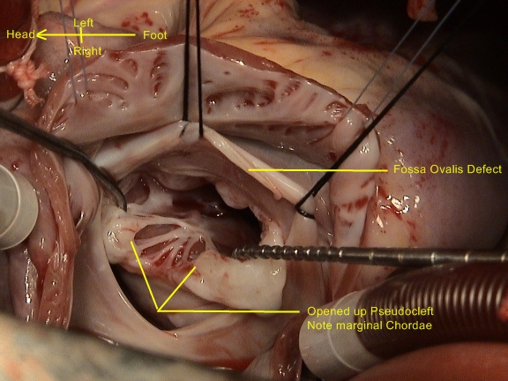
Congenital mitral valve diseases
Parachute
mitral valve
Mitral valve
dysplasia
Hammock
mitral valve
Mitral cleft

Slide 18
Mitral valve diseases
Etiology:
• Mitral valve prolapse • Cardiomyopathy
• Degenerative/myxomatous • Ischemic
• Papillary muscle dysfunction • Dilated
• Ruptured chordae tendineae • Restrictive
• Rheumatic • Hypertrophic
• Endocarditis • Congenital
• Mitral annular calcification • Trauma

Slide 19
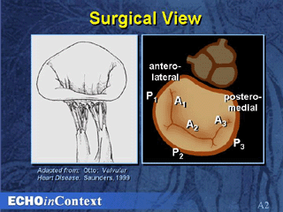
Surgical Anatomy of the Mitral Valve

Slide 20
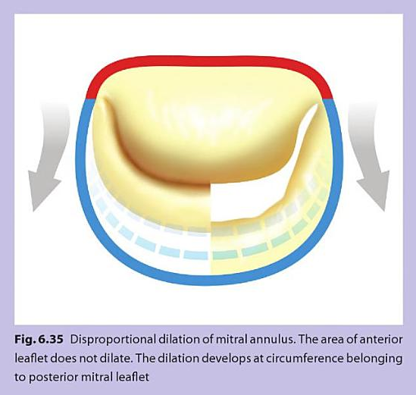

Slide 21
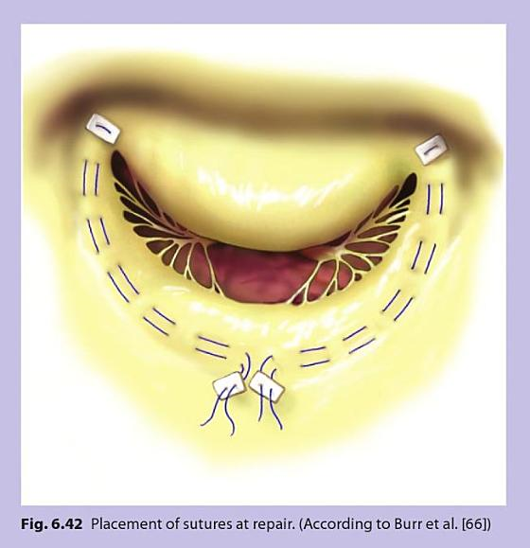
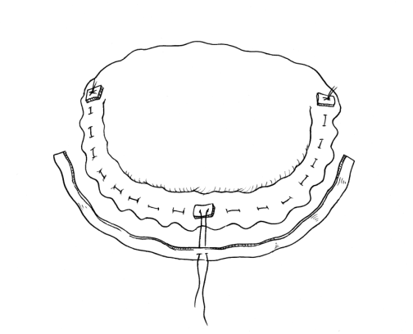
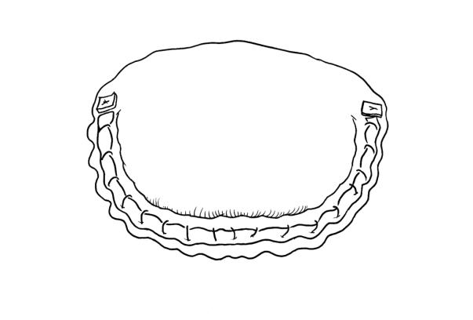
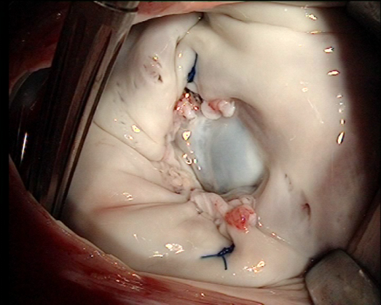
Posterior annuloplasty (Paneth)
Paneth posterior suture and
pericardial strip annuloplasty

Slide 22
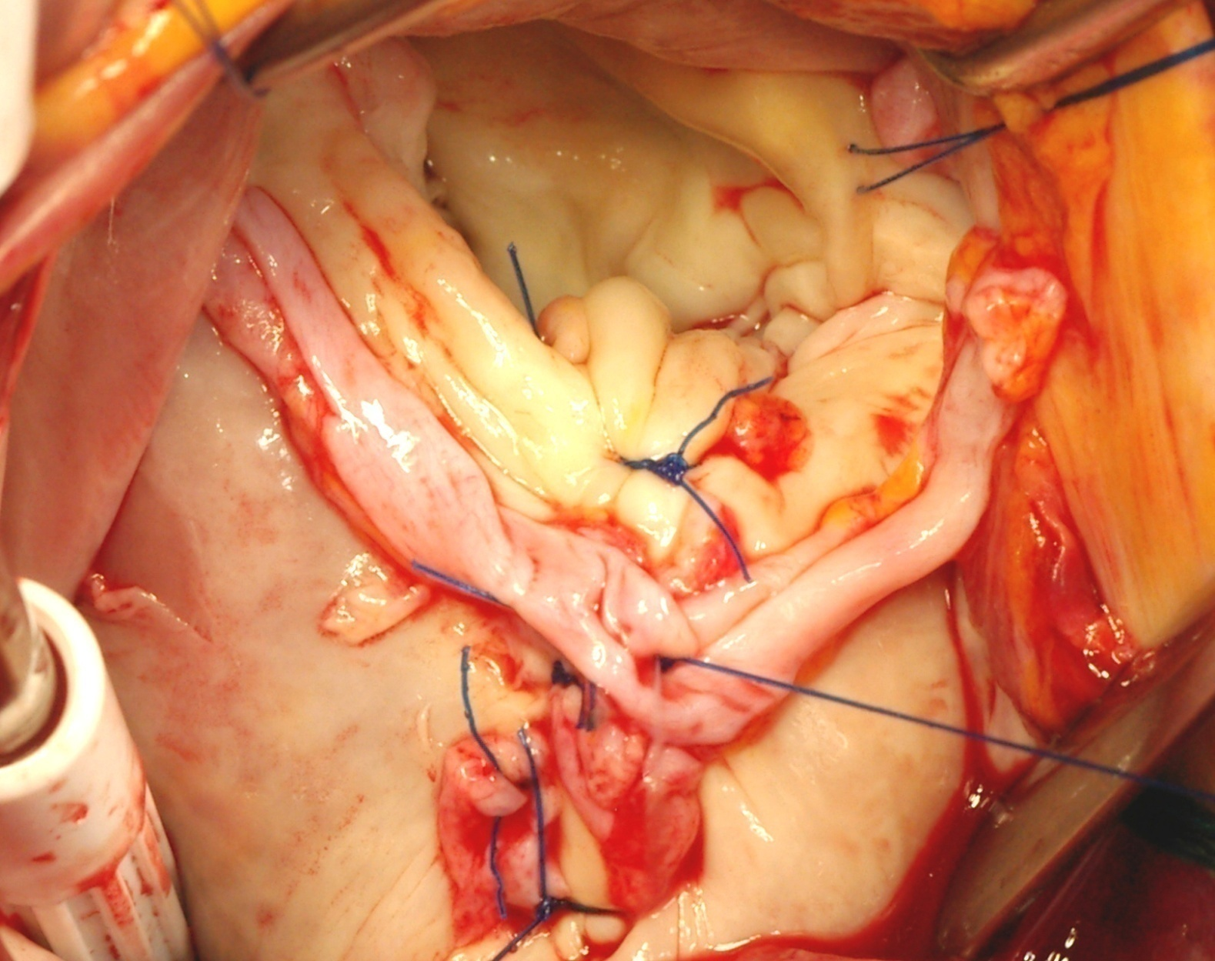
Mitral repair in AIE: Posterior leaflet plication (Gerbode) + Posterior annuloplasty with autologous pericardial strip

Slide 23
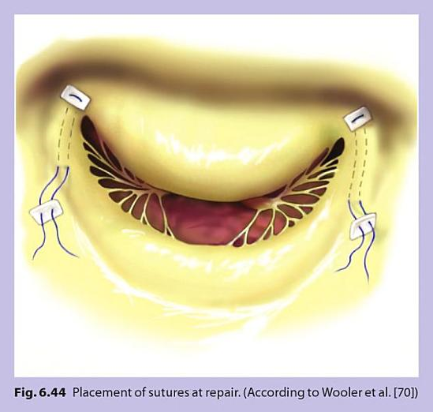
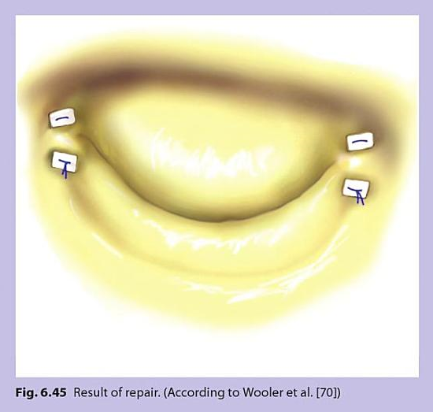
Wooler mitral commissuroplasty

Slide 24
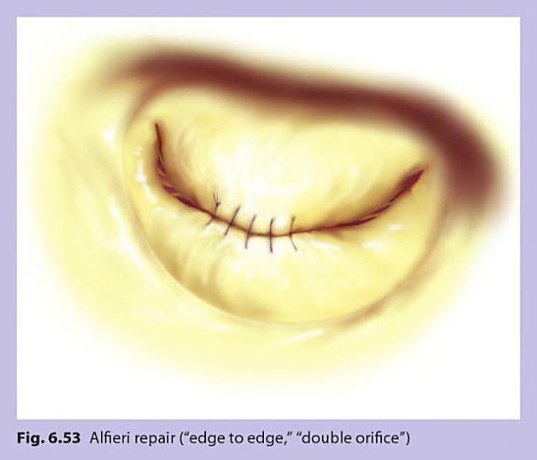
Alfieri repair: Edge to edge double orifice

Slide 25
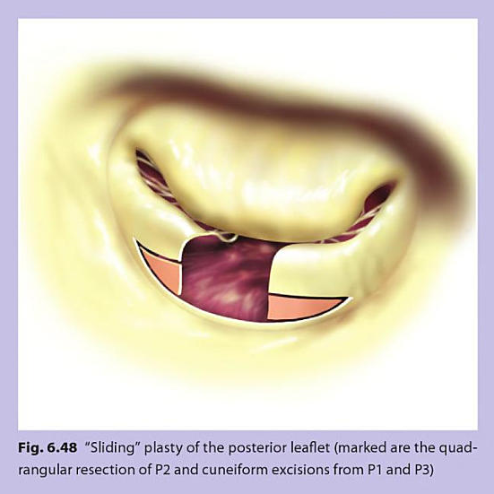
Sliding plasty of the posterior leaflet
Quandrangular resection of P2 and cuneiform excisions from P1 and P3

Slide 26
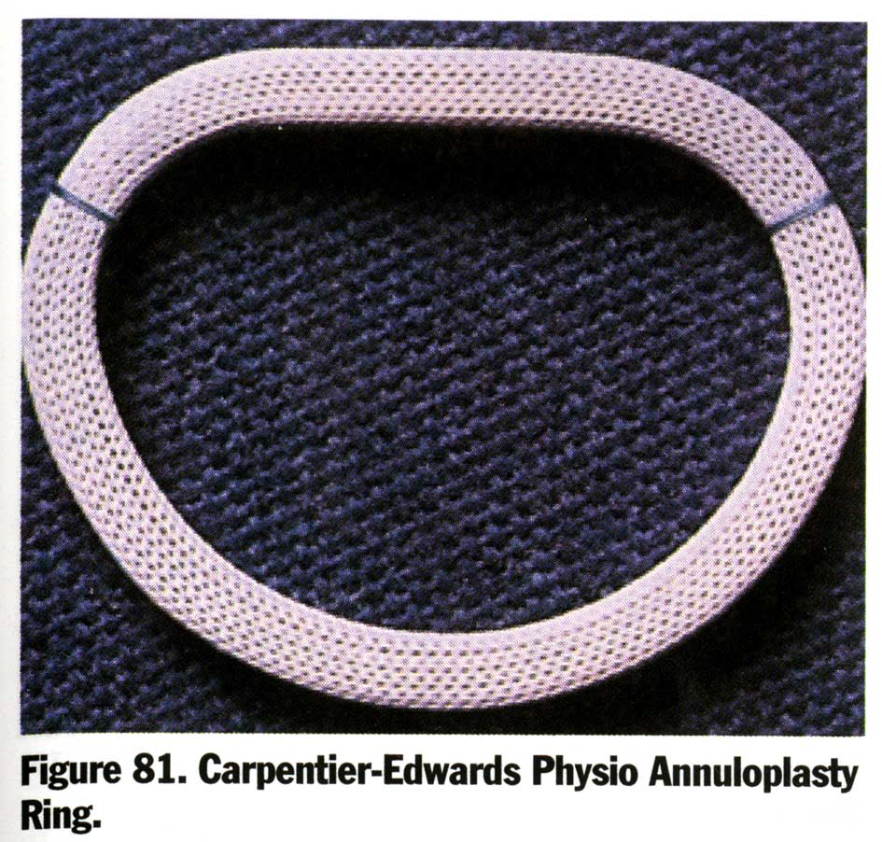
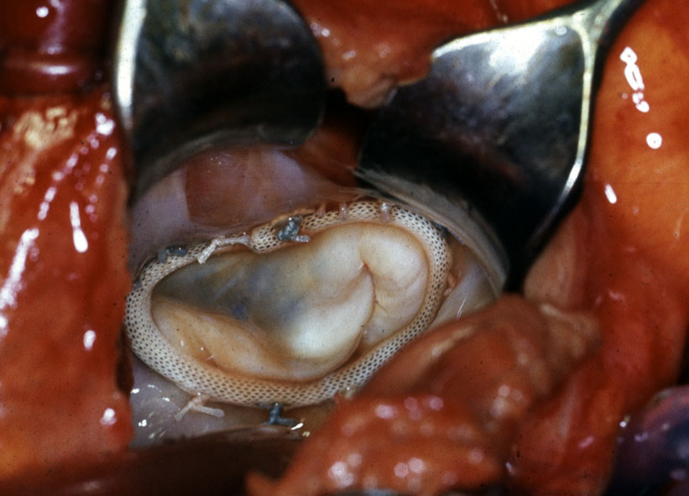
Annuloplasty Prostheses for
Valvular Reconstructive Surgery
Jamieson et al, 2006

Slide 27
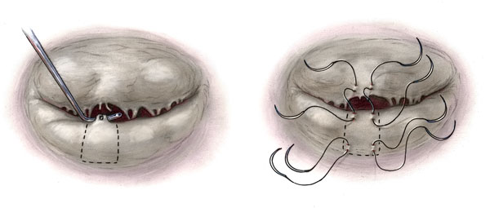
Elongated chord of posterior ML: Technique of posterior chordal transfer to the AML
Riley and Kon, CTS Net 2008
Notes:
27

Slide 28
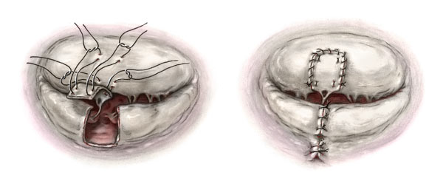
Chordal transfer
Chordae of proper length are borrowed from the posterior leaflet and transposed to the anterior leaflet
Riley and Kon, CTS Net 2008

Slide 29
Mitral valve disease
Establishing the diagnosis
Perioperative Echocardiography
Transesophageal (TEE) and Transthoracic (TTE)
Transesophageal echocardiography (TEE)
is a useful adjunct to confirm the diagnosis and understand the mechanism of degenerative valve disease in the case of a non-definitive transthoracic examination.

Slide 30
Mitral valve disease
Establishing the diagnosis
Echocardiography
2-D and 3-D (dimensional) Echocardiography
In the assessment of annular geometry
Leaflet dysfunction in the setting of mitral regurgitation
Significant role in planning reparative procedures in the future.

Slide 31
Rheumatic Heart Disease
Frequency and pattern of valve involvement at autopsy N= 221
Valve involved n %
Mitral alone 70 31.6
Mitral and aortic 57 25.7
Aortic alone 2 0.9
Mitral, aortic and tricuspid 60 27.1
Mitral and tricuspid 25 11.3
Mitral, aortic, tricuspid and pulmonary 7* 3.2
*Acute rheumatic carditis
Chopra and Bathia JHVD 1992

Slide 32
Rheumatic Mitral Valve Incompetence
Incidence
Annular dilatation 10-80%
Chordal lesions 94%
(thickening, shortening,
elongation, fusion
and rupture)
Leaflet prolapse, retraction 30%

Slide 33
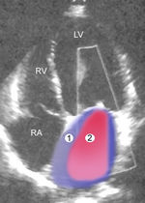
Importance of preop. echocardiographic studies.
Pericarditis with a severe MI

Slide 34
Echocardiographic study to exclude other space occupying tumor when the patient has a history of embolic episode.
TTE from apical 4-chamber view. Diastoloic image of an LA myxoma

Slide 35
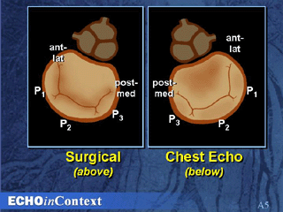
Surgical and Echo Views of the Mitral Valve

Slide 36
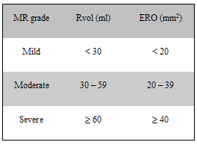
Mitral valve disease: Echo diagnostics
Regurgitant jet geometry and area are assessed in multiple views
Mitral regurgitation severity is graded typically as a rank order variable:
1+ trace/trivial
2+ mild
3+ moderate
4+ severe
Grading severity of mitral regurgitation.
Rvol.: regurgitation volume, ERO: effective regurgitant orifice

Slide 37
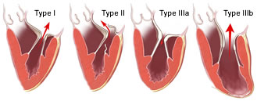
Carpentier’s functional classification
Type I: normal leaflet motion (annular dilatation)
Type II: increased leaflet motion (leaflet prolapse);
Type IIIa: restricted leaflet motion during diastole and systole;
Type IIIb: restricted leaflet motion predominantly during systole

Slide 38
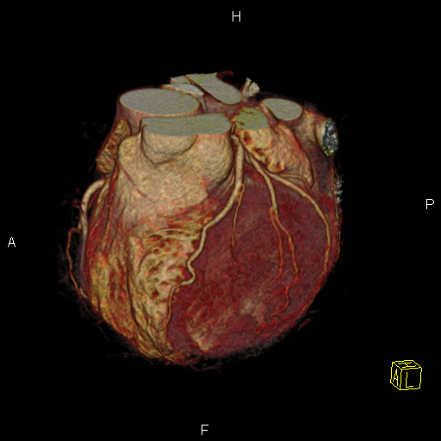
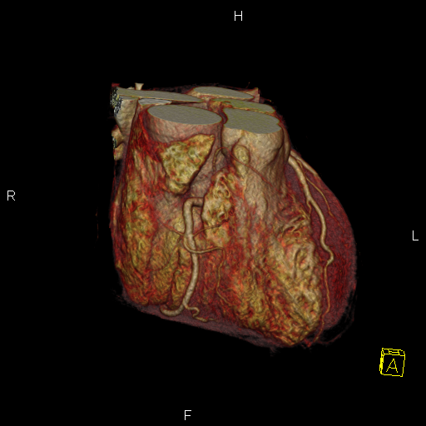
Cardio-CT scan for excluding CAD

Slide 39
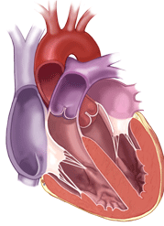
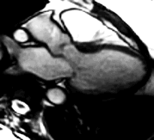
The mitral valve: Functional assessment by imaging: CT scan, MRI

Slide 40
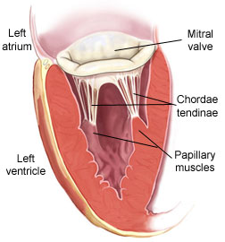
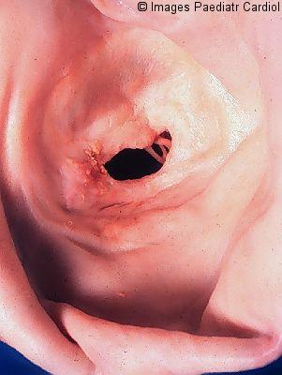
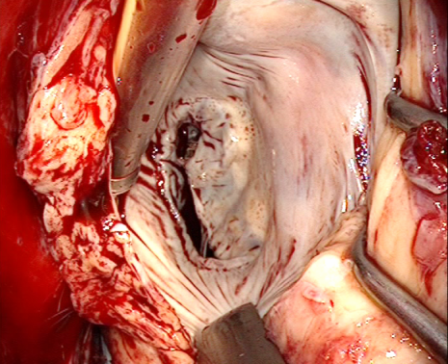

Rheumatic fever-Rheumatic Mitral Valve Disease
Can manifest as:
Pure stenosis (MS)
Pure regurgitation (MR)
Mixed lesion (MS + MR)

Slide 41

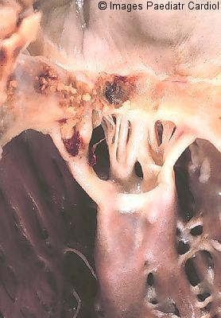
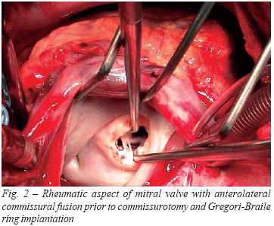
Rheumatic fever-Rheumatic Mitral Valve Disease
Pathological process includes
fibrosis and calcification:
Fibrosis manifests as:
Annular dilatation
Leaflet thickening
Leaflet retraction:
(Fibroelastic deficiency)
Leaflet prolapse
Commissural fusion

Slide 42
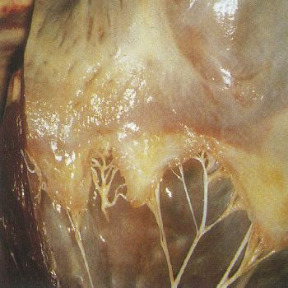
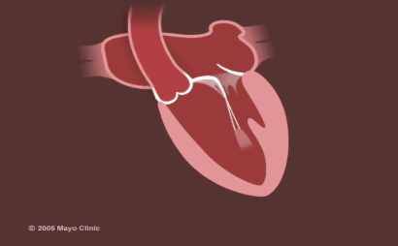
Rheumatic fever-Rheumatic Mitral Valve Disease
Pathological process includes
Fibrosis and calcification:
Fibrosis manifests as:
Chordal fusion
Chordal thickening
Chordal shortening
Chordal elongation
Chordal rupture
Papillary muscle retraction
Papillary muscle rupture

Slide 43
Rheumatic Mitral Valve Disease
The pathogenesis and the natural history show differences in:
- The time course
- The surgical anatomy
Relation to disease outcome

Slide 44
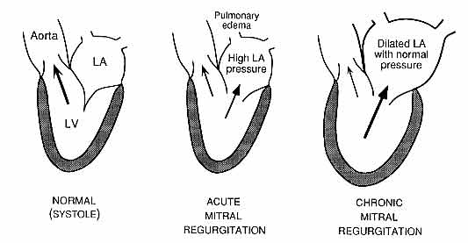
Complications resulting from mitral regurgitation

Slide 45
  Valve surgery: Repair or replace
Concepts
Closed
Open
  Repair
  Replacement
  Catheter-based
  Implantation: Valve-in-valve
  Biological
  Mechanical
Stentless
Xenograft
Allograft
Autograft :
Ross I and II
Stented
Bovine pericardial
Porcine valve

Slide 46
Rheumatic Mitral Valve Disease
Surgical/ medical treatment and the natural history
The dilema and surgical strategy: What, When and Which does one repair or replace
Surveillance: In Africa over 90% of patients after surgery are not retraceable.
Incidence of prosthetic valve thrombosis (PVT) in India is estimated to be 9.7%.
Incidence of PVT in Africa?

Slide 47
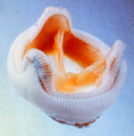





The dilema: Valve of choice
Degeneration, Prosthetic infection Reoperation
Anticoagulation: Bleeding, Thromboembolism
Age, Quality of Life
Notes:
47
The selection of an aortic prosthesis should be based on:
- scientific arguments comparing the risks of thromboembolic and bleeding complications on one hand and the risks of re-operation, depending on age, on the other hand
- psychological approach centered on the quality of life

Slide 48

Major valve-related morbid events after mechanical valve replacement

Slide 49

27 years old man with a severe rheumatic mitral stenosis.
Late presentation
Uwe Schultz, Der Kardiologe, 2009, Vol. 3, No. 5

Slide 50

Burn-out rheumatic heart valve disease
Bilateral commissurotomy and PM spliting
Pure rheumatic mitral valve stenosis
Binotto et al. Images Paediatr Cardiol 2002;11:12-25
Yetkin et al., Int. JTCVS 2008
Notes:
50

Slide 51

Thickened and shortened Chordae tendinae and hypertrophic papillary muscles
Notes:
51

Slide 52


Technique of artificial chordal repl acement (ACR)
with e-Gore-Tex David et al.
Rankin et al. et al

Slide 53

Rheumatic mitral valve stenosis in a child

Slide 54




Closed mitral valvotomy techniques
Transatrial digital fracture
Spanish transatrial dilator
Transapical Tubbs valvotomy

Slide 55




Transcatheter bovine pericardial aortic valve implantation
Deutsches Herzzentrum Berlin
4/2008- 05/2011: n= 487 (399 E-Sapien, 88 Core Valve)
Distribution of implantation techniques
TAVI (+ v-in-v: 21) 385
TFHVI 85
Transaxillary 15
Transconduit 1
TAVI mitral (v-in-v) 1
(v-in-v: Homograft, Hc, CE-P, Mosaic, Freestyle, Sapien)
Logistic EuroScore 38.5% STS Score 19.1%
E-Sapien
CoreValve
By courtesy of Pasic et al. Deutsches Herzzentrum Berlin

Slide 56



Closed mitral valvotomy and associated complications
Cribier‘s percutaneous metallic mitral valvotome

Slide 57

Rheumatic Heart Valve Disease
2-D color flow Doppler - 4-chamber view (top panel) and 2-D parasternal long-axis view (lower panel): Lack of apposition of the leaflets of the mitral valve during systole (arrow)
Hetzer et al.
Pure rheumatic mitral incompetence
Notes:
57

Slide 58

Pericardial patch augmentation

Slide 59



Pure rheumatic mitral valve incompetence (C Type 1)
Repair with the
Paneth posterior suture + pericardial strip annuloplasty technique

Slide 60


Rheumatic mitral valve disease: mixed lesion (MS + MR)
By courtesy of Dr. El Oumeiri
Burn-out rheumatic mitral valve (MS +MR) with fibroelastic deficiency
Subacute rheumatic mitral valvulitis with fibroelastic deficiency
Binotto et al. Images Paediatr Cardiol 2002;11:12-25
Notes:
60

Slide 61
Rheumatic mitral valve disease: mixed lesion (MS + MR)
By courtesy of Dr. El Oumeiri
By courtesy of Dr. El Oumeiri
Burn-out rheumatic mitral valve
(MS +MR) with fibroelastic deficiency
of the leaflet and retracted chordae
Chordal replacement with e-Gore-Tex (PTFE)
Notes:
61

Slide 62


Slide 63

Anterior mitral leaflet
augmentation with autolog
pericardium. Acar et al.
Rankin et al.
Technique of artificial chordal
replacement (ACR) with e-Gore-Tex (PTFE)
David et al.

Slide 65

Anatomy and rheumatic fusion of the anterolateral chordae and commissure
Anatomy of the anterior and posterior commissure of the mitral valve
Binotto et al. Images Paediatr Cardiol 2002;11:12-25

Slide 66
Rupture of Chordae tendinae and artificial chordal replacement
Technique of artificial chordal
replacement (ACR) with
e-Gore-Tex (PTFE)
David et al.
Notes:
66

Slide 67
Chordal transfer
Chordae of proper length are borrowed from the posterior leaflet and transposed to the anterior leaflet
Ruptured chord of anterior mitral leaflet (AML) or elongated chord of posterior mitral leaflet (PML). Technique of posterior chordal transfer to the AML
Riley and Kon, CTS Net 2008

Slide 68

Postrheumatic or ischemic chordal rupture:

Slide 69


Post rheumatic or ischemic papillary muscle rupture and treatment option
Papillary muscle rupture
Transapical artificial chords insertion

Slide 70
Contemporary Use of Mitral Valve Repair
51%
Replacement
53.5%
Replacement
49%
Repair
46.5%
Repair
Frequency of MV repair?
Society of Thoracic Surgeons
Database, 2003
n=8086
Euro Heart Survey
Iung et al, Eur Heart J 2003;24:1231
n=115

Slide 71
Trends in Mitral Valve Surgery
Repair vs Replacement
Deutsches Herzzentrum Berlin 1986 – 2006
[n]

Slide 72
Rheumatic mitral valve repair
Deutsches Herzzentrum Berlin
April 1986 and December 2009
Total mitral valve repair procedures 2211
Rheumatic mitral valve repair 50 (2.3%)
Isolated mitral valve repair 20 (40%)
Concomitant procedures
(CABG, re-CABG, AVR, re-AVR) 30 (60%)
Follow –up time 0.1-22 years
Patient-years 412
Median follow-up 6.02 years
Complete follow-up 100%
Yankah et al. J Heart Valve Dis May 2011

Slide 73
Mitral valve repair in rheumatic disease
With recent improvements in reconstructive techniques, however, the overall success rate of mitral valve repair in North America is increasing steadily, and repair is expanding into more complex pathologies.
In the study by Yau and associates, 25% of 573 patients with rheumatic mitral disease had repair. Operative mortality was better with repair (0.7% after repair vs 5.1% for replacement) as was late survival.
At 5-6 years 16 - 19 % of repair patients required reoperation.
Yau et al. 2000, Gaca et al.

Slide 74

Mitral valve repair in rheumatic disease: Patients survival
Operative mortality:
Repair: 0.7% vs.
Replacement: 5.1%
Yau et al. J Thorac Cardiovasc Surg 2000;119:53-61

Slide 75

Rheumatic mitral valve surgery: Repair vs. replacement
JS Rankin, MA Daneshmand and JG Gaca

