Slide 1
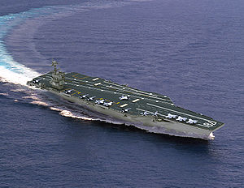
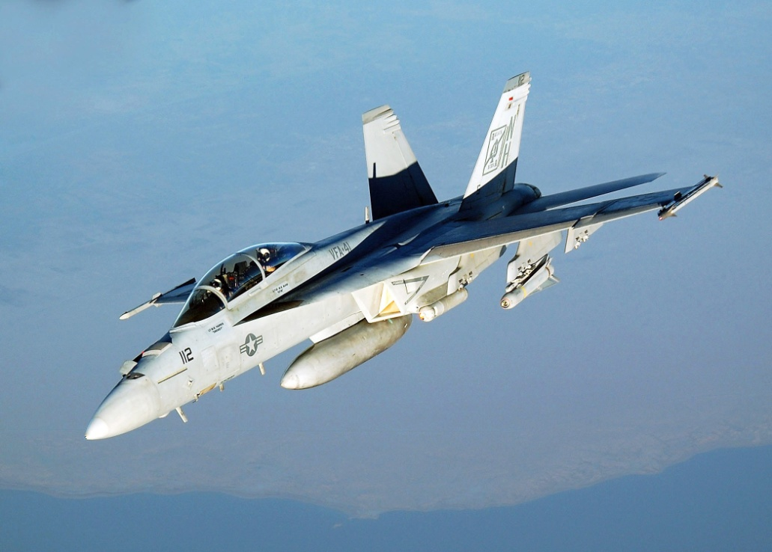
The Gerald R Ford-class aircraft carrier
14 billion dollar price
The F/A-18E/F Super Hornet
55 million dollar price
Landing the Super Hornet on an aircraft carrier can destroy both and kill 7002 persons
The average age of a Hornet pilot is 23 years.
He can land this plane because he has learned to do so in the appropriate way.

Slide 2
Drivers toward simulation
Quantify surgical performance
  Mandatory formative (progress) and summative (versus standard) assessments
Ethical concerns : environment that does not jeopardize patient safety
Training not dictated by random case exposure, but by curricular design
Variability in individual rates of learning,
Objective proficiency level and evaluation of trainee
Complexity of current surgery (if true?)
Less open, more minimal invasive, Patients older, more co-morbidities
New skills and techniques, ACGME competency initiative
Reimbursement, fewer mentor opportunities

Slide 3
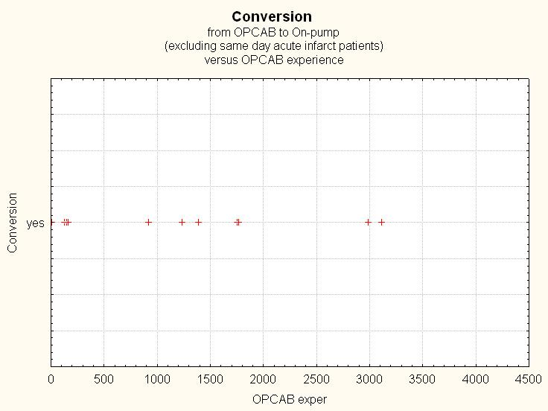
K.U.Leuven
N = 4500
Conversions = 12
Rate = 0.26 % 50 x higher conversion rates in Rooby trial

Slide 4
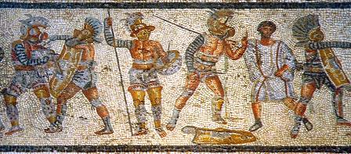

Gladiator rudis
Wikipedia
In the 1st Century the death rate of the gladiators entering the arena was 19 % rising to 25 % later. The average combat lasted 10-15 minutes.
Roman legionaries training was based on Roman gladiator training.
In the schools: lethal weapons were forbidden and replaced with blunted and weighted weapons. Training Pilum = 2x weight of normal Pilum.
Individual combat training was preceded by combat against wooden stakes.
In the main events: warm-up matches used blunted and weighted weapons.

Slide 5
The Cardio-thoracic
Surgical Hand
Multi-national
Multi-organizational
Multi-domain
Science of learning
Science of business management
Collaboration with societies

Slide 6
The Cardiothoracic
Surgical Brain
Educational objectives
Educational objects
Educational assessments
Educational portfolio

Slide 7
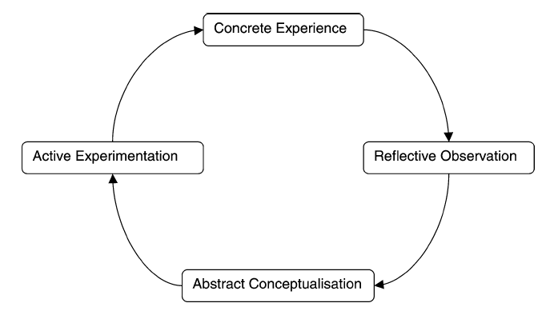
Constructivism Kolb
Residents are considered adult learners.
Self-directed approach
Formative evaluations and ongoing feedback
After reaching a certain proficiency, new tasks in a validated curriculum is practiced
Focus on problem or task
Recognize past experiences
simulation
Metacognition: aware of learning strategies
Teach strategies that can be transferred
articulate goals and objectives
Provide with list of objectives
Cognitive learning/teaching

Slide 8
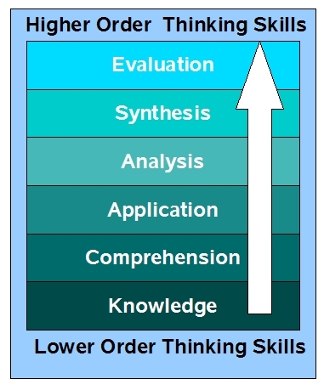
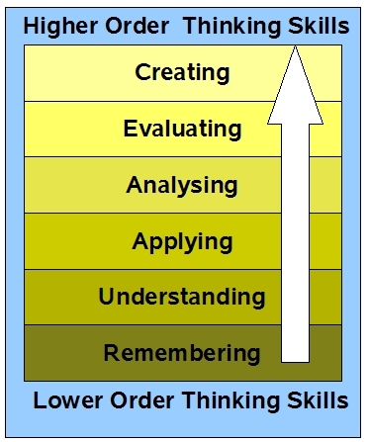
Taxonomy for “cognitive learning and teaching” Bloom
Holistic approach with 3 overlapping domains:
1. cognitive = Bloom’s taxonomy
2. psychomotor = doing/hands-on
3. affective = behavior/attitude
Am J Surgery 2004;187:114-119
Practice on artificial models combined with cognitive training according to the principles of cognitive task analysis improved significantly the knowledge and the skill compared to training by traditional methods in a real clinical scenario. The trainees become more competent technically, more confident than traditional interns, needed less directions and required less time for the procedure
Original bloom’s taxonomy
Revised bloom’s taxonomy

Slide 9
How to obtain technical skills
  Acquisition of technical skills has two parts:
  - cognitive skills
  - psychomotor skills
  Both skills need to be in “working memory” to accomplish a task.
  Surgical rehearsal or repetition allows automation (psychomotor skills).
  More place for cognitive aspect in working memory
DELIBERATE PRACTICE IN CARDIOTHORACIC SURGERY
DELIBERATE PRACTICE IN CARDIOTHORACIC SURGERY

Slide 10
Attention in learning process Broadbent D.. Cognition. 1981;10:53–58.
Attention is of paramount importance to learn a new task or skill,
  attend to a finite amount of information or stimuli at any given time.
  the end product of a process of perception, attention, information processing, information storage
Maximum
attention
resource

Slide 11
Induced learning
  Conceptual learning
  Virtual learning
Autonomous learning
  Learning by doing

Slide 12

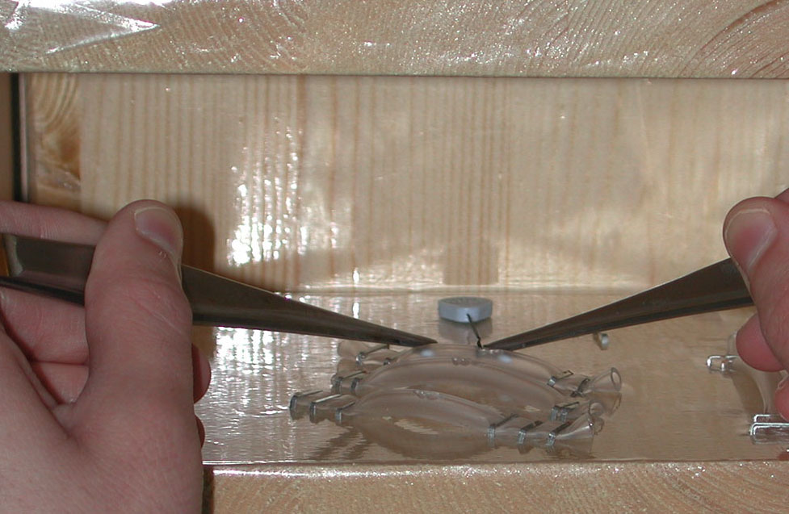
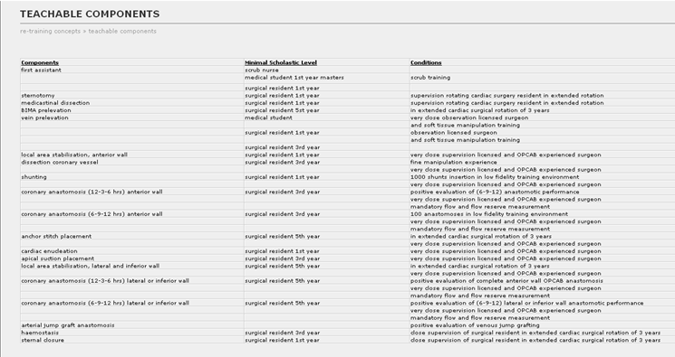
Deconstruction into
teachable components

Slide 13
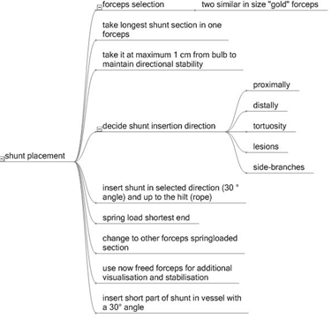
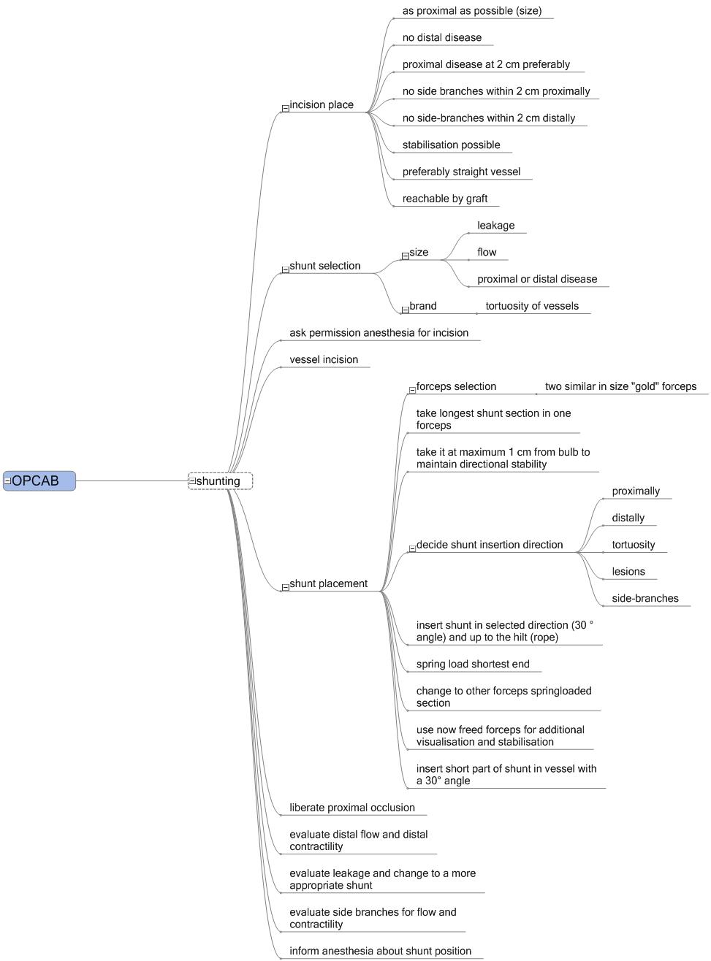
Conceptual learning:

Slide 14
Different levels of simulation according fidelity
Organic High fidelity |  |  | advantages |  | disadvantages
Human Live |  |  | Best modality: provides exact anatomy and bleeding, real operating theatre environment |  | Ethical consideration Requires consent Pressure of training vs provision of service
Human Cadaver |  |  | High fidelity , costly, same anatomy Consent issue No time pressure Less ethical concerns |  | Limited availability Non-compliant bloodless tissue makes difficult Variability in humans
Animal Live |  |  | Provides bleeding and real operating theatre environment |  | Anatomical differences from humans Ethical concerns Inherent costs in facilities and personnel
Animal Cadaver |  |  | Cheap Ubiquitous availability Good tissue handling if fresh |  | Potential risk of infection Unproven transferability from inanimate models to human operating

Slide 15
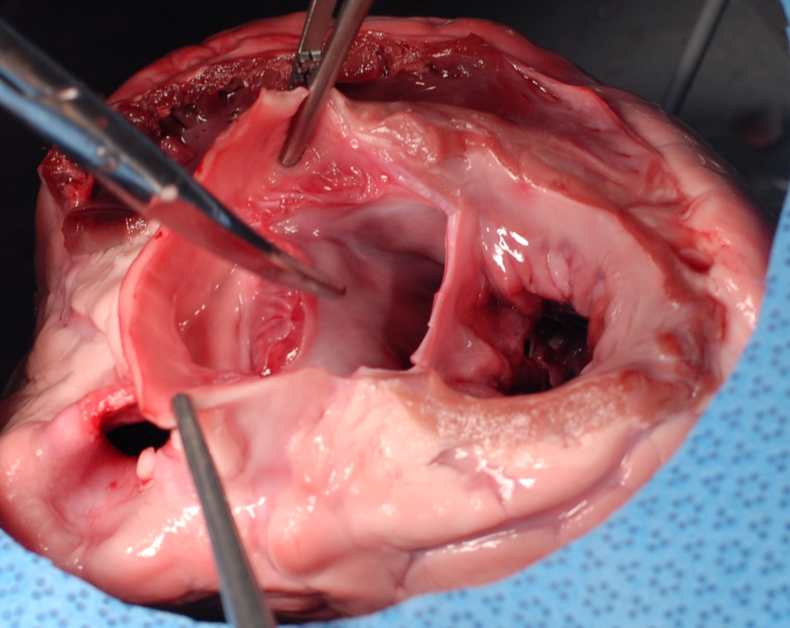
High-Fidelity” Biological Simulator
Aortic-Mitral Curtain Removed Northrop Cryolife
Right Fibrous Trigone
Aortic Valve Hinge Plane
Aortic Root
Left Atrium
Mitral Valve Hinge Plane
Left Fibrous Trigone

Slide 16
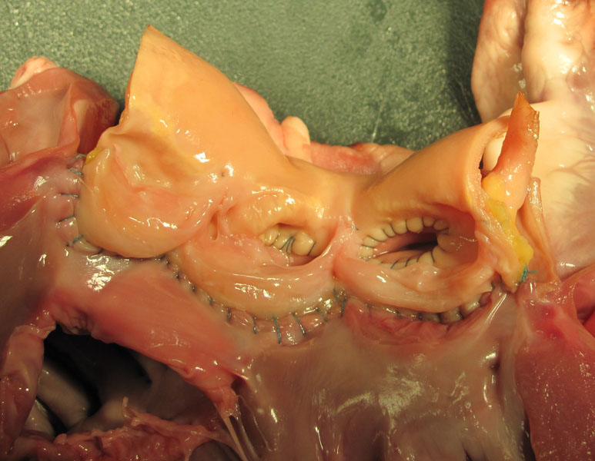
Summative Assessment Tool
Immediate Feedback Northrop Cryolife

Slide 17
“Machine-Made By Hand”
Equal Spacing From Edges and Each Other Northrop Cryolife
Dog-ears,
gaps
Yes
No
Yes

Slide 18
Different levels of simulation according fidelity
Inorganic median fidelity |  | virtual reality |  | Reproducible and standardized, can be used for training and assessing isolated skills, virtual reality, ability to perform operation, real time, instant objective feedback |  | limited availibility
lnorganic low fidelity |  | box trainer |  | as performant as animal/cadaver model, low cost, reusable, safe, portability maximal availibity, perfect for novice learners, maybe less optimal for the expert surgeon |  | deconstruction in teachable components
Notes:
.

Slide 19
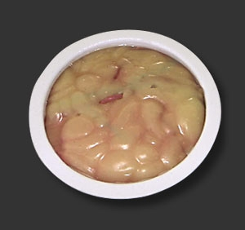
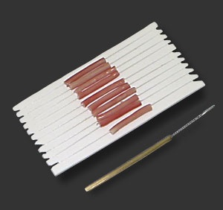
Commercially available
Native Coronary Artery 10-pack, @ $129
Allowing 40 anastomoses
3mm Vessel (0.8mm wall), 60-pack @ $34.
Allowing 600 anastomoses
Heart LAD Pod, @ 69$

Slide 20
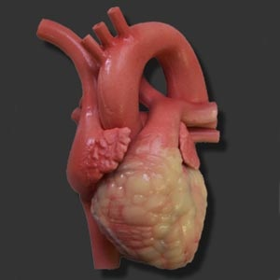
Commercially available

Slide 21
Simulation in cardiac surgery
LABORATORY SET-UP
  Disposables per trainee No. used Price/each Total
    Coronary artery segments* 4 $11 $44
    Vein segments* 10 $25 $250
    Sutures, 6-0 Prolene 15 $20 $300
    Aortic root model* 1 $205 $205
    Mitral valve model* 1 $55 $55
    Synthetic aorta* 1 $60 $60
    Porcine hearts 4 $10 $40
    Expired valves, sutures, pump kit, cannulas
    TOTAL $954
    Additional:
    Environmental simulation (Sim Center) $200/hr $400
    * From Chamberlain Group (Great Barrington, MA)
Notes:
21

Slide 22
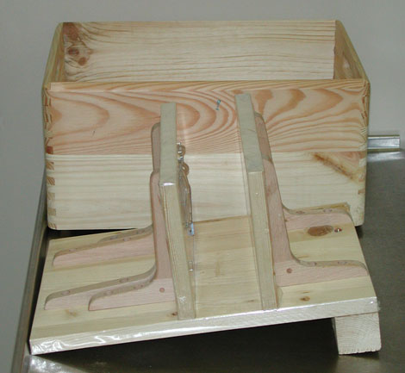
Training the untrained surgeon a low-fidelity training box

Slide 23
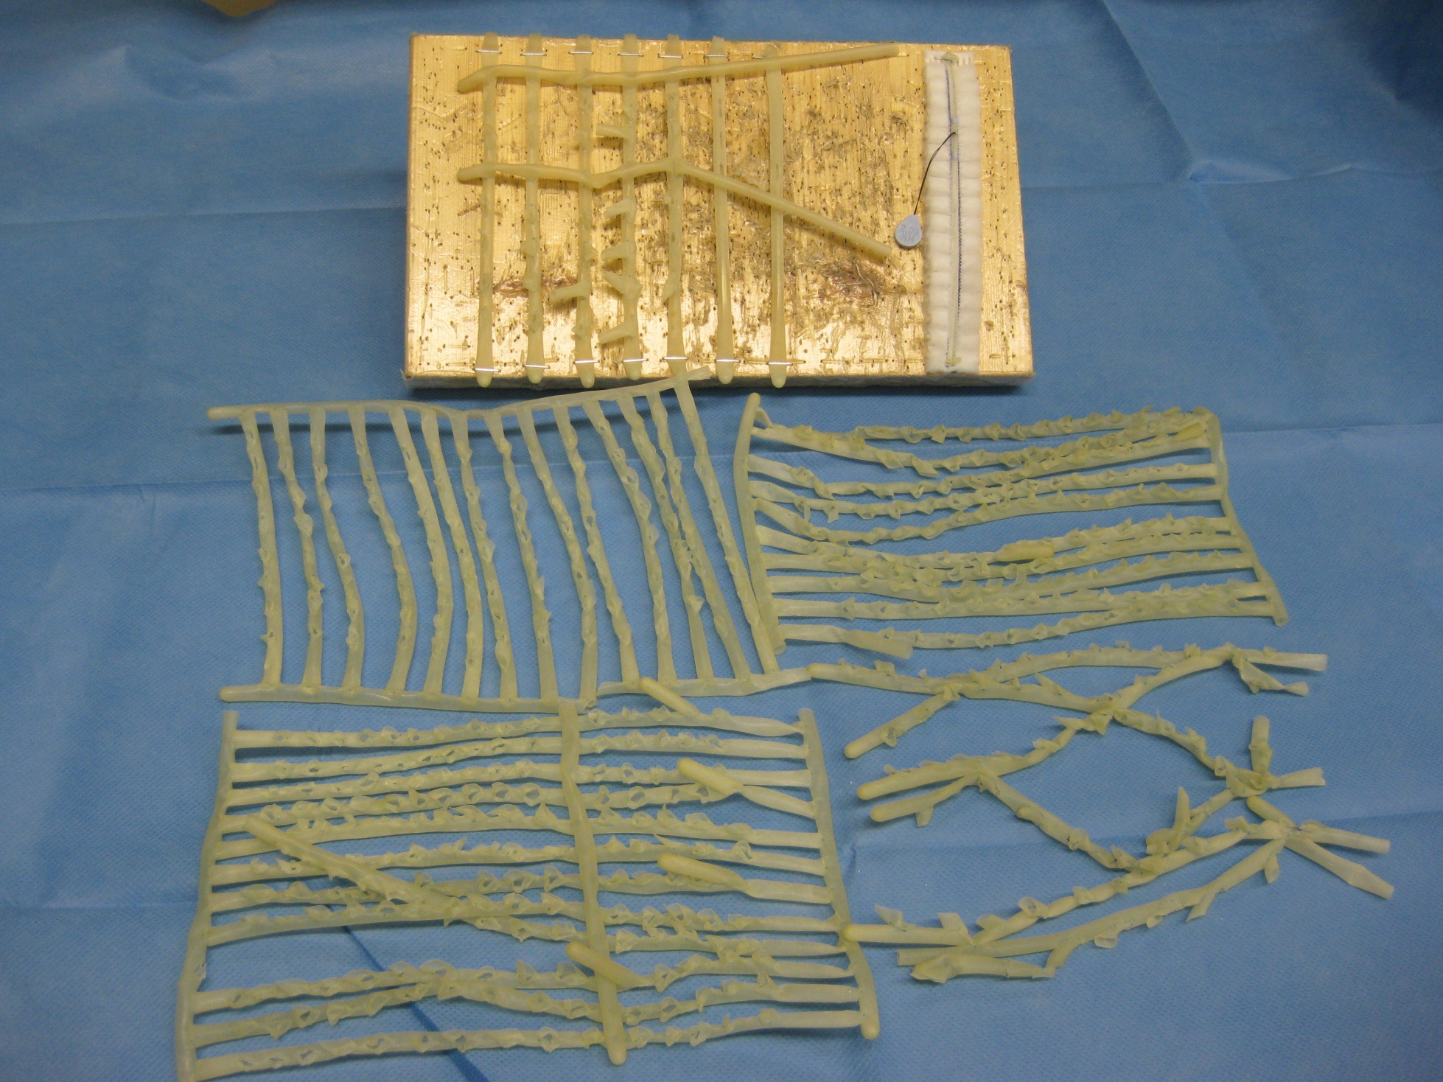

Slide 24
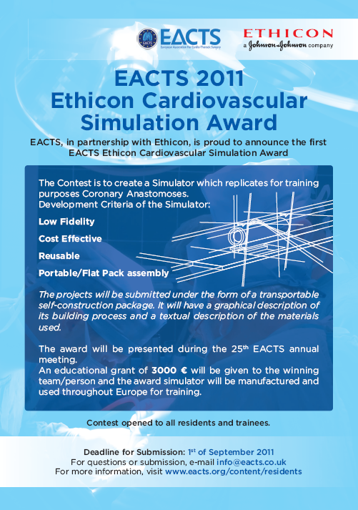
The cardiothoracic surgical Hand
Simulator building awards
EACTS 2011 coron a
EACTS 2012 mitral v
Brazil 2012 aortic v
SA Bloemfontein 2012
Simulator portfolio on CTSNet
Simulator use wetlabs
…
Integration with CT surgical brain
Portfolio of virtual learning is needed
    Low-fidelity
    Wet-labs
    Animal labs
    Cadaver–labs
    High tech environments

Slide 25
Shaping and Fading
Shaping: successive approximations of the desired response pattern are reinforced until the desired response occurs. Tasks are configurable from easy, medium, and difficult settings, and tasks can be ordered so that they become progressively more difficult.
Fading: giving trainees major clues and guides at the start of training. Indeed, trainees might even begin with abstract tasks that elicit the same psychomotor performance as would be required to perform the task in vivo. As tasks become gradually more difficult, the amount of clues and guides is gradually faded out until the trainee is required to perform the task without support.
Inacceptable: practice on the simulator without guidance

Slide 26
Formative and summative assessment
Formative assessment aims at development by monitoring a trainee’s progress over time and giving structured feedback. It should be able to identify different levels of performance (construct validity).
Summative assessment would be required for credentialing. Higher standards for construct validity and reliability are required with this form of assessment than with formative assessment. Clear cut-off values have to be defined adherent to the predefined consequences and, ideally, the sensitivity and specificity of these values should be tested. A summative assessment is used for selection and therefore needs predefined levels of outcome.

Slide 27
OSATS objective score assessment tools
  a global rating scale and a procedure specific checklist
  validity and reliability tested
  only high level of evidence in gynecological bench tasks in laboratory setting
  uncertain whether OSATS can distinguish between different levels of performance in surgery
  no good studies of correlation between bench tasks and surgical tasks
  no defined cut-of values
  It can not be used for summative assessment
  good enough for discussions and feedback ( formative assessment )

Slide 28
PAR matrix OSATS Eur J Cardiothorac Surg 2009;36:511-5
Criterion | Unsatisfactory | Competent | Good
Level 1: Posture The ability to attain the optimal posture | 1 | 2 | 3
Level 1: Address The ability to dynamically change body stance | 1 | 2 | 3
Level 1: Relaxation The ability to maintain a relaxed state of mind | 1 | 2 | 3
Level 2: Pick-up The ability to accurately pick up the needle with the appropriate instrument. | 1 | 2 | 3
Level 2: Airtime The ability to accurately pick up the needle while minimizing the amount of airtime | 1 | 2 | 3
Level 2: Rotation The ability to achieve satisfactory rotation of the needle | 1 | 2 | 3
Level 3: Placing The ability to place the needle in relation to the tissue. | 1 | 2 | 3
Level 3: Angles The ability to place the needle and to utilize the appropriate angle to achieve accuracy. | 1 | 2 | 3
Level 3: Rhythm The ability to place the needle accurately and to repeat the process rhythmically, not quickly. | 1 | 2 | 3
Level 4: Precision The higher skill of accuracy of suture placing | 1 | 2 | 3
Level 4: Adaptability The higher skill of accuracy of suture placing adapted to variable anatomy | 1 | 2 | 3
Level 4: Reproducibility The ability of suture placing, adapted to variable anatomy and reliably on every occasion (reproducibility). | 1 | 2 | 3
Level 5: Pace Emphasis on economy of time and movement | 1 | 2 | 3
Level 5: Awareness The ability to monitor the whole operation and theatre staff | 1 | 2 | 3
Level 5: Relations Communication skills with theatre team and assistant | 1 | 2 | 3
Level 6: Planning Preoperative, operative and postoperative planning, to manage each case independently and anticipate potential problems. | 1 | 2 | 3
Level 6: Announce The skill to communicate clearly with the theatre team before each critical step to ascertain focus and prevent errors | 1 | 2 | 3
Level 6: Review/Reflection The ability to assess objectively one’s own and the team’s ability in the management of the patient. To identify problems and to accept comments, to debrief after the operation | 1 | 2 | 3
Totals
Grand total

Slide 29
Fann OSATS JTCVS2008;136:1486
Criterion | Poor |  | Avg |  | Excel
Arteriotomy (porcine model: able to identify target, proper use of blade, single groove, centered) | 1 | 2 | 3 | 4 | 5
Graft Orientation (proper orientation for toe-heel, appropriate start and end-points) | 1 | 2 | 3 | 4 | 5
Bite appropriate (entry and exit points, number of punctures, even and consistent distance from edge) | 1 | 2 | 3 | 4 | 5
Spacing appropriate (even spacing, consistent distance from previous bite, too close vs too far) | 1 | 2 | 3 | 4 | 5
Use of needle holder (finger placement, instrument rotation, facility, needle placement, pronation and supination, proper finger and hand motion, lack of wrist motion) | 1 | 2 | 3 | 4 | 5
Use of forceps (facility, hand motion, assist needle placement, appropriate traction on tissue) | 1 | 2 | 3 | 4 | 5
Needle angles (proper angle relative to tissue and needle holder, consider depth of field, anticipating subsequent angles) | 1 | 2 | 3 | 4 | 5
Needle transfer (needle placement and preparation from stitch to stitch, use of instrument and hand to mount needle) | 1 | 2 | 3 | 4 | 5
Suture management/tension (too loose vs tight, use of tension to assist exposure, avoid entanglement) | 1 | 2 | 3 | 4 | 5
Knot tying (adequate tension, facility, finger and hand follow for deep knots) | 1 | 2 | 3 | 4 | 5
Totals
Grand total

Slide 30
Assessment tools of simulation environments
Standards for educational and psychological tests APA, Washington 1974
Validation The degree to which a test measures what is is designed to measure,
  Face validity The extent to which the examination resembles the situation in the real world. Suturing on a simulator versus suturing on a patient.
  Content validity The extent to which a measurement reflects the trait or domain it purports to measure. Multiple choice of the anatomy of the gall bladder versus a cholecystectomy on a pig.
  Construct validity the agreement between a theoretical concept and a specific assessment tool. Better surgeons should score better.
  Criterion validity How it correlates with other measures of performance
    Predictive validity How it predicts future performance
    Concurrent validity How it correlates with the golden standard
Reliability The power to generate similar results in different observations
  Inter-rater reliability The degree to which 2 observers agree in their ratings

Slide 31
Simulation for experienced surgeons
    Experience building in new procedures
    Credentialing in new procedures
    Competency documentation
    Profiling
    Third part scrutiny
    Warming up improves performance in surgery
      more effect in lesser experienced hands
      RCT in lap cce: Significant beneficial impact
      practice potential problems and strategies
      increased perceived control of the situation
      reduced anxiety,
      increased preparedness

Slide 32
Simulation in cardiac surgery
Simulation sub-procedures/tasks
GENERAL
Sternotomy
IMA takedown
Pericardial cradle
Cannulation sutures
Aortic cannulation
Right atrial cannulation
Antegrade cardioplegia
Retrograde cardioplegia
Initiate CPB
Pulmonary artery vent placement
Aortic cross-clamp
Cardioplegia (antegrade / retrograde)
Remove cross-clamp
Weaning from CPB
Chest tube placement
Sternotomy closure
MITRAL VALVE REPAIR/REPLACEMENT
Mobilize SVC from pericardium
Left atriotomy
Place retractor
Evaluate mitral valve apparatus pathology
Leaflet resection/preservation
Annular suture placement
Valve/annular sizing
Sutures through sewing ring
Atriotomy closure
De-airing
Echo interpretation
AORTIC VALVE
REPLACEMENT
Aortotomy
Excise leaflets
Debride annulus
Annular suture placement
Valve sizing
Sutures through sewing ring
Tie sutures
Close aortotomy
De-airing
Echo interpretation

Slide 33
A template for developing a training curriculum
Didactic teaching of relevant knowledge (ie, anatomy, pathology, physiology)
Deconstruction of the procedure in teachable components
Conceptual learning process for each component
Defining and illustrating common errors
Test whether the student understands all the cognitive skills and error recognition before going to the technical skills training
Technical skills training on the simulator
Immediate (proximate) feedback when an error occurs in virtual training
Summative (terminal) feedback at the completion of a virtual training
Iterate the skills training while providing evidence at the end of each trial of progress (graphing the “learning curve”), with reference to a proficiency performance goal.

Slide 34
Learning
Standards Science
Platform, Portfolio, Learning Management System
Learning
objective
E-learning
Course X
E-learning
Knowledge
MD /specialist
(re)certification
content
Low-fidelity simulation
medium-fidelity simulation
High-fidelity simulation
assessment
Notes:
Courses should not be stand-alone projects. A lot of content should not be offered to scholars without previous e-learning courses, or can be much better presented in e-learning courses. This would be based on an individualized LMS approach for rehearsing and transfer into long-term memory.
The content of these e-learning courses will be guided by the Domain Committees of the EACTS.
These e-learning courses can be licensed from outside parties or be created by EACTS. If EACTS creates these e-learning courses they should be created using low-cost software as there is Articulate presenter, Articulate Quizmaker.
These e-learning projects should be integrated in the CTSNet platform and the CTSNet Learning Management System.

Slide 35
The era of fraternally determined patterns of training and processes of credentialing in surgical training is coming to an end.
No doubt there is a sense of cultural loss in that for many physicians.
It is time for simulation to take its place in surgical curricula as a tool that allows skill acquisition via methods appropriate to the adult learner, in a fashion that is cost effective and outcome focused.

