Slide 1
SYSTEMIC - to - PULMONARY ARTERY SHUNTS
M. A. Long
Hannes Meyer Symposium, UFS
June 2011

Slide 2
GOALS OF INTERVENTION IN CONGENITAL HEART DISEASE
Correction :
➢ produce normal/near normal physiology
➢ irrespective of persistence of anatomical abnormalities or long term durability of repair
Palliation :
➢ mitigate symptoms/extend life
➢ without addressing underlying abnormal pathophysiology (abnormal shunting, volume overload, pressure overload):
⬥ temporary
⬥ permanent

Slide 3
PALLIATIVE PROCEDURES
To increase pulmonary blood flow:
➢ Systemic-PA shunts, Brock procedure
To decrease pulmonary blood flow:
➢ PA banding, Norwood I
To enhance interatrial mixing:
➢ Blalock-Hanlon septectomy
To reduce ventricular workload:
➢ BDG shunt

Slide 4
SYSTEMIC - to - PULMONARY ARTERY SHUNTS : GOALS
To increase pulmonary blood flow & alleviate cyanosis in patients with inadequate pulmonary blood flow
To induce pulmonary artery growth where pulmonary arteries are too hypoplastic to accommodate full cardiac output
To maintain systemic blood flow in patients with inadequate systemic ventricles (hybrid palliation of HLHS)

Slide 5
INDICATIONS for SYSTEMIC - PA SHUNTS
Early, total correction is possible/advisable in many cyanotic congenital anomalies
BUT
Shunting indicated:
➢ when definitive surgery is not possible due to anatomical / physiological reasons
➢ when definitive surgery has a higher mortality risk than staged procedure
➢ where open heart surgical facilities are unavailable

Slide 6
DELETERIOUS PATHOPHYSIOLOGICAL EFFECTS of PALLIATIVE SHUNTS
Volume overload of systemic ventricle (workload doubled) with pathologic remodelling of the ventricle - ventricular hypertrophy, dilatation & AV valve regurgitation
Myocardial perfusion is impaired because of:
➢ reduced diastolic pressure due to shunt run-off
➢ increased wall tension due to volume overload
Doubled workload performed under hypoxemic conditions - functioning at limits of physiological reserve with little margin for stability
Pulmonary & systemic circulations in parallel arrangement which is highly unstable especially in single ventricle patients
Notes:
These effects esp. pronounced in SV physiology which is already volume overloaded @ rest [CO = 200 – 250% of (N)]. Addition of shunt increases volume overload to 250 – 350%.
Pa02 = 30 – 40mmHg. Person summiting Mt Everest without supplemental O2 = PaO2 of 30 – 35 mmHg
Cellular & end organ

Slide 7
FEATURES OF THE OPTIMAL SHUNT
Technically simple & rapid to construct
Easily excluded from circulation at definitive op
Preserves pulmonary artery architecture
Ensures symmetric lung flow distribution
Ensures satisfactory systemic O2 delivery
Minimizes volume overload & CCF
Minimizes pulmonary hypertension
Maintains long term patency (long term palliation)
Provides appropriate distribution to systemic & pulmonary circulations (SV physiology)

Slide 8
FACTORS AFFECTING SHUNT HAEMODYNAMICS / FLOW
Location of proximal & distal anastomoses
Size of anastomoses
Cross-sectional area of conduit
Length of conduit
Contour of conduit (straight/curved)
Angle of shunt implantation into PA
Systemic - PA pressure differential

Slide 9
SYSTEMIC to PULMONARY ARTERY SHUNTS: HISTORICAL ASPECTS
Nov 1944 – Blalock 1st systemic - PA shunt
“B-T shunt” appeared in literature in 1966
But technically difficult/no microsurgery techniques
1946 - Potts shunt (widespread use in ‘40s & ‘50s)
1955 - Davidson (direct central shunt)
1962 - Waterston / 1966 - Cooley shunts
1961 - Klinner introduced interposition graft (Teflon)
1970’s PTFE - increased prosthetic material usage
1976 - Gazzaniga 1st to publish PTFE shunt (S-PA)
Although De Leval 1st to perform PTFE interposition S-PA shunt in ‘75 (‘81 coined term “modified BTS”)
Notes:
Klinner – Thoraxchirurgie 1962;10:68-75
Vivien Thomas, Blalock’s surgical technician did much of experimental work in animal lab, & was present during initial ops

Slide 10
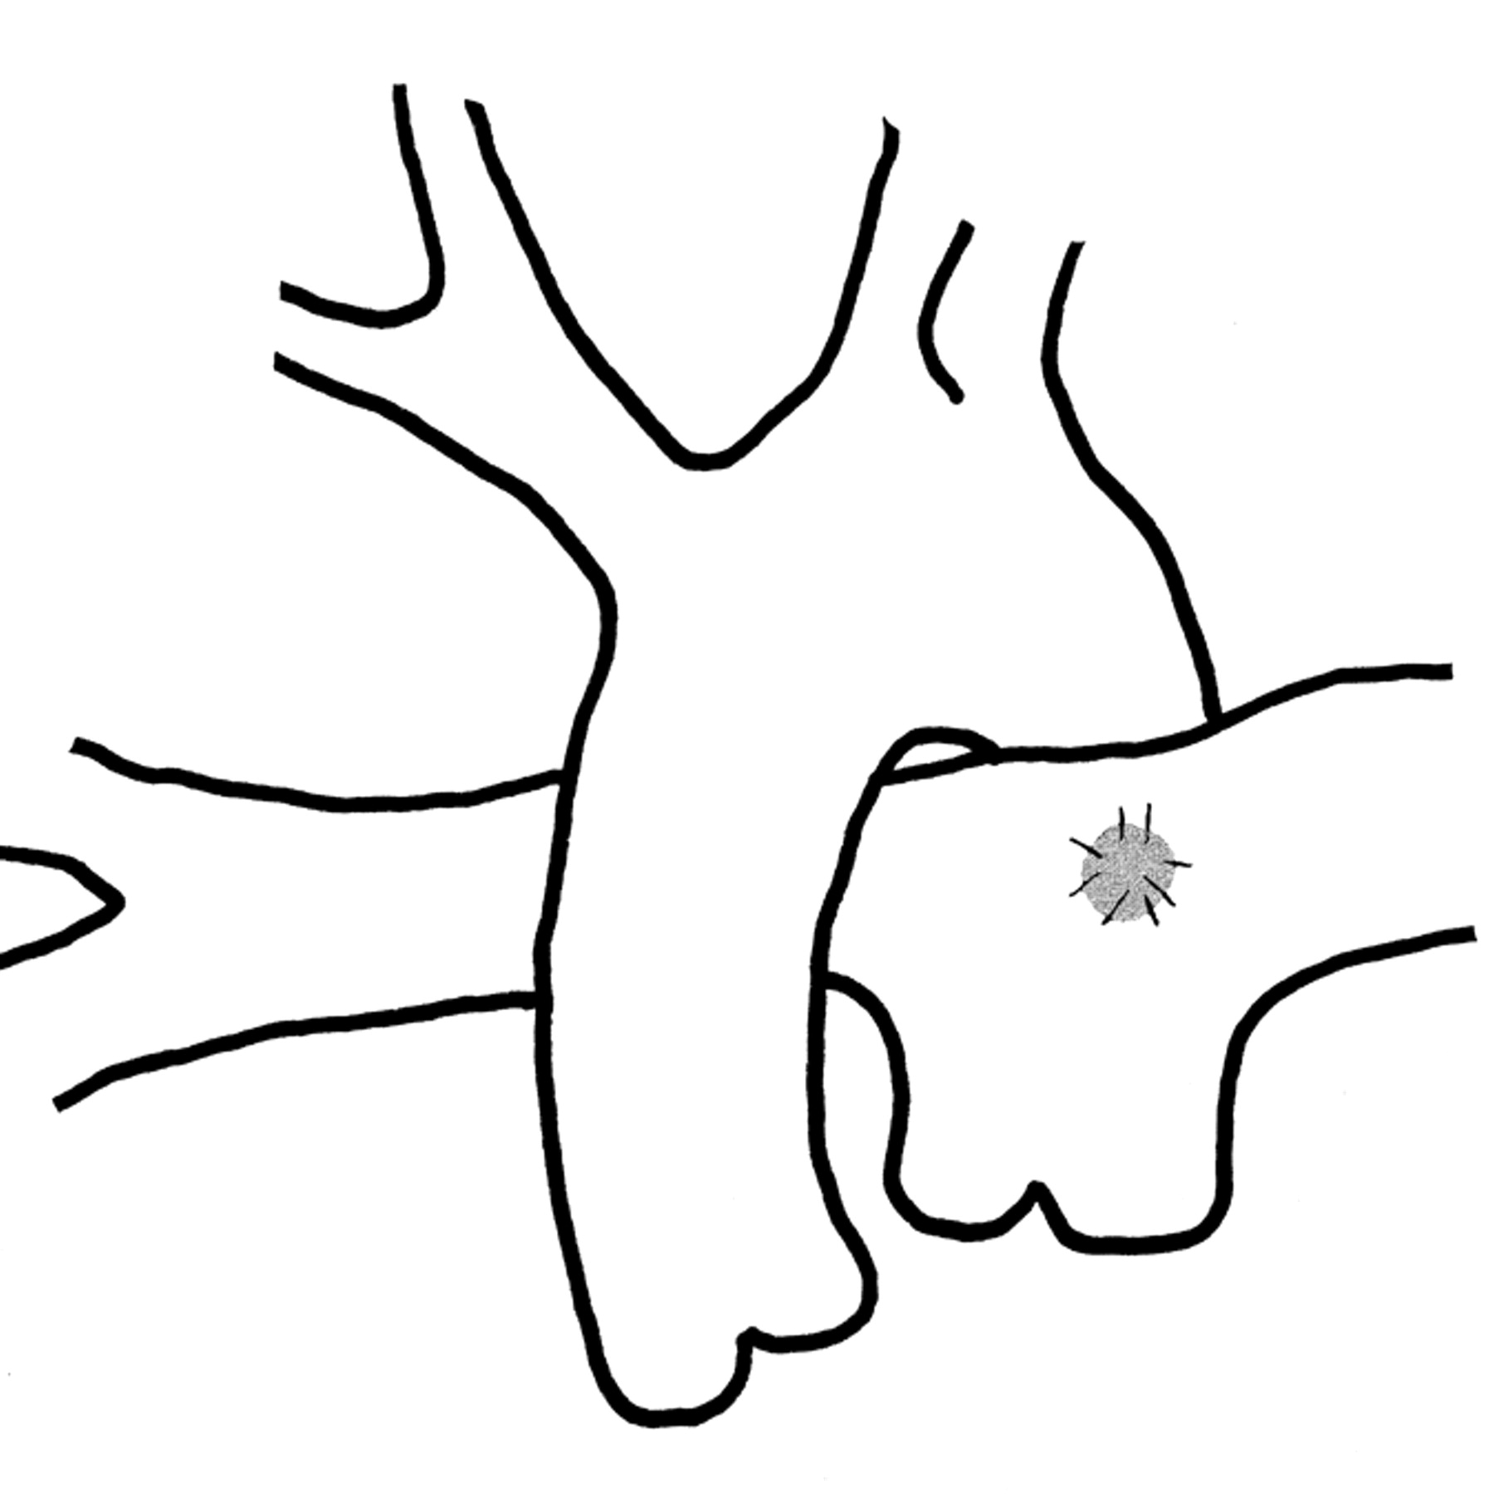
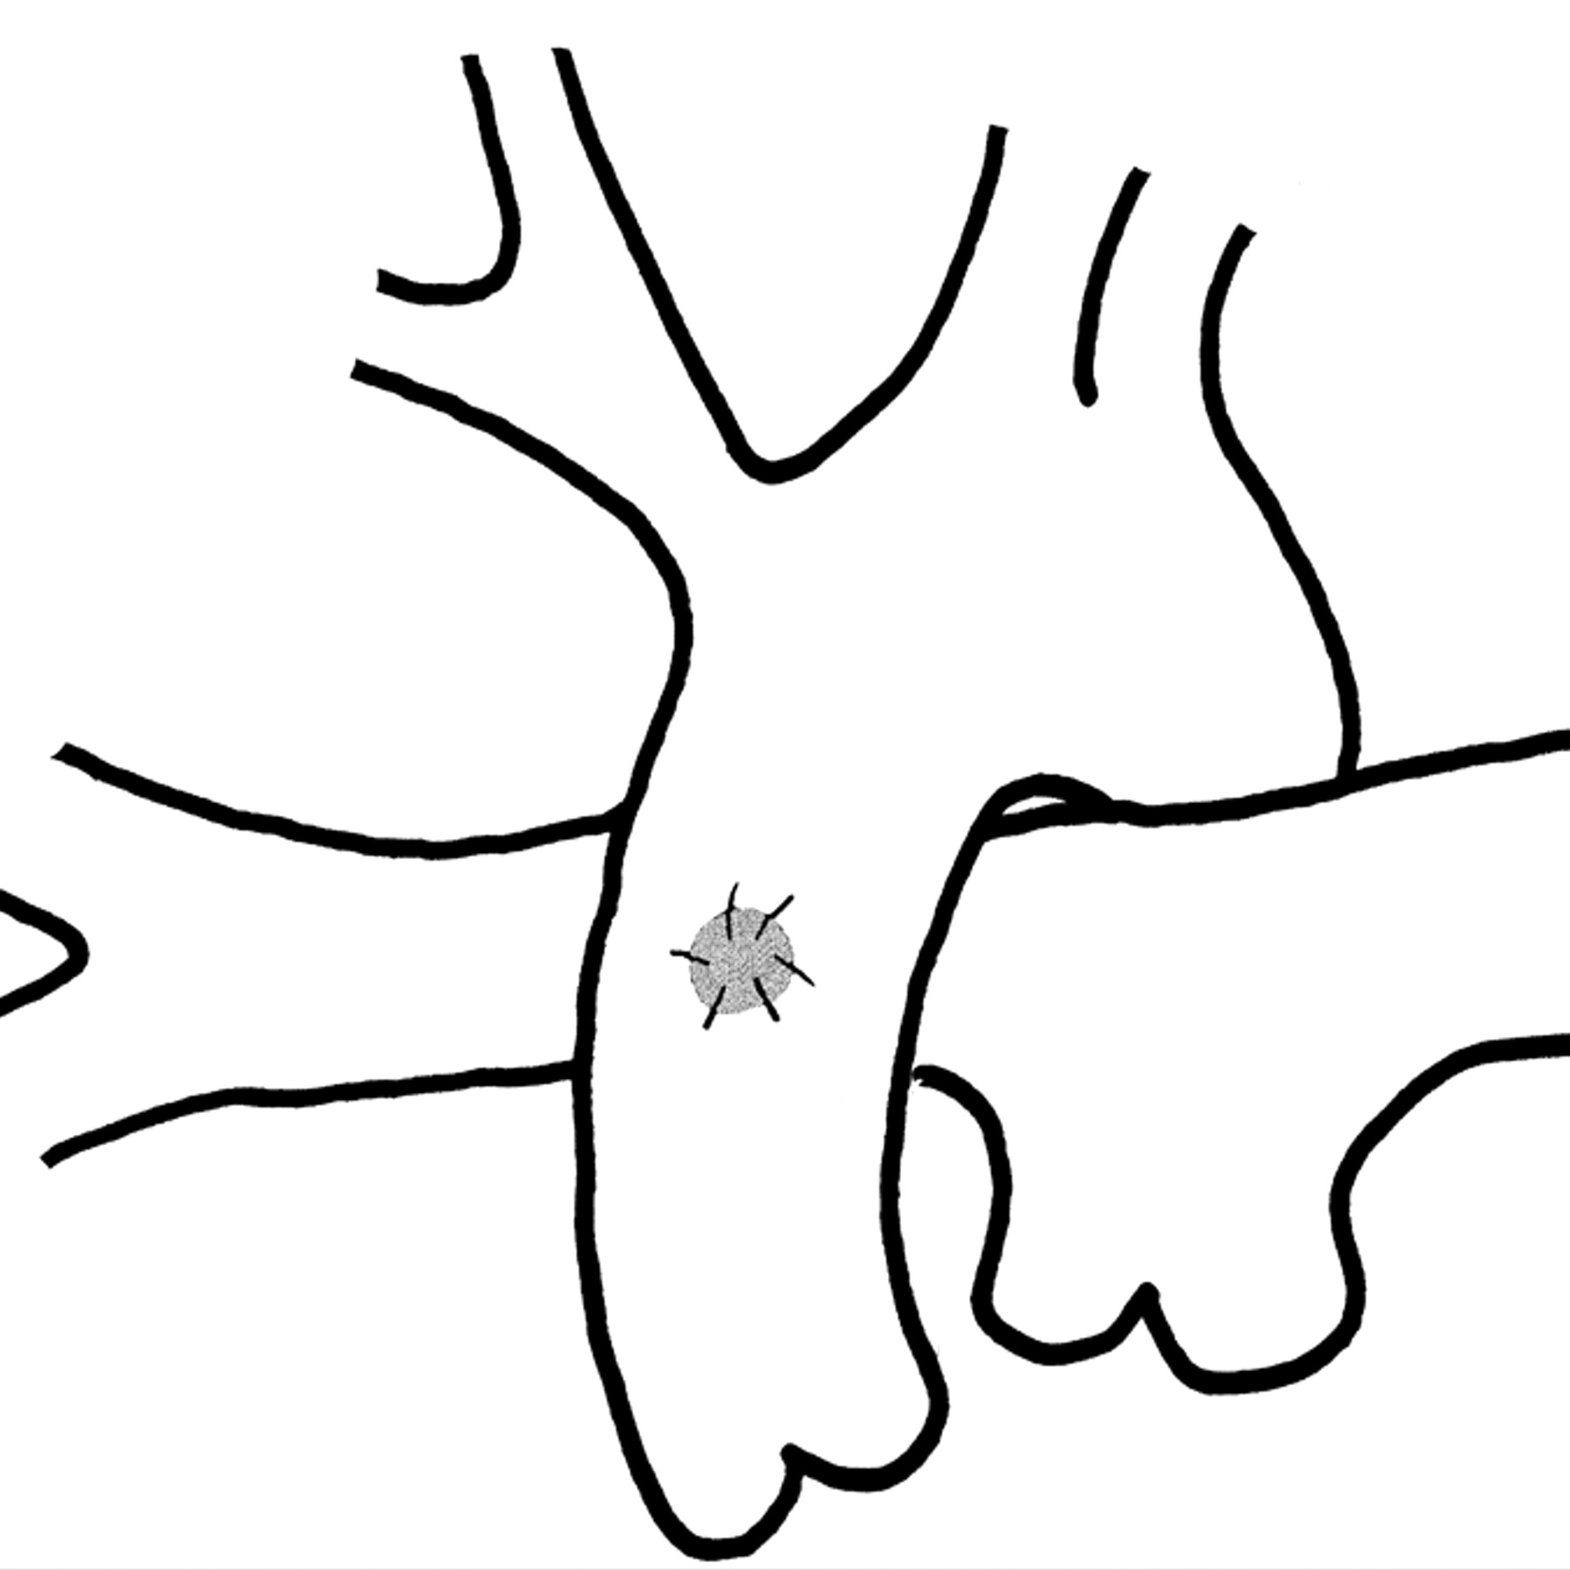
HISTORICAL SHUNTS
POTTS:
AM J ROEnT 2007;189:1353
Waterston / Cooley:
AM J ROENT 2007;189:1353

Slide 11
HISTORICAL SHUNTS: DISADVANTAGES
Difficulty in shunt calibration
Differential pulmonary artery flow / growth and contralateral PA hypoplasia
Pulmonary artery stenosis
Pulmonary vascular disease
Difficult shunt takedown (esp. Potts shunt) @ definitive repair
No longer in use presently

Slide 12
CURRENT SYSTEMIC - PA SHUNT OPTIONS
Blalock - Taussig shunts:
➢ Classical
➢ Modified
Central shunts:
➢ modified Davidson
➢ Melbourne
Sano shunt
Ductal stent (BT “wanna-be”)
Other (eg. IMA - PA shunt)

Slide 13
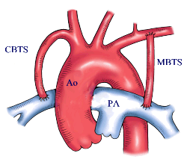
BLALOCK - TAUSSIG SHUNTS

Slide 14
CLASSIC B-T SHUNT
Direct anastomosis between transected subclavian artery and PA
Advantages:
➢ Shunt flow is predictable (subclavian artery acts as flow regulator)
➢ Potential for adaptive growth of anastamosis
Constructed on side of innominate artery (to minimize kinking of the subclavian artery as it crosses over the aortic prominence. Innominate artery adds length to shunt)
Technical aspects:
➢ extensive med dissection / art mobilization
➢ disengage SA from loop of N Recurrens
➢ avoid anastamosis to upper lobe branch of RPA
➢ spatulate end of SA (anastamosis 1,5-2 x > art. circumference)
➢ continuous PDS technique advocated in infants (Ann Thorac Surg 1998;65:1746)

Slide 15
CLASSIC B-T SHUNTS: LIMITATIONS
Extensive mediastinal dissection:
➢ phrenic nerve injury (2-10%)
➢ Horner’s syn
Subclavian artery sacrificed:
➢ acute ischaemia (0,2 %)
➢ decreased arm growth
➢ subclavian steal syndrome
PA distortion:
➢ inadequate length of subclavian artery
➢ anastamotic scar tissue
Arch geometry limits usage
Small size of SA in neonates

Slide 16
MODIFIED B-T SHUNTS
Has more predictable lifespan, limited by lack of growth potential
Subclavian art. acts as flow regulator through shunt
Advantages (vs. Classic shunt):
➢ mediastinal dissection limited
➢ Subclavian artery is preserved
➢ guarantee of adequate shunt length
➢ less tendency to deform hypoplastic PAs
➢ technically easier to construct
➢ arch geometry irrelevant

Slide 17
MODIFIED BTS: TECHNICAL FACTORS
Length of graft critical
Size of graft - take into account:
➢ weight / age of patient
➢ duration of palliation required
➢ size of inflow systemic artery
➢ presence of additional pulmonary blood flow
➢ pulmonary vascular resistance
avoid clamping of graft itself (risk of stasis / graft damage - thrombosis)
Intraoperative signs of adequate shunt:
➢ palpable, continuous thrill in shunt
➢ 10 -15% increase in SaO2
➢ fall in diastolic BP
Surgical approach (thoracotomy vs sternotomy)

Slide 18
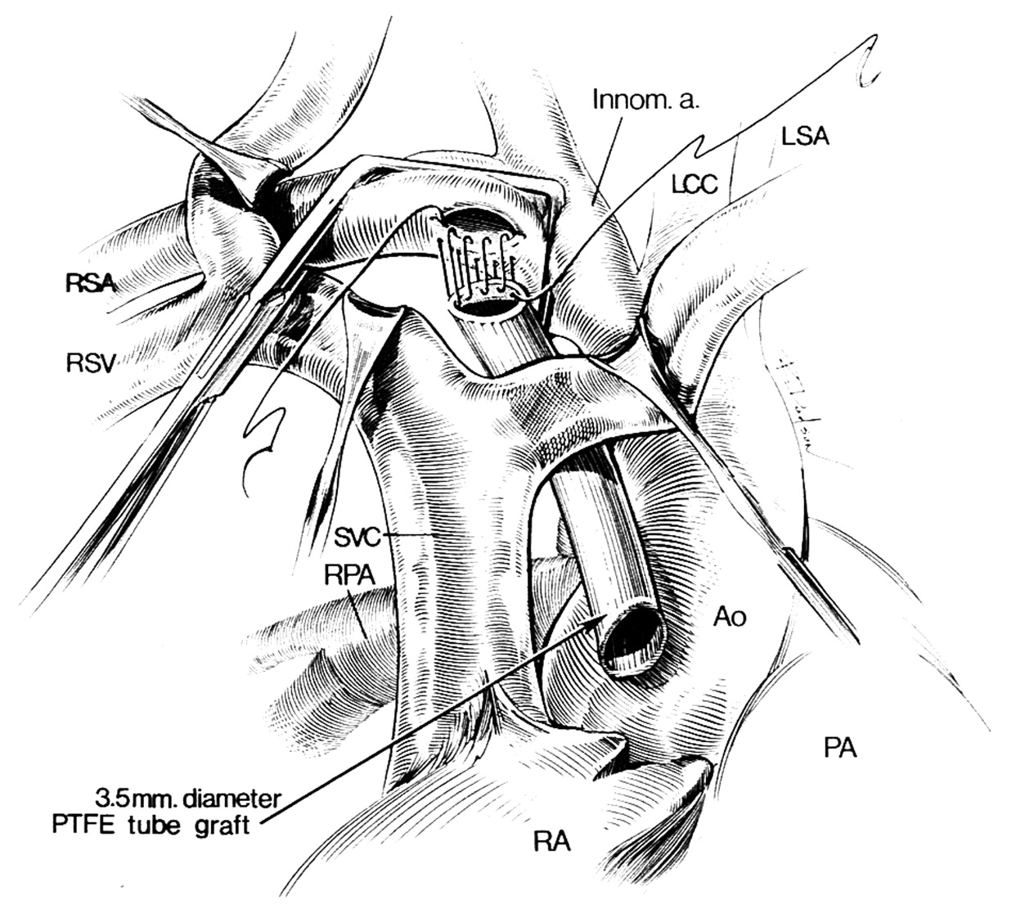
RIGHT MBTS via MEDIAN STERNOTOMY
Odim et al. Circulation 1995;92:256

Slide 19
ADVANTAGES OF MEDIAN STERNOTOMY APPROACH vs THORACOTOMY
Technically easier
Anastomosis ipsilateral to SVC (SV patients)
Anastomosis more centrally on RPA vs anastomosis distal to upper lobe branch:
➢ preservation of upper lobe PA branch
➢ easier/less traumatic shunt takedown
➢ easier correction of PA distortion/stenosis
➢ more uniform blood flow distribution
No pulmonary manipulation/compression
Access to CPB if required

Slide 20
ADVANTAGES (cont.)
Allows for ductal closure
Flexibility in choice of procedure eg. central shunt construction for PA hypoplasia
Avoids distal Suclavian a. dissection (Horner’s syn)
Avoidance of thoracotomy complications:
➢ cosmetic
➢ wound healing
➢ scoliosis (neonates)
➢ chest wall - pulmonary collaterals
Improved shunt patency (Jonas et al)

Slide 21
MODIFIED BTS: COMPLICATIONS
Pulmonary artery: stenosis/distortion
Prosthesis: 1) lack of growth potential
2) obstruction:
➢ acute thrombosis (1,6 - 12%)
⬥ early (periop) (4 - 10%)
⬥ late (interim)
➢ chronic - neointimal peel of concentric fibrous / myofibroblastic layers with endothelial cell infiltration (30% mean narrowing @ 1 yr / 20% > 50% stenosis)(Starnes et al)
3) seroma formation (10%)
4) infection
5) pseudoaneurysm formation
Pulmonary overflow: CCF & pulmonary oedema (inflow artery serves as flow regulator)
(L)-sided shunt takedown: requires extrapericardial mediastinal dissection (MUST be divided at takedown)

Slide 22
MODIFIED BTS: PULMONARY ARTERY COMPLICATIONS
STENOSIS: ➢ in 12 - 25% (Sachweh et al)
➢ 50% (Godart et al) - @ postop period of 6 - 317 months (mean 51 +/- 55 months):
➢ severe (>50% diametre stenosis) in 14% of cases
➢ Etiology: 1) presence of PDA / PGE1 infusion
2) inappropriate surgical technique:
⬥ stenosis / distortion
⬥ intimal clamp injury
⬥ graft length issues
3) PA intimal proliferation due to abnormal haemodynamics
DISTORTION:
➢ in 20% (Godart et al)
➢ related to fixed length of graft & growth of patient

Slide 23
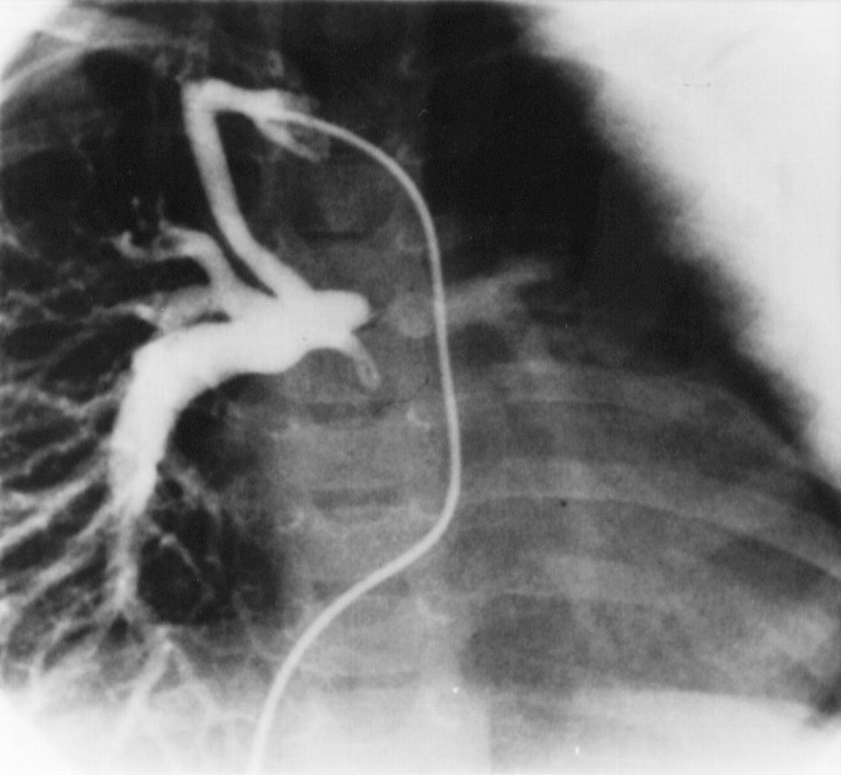
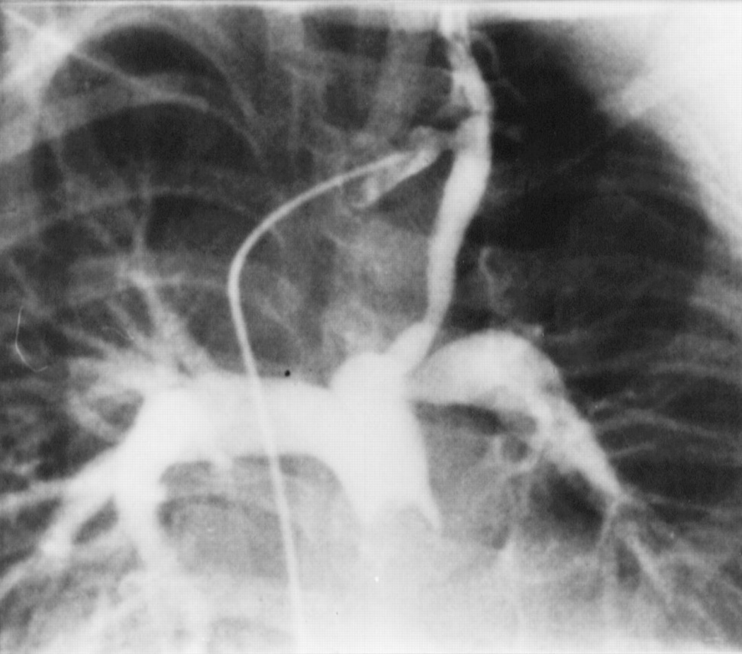
PA COMPLICATIONS (cont.)
LPA discontinuity @ site of PDA insertion
Eur j cardiothorac surg 1998;14:229
Lpa stenosis & distortion
Eur j cardiothorac surg 1998;14:229

Slide 24
MODIFIED vs CLASSIC BLALOCK TAUSSIG SHUNTS
103 pts with BTS (Jpn J Surg 1987;17(6):470-477)
40 Modified BTS: (1mth – 11 yrs [33,8 mths])
➢ 4-6 mm shunts inserted
➢ 6 shunts failed over 6 yr follow-up period (all in 4 mm size grafts)
➢ 3 yr patency = 88,8% / 5 yr patency = 88,8%*
➢ 5 yr patency in 5/6 mm grafts = 100%
➢ @ 3 yrs non significant advantage in SaO2 & Hb for Modified vs Classic BTS
63 Classic BTS: (7days – 17 yrs [33,9 mths])
➢ 12 shunts failed over 8 yr follow-up period
➢ 3 yr patency = 78% / 5 yr patency = 75% *(NS)
Conclusion: > 4 mm shunt gives as good palliation as Classic shunt

Slide 25
MODIFIED vs CLASSIC BTS (cont.)
In infants (< 1 yr) (Ann Thorac Surg 1987;44:539) :
➢ 51 concurrent pts (24 M0dified / 29 Classic shunts)
➢ pts receiving modified shunts did significantly better than classic shunts regarding:
⬥ greater PA growth
⬥ less PA distortion
⬥ less shunt failure • early: 4% vs 14%
• late: 17% vs 38%
Conclusion: ➢modified shunt to be considered a better alternative to classic shunt in infants
Confirmed by Moulton et al (Circ 1985:72(Suppl II) 35) :
➢ 21% incidence of PA stenosis / lack of SA growth in neonates & small infants receiving classic shunts

Slide 26
MODIFIED vs CLASSIC BTS (cont.)
546 shunts (128 C /418 M) (Cardiol Young 1998;8:486) :
➢ mortality 2,9% (0% mortality in pts > 1yr)
➢ early shunt failure: 4,0% C / 1,6% M (NS)
⬥ PA size < 5 mm & non usage of perioperative heparin - most NB factors
➢ late failure over 9 yr follow-up (mean 38 mths):
⬥ 10,2% C / 6,7% M (NS)
➢ PA distortion: 0,7% C / 3,7% M (NS)
Conclusions:
➢ periop heparin reduces early shunt failure
➢ modified shunt insertion decreases late failure

Slide 27
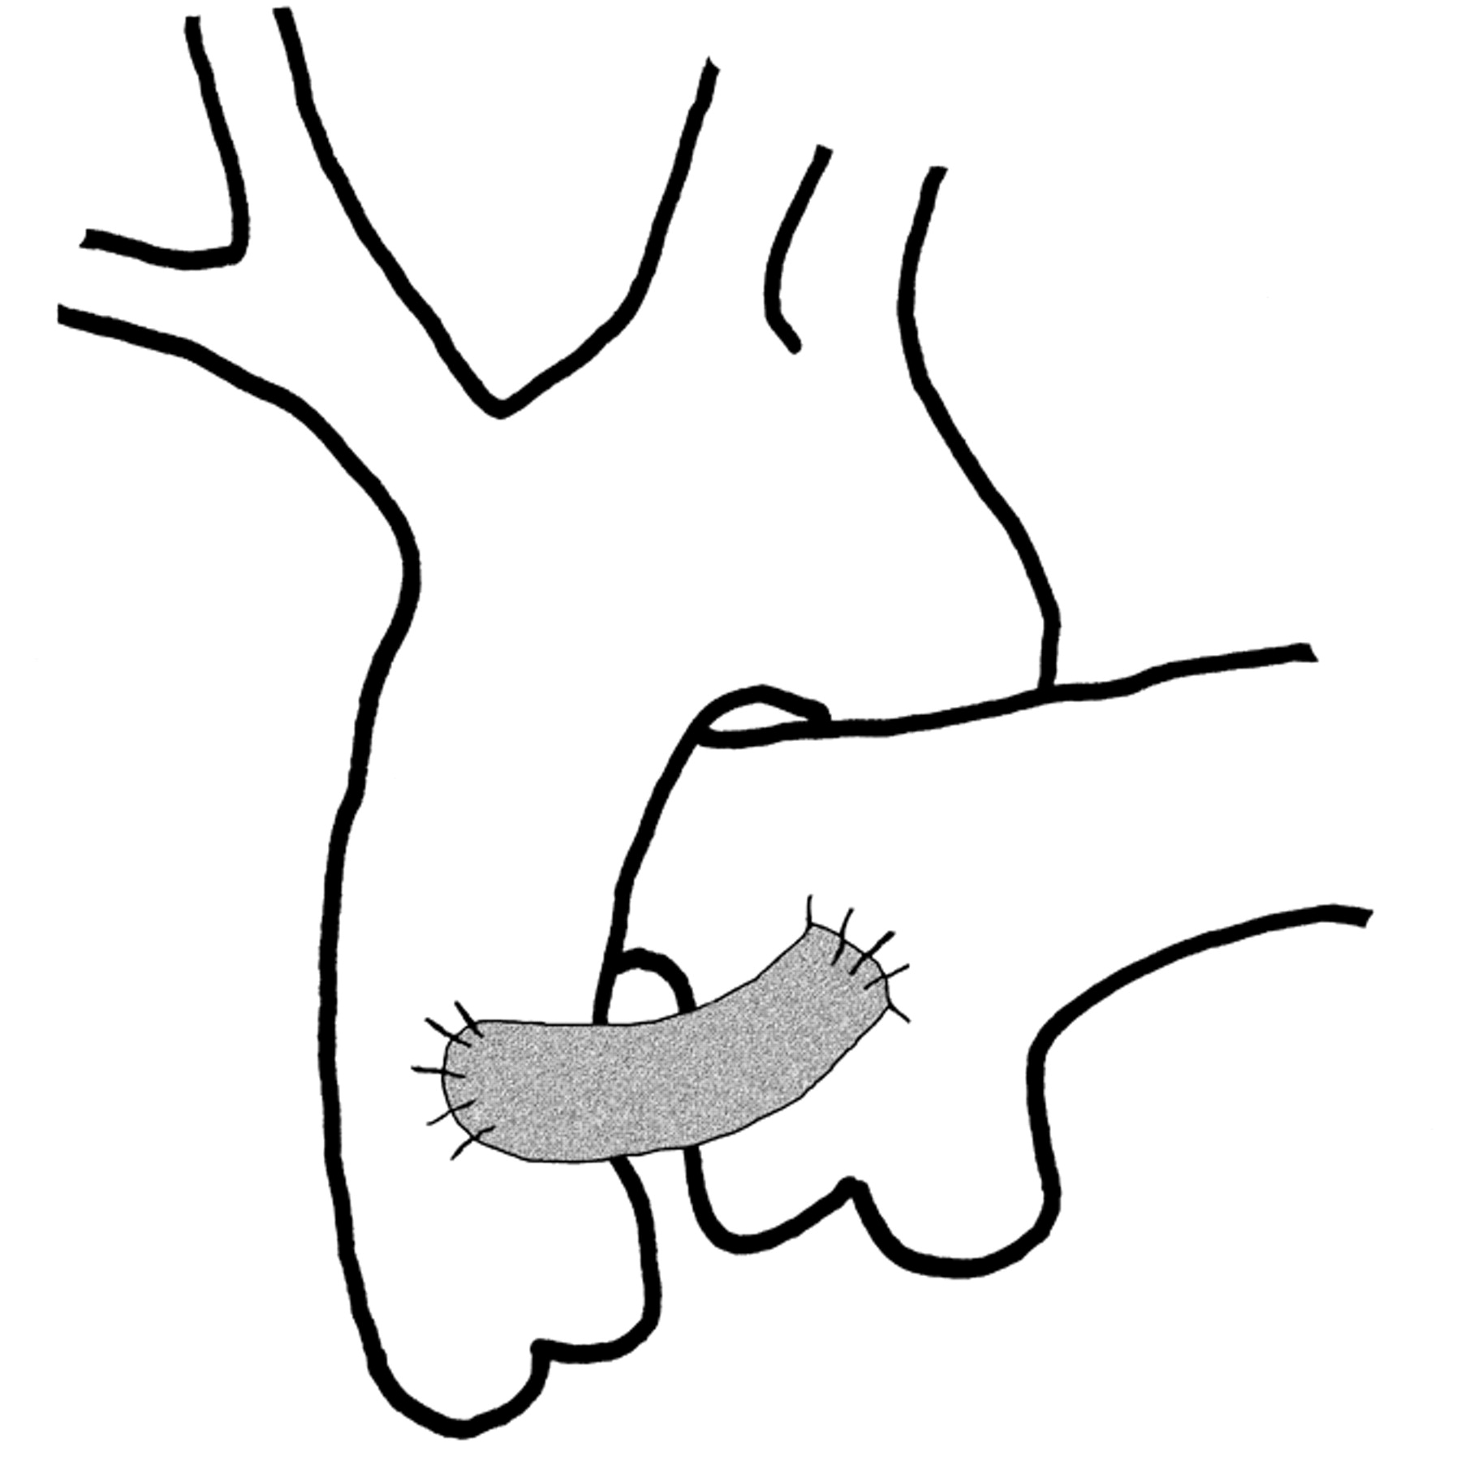
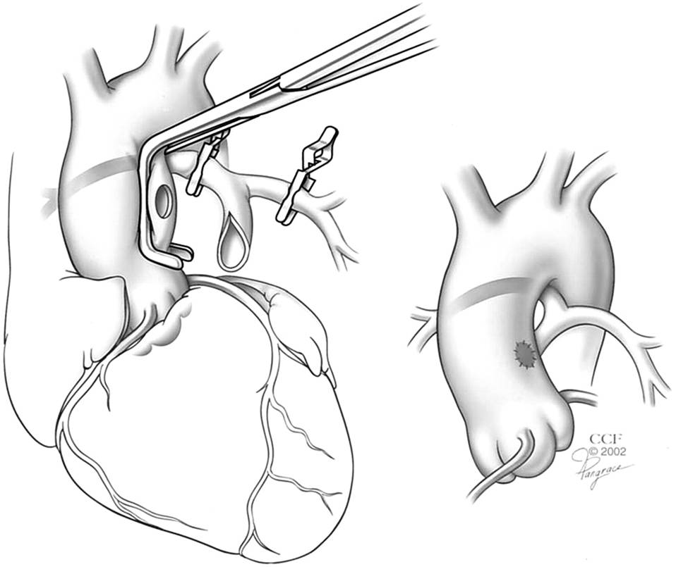
CENTRAL SHUNTS
Modified Davidson:
Am J Roent 2007;189:1353
Melbourne:
Ann Thorac Surg 2008;85:2079

Slide 28
CENTRAL SHUNTS (cont.)
Melbourne shunt :
➢ usage limited to Pulmonary Athresia patients with diminutive PAs
➢ problem of kinking/stenosis of RPA
Modified Davidson shunt:
➢ good choice in cases of hypoplastic PAs
➢ PDA must be present to allow MPA clamp
➢ no distortion of PA tree
➢ more uniform PA flow / growth
➢ too large shunt will cause pulmonary overflow

Slide 29
CENTRAL SHUNTS (cont.)
Amato et al (J Thorac. Cardiovasc. Surg 1988;95:62)
80 pts receiving modified Davidson shunts
Short, straight graft used
Pt selection: ➢ neonates / infants < 3 mths
➢ PDA present
➢ hypoplastic PAs
➢ failing previous shunts
Follow-up (3 - 82 mths):
➢ occlusion rate = 3,8% (compared to 11,5% for Modified BTS & 19,2% for Classic BTS)
Procedure of choice in neonates / infants < 3 mths

Slide 30
POSTOPERATIVE CARE

Slide 31
MANAGEMENT OF SUSPECTED SHUNT THROMBOSIS
Diagnosis:
Significant sustained desaturation / desaturation & disappearance of shunt murmur
Especially in a new shunt / dehydrated patient known to have a shunt
Management: EMERGENCY
Resuscitate
Urgent Echo
↑ SVR: volume bolusses / vasopressors
↓ PVR: sedate / paralysis / decrease PaCO2
Begin heparin: ➢ bolus 50 units/kg
➢ infusion at 20 units/kg/hr
Restart PGE1 infusion in neonate.
Consider systemic antifibrinolytics
Intervention: ➢ percutaneous (thrombolysis / PTCA / stent)
➢ surgical shunt revision

Slide 32
MANAGEMENT OF PULMONARY OVER-FLOW
Often difficult
More common if PDA is present & may resolve as the duct closes.
In immediate post-op period or later when ventilation is weaned.
Diagnosis:
↑SaO2, ↓ SvO2 & increasing lactate /BD
Widening toe - core temperature gap
CXR- oedematous lungs
ECG changes due to ischaemia from low diastolic BP (more severe cases)
Signs of right heart failure (late sign)
Treatment:
Mild form : fluid restriction and diuretics.
More severe form : manipulate PVR and SVR ( ↑ PVR/↓ SVR)
If ECG changes are present - emergency.
May occur with low cardiac output state - inotropes may be required.
The shunt may need to be clipped/banded /redone

Slide 33
INTERIM SHUNT MANAGEMENT
Inherently unstable parallel circulation with CO partitioned to lungs/body based on relative resistances of pulm & systemic circulations
Interim mortality - 14 %
Current concepts relating to this mortality focused on: ➢ haemodynamic shunt status
➢ potential for shunt thrombosis
Limited ability to withstand physiologic stress:
➢ if shunt is too large: ↑pbf, CCF & ↓diastolic BP & if pt stressed, autonomic refelexes cause increased sympathetic tone - ↑↑pbf /sbf ratio - ↓O2 delivery
➢if shunt flowis limited: increasing pbf during stress cannot occur - critical ↓ O2 delivery

Slide 34
INTERIM MANAGEMENT (cont.)
Dehydration may precipitate shunt thrombosis
Additional limitations of parallel circulations (cause further decrease in O2 delivery):
➢parenchymal lung disease
➢anaemia
➢decreased CO (AV valve regurg,arrhythmias)
Management:
➢ routine aspirin (clopidogril?)
➢ aggressive & proactive home surveillance:
⬥ daily weighing
⬥ twice daily SaO2 monitoring
⬥ any symptoms (irritability/poor appetite/ emesis) – seek medical advice / echo

Slide 35
LONGTERM / PERMANENT PALLIATION

Slide 36
BT SHUNTS IN OLDER PATIENTS
Royal Brompton experience (Cardiol Young 2005;15:368-72)
BTS in pts > 12 yrs (n=21; median age = 18,5 yrs)
type: ➢ Classic (5)
➢ Modified (16) - Median shunt size = 8mm
Operative mortality (1 - unilat. pulmonary oedema)
76% reported improvement of symptoms
Median time to correction / final palliation: 12 yrs
➢ 48% had shunt > 5 yrs
➢ 38% had shunt > 10 yrs
➢ after 5 yrs 20% required venasections
1 pt underwent 2nd shunt for shunt blockage ( 5 yrs)
Actuarial 10yr survival with patent shunt = 50%

Slide 37
BTS IN OLDER PATIENTS (cont)
4 pts died during follow up (19%):
➢ CCF (3 months postoperatively)
➢ sudden death x2 (2,5 yrs / 4,5 yrs post op)
➢ S.B.E. (1 yr post op)
Actuarial freedom from death @ 15yrs = 76%
Conclusions:
➢ BTS can be performed safely in older pts
➢ provides effective palliation for minimum of 5 yrs
➢ compares favourably with Fontan results over short to medium term in SV patients

Slide 38
AORTA-PULMONARY SHUNTS: DEFINITIVE PALLIATION
UTCCCA experience - 50 SV pts (Heart 2000;83:51-57)
15 pts had permanent palliation with A-P shunts
Types of shunts: ➢ BTS (10)
➢ Waterston (2)
➢ Interposition A-P (3)
Age @ 1st palliation: 6mths (1 day – 13 yrs)
No operative mortality
Follow-up period was 17,9 yrs (10,9 – 25,9 yrs):
➢ 4 patients required 2nd shunt
➢ 6 patients died (all sudden cardiac - arrhythmia)
➢ 4 patients required phlebotomies
➢ above 4 patients had minor systemic TE events

Slide 39
DEFINITIVE PALLIATION (CONT.)
Survival: ➢ 89,4% @ 10 yrs
➢ 51,9% @ 20 yrs
Conclusions:
➢ A-P shunts offer sustained palliation for selected patients with SV physiology
➢ survival compares favourably with Fontan survival
➢ compared to pts palliated with superior cavopulmonary connections, A-P shunt patients had worse systemic ventricular function
➢ arrhythmias are major cause of late M&M. Onset of VT is an ominous sign

Slide 40
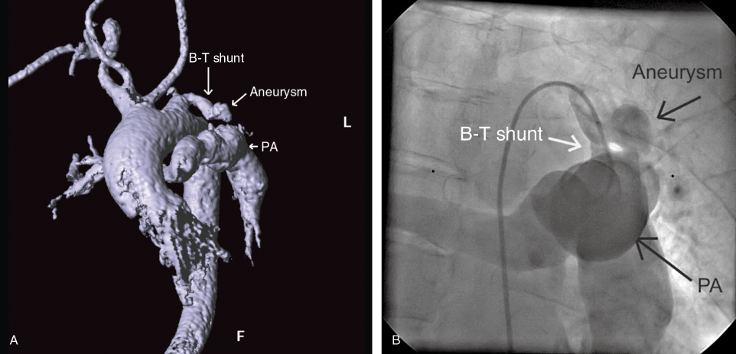
CLASSIC SHUNTS: DEFINITIVE PALLIATION
63-yr-old Tricuspid athresia
Classic shunt 60 yrs earlier
(Congenit.heart dis. 2011;6:179)
72-yr-old tet of fallot
Classic shunt 46 yrs earlier
(Ann thorac s urg. 2010;89(1): 311 )

Slide 41
SYSTEMIC-PA SHUNTS in the AFRICAN CONTEXT
Limited availability of catheterization labs & open heart surgical facilities
As shown A-P shunts can play a role in long term or permanent palliation:
➢ systemic - PA shunts can be performed with negligible mortality in pts > 1yr
➢ palliation is good if a large prosthetic shunt is inserted (? as good as Fontan)
Alternative - early death

Slide 42
RECOMMENDATIONS: PATIENT MANAGEMENT
Biventricular cyanotic CHD:
➢ palliative Systemic-PA shunting procedure
➢ consider alternative procedures where possible (eg. Brock procedure for Pulmonary valvar stenosis)
Univentricular CHD:
➢ RV morphology: - no surgery
➢ LV morphology: - palliative systemic-PA shunting if:
⬥ Left-sided AV valve competent
⬥ LVEF is normal
⬥ Non-restrictive interatrial septum
- consider superior cavopulmonary shunt in ideal patients (“off pump” BDG).
➢ Site of systemic-PA shunt placement (left vs right vs central) in single ventricle patients should take into account SVC arrangement & additional source of pulmonary blood supply so as to make future “off pump” BDG possible

Slide 43
RECOMMENDATIONS: SYSTEMIC - PA SHUNT CHOICE
Neonates / young infants :
➢ Modified BTS is shunt of choice
➢ Consider central shunt in appropriate pts (eg. patients with hypoplastic PAs)
Older infants:
➢ Modified shunt with large a graft (5mm)
Children:
➢ Modified shunt with largest possible graft (5 mm+)
➢ Classic shunt considered in older pts

