Slide 1
Pulmonary artery banding
Dr DG Buys
Department of paediatric cardiology
Sunday 5 June 2011

Slide 2
Overview
Introduction
History
Pathophysiology
Pulmonary hypertension / pulmonary vascular resistance
Diagnosis
Indications
Formulas/ how tight
Future
Discussion

Slide 3
Inroduction
Banding in Africa
Palliative – not curative
Performed as stage approach
Purpose to maintain balanced pulmonary-to-systemic blood flow (Qp/Qs)
Not to distort the pulmonary arteries
Facilitate future surgical interventions

Slide 4
History of banding
Muller and Dammonn – UCLA – 11July 1951 (1952)
Patient 5/12 infant with large VSD
To create PS and prevent Qp
Used 1cm umbilical tape
Started in period when surgical repair not available
25 patients – 1951-1955
- 9 operative deaths – 5 before surgery
1 late death
Kron et al Ann Surg May 1989

Slide 5
History
Describe – banding 1955-1988
170
Total mortality rate 45% - did not vary from different decades
Remains preferred palliation to delay surgery
Later used for more complex lesions
Materials – tape, nylon, PTFE , non-stretchable Gore-Tex
Devices and dilatable bands
Although use decreased it continues to play role in management of some CHD – up to 2% of congenital cardiac cases in current surgical databasis

Slide 6
Pathophysiology
6 weeks drop in PVR
Pulmonary overflow
Medial hypertrophy of pulmonary arterioles and fixed pulmonary hypertension – Eisenmenger
Creating PS – decreased flow – decreased return to LV – improved LV function
PHPT: mPA pressure >25mmHg in rest and >30mmHg with exercise

Slide 7
Diagnosis
Clinical - AP, Load P2 , RVHT, HTS
ECG/CXR - RVHT , p-pulmonale, decreased flow, RVHT, PA
Echo - usually indirect
- variable
- patient / songrapher / machine dependant
- RVPSP - needs TR
- PIG – needs shunt
- BP - can be inacurate

Slide 8
PVR = PAP/ PAflow
Substitude PA pressure with TR jet
Substitude PA flow by RVOT VTI (velosity time integral)
And we get
PVR = TR jet velocity/ RVOT VTI x10

Slide 9
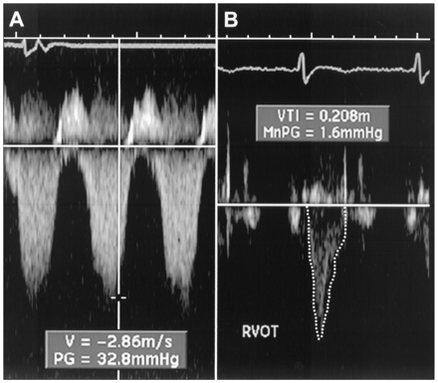
Figure 1 Images showing peak tricuspid regurgitant velocity (TRV) and right ventricular outflow time-velocity integral (TVI_{RVOT}) in a patient with normal pulmonary vascular resistance (PVR). (A) TRV is 2.86 m/s. (B) TVI_{RVOT} is 20.8 cm. The ratio of TRV/TVI_{RVOT} = 2.86/20.8 = 0.1375. . This patient’s invasive PVR measurement was within 0.4 WU of the echocardiographic value (PVR_{CATH} = 1.3 WU). PVR_{ECHO} = PVR in WU calculated based on the linear regression equation in which a value for PVR in WU was modeled based on TRV/TVI_{RVOT}. PVR_{CATH} = invasive PVR.

Slide 10
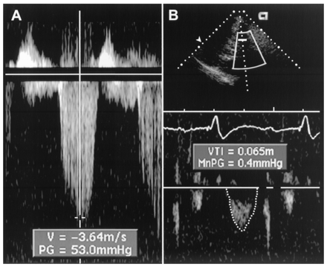
Figure 2 Images showing TRV and TVI_{RVOT} in a patient with elevated PVR. (A) TRV is 3.64 m/s. (B) TVI_{RVOT} shows a clear deceleration of pulmonary flow before the pulmonic valve closure click and is calculated at 6.5 cm. The ratio of TRV/TVI_{RVOT} = 3.64/6.5 = 0.56. . This patient’s invasive PVR measurement is also within 0.4 WU of the echocardiographic value (PVR_{CATH} = 6.0 WU). Abbreviations as in Figure 1.
J Am Coll Cardiol, 2003; 41:1021-1027

Slide 11
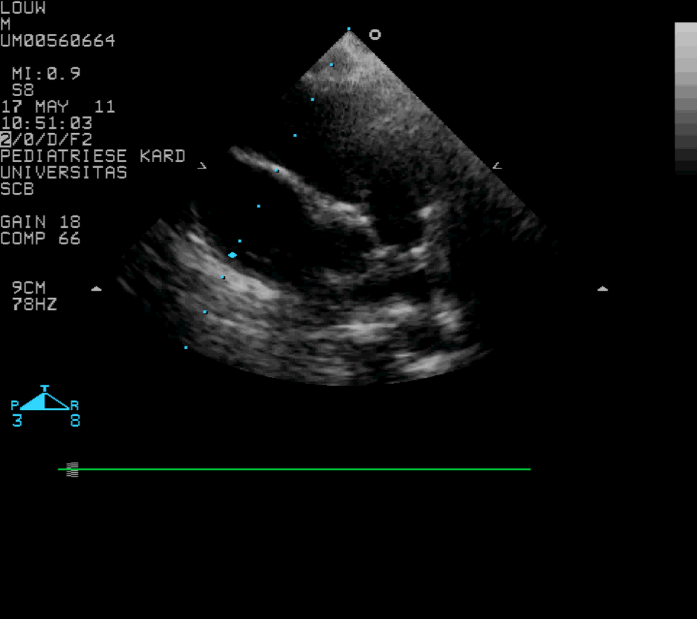
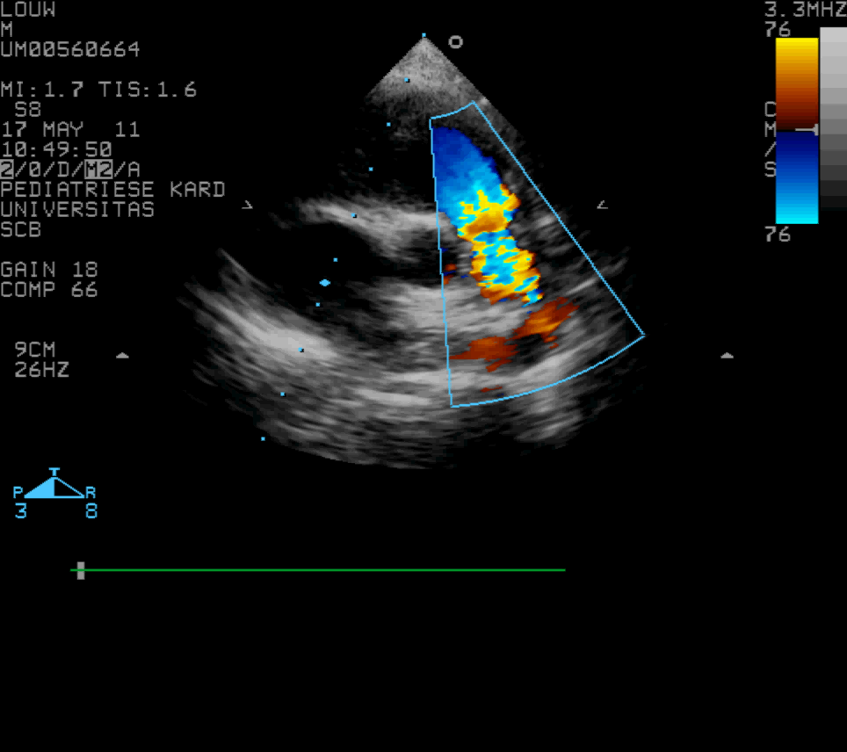

Slide 12
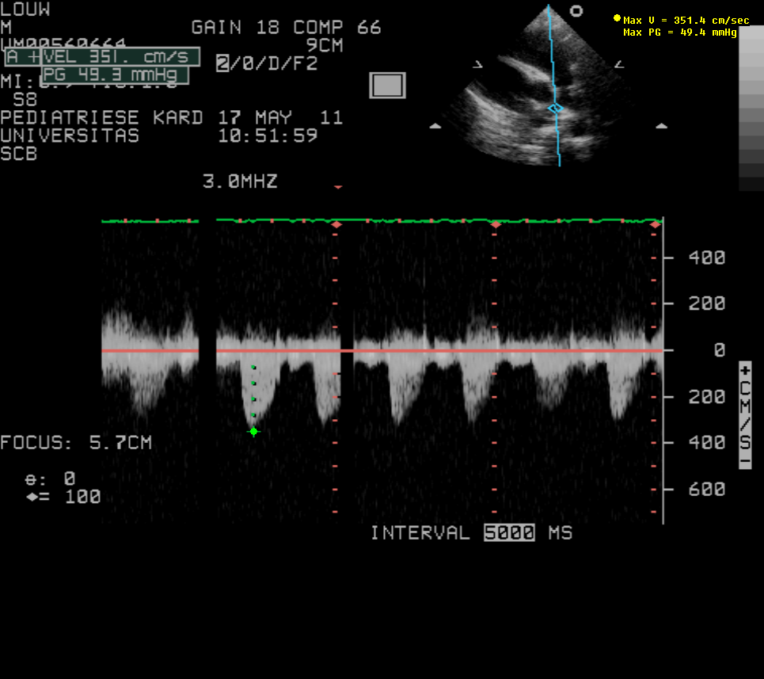
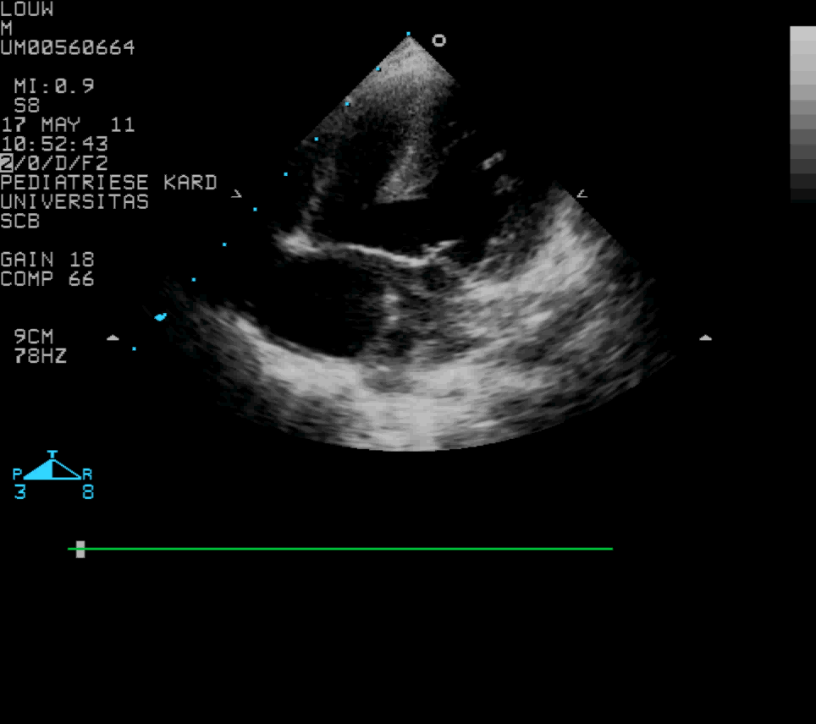

Slide 13
Cath – more accurate, but still
uses Fick’s principle
Qp/Qs = Ao – RA(SVC) / LA – PA
Many variables

Slide 14
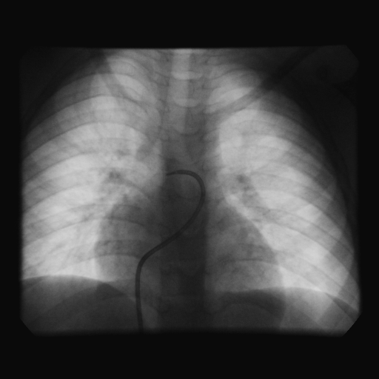
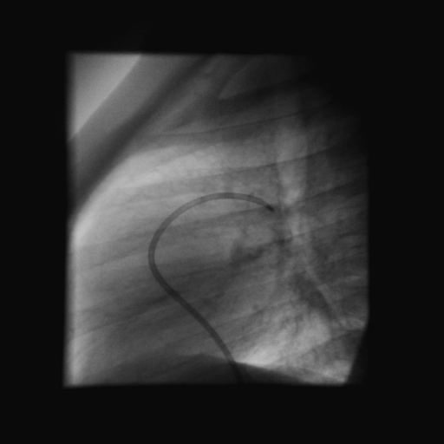

Slide 15
Who should we Band?
Indications:
3 Groups - A: Pulmonary over circulation – L-R shunting who require reduction in PBF
B: TGA/VSD
C: Hybrid

Slide 16
Group A: VSD, AVSD, TA type 1C, DURV without PS, Truncus arteriosus, absent pulmonary valve syndrome ext.
- Prevent Pulmonary over circulation / reduction in pulmonary hypertension
Group B: dTGA with initial late presentation
- To train LV for arterial switch
Group C: HLHS – ductal stent and branch PA banding

Slide 17
Limited by several factors
a) Difficulty in determining tightness of band
b) Several peri-operative variables – anaesthesia, pH , PPV
c) Age-related variability of ventricular adaptive response
d) Repeat banding to adjust the band parameters – overbanding / underbanding
e) Long periods of meds and ICU to control pulmonary bloodflow
f) Need for reconstruction of PA at time of debanding

Slide 18
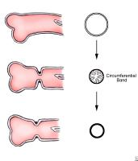
Caption: Picture 4. Pulmonary artery banding. Circumferential banding of a dilated pulmonary artery can acutely lead to internal infolding of the arterial wall. Later resorption of the infoldings and remodeling of the arterial wall restore a greater internal cross-sectional area.

Slide 19
How tight should the band be?
Trusler formula - early 1972
A method of banding the pulmonary artery for large isolated ventricular septal defect with and without transposition of the great arteries.
Trusler GA, Mustard WT.
I - noncyanotic nonmixing lesions - 20mm + 1mm/kg
II - Mixing lesions (TGA+VSD) - 24mm + 1mm/kg
III - Single ventricle for Fontan - 22mm + 1mm/kg

Slide 20
Intra-op pressure and saturation monitoring , aim to lower PAP to normal or ½ of systemic without desaturation or bradycardia - many variable factors
- GA
- Mechanical ventilation
- Open chest
- Days after op when hematocrit / pH ext.
Determine Qp/Qs after Trusler formula was used.
Site of placement – mid MPA trunk

Slide 21
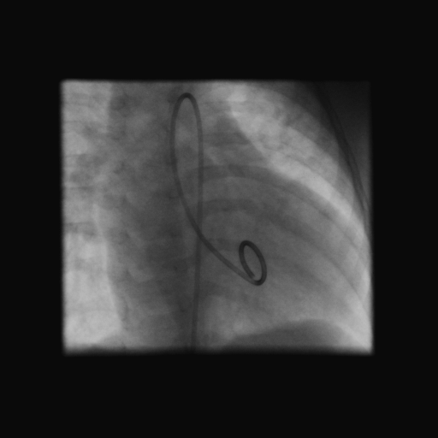
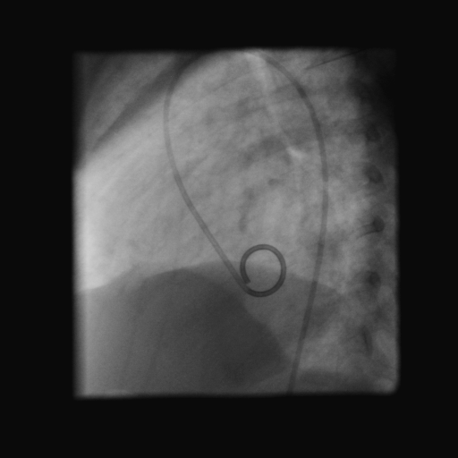

Slide 22
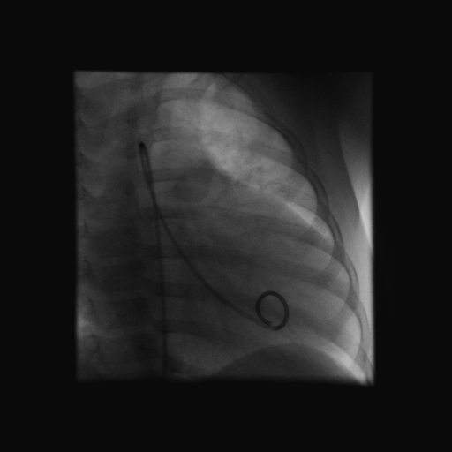
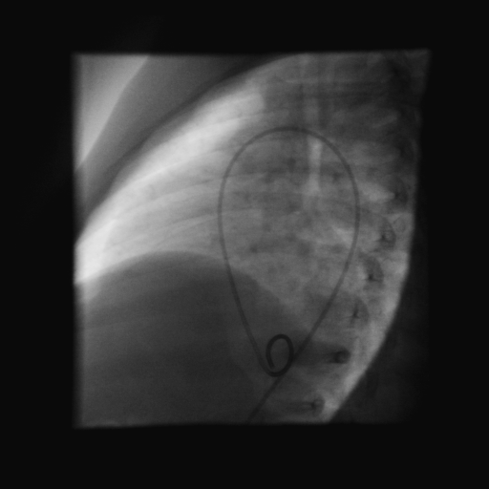

Slide 23
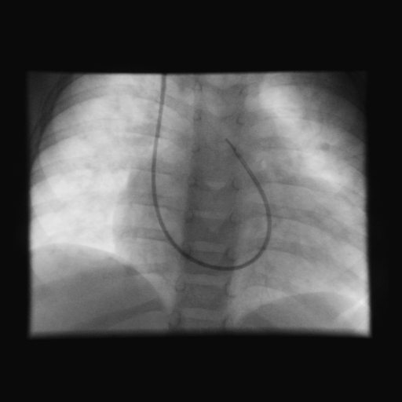
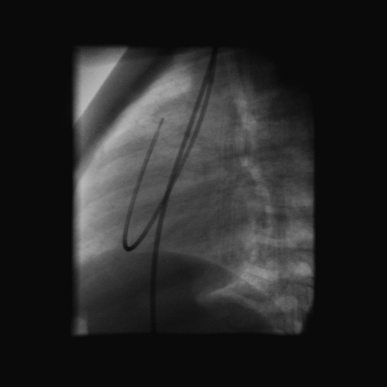

Slide 24
Complications
Migration of band
- impingement and stenosis of branch PA
To proximal placement – PV distortion
Inadequate banding – Pulm overflow/CCF
Over banding
Erotion of PA
Distortion of PA
Mortality rate assosiated with complexity of lesion and overall condition of the patient.
Early day as high as 25% - now 3-5%

Slide 25
Future
Intraluminal
Thoracoscopically implantable
Adjustable bands – FloWatch-R-PAB(Endoart SA, Lausanne, Switserland) – clinical trials
Devices – not option for Africa

Slide 26
General View of the FloWatch-PAB implant: the four main functional parts are:
1) The case (body of the device)
2) The silicone membrane
3) The piston
4) The counter-piece
5) The clip (a) with the place for the attachment to the case (b)

Slide 27
Alternatives
Dilatable bands – may postpone to more desirable weight
- S Brown et al. / EJCTS 37 (2010)
- 2003 – 2009 (20)
- non-resorbable 2mm nylon with vascular clips, 6/0 prolene
- open ring 3.0-4.0mm Gore-Tex , polypropylene 7/0
- not exceeded 120%
- Handmade, cheap ,already available
- Allows surgeon to make band tighter
- Pulmonary artery pressures can progressively increased

Slide 28
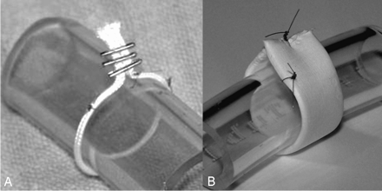
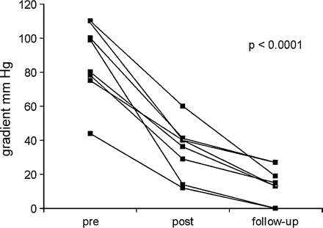
S Brown et al. / EJCTS 37 (2010)

Slide 29
When and who to band in Africa ?
Timing – important
- lesion
How will one decide to band – Echo / Cath / Other
- What will be the minimum diagnostic equipment be
How will these patient be followed
What will the future hold for these patients

