Slide 1
Post traumatic empyema
20 yrs
Stab chest
Chest drain

Slide 2
Post traumatic empyema
2 months post trauma
38.5 °C
tachypnoea

Slide 3
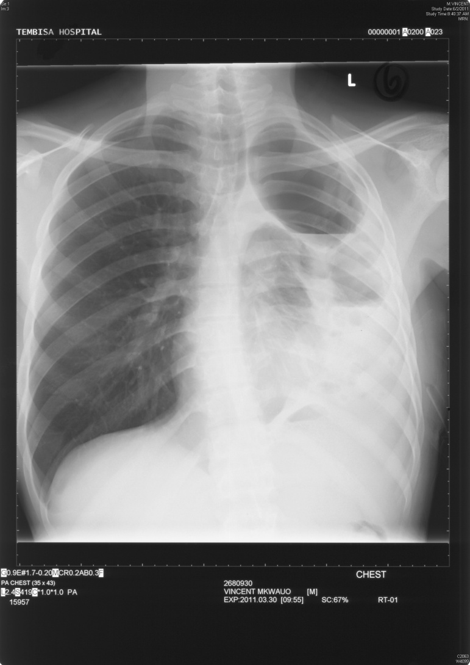
Post traumatic empyema

Slide 4
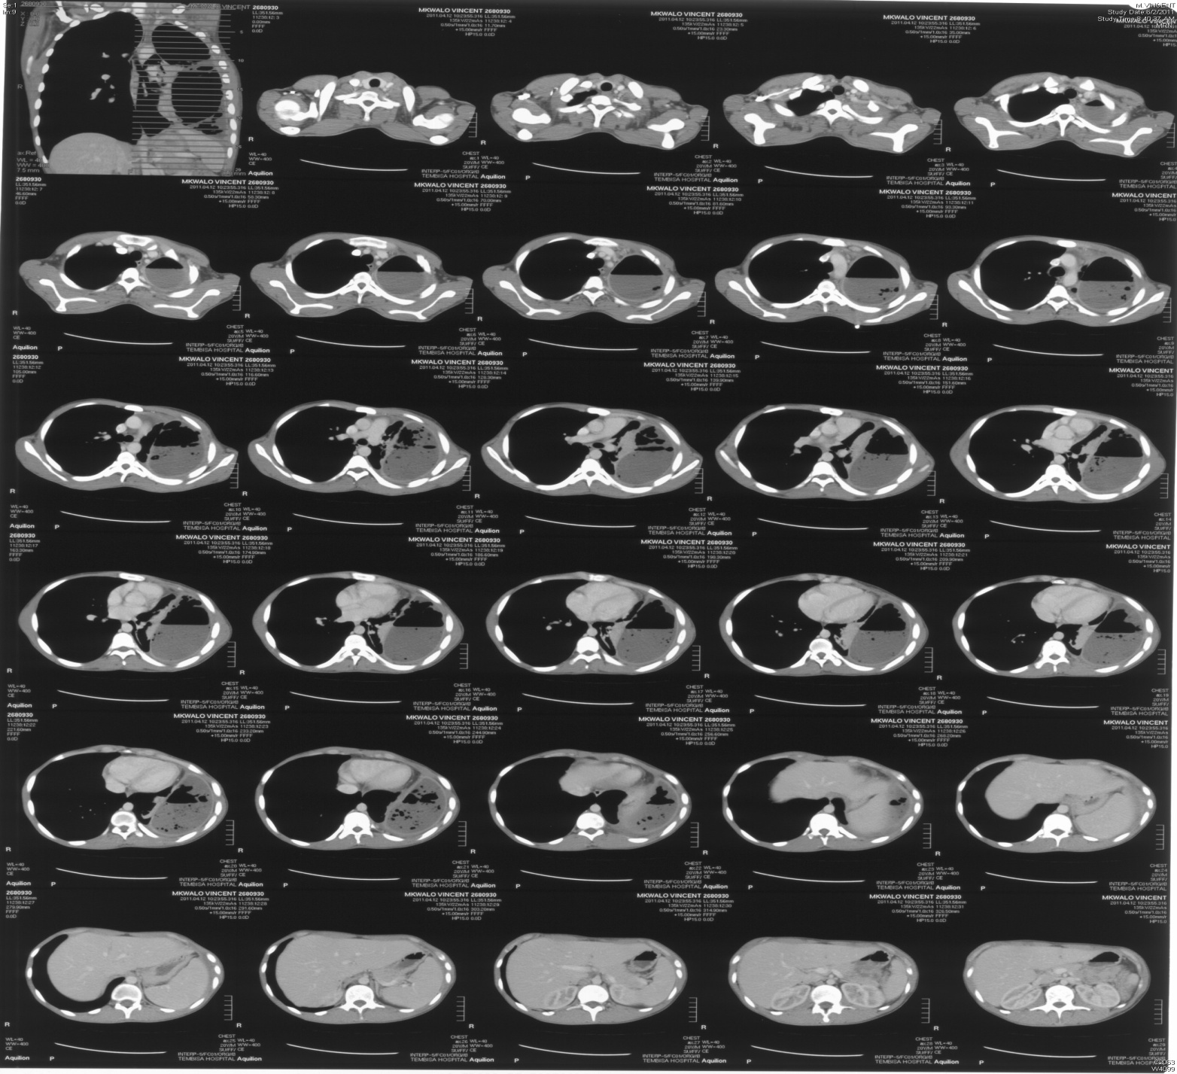

Slide 5
Post trauma empyema
IV antibiotics
decortication

Slide 6
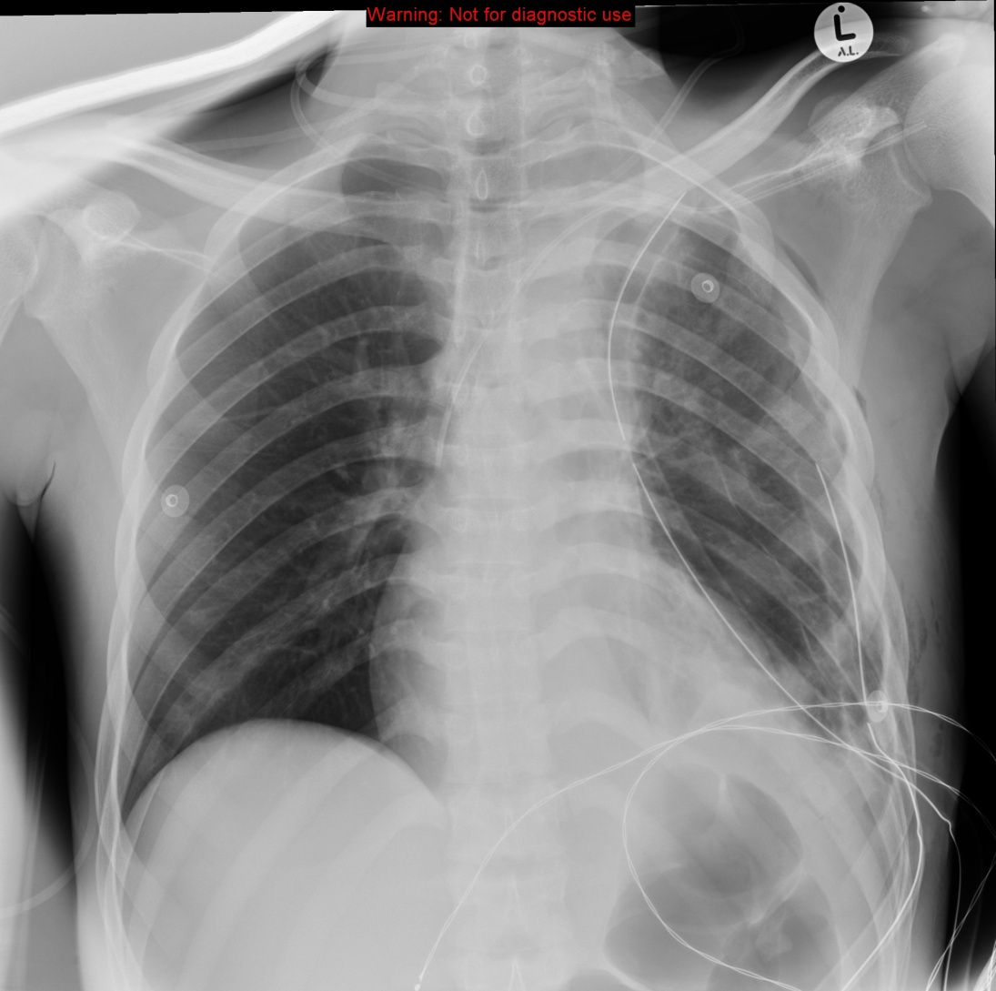
Post trauma empyema

