Slide 1
Perioperative coagulopathy in coronary artery bypass surgery
Dr Lelanie Pretorius
MBChB, Mmed (Hemat),
PG Dip (Transfusion Medicine)
Dept of Haematology
University of the Free State

Slide 2
content
Normal haemostasis
Mechanisms of peri-operative coagulopathy
Laboratory monitoring
Management

Slide 3
The major role players
Blood vessel endothelium
Blood Coagulation factors
Blood platelets
Inhibitors of coagulation
Fibrinolysis
3

Slide 4
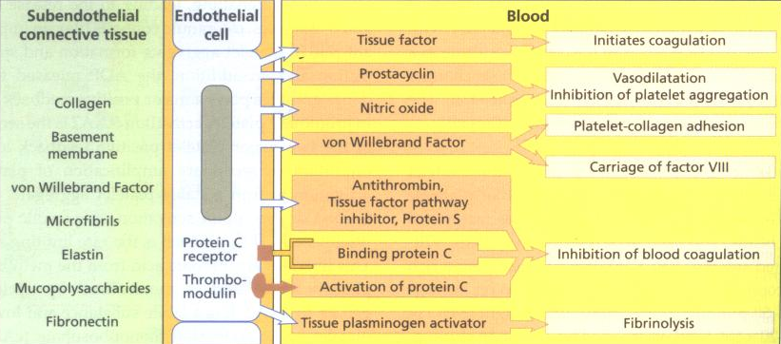
Endothelial function

Slide 5
Classic coagulation cascade

Slide 6
EXSTRINSIC
INTRINSIC
XIIa XII Complement
and contact
XIa XI activation
IX IXa
VIII, Pl & Ca⁺⁺
X
TISSUE FACTOR
PL
VII
Ca⁺⁺
X
Xa
V, Pl
& Ca⁺⁺
II IIa
FIBRINOGEN FIBRIN
IIa (Thrombin)
COMMON PATHWAY

Slide 7
Cell based model of coagulation

Slide 8
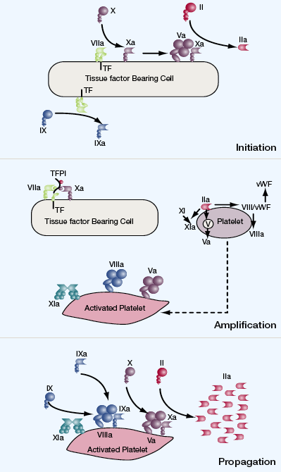

Slide 9
Platelet function

Slide 10
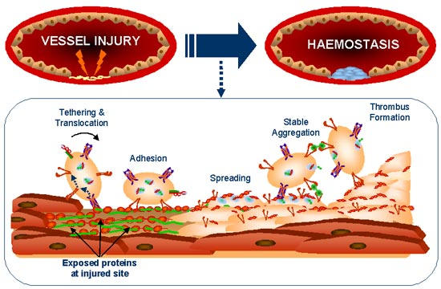

Slide 11
Inhibitors of coagulation

Slide 12
Tissue Factor +
factor VIIa
TFPI
Factor IXa
(+ factor VIII)
Factor Xa
(+ factor Va)
Anti-
thrombin
Factor XIa
Factor IIa
(thrombin)
Protein C
system
Fibrinogen
Fibrin

Slide 13
fibrinolysis

Slide 14
INTRINSIC
ACTIVATION
EXTRINSIC
ACTIVATION
Factor XIIa
Kallikrein
Tissue Plasminogen Activator
Urokinase-like Activator
Fibrin
Fragment X
Fragment Y + D
Fragment E + D
Plasminogen Plasmin
Streptokinase

Slide 15
Peri-operative coagulopathy
Hypo
Fibrino-
lysis
Hyper
Antithrombotic drugs
Blood components
Antifibrinolytic drugs

Slide 16
Mechanism of coagulopathy in CABG
Coagulation activation
Systemic heparinazation
↓ Platelet nr & fx
Fibrinolysis
HIGH INTENSITY PREOPERATIVE ANTITHROMBOTIC THERAPY
Haemodilution

Slide 17
Activation of coagulation
Activation of extrinsic pathway
Extensive contact artificial surfaces
Surgical trauma – TF release
Retransfusion of pericardial blood
Consumptive process: contact activation + TF

Slide 18
Impaired haemostasis
Systemic heparin
Protamine reversal
Haemodilution
Hypothermia
Non-pulsatile flow

Slide 19
Platelets
↓ Number
↓Function
Adhesion
Hypothermia
Notes:
Activation by foreign surface

Slide 20
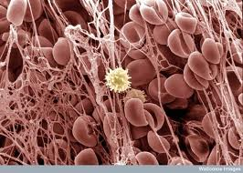
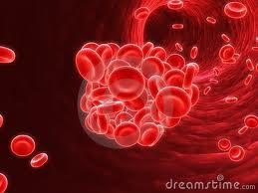
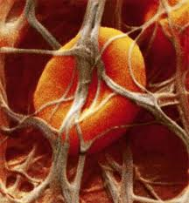
INCREASED FIBRINOLYSIS
Endothelial activation
Increased tPA release
Contact activation
Notes:
Increased t-PA = extrinsic activation and contact activation = intrinsic activation

Slide 21
Haemodilution
Pump prime
Trans-fusion
Notes:
Pump prime with balanced physiologic solutions
Transfusion of large amounts of salvaged blood

Slide 22
Identify high risk
PATIENT FACTORS | PROCEDURE FACTORS
Advanced age (>70 yrs) | Complex aortic
Preoperative anaemia | Valve/CABG
Females | Valve
Small body size/body surface area | CABG
Hereditary coagulopathies/plt defects | On-pump > off-pump
Acquired coagulopathies/plt defects | Bilateral internal mammary > SV grafts
Cardiogenic shock | Urgent/emergent surgery
CHF/poor LV function
Non-cardiac comorbidities: Renal insufficiency Type II DM – insulin dependent Peripheral vascular disease Sepsis, liver failure, hypoalbuminaemia

Slide 23
Blood conservation strategies
Identify high risk pt
Limit antithrombotic thx
Antifibrinolytic Rx
Off-pump CABG
Cell salvage device
ANH/preop autologous donation
Appropriate transfusion indications
Notes:
Selective off-pumt CABG

Slide 24
Laboratory monitoring
POC
ACT
PFA-100
Lab
PT/aPTT/TT
Fibrinogen
FDPs/D-dimers
TEG

Slide 25
POC
Prolonged by: Hypothermia
Haemodilution
Thrombocytopenia
ACT
PFA-100
Value proven in blood conservation
TEG

Slide 26
PFA-100
Rapid detection of platelet dysfunction
Uniquely simulates the in vivo function of platelets

Slide 27
PFA 100
Injured Blood Vessel
PFA-100® Test Cartridge
Flow
Agonist
Collagen
Platelet Plug
The system measures platelet function under high shear
conditions similar to the environment of a partially occluded
blood vessel

Slide 28
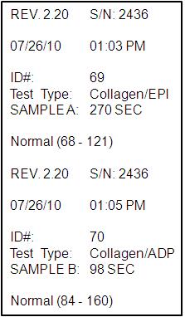
PFA 100
 | Normal | Aspirin-like Effect
COL/EPI | normal | Prolonged
COL/ADP | normal | normal

Slide 29
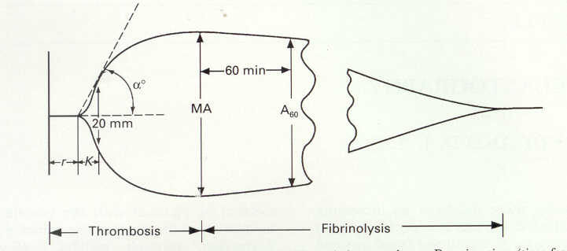
TEG measures
What does it measure?
Viscoelastic changes that occur during coagulation
Graphical representation of fibrin polymerization
Thus measuring:
Rate of fibrin polymerization
Overall clot strength
Complete evaluation
Clot initiation
Clot formation and
Clot stability
29

Slide 30
TEG Guided transfusion
Clinical case
57yo female with Marfan syndrome and history of aneurysm presents now with a second aneurysm. Platelet count is approximately 16K.

Slide 31
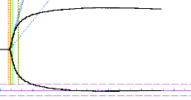
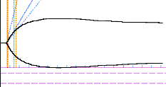
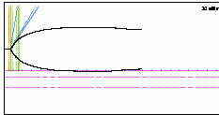
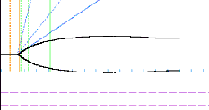
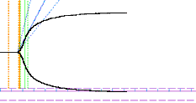
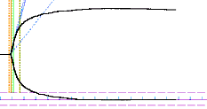
Normal tracing
Platelet count 16K, MA and CI are low.
On pump. Lower MA indicates minimal platelet function; clot is mostly fibrin. CI is very low and R slightly elongated, attributable to low levels of phospholipid surfaces to support the enzymatic reaction.
Rewarming. Platelet function is still deteriorating. 12 U platelets given.
Post protamine. All parameters are approaching normal.
Post-op. After treatment, everything looks normal. The patient's first hour chest tube drainage was less than 100 cc.

Slide 32
Delayed clot formation
Delayed Clot formation
K
R
α°
MA
Heparin Effect
Factor deficiency
Treatment: Protamine or FFP
R K Angle MA
2- 8 min 1- 3 min 55 – 78 deg 53 – 69 mm
13 min 3 min 56 deg 60 mm

Slide 33
Weak clot formation
Weak Clot formation
K
R
α°
MA
Treatment: FFP, platelets
and possible cryoprecipitate
R K Angle MA
2- 8 min 1- 3 min 55 – 78 deg 53 – 69 mm
5 min 6 min 35 deg 42 mm

Slide 34
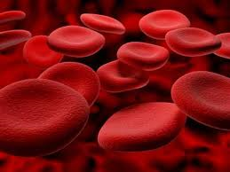
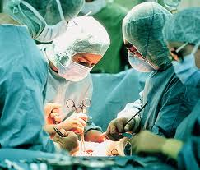
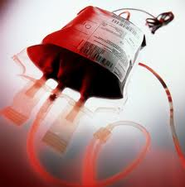
Bleeding
Surgical
Sepsis
Atrial fibrillation
Non-surgical
Minimise blood loss & transfusion
Renal failure
Mortality

Slide 35
management
Blood products
Pharmacologic agents

Slide 36
Pharmacologic agents
To reduce of peri-operative bleeding and aim at blood conservation

Slide 37
Drugs used to reduce blood loss
Limit use of high intensity anti-thrombotics
Discontinue clopidogrel 5 – 7 days pre-op
DDAVP
Tranexamic acid
Aprotonin – Drug removed from market
rFVIIa (Novo-seven)
PCC – further investigation needed

Slide 38
Drugs ass with ↑ periop blood loss
Thienopyridines
GP inhibitors
LMWH
Direct thrombin inhibitors
Dipyrimadole

Slide 39
Blood products
FFP
Coagulation factor deficiency
Cryoprecipitate
Source of fibrinogen
Hypofibrinogenaemia/fibrinolysis
Platelets: Plt < 50 or abnormal BT/PFA-100/TEG
Improve oxygen carrying capacity
RCC

Slide 40
Additional transfusion related methods
Pre-op autologous
Elective
Epo
ANH
1 or 2 U blood removed
Replaced by isotonic crystalline/colloid solutions

Slide 41
Other strategies used
Dose of protamine: 50% of heparin dose
Heparin-bonded circuits
Low prime volume/retrograde autologous priming
Intraoperative use of red blood cell salvage
Off-pump CABG

Slide 43
The Society of Thoracic Surgeons Blood Conservation Guideline Task Force, 2007: 83 (5): S27 – S86.
Perioperative coagulopathy, bleeding and hemostasis during cardiac surgery. Makar et al. ICU Director,

