Slide 1
Perfusion Education in Africa
The Way Forward
Z.A.A Musa
EACTS Perfusion Symposium 2011
Bloemfomtein, South Africa

Slide 2
Challenges in Cardiac Disease
Paediatric Cardiac Disease – Congenital (1.3/1000 live births) and Rheumatic Heart Disease(1.1/1000) – mid-2004 analyses of WHO figures and US Census Bureau International Database by Children's’ Heartlink
Less than 1% receives required surgery in Africa (Children's’ Heartlink Report 2007)
Incidence of CHD is 8 cases per 1000 live births (Cohen et al., 2001; Joshi 2006), of which one third die within the first month (Thakur et al., 1997)
Mortality rates 12 times higher in kids with CHD by end of one year (Vaidyanathan and Kamur, 2005)
Estimated 5 million kids require heart surgery in the developing world

Slide 3
Rheumatic Heart Disease in Children
Sub-Saharan Africa
1 008 207
China
176 576
South-Central Asia
734 786
Asia (other)
101 822
Latin America
136 971
Eastern Mediterranean & North Africa
153 679
Eastern Europe
40 366
Pacific
7 744
Developed Countries
33 330

Slide 4
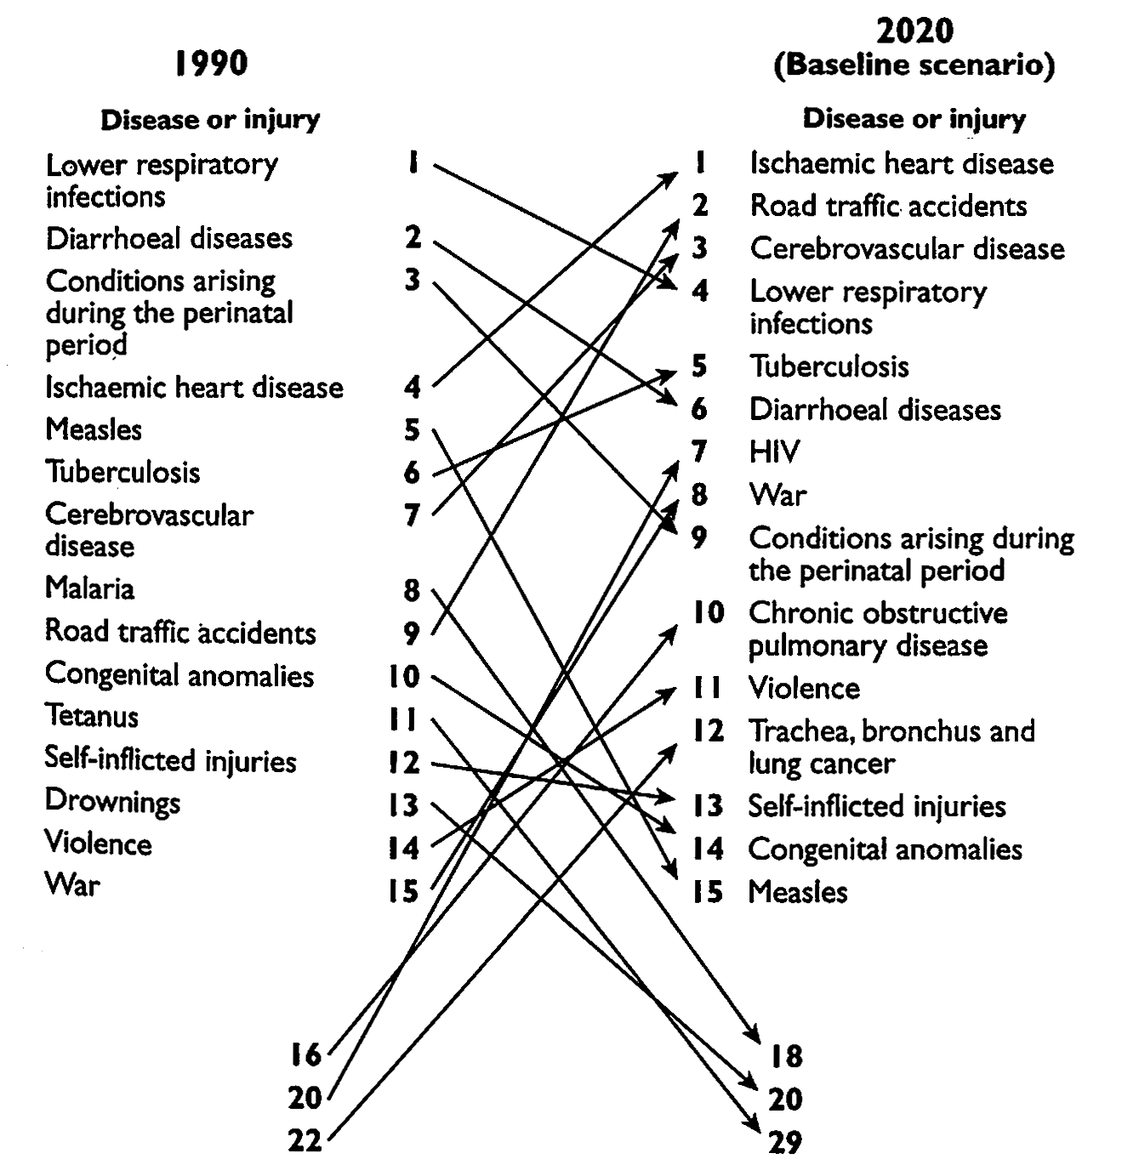
WHO PROJECTIONS
LEADING CAUSE OF DEATH - DEVELOPING WORLD

Slide 5
Number of Open Hearts
Figure 1: Number of open-heart operations per million in selected regions (Pezzella, 2002)

Slide 6
Millions of people per centre
Figure 2: Millions of people per cardiac centres in selected regions (Pezzella, 2002)

Slide 7
Factors that prevent Diagnosis and Treatment of Heart Disease
Lack of Access (90/mil SA Public vs.600/mil Private)
Few facilities (underfunded)
Shortage of trained personnel
Prohibitive expense of cardiac treatment
Lack of basic health care
Shortage of Health Care Workers
Migration of Health Care Workers
Lack of Investment in Public Health Sector
Competing priorities in Health Care

Slide 8
International Strategies
Transporting patients to other countries
Surgical missions
Training of local teams in developing countries
Creating regional centres for treatment and training as well as research
The World Heart Foundation and other NGO’s

Slide 9
Training Challenges-1
Cardiac surgery is a team sport – a cardiac unit needs a team, not an individual
Hands-on training of surgeons, anaesthetists, cardiologists, perfusionists, nurses required
The team is dysfunctional if any member is absent or under-performs
Teams function well using one system (e.g. the Mayo Clinic, Great Ormond Street)

Slide 10
Training Challenges-2
Haphazard training with no set training curriculum, assessment of training or minimum standards produce substandard teams or individuals with subsequent poor patient outcomes
Visits to training institutions in other countries does not provide outcome based education and training
Africa does not require or deserve substandard services

Slide 11
Outcomes
To provide qualified personnel, trained at a level consistent with HPCSA requirements, in all the fields of perfusion medicine.
To provide integrated training in order to develop a co-ordinated team that would be able to manage in a sustainable way a cardiac centre independently after four years of training
To facilitate international support for the program and long-term support for the local unit

Slide 12
Training Certification
To assist in the development of a local (referring country) examination system for licensing purposes in the country of origin or the development of an African Board Examination

Slide 13
Current Curriculum
Two year Theory full time (Clinical Technology) plus two years practical with part time theory.
End of third year ( N. Diploma)
End of fourth year (B.Tech)

Slide 14
Current Curriculum
Third year
  Clinical Practice III (Year Subject)
  Clinical Technology Practice III (Year Subject)
  Biomedical Apparatus and Methodic(Year Subject)
Fourth year
  Perfusion IV (Year Subject)
  Principles of Management (Semester Subject)
  Research Methodology: Nat. Sciences (Semester Subject)
  Research project (One Year)

Slide 15
Clinical Practice III
Module 1
  Haematologic System Disorders
  Haemolysis
  Haemodilution
  Module 2
    Fluid and Electrolyte Balance and Assessment
    Cardioplegia & Myocardial protection
    Parameters During CPB
Module III
  Acid Base Disorders
  Hypothermia
  Module IV
    Pharmacology

Slide 16
Clinical Technology Practice III
Section A: Anatomy
  Embryology
  Anatomy of the Normal Heart
  Anatomy of the Abnormal Heart
  Obstruction of Blood Flow
  Coronary Atherosclerotic disease
  Defects of Aorta
  Pulmonary Hypertension
  Shock
Section B: Physiology
  The Heart
  Coronary Blood Flow
  Electrophysiology
  Electrocardiograph
  Electrocardiographic Leads

Slide 17
Biomedical Apparatus and Methodic
THE HEARTLUNG-MACHINE.
FLOW METERS.
VAPORIZERS.
THERMOMETERS.
WARMING- AND COOLING APPARATUS.
SAFETY DEVICES.
CARDIOPLEGIA ADMINISTRATION.
ACTIVATED CLOTTING TIME.
HEMATOCRIT.
OXYGENATORS.
CARDIOTOMY RESERVOIRS.
FILTERS.
TUBING.
PRESSURE MONITORING SYSTEMS.
CANNULAS.
SUCKERS.
STERILIZATION.
CELL SAVING
INTRA AORTIC BALLOON PUMP

Slide 18
Perfusion IV
FREE RADICALS
ISCHEMIC REPERFUSION INJURY (IRI)
ISCHEMIC PRECONDITIONING (IPC)
THE INFLAMMATORY RESPONSE TO CPB
NEURO-ENDOCRINE METABOLIC AND ELECTROLYTE RESPONSES
NEUROLOGIC EFFECTS OF CPB.
EMBOLIC EVENTS.
HEMATOLOGIC EFFECTS OF CPB
MANAGEMENT OF COAGULOPATHY
AORTIC ANEURYSMS AND CPB

Slide 19
New Curricullum
Seven subjects (18 Months)
  Clinical Practice
  Perfusion Technology
  Blood Management (Haematology)
  Perioperative and ICU Haemodynamic Monitoring, and Related Technologies.
  Mechanical Circulatory Support
  6. Principles of Management
  7. Research Methodology: Natural Sciences
  8. Research project (Fourth Year)

Slide 20
1. Clinical Practice
Dr.J Jordaan
Section A:
  Embryology
  Anatomy of the New Born
  Anatomy of the Abnormal Heart
  Congenital Heart Disease And Treatment
  Cardiac and respiratory Anatomy
  Obstruction of Blood Flow
  Acquired Heart disease and Treatment (eg. Atherosclerosis)
  Disease of the Respiratory system
  Defects of Aorta
  Pulmonary Hypertension

Slide 21
Clinical Practice
Dr. Jordaan
  Section B:
  The Heart (ultrastructure, Mitochondria etc.)
  Coronary Blood Flow
  Cardiac physiology
  Respiratory physiology
  Acid Base Management
  Pathological Effects of CPB
  The Inflammatory Response to CPB
  Free Radicals
      Ischemic Reperfusion Injury (IRI)
      Ischemic Preconditioning (IPC)
      Neuro- Endocrine, Metabolic and Electrolyte Responses
      Neurologic Effects of CPB.
      Embolic events.
      Death & Dying

Slide 22
Clinical Practice
Section C: Pharmacology (Dr. E.Turton)
  Pharmacological Concepts
  Clinical Pharmacology
  Solutions: Composition and Therapy
  Fluid and Electrolyte Balance and Assessment
  Section D: Medical Law & Ethics (TBC)

Slide 23
2. Perfusion Technology
(D.Bester)
Section A: Equipment/Materials
The Heartlung Machine.
PUMPS (Roller vs Centrifugal)
Flow meters.
Vaporizers.
Thermometers.
Warming and Cooling apparatus.
Safety devices.
Oxygenators.
Cardiotomy Reservoirs.
Filters.
Tubing.
Pressure monitoring systems.
Cannulas.
Suckers
Ultra-Filters
Maze machine
Cell Savers
NIRS Monitoring

Slide 24
Perfusion Technology
(Z.Musa)
      Section B: Techniques
      Historical Perspectives
      Priming Composition and Methods
      Temperature Management & Hypothermia
      Blood Gas & Supplementary Measurements and Interpretation
      Blood Gas Strategies (α and pH Stat)
      Coagulation Management
      ECC Techniques (Normal, High risk, Mini Bypass etc.)
      Myocardial protection
      Ultra- filtration
      Cardio-Ablation (Maze)
      Emergencies During CPB
      Organ Perfusion (Lung, Kidney, Liver, Limb)
      13. Theatre and ICU Emergencies (fire etc.)

Slide 25
3. Blood Management
(Prof. Muriel) TBC
  Section A: Haematology
    Haematologic System Disorders
    Haemolysis
    Haemodilution
    Hematologic Effects of CPB
    Management of Coagulopathy
    Section B: Blood
    Conservation & Salvage
    Cell saving
    Conservation Techniques
    3. Platelet Sequestration
    Section C
    1. Applied Microbiology
    2. Sterilization & Sterile Techniques

Slide 26
Perioperative and ICU Haemodynamic Monitoring, and Related Technologies.
Section A: Haemodynamic Monitoring(Dr. Jordaan)
  Laws of gas & fluid flow
  Bedside Assessment
  Cardiac Factors and Measurement
      Pulm. Art. Cath.
      CVP
      PAWP
      Arterial
  Shock
  Electrocardiograph
  Electrocardiographic Leads
Section B: Related Technologies
(Dr. Turton/vdWesthuizen)
Non invasive Radiological Techniques
MRI
Nuclear Cardiology
CT Scan
Echocardiography
  TEE
  TTE

Slide 27
5.Mechanical Circulatory Support
(D. Bester/ Z. Musa/MJ vVuuren)
  Indications for the use of Circulatory Support Systems
  Intra Aortic Balloon Pump Counter pulsation
  Ventricular Assist Devices
  Extracorporeal Membrane Oxygenation
  Implantable Devices
  Pacemakers

Slide 28
Conclusion
As hands–on, outcomes based training access to many high income countries is severely restricted, there is a need to develop African based training programs (with international support)
Model can potentially be cloned to other institutions (Eastern African, Western African and Southern African Hubs)
Funding of regional hubs can be supra-national (e.g. SADC, AU) and international (e.g. EU, NGO’s), private public partnerships, multinational - resource based companies

Slide 29
Conclusion
In order to create local awareness and to provide for the possibility of local training and service delivery, the training institution must facilitate missions and international support for this project
After training cycle is completed, post graduate training and research programs must be supported
Post-graduate training in sub-specialities must be facilitated at internationally leading units
Support by international leading physicians must be facilitated

