Slide 1
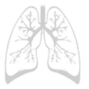

SURGICAL DECISION MAKING IN INFLAMMATORY LUNG DISEASE
Anthony Linegar
MBChB., FC(Cardio)SA., Ph.D.
Registrars’ Symposium Bloemfontein,
June 2011.
Faculty of Health Sciences
Dept. Cardiothoracic Surgery
University Free State

Slide 2
EBM / SBM in thoracic surgery
Evidence based medicine – clinical decisions are based on experimental evidence of proven treatment efficiency.
Purely intuitive, traditional, experiential decision making.
Integrate experimental evidence with clinical experience.
Evidence based medicine is the conscientious, explicit, and judicious use of current best evidence in making decisions about the care of individual patients.
CABG vs thoracic surgery (6/119 Anyanwu & Treasure)
Experimental evidence is not surgical but addresses broad treatment protocols e.g. neoadjuvant and adjuvant therapies.

Slide 3
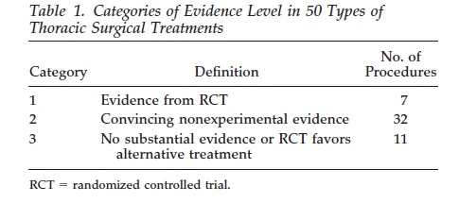
Is General Thoracic Surgical Practice Evidence Based? One study.
Lee, et al, Ann Thorac Surg 2000;70:429 –31

Slide 4
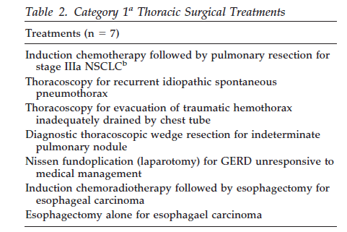
7 operations with RCT evidence
(1;A)
(3; C)
( 3;C )
(3; C) cf. (4;D)
(1;A)
(1;A)
(1;A)
Notes:
Check individual papers
Cochrane Database Syst Rev. 2005 Oct 19;(4):CD001956. Links
Update of:
Cochrane Database Syst Rev. 2002;(2):CD001956.
Surgical versus non-surgical management of pleural empyema.
Coote N,
Kay E.
Hammersmith and Queen Charlotte's Hospitals, Paediatric Ambulatory Care Unit, Du Cane Road, London, UK W12 0HS. Ncoote@hhnt.nhs.uk
BACKGROUND: Pleural empyema is a collection of pus between the lungs and the chest wall. There is debate about treatment options with the advent of both fibrinolytic enzymes to facilitate tube drainage and less invasive video-assisted thoracoscopic surgery (VATS). OBJECTIVES: To determine which

Slide 5
Empyema open drainage by VATS vs ICD drainage.
Cochrane Database Syst Rev. 2005 Oct 19;(4):CD001956. Coote N, Kay E.
Surgical versus non-surgical management of pleural empyema adults and children
1 small RCT (n= 20); Wait et al Chest 1997
Conclusion VATS appears to be better than ICD with streptokinase wrt LOS, repeat interventions.

Slide 6
RCT intrapleural streptokinase in empyema in children
Empyema > Stage 5 (Light.R, Chest 1995.)
n=19 Streptokinase vs n = 21 Saline
No difference in outcome
Stage 7 cases Rx’ed with streptokinase did not get pleural thickening later
No short term benefit for S’kinase but should be used in Stage 7 cases to reduce pleural thickening and avoid later surgery?
Singh, M. et al. Acta Paediatr, 2004

Slide 7
RCT of VATS decortication vs TPA and ICD in children
Prospective RCT in 36 children with locations and or WCC > 10000
LOS = no difference
Costs higher in the VATS group
3 patients (16%) had to go for VATS for failure of TPA
Recommended fibrinolysis via ICD as 1st line therapy in kids with empyema
St Peter, S. D. et al. J Pediatr Surg, 2009

Slide 8
Conclusions?
RTCs have not shown clear advantage for TPA or Streptokinase (1;A)
Subgroup analysis within RCT can be problematic
- TPA for Stage 7 empyema (n=3)
Individual units are unlikely to change their practice on the basis of these 3 RCTs
Basic principles
Aim to achieve early control of the pleural space by drainage by ICD, VATS or thoracotomy
- VATS superior to ICD wrt LOS, repeat interventions
- better in controlling the pleural space

Slide 9
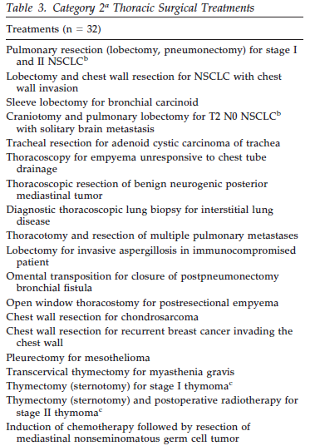
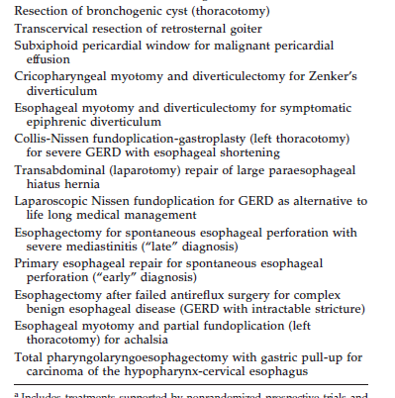
Non-experimental evidence n = 32/50

Slide 10
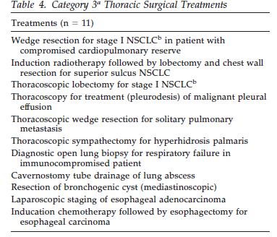
11 operations with no substantial evidence or RCT favours alternative treatment

Slide 11
SA literature base of evidence 1955 – 2006 – systematic review
n = 252
Linegar, Smit, Goldstraw, Van Zyl, SAMJ 2009

Slide 12
SA literature on Inflammatory lung disease
N = 72/252 = 37% of all our literature
N = 72/147 = 49% of the pulmonary literature
2 papers on HIV (205 patients)
Empyema 10 papers
Pneumonectomy through empyema 2 papers
All non-experimental, descriptive papers, some are analytical
No papers on chronic empyema spaces which we see so often
Notes:
Look at odell and shama on pneumonectomy and tell what did is tell us

Slide 13
SA literature 1955 - 2006
Table 5.23 Publications by Study Design (n = 252)
Type of Paper | Number of Publications
Randomised controlled trials | 2
Meta-analyses | 0
Systematic reviews | 0
Cohort studies | 6
Descriptive review of series | 87
Case reports | 94
Reviews of topics, CME | 36
Editorial, letters, advocacy, history, instrumentation, etc | 23
Scientific studies (viral, chromosomal) | 4
Total publications in thoracic surgery | 252

Slide 14
Impact factor of SA Literature
Table 5.20. Most frequently published in Journals
Journal | Journal citation impact factor* | Number of publications | %
S Afr Med J | 1.268 | 88 | 35
Thorax | 6.226 | 28 | 11
S Afr Resp J | Not reviewed | 19 | 8
SA J Surg | 0.265 | 18 | 7
Ann Thor Surg | 2.022 | 12 | 5
J Thorac Cardiovasc Surg | 3.354 | 10 | 5
Br J Surg | 4.304 | 5 | 2
Eur J Cardiothoracic Surg | 2.011 | 5 | 2
Chest | 4.143 | 4 | 2

Slide 15
What are the important surgical decisions in inflammatory lung disease?
Resectability and operability
Risk benefit assessment
TB / HIV status; CD4 count; Albumin; BMI
Gas; lung function; V/Q;
PHT – the great leveller
Anticipation of complications and technical difficulties

Slide 16


Slide 17
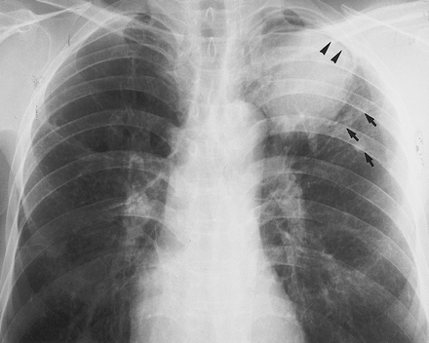
Problems in surgery for pulmonary aspergilloma
The evidence level 4 i.e. case reports / series
Recommendation grades C & D

Slide 18
Problems in surgery for pulmonary aspergilloma
1. Patient selection
Asymptomatic aspergilloma
Complex disease
Bilateral disease
Combination of disease pattern and respiratory compromise or co-morbidities

Slide 19
Aspergilloma – UFS strategy
1 | Fit | Simple | Asym
2 | Fit | Simple | Sym
3 | Fit | Complex | Sym
4 | Fit | Complex | Asym
5 | Unfit | Simple or Complex | Asym or Sym
Resection
Cavity or haemoptysis mx
Aggressive policy – 50% will bleed and up to 30% may die from it (4;C)
A very few cases of spontaneous resolution
Lobectomy, wedge, pneumonectomy, cavernostomy, myoplasty, t’plasty
Adapted from el Oakley, R. et al, Thorax 1997

Slide 20
Algorithm Aspergilloma
Aspergilloma
ZN negative or after 3 months treatment with 4 drugs
Patient physiologically FIT for surgery
Patient physiologically UNFIT for surgery
Asymptomatic
Symptomatic
Simple
Simple
Complex
Complex
Wait and see approach (Morbidity higher in complex disease)
Individualise the decision.
If disease not too bad operate especially if resection likely to be less than a pneumonectomy
Operate early when minor symptoms occur
Age, Extent of resection, HIV status
Stabilise and operate
Preferably on an elective list
Individualise in complex disease
Embolisation
Cavernostomy
Medical management
Operate to prevent haemoptysis
(Mortality of surgery is less than that of serious bleed)

Slide 21
Problems in surgery for pulmonary aspergilloma
2. Surgical problems
Lobectomy and extension to pneumonectomy
Dealing with the bronchus
Air leaks
Pleural space problems
Stick to basic principles and always ask “what am I trying to achieve
by this intervention”

Slide 22
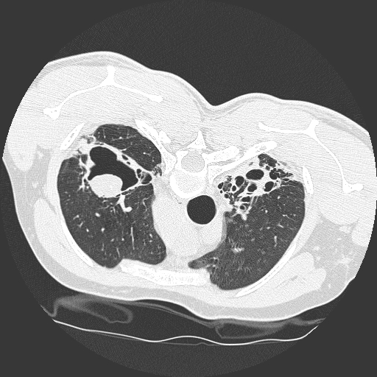
Bilateral and complex
Problems
Indications for surgery
- haemoptysis
- suppuration
Side first?
Reserves and achievable benefit

Slide 23
Lobectomy / Pneumonectomy

Slide 24
Alveolar air leaks
Definition? 5:7:14
Why is it a problem?
Prolonged LOS, cost
Empyema
Air leak with incomplete expansion of lung
Who gets it?
How does it happen?
- Denude the visceral pleura
- Incisions in lung
- Inadvertent puncture.

Slide 25
How do we deal with air leaks at surgery?
Suture (pleural peel)
Cautery
Patch (pleura, pericardium, fat, bovine, artificial)
Staple
Pleural tent
Resect lung (convert to lobectomy; pneumonectomy)
Thoracoplasty
Talc

Slide 26
Autologous blood
Shackcloth et al ATS, 2006
319 lobectomies over 18 month period
7% leaks > 5 days (n=22)
120ml blood on day 5 and day 7 if needed
60% stopped within 24 hours
Significant advantage ito. ICD duration and LOS

Slide 27
Suction?
Sanni et al, Interactive CV&TS, 2006
Systematic review of RCTs
n=391 papers,
5 RCTs, n=585,
none favoured suction
except perhaps in large leaks with PT.

Slide 28
Glues: a neo-pleura?
Fibrin
Polyethylene-glycol
Cyanoacrylate
Gluteraldehyde
Raw surface
Over buttressed staple line
Elastic, adhere to visceral pleura and lung parenchyma
Wet surface
Expansion of lung
Airway pressure
Buttressed by apposition against parietal pleura

Slide 29
What evidence for glue?
11 RCTs + 1 Cochrane review (Serra-Mitjans et al., 2005).
1950 – 2007 (Tambiah et al 2007); 261 papers 11 RCTs as best available evidence
6 showed significant reduction in air leaks
5 did not (LOS; removal ICD)
3 RCTs polyethylene-glycol sealant 2 in favour and one against (Allen et al., 2004, Wain et al., 2001, Porte et al., 2001).

Slide 30
What evidence for glue?
Up to 2006 fibrin glues not proven to be beneficial (1;A)
2006 Tansley et al J Thorac Cardiovasc Surg, 132, 105-12.
Bioglue with surgery vs surgery alone (n=52)
Clear benefit of the Bioglue; shorter duration leak (p=s); LOS (p=s)
Bioglue may be warranted for AAL not responsive to surgical methods.

Slide 31
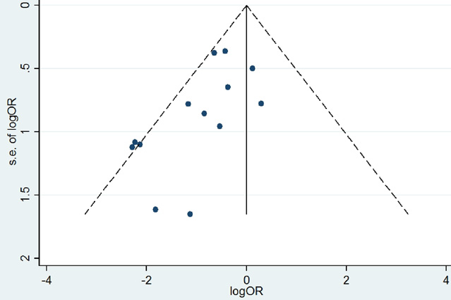
French meta-analysis
Ann Thor Surg 2010,90, 1779
Malapert et al, 1995-2009, n=1335
Meta analysis 11 RCTs
8 + > 7 days; arrhythmias
Did not influence other respiratory complications though
Caution advised in presence of an asymmetrical funnel plot (Rx effect against study size) ~ publication bias

Slide 32


Slide 33
Recommendation
Glue associated with reduction in duration of leaks in some but not all studies
Still get air leaks – suggests it is not a “sealant”
Perhaps bioglue is better than fibrin and cyanoacrylate
Cost factor
We do not have a “glue”
Are we not trying to make something work
Not effective in creating a neo-pleura
Use selectively
Future – endobronchial solution?

