Slide 1
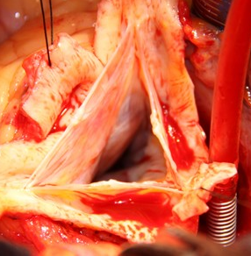
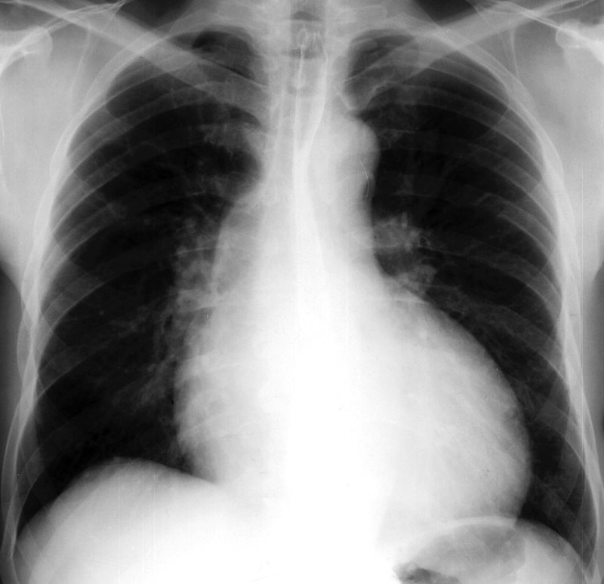
Aortic Regurgitation 23 March 2012 – Hannes Meyer Symposium
Jehron Pillay
le Roux Institute of Thoracic Surgery

Slide 2
Aortic Valve Competence
Dependant on the normal anatomical and physiological functioning of the contents of the aortic root…
sinuses
aortic valve leaflets
commissures
interleaflet triangles
annulus
Notes:
competence - normal structural and physiological functioning of the contents of the aortic root.

Slide 3
Aortic Regurgitation
The anatomy of the aortic root
How the root functions
Surgical consideration of the valvular and leaflet component
Surgical consideration of the annular component
Notes:
The talk will briefly address
The anatomy of the aortic root
How the root functions
Surgical consideration of leaflet or valvular component
Surgical consideration of the annular component

Slide 4
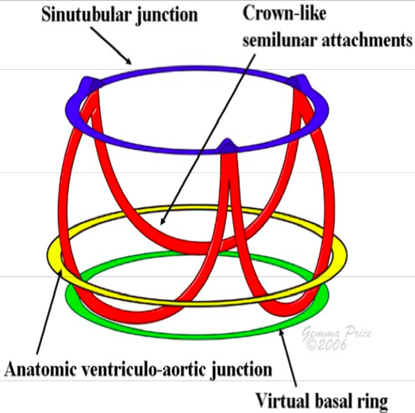
Aortic Valve Competence
Sinotubular junction
Leaflets
Ventriculo aortic junction
Notes:
Skeletal structure

Slide 5
AORTIC ROOT
Boundries:
Sinotubular Junction
Ventriculo-aortic Junction
Contents:
sinuses
aortic valve leaflets
commissures
interleaflet triangles
Notes:
The aortic root is delineated superiorly and inferiorly by:
Sinotubular Junction
Ventriculo-aortic Junction
It comprises the:
sinuses
aortic valve leaflets
commissures
interleaflet triangles

Slide 6
ANATOMY OF THE ROOT
Notes:
Puts in context

Slide 7
ANATOMY OF THE ROOT
Notes:
sinuses
expanded portions of the aortic root
in between the attachments of the valve leaflets and sinotubular junction.
named according to the coronary arteries arising from them—right, left, and non-coronary.

Slide 8
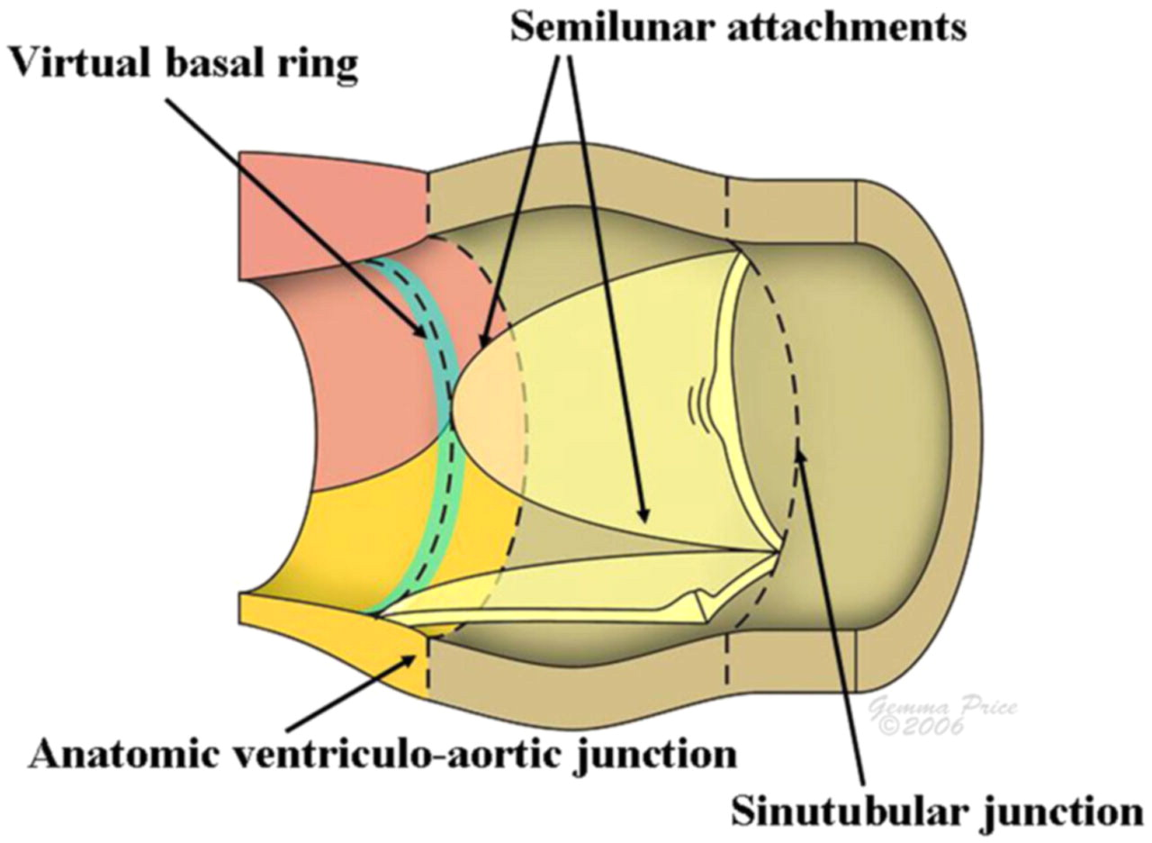
ANATOMY OF THE ROOT
Notes:
The sino- tubular junction
composed of primarily elastic tissue, and it supports the peripheral attachments of the valve leaflets.
leaflets
separate, haemodynamically, the aorta and the left ventricle.
inserted into the wall of the root in a semilunar fashion.
“annulus” - area of collagenous condensation - leaflet attachment,

Slide 9
ANATOMY OF THE ROOT
Notes:
midpoint of the free edge - fibrous nodule,
“lannula” which are occasionally fenestrated near the
commissures.
semilunar attachments of the leaflets - interleaflet triangles.

Slide 10
ANATOMY OF THE ROOT
Notes:
Mathematical relation between root size and leaflet size.
The diameter of the sinotubular junction is 10–15% smaller than the diameter of the annulus.
Echocardiographic assessment of the root is measured at 4 places.

Slide 11
ANATOMY OF THE ROOT

Slide 12
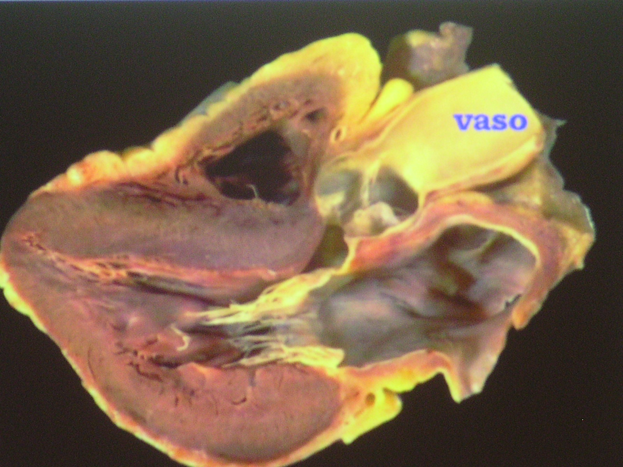
ANATOMY OF THE ROOT
120 degree - LAX
Systole
Annulus
ST junction
Sinuses
Tubular aorta
Diastole
Notes:
Scomp fig

Slide 13
ROOT FUNCTION
MYTH
Complex haemodynamic system
Distal Root
Proximal Root
Role of the sinuses
Notes:
Used to be thought to be entirely passive
Pressure analogy
distinct haemodynamic system.
The upper portion
exposed to aortic pressure changes
expands during systole
leaflets retract and open.
The proximal part
exposed to ventricular pressure changes
expand as the ventricle fills
contracts during peak systole
decreases the distance the valve leaflets have to travel to coapt.

Slide 14
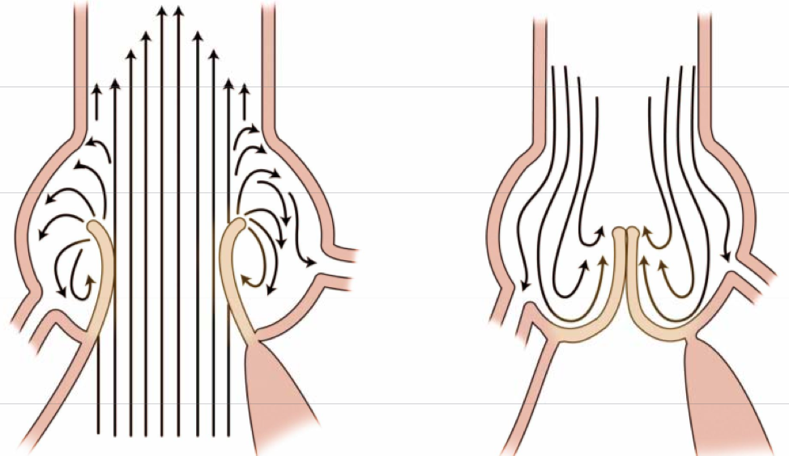
ROOT FUNCTION
Notes:
sinuses
most important physiological role in valve function
space behind open aortic leaflets do not occlude the coronary artery ostia
eddy currents - when they are open.
hold the leaflets away from the aortic wall
promotes valve closure
Column pressure support during diastole
Valve insufficiency
dilatation of the root and sinotubular junction
Disease of the sinuses may also effect competence because of the disruption of the complex role it plays in valve function.

Slide 15
Surgical considerations LEAFLET DISEASE
Rheumatic
Infective endocarditis
Congenital
Iatrogenic
Notes:
LEAFLET DISEASE
Due to…
Structural abnormality dictates the surgical intervention
small proportion of patients with aortic valve disease
Transesophageal echocardiography - best diagnostic tool

Slide 16
Surgical considerations LEAFLET DISEASE
Valve replacement
mechanical
bioprosthesis
- allograft
- xenograft
- autograft (Ross)

Slide 17
Surgical considerations LEAFLET DISEASE (ROSS)
Notes:
ROSS PROCEDURE
type of specialized aortic valve surgery
diseased aortic valve is replaced with his or her own pulmonary valve.
The pulmonary valve is then replaced with cryopreserved cadaveric pulmonary valve.
pulmonary valve and a segment of the pulmonary artery are excised.
diseased aortic valve and proximal tissue removed, leaving coronary arteries with only a button of tissue.
pulmonary autograft is placed in the aortic position
coronaries implanted
A cadaveric pulmonary valve and artery homograft is then replaced in the pulmonary position to replace the excised pulmonary segment.

Slide 18
Surgical considerations LEAFLET DISEASE
Valve repair
cusp perforation
cusp extension
cusp prolapse
cusp with stress fenestration
bicuspid aortic valve
Notes:
TECHNIQUES OF AORTIC VALVE REPAIR

Slide 19
Surgical considerations LEAFLET DISEASE
cusp perforation
Notes:
Cusp Perforation
Occasionally the sole reason for aortic insufficiency.
iatrogenic,
sequela of healed endocarditis
or the result of resection of a papillary fibroelastoma.
patch of fresh or glutaraldehydefixed autologous pericardium
If fresh autologous - patch should be larger (retracts)

Slide 20
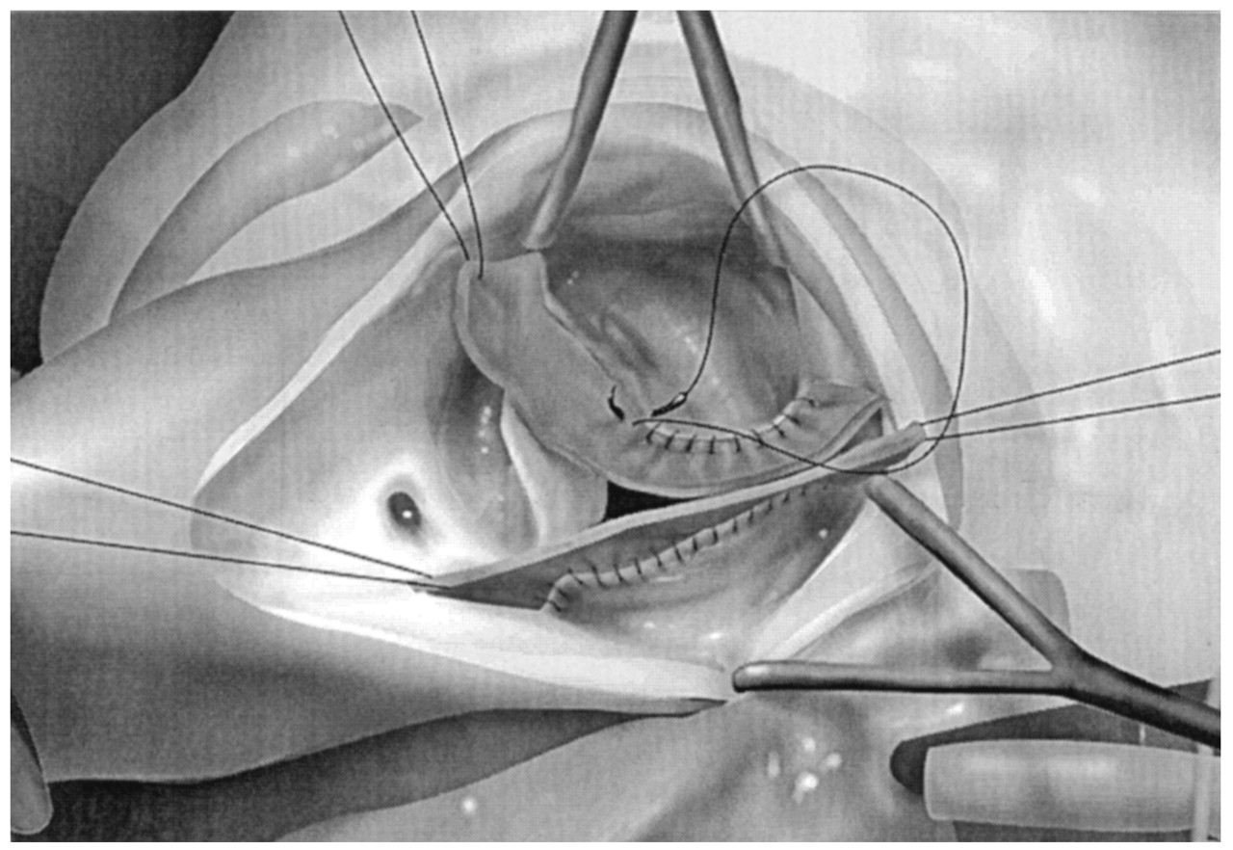
Surgical considerations LEAFLET DISEASE
cusp extension
Notes:
Cusp Extension
Cusp augmentation has been used to repair incompetent aortic valves due to rheumatic and congenital disease.
Glutaraldehyde-fixed bovine or autologous pericardium has been used for this purpose.

Slide 21
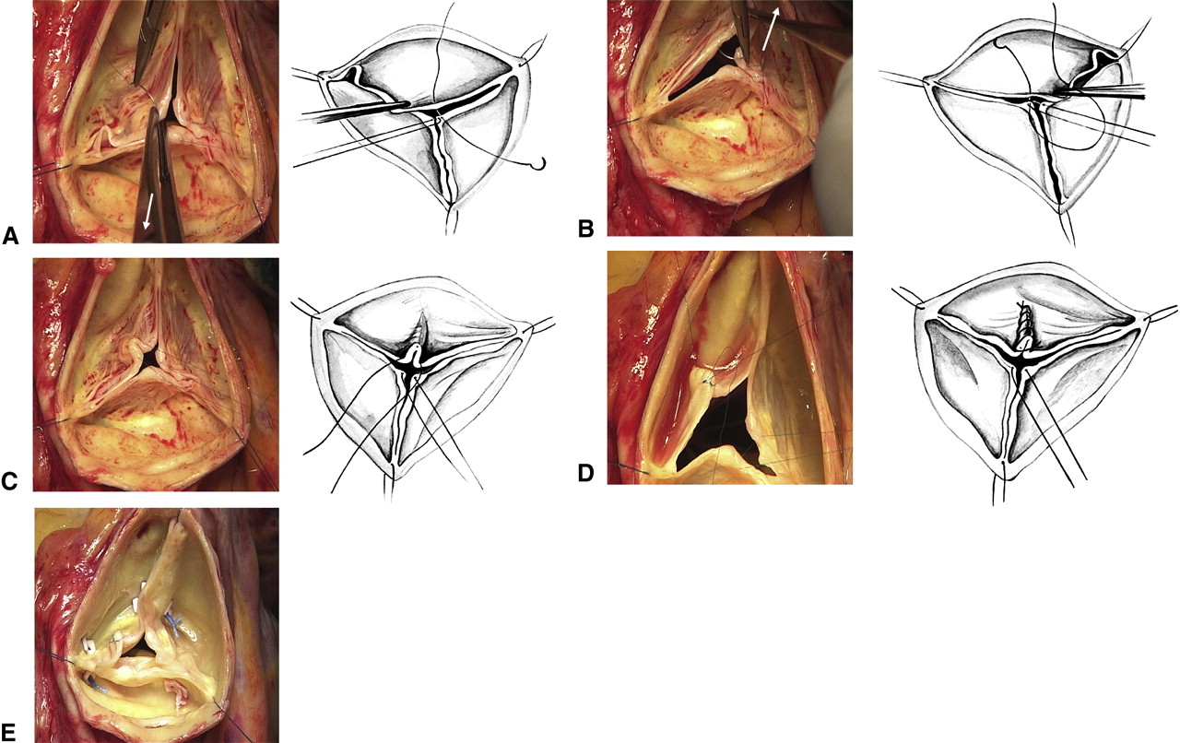
Surgical considerations LEAFLET DISEASE
cusp prolapse
Notes:
Cusp Prolapse
due to elongation of the free margin.
This is corrected by plication along the nodule of Arantius.
The degree of shortening is determined by examining the other cusps and the common level of coaptation.

Slide 22
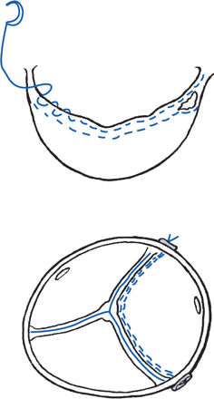
Surgical considerations LEAFLET DISEASE
cusp with stress fenestration
Notes:
Cusp with Stress Fenestration
Dilation of the sinotubular junction - increases the mechanical stress along the free margin of the cusp - fenestration in the commissural area.
This type of lesion has been successfully corrected by weaving a double layer of suture along the free margin of the cusp.

Slide 23
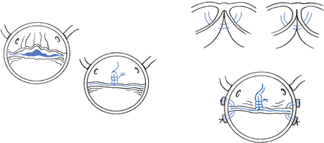
Surgical considerations LEAFLET DISEASE
bicuspid aortic valve
Notes:
Bicuspid Aortic Valve
The most commonly performed aortic valve repair in adults is for :
bicuspid aortic valve with prolapse of one cusp.
anatomic arrangement of the bicuspid aortic valve varies,
most patients have an
anterior cusp - attached to the interventricular septum
posterior cusp - attached to the fibrous components of the (LVOT).
The anterior cusp often contains a raphe at approximately where the commissure between the right and left cusps would be.
This cusp is usually the one that is elongated and prolapsed.
The raphe is excised and the free margin of the anterior cusp is shortened with plicating sutures.
Since most patients with incompetent bicuspid aortic valves have a dilated aortic annulus,
an aortic valve–sparing operation may be a more appropriate procedure than simple cusp repair.
If not aneurysmal and the annulus is only mildly dilated - a reduction annuloplasty to increase the coaptation area of the cusps can be done.

Slide 24
Surgical considerations ROOT
Aneurysms
Annulo Ectasia
Marfans
Other
Notes:
ROOT - SURGICAL OPTIONS AND COMPARISONS
Aortic dissection
Trauma
chronic systemic hypertension
aortitis from syphilis
viral syndromes
systemic arteritides (e.g., giant cell and Takayasu)
connective tissue disorders
Marfan syndrome
Reiter disease
Ehlers-Danlos syndrome
osteogenesis imperfecta
rheumatoid arthritis
all lead to annular dilatation and valvular insufficiency.

Slide 25
Surgical considerations ROOT
REMODELING
YACOUB
DAVID
Notes:
REMODELLING VS RECONSTRUCTION
WHY?
thromboembolism, endocarditis, and problems related to the long term anticoagulation
DAVID
Yacoub

Slide 26
Surgical considerations ROOT
YACOUB PROCEDURE
Notes:
Remodelling
At surgery, the dilated sinuses and diseased ascending aorta are excised so that only 4–5 mm of aortic wall is left attached to the annulus.
The coronary ostia are also mobilised and prepared for reimplantation.
The diameter of the aortic annulus is then MEASURED. If it is not dilated, then based on the previously described aortic root relations, a Dacron graft approximately 10% smaller than the size of the annulus is chosen to remodel the sinuses.
Intra operative techniques to create “pseudosinuses” in the supravalvar region (YACOUB)
The coronary arteries are then reimplanted and the graft anastomosed to the distal aorta in conventional fashion.
If the annulus itself is seen to be dilated, an annuloplasty can be added to the procedure.

Slide 27
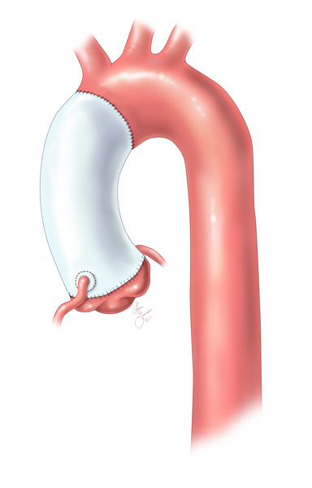
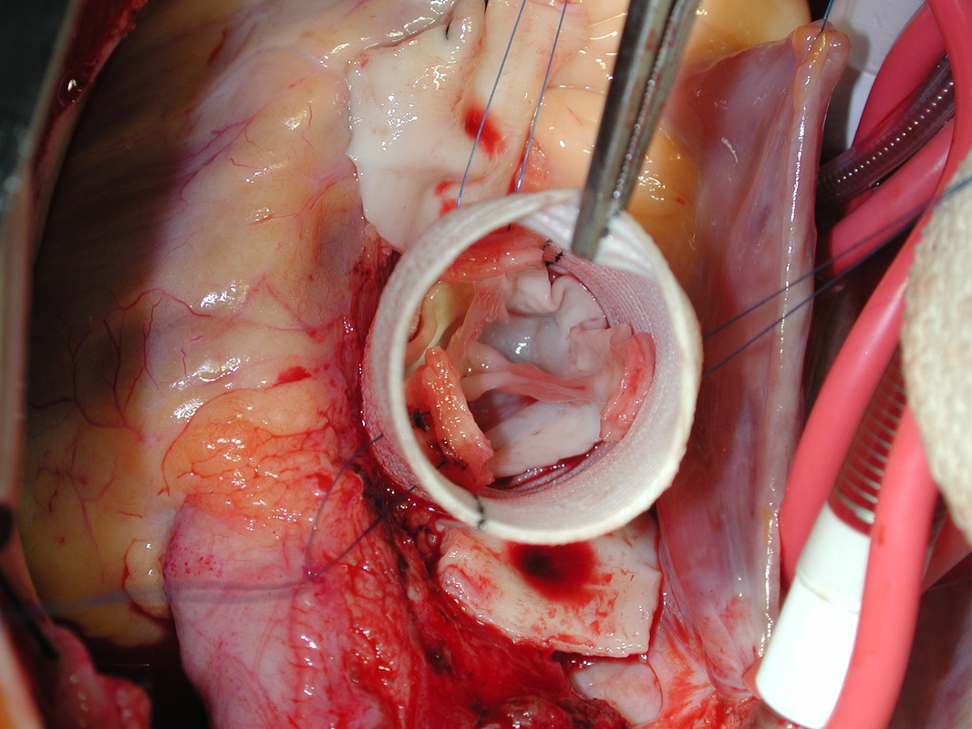
Surgical considerations ROOT
DAVID PROCEDURE

Slide 28
Surgical considerations ROOT
RECONSTRUCTION
BENTALL

Slide 29
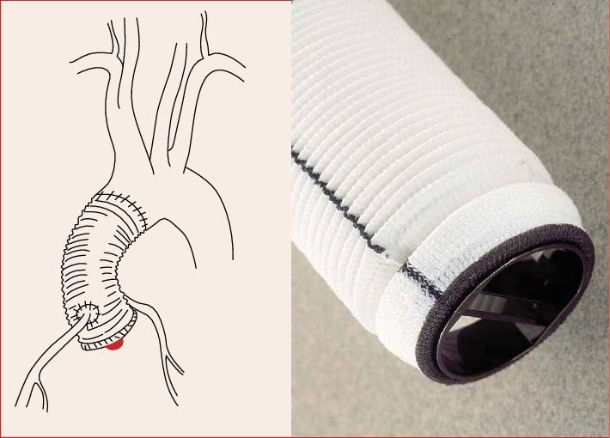
Surgical considerations ROOT
BENTALL PROCEDURE

Slide 30
FINAL POINTS
remodeling - late deterioration in valve function
dacron damage
marfan syndrome
Notes:
Discussion
data available show that overall remodeling and reconstruction have similar mortalities.
Remoddelling Long term, however, concerns still exist with respect to the potential for late deterioration in valve function and continued follow up is required.
remodelling - operation is carried out using a non-compliant tube (Dacron) which in the long term may have a detrimental effect on the function of the aortic valve because of leaflet damage.
Only the follow up of increasing numbers of patients for longer periods of time can truly answer the question regarding the durability of the remodelling procedure.
It may also be that, in the future, prosthetic materials can be developed which mimic more closely the dynamic move- ments of the aortic root and help maintain the important equilibrium required for valve function.
Another concern is the use of this technique in patients with the Marfan syndrome because of the potential for ongoing annular dilatation and valve degeneration.
Contraindications agreed by the proponents of this technique include bicuspid aortic valves or deformed valve leaflets.
Thromboembolism has also been reported after root replacement in the setting of inadequate anticoagulation, a problem eliminated by the valve sparing procedure.
left axis deviation. Q waves in leads I, V₁, and V₃ to V₆ are indicative of diastolic volume overload.

Slide 31
REFERENCES
The aortic root: structure, function, and surgical reconstruction, M J Underwood, G El Khoury, D Deronck, D Glineur, R Dion, Heart 2000;83:376–380
David T Ei . Aortic Valve Repair and Aortic Valve–Sparing Operations. Cohn Lh, ed. Cardiac Surgery in the Adult. New York: McGraw-Hill, 2008:935-948.
Kunzelman KS, Grande J, David TE, Cochran RP, Verrier ED. Aortic root and valve relationships: impact on surgical repair. J Thorac Cardiovasc Surg 1994;107:162–170.
The surgical anatomy of the aortic root, Robert H. Anderson, mmcts.2006.002527

