Slide 1

Is this the “spioenkop” for CABG?

Slide 2
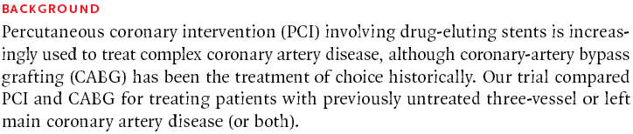
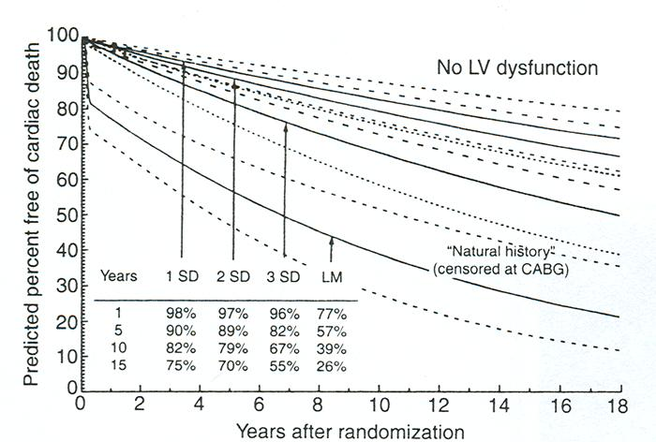

Slide 3
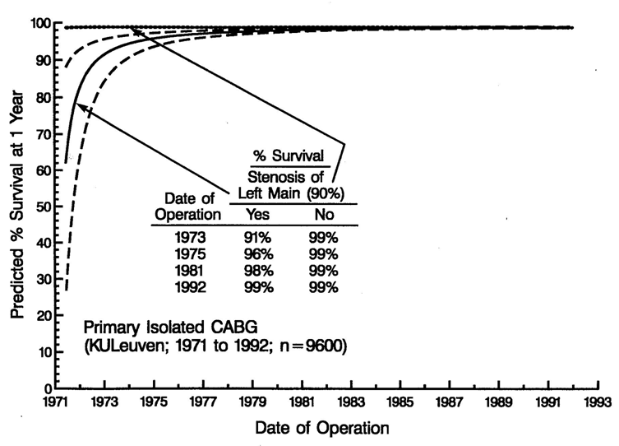
Is left main an issue in CABG surgery?
Is left main an issue in PCI?

Slide 4
Is Syntax an all-comers randomized trial ?
Excl: previous CABG, combined surgery and acute MI
Heart Team (surgeon & interventionalist)
Amenable for both
treatment options
?
Amenable for only one treatment approach
Randomized Arms
n=1800
CABG = 897
PCI-Taxus = 903
Two Registry Arms
n = 1275
CABG = 1077
PCI = 198
No, Syntax is no all-comers,
The bias is residual in allowing the choice between RCT and registry.
A lot of information is hidden in the N of the registries.
The H.T. considered that CABG was the only choice for 35 % of patients.
The H.T. considered that PCI was the only choice for 6 % of patients.
Notes:
4

Slide 5
Reasons for Registry Allocation
PCI Registry- CABG ineligible due to:
  … (71 %)
  … (9 %)
  Anatomy (1 %)
  … (6 %)
  More complete revascularization achievable (3.5%)
  … (10 %)
CABG Registry- PCI ineligible due to:
  Anatomy (71 %)
  … (22 %)
  … (1 %)
  … (1 %)
  More complete revascularization achievable (0.3%)
  … (5 %)

Slide 6
The Syntax one-year primary MACCE is
(for power reasons)
a combination of biased and non-biased events
with different weights (lethal and non-lethal).
MACCE ARC MACCE definition Circ 2007; 115:2344-2351 :
  All cause Death
    Clear unbiased dramatic event
  Cerebro-vascular Accident (CVA/Stroke)
    Unbiased dramatic event
    At discharge 50 % of events are symptom free
    Equal to death?
    Method of diagnosis biased
  Documented Myocardial Infarction
    Unbiased lab result but difficult interpretation
    Equal to death? Does a summation with death make any sense?
    Even in the presence of no HD or echocardiographic changes, sometimes not even a single PVC ?
  Any Repeat Revascularization (PCI and/or CABG)
    The drivers to re-ïntervention are unbiased, the event is biased.
    Equal to death?

Slide 7
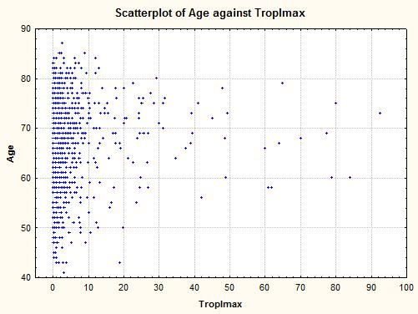
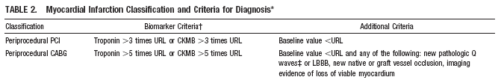
Interpretation
easy difficult easy

Slide 8
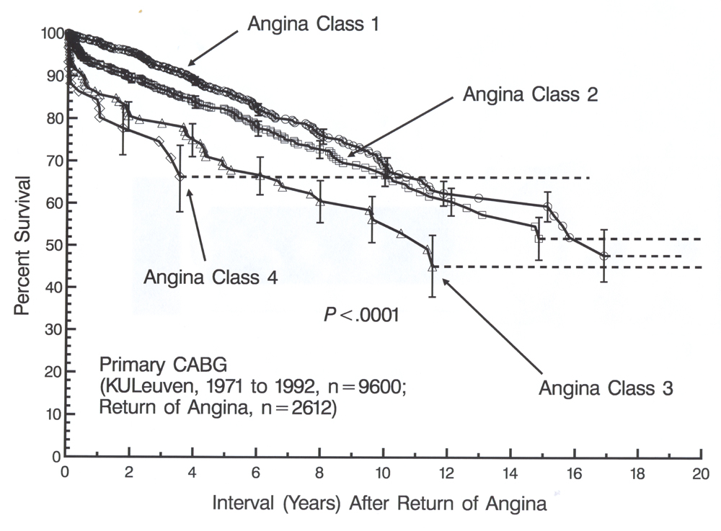
Drivers of re-intervention: survival after return of angina

Slide 9
Primary Endpoint (12 Month MACCE)
Non-inferiority to CABG
Zone of Non-inferiority
Pre-specified Margin = 6.6%
Non-inferior
Non-inferior
Inferior
Inferior
-4%
-2%
0
2%
4%
6%
8%
10%
Difference in MACCE rates
(CABG-PCI with TAXUS Express)
Difference in MACCE rates
Upper 1-sided 95% confidence intervals
Piaggio et al, JAMA 2006; 295: 1152-1160
Notes:
9

Slide 10
Syntax RCT Pt data I
 | CABG n=897 | TAXUS n=903 | P value
Age, mean ± SD (y) | 65.0 ± 9.8 | 65.2 ± 9.7 | 0.55
Male, % | 78.9 | 76.4 | 0.20
BMI, mean ± SD | 27.9 ± 4.5 | 28.1 ± 4.8 | 0.37
Diabetes, % | 28.5 | 28.2 | 0.89
Hypertension, % | 77.0 | 74.0 | 0.14
Hyperlipidemia, % | 77.2 | 78.7 | 0.44
Current smoker, % | 22.0 | 18.5 | 0.06
Prior MI, % | 33.8 | 31.9 | 0.39
Unstable angina, % | 28.0 | 28.9 | 0.67
Additive EuroSCORE, mean ± SD | 3.8 ± 2.7 | 3.8 ± 2.6 | 0.78
Notes:
10

Slide 11
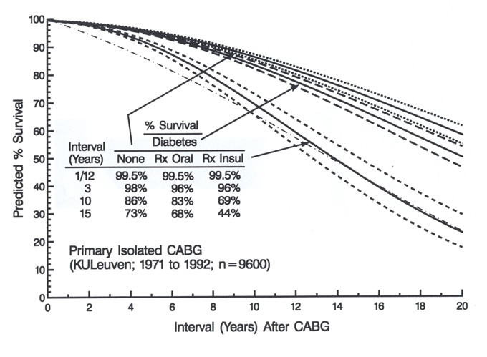
Very young patients!
Medically Treated Diabetes is an irrelevant risk factor.
Only insulin treated diabetes (in Syntax only 7 %) has any impact.

Slide 12
Syntax RCT Pt data II
 | CABG n=897 | TAXUS n=903 | P value
Total SYNTAX Score | 29.1 ±11.4 | 28.4 ±11.5 | 0.19
Diffuse disease or small vessels, % | 10.7 | 11.3 | 0.69
No. lesions, mean ± SD | 4.4 ±1.8 | 4.3 ±1.8 | 0.44
3VD only, % | 66.3 | 65.4 | 0.70
Left main, any, % | 33.7 | 34.6 | 0.70
Left Main only | 3.1 | 3.8 | 0.46
Left Main + 1 vessel | 5.1 | 5.4 | 0.78
Left Main + 2 vessel | 12.0 | 11.5 | 0.72
Left Main + 3 vessel | 13.5 | 13.9 | 0.78
Total occlusion, % | 22.2 | 24.2 | 0.33
Bifurcation, % | 73.3 | 72.4 | 0.67
Trifurcation, % | 10.6 | 10.7 | 0.92
Notes:
12

Slide 13
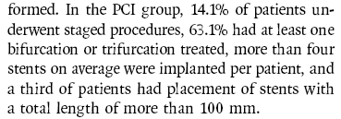
The staged procedures of the PCI were not considered as re-interventions of incomplete procedures
but as staged procedures !!

Slide 14
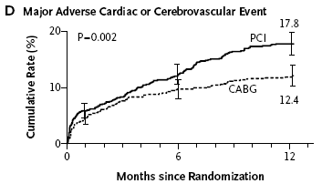
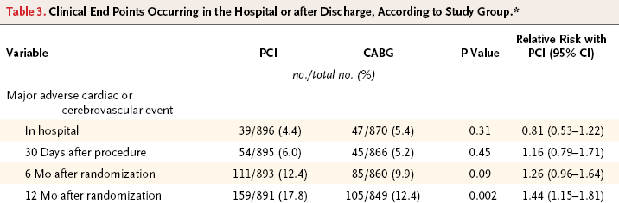
Primary Outcome event: MACCE

Slide 15
Primary Endpoint:12 months MACCE
Non-inferiority analysis
Pre-specified Margin = 6.6%
5.5%
+95% CI = 8.3%
0
5%
10%
15%
20%
Difference in MACCE
The criteria for Non-inferiority comparison was not met for the primary endpoint, further comparisons for the LM and 3VD subgroups are observational only and hypothesis generating
Notes:
Exhibit 1

Slide 16
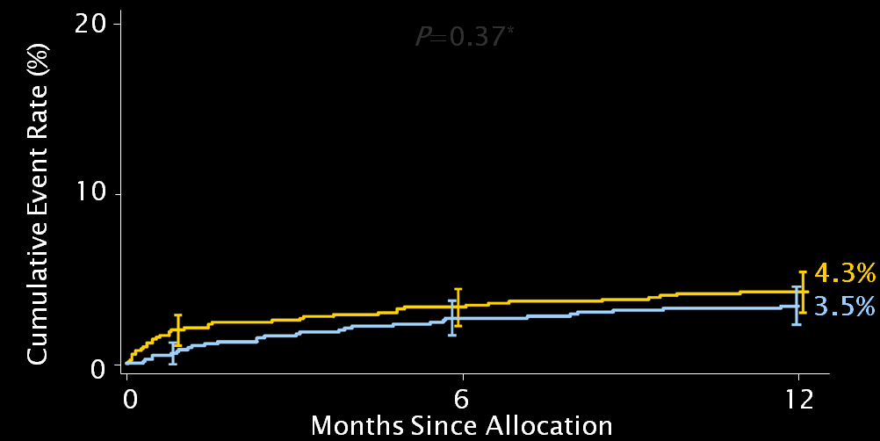
P=0.37
22 % higher mortality in PCI
PCI-CABG
Death
P=0.37*
CABG |  | PCI
RCT | Registry | RCT | Registry
3.5 % | 2.5 % | 4.3 % | 7.3 %

Slide 17
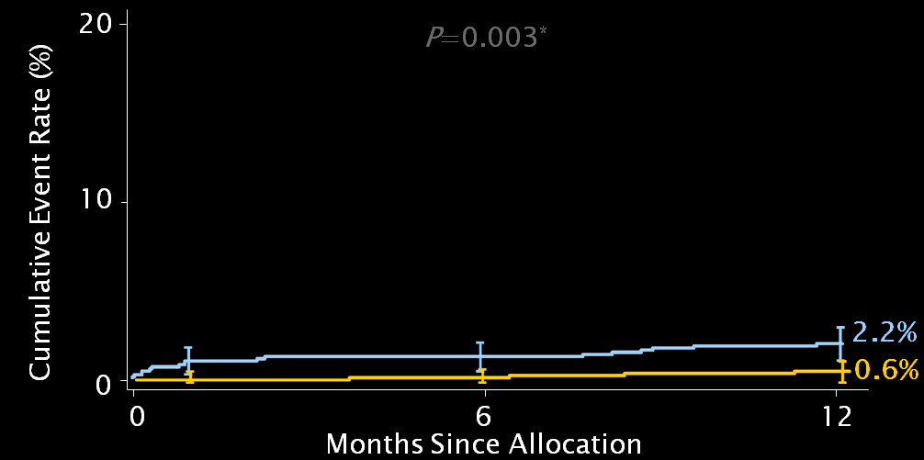
Stroke
P=0.003
PCI-CABG
2.2 % CABG:
0.8 % pre-op
1.2 % peri-op
0.2 % post-op
CABG |  | PCI
RCT | Registry | RCT | Registry
2.2 % | 2.2 % | 0.6 % | 0 %

Slide 18

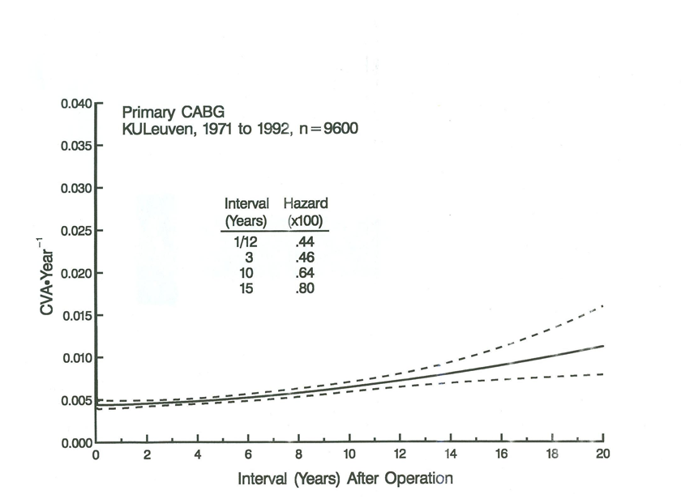

Slide 19
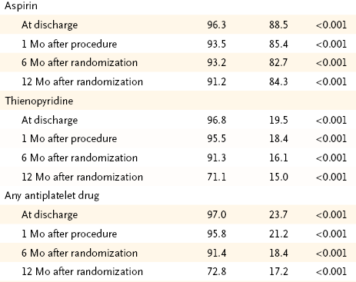
Stroke

Slide 20
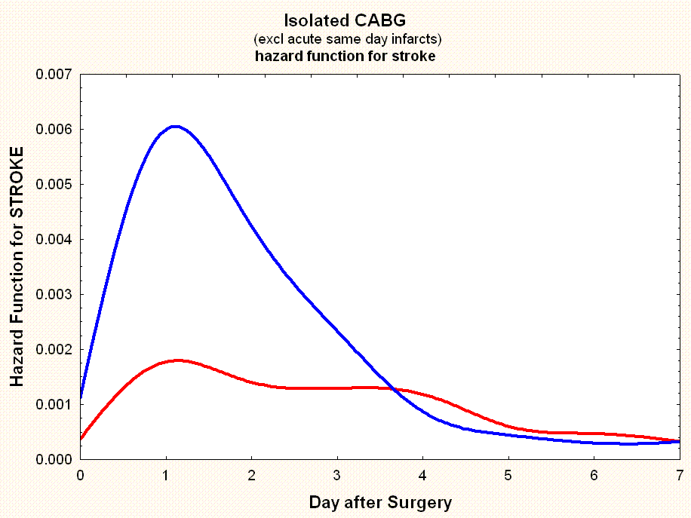
CABG on-pump (N=1583)
CABG off-pump (N=3247)

Slide 21
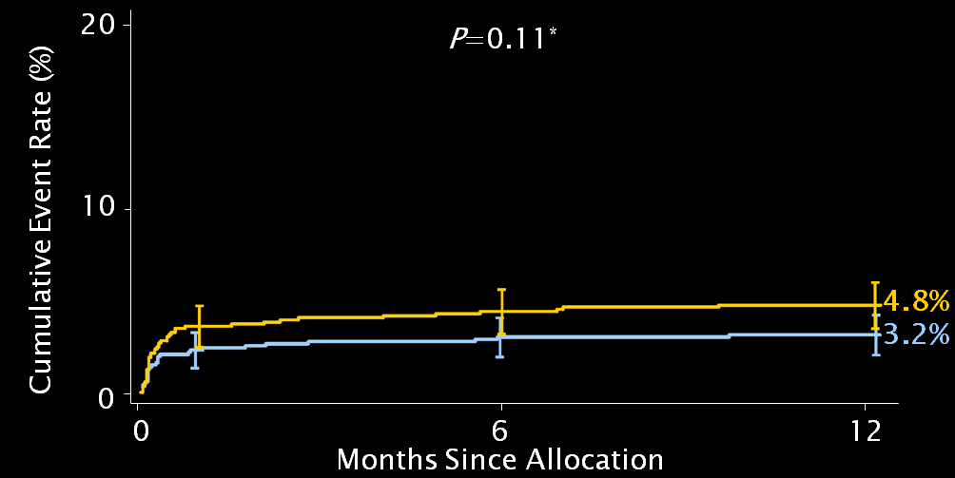
P=0.11
50 % higher infarct in PCI
PCI-CABG
Infarct

Slide 22
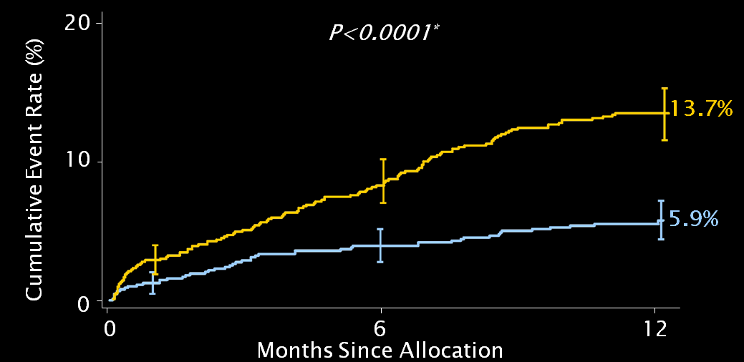
P<0.0001
PCI-CABG
Re-
intervention
Graft revascularization, % | CABG n=897
At least one arterial graft | 97.3
Arterial graft to LAD | 95.6
LIMA + venous | 78.1
Double LIMA/RIMA | 27.6
Complete arterial revascularization | 18.9
Radial Artery | 14.1
Venous graft only | 2.6
Notes:
The reïntervention rate within the first year in the CABG group is half the rate in the registry versus in the trial.
In the registry were the worst patients situated.

Slide 23
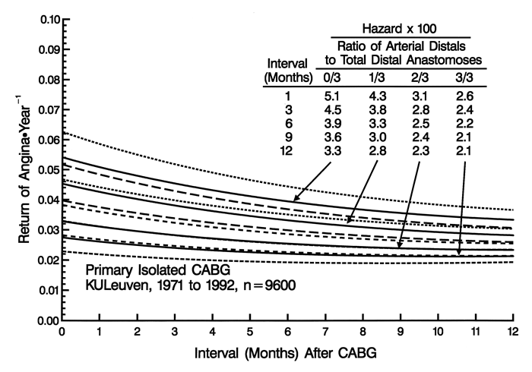

Slide 24
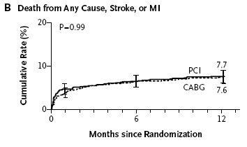
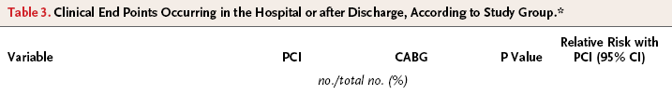
Death, Stroke, Infarct

Slide 25
All-Cause Death to 3 Years
CABG (N=897)
TAXUS (N=903)
P=0.13
40
Before 1 year*
3.5% vs 4.4%
P=0.37
1-2 years*
1.5% vs 1.9%
P=0.53
2-3 years*
1.9% vs 2.6%
P=0.32
Before 1 year
3.5% vs 4.4%
P=0.37
1-2 years
1.5% vs 1.9%
P=0.53
2-3 years
1.9% vs 2.6%
P=0.32
Cumulative Event Rate (%)
20
8.6%
6.7%
0
0
12
24
36
Months Since Allocation
Cumulative KM Event Rate ± 1.5 SE; log-rank P value;*Binary rates
ITT population

Slide 26
CVA to 3 Years
CABG (N=897)
TAXUS (N=903)
P=0.07
40
Before 1 year*
2.2% vs 0.6%
P=0.003
1-2 years*
0.6% vs 0.7%
P=0.82
2-3 years*
0.5% vs 0.6%
P=1.00
Before 1 year
2.2% vs 0.6%
P=0.003
1-2 years
0.6% vs 0.7%
P=0.82
2-3 years
0.5% vs 0.6%
P=1.0
Cumulative Event Rate (%)
20
3.4%
0
2.0%
0
12
24
36
Months Since Allocation

Slide 27
Myocardial Infarction to 3 Years
CABG (N=897)
TAXUS (N=903)
P=0.002
40
Before 1 year*
3.3% vs 4.8%
P=0.11
1-2 years*
0.1% vs 1.2%
P=0.008
2-3 years*
0.3% vs 1.2%
P=0.03
Before 1 year
3.3% vs 4.8%
P=0.11
1-2 years
0.1% vs 1.2%
P=0.008
2-3 years
0.3% vs 1.2%
P=0.03
Cumulative Event Rate (%)
20
7.1%
0
3.6%
0
12
24
36
Months Since Allocation

Slide 28
Repeat Revascularization to 3 Years
CABG (N=897)
TAXUS (N=903)
P<0.001
40
Before 1 year*
5.9% vs 13.5%
P<0.001
1-2 years*
3.7% vs 5.6%
P=0.06
2-3 years*
2.5% vs 3.4%
P=0.33
Before 1 year
5.9% vs 13.5%
P<0.001
1-2 years
3.7% vs 5.6%
P=0.06
2-3 years
2.5% vs 3.4%
P=0.33
Cumulative Event Rate (%)
19.7%
20
10.7%
0
0
12
24
36
Months Since Allocation

Slide 29
MACCE to 3 Years
CABG (N=897)
TAXUS (N=903)
P<0.001
40
Before 1 year*
12.4% vs 17.8%
P=0.002
1-2 years*
5.7% vs 8.3%
P=0.03
2-3 years*
4.8% vs 6.7%
P=0.10
Before 1 year
12.4% vs 17.8%
P=002
1-2 years
5.7% vs 8.3%
P=0.03
2-3 years
4.8% vs 6.7%
P=0.1
28.0%
Cumulative Event Rate (%)
20
20.2%
0
0
12
24
36
Months Since Allocation

Slide 30
Syntax
The interventional cardiologists have shown that it is possible to treat the left main, but have as yet totally failed that this makes sense from a societal and patient perspective.
Have their aggressive re-interventions after the primary therapy made any sense? Where is the evidence to re-intervene?
The surgeons have shown that they do not control risk by failing in
  The no-touch aorta
  The more complete arterial revascularization
  The off-pump CABG
  The reduction of risk and early reïntervention.

