Slide 3
Mission of EuroSCORE II
How can we improve the EuroSCORE project?
Are there different options and if so which?

Slide 4
Methods for prediction of rare events Technological forecasting & social change (2010) 77, 355-36
Statistical forecasting
Optimal reference class essential
Expert judgment
Good calibration in horse racing, interest rates, bridge
Poor calibration in politics, economics, psychology
Structured judgmental decomposition
Decomposition (event trees), improves calibration above expert judgment, reduces optimism bias and groupthink
Structured analogies
Improves calibration above expert judgment
Statistical forecasting with judgmental intervention or adjustment
Can improve statistical forecasting if reference class incomplete
Delphi
Judgment alone, by several actors, providing numerical information
Calibration optimized through feedback involving iteration, statistical, feedback and reasons feedback
Prediction markets
Strongly influenced by negative , recent and known events
Scenario planning
The random character of the rare event is accepted and the consequences of the event are studied
Notes:
Reference class is the basis of knowledge (eg database).
Hoe meer records hoe beter, hoe minder specifiek de uitkomstvariabele hoe beter.
Eg Prediction of any death, or prediction of death at home

Slide 5
Methods for prediction of rare events Technological forecasting & social change (2010) 77, 355-36
 | Sparsity of reference class | Inapprop. reference class | Inapprop. statistical model | Misplaced causality | Cognitive bias | Frame blindness
Statistical forecasting | unreliable | unreliable | unreliable | possibly embedded | mostly absent | not adressed
Expert judgement | outperforms statistical f. | unfocused prediction | not applicable | increased | increased | not adressed
Decomposed judgment | outperforms statistical f. | unreliable | not applicable | increased | reduced
Structured analogies | unreliable | unreliable | not applicable | possibly embedded | reduced | not adressed
Judgment adjustment of Statistical forecast | outperforms statistical f. | unreliable | mixed evidence for model adjustment | not reduced | unreliable but could reduce bias | not adressed
Delphi | corrects for | corrected for | not applicable | not reduced | reduced | adressed in part
Prediction markets | outperforms statistical f. | corrected for | not applicable | not reduced | reduced | not challenged
Scenario planning | corrected for | not corrected for | not applicable | not reduced | false confidence | reinforces frame

Slide 6
Causes of low predictability of rare events Technological forecasting & social change (2010) 77, 355-36
Sparsity of reference class
Reference class increases with size of database and the decrease in specificity of the event
Density in extremes of variability
Outdated reference class or without extreme events
Use of inappropriate statistical models
Oversimplified models, inappropriate distribution, poor calibration
Misplaced causality
Reference class specific or spurious correlations
Cognitive bias
Availability
Prevalence is incorrectly associated with recent, vivid, unusual events
Representativeness
Base-rate frequencies are often ignored versus subjective probabilities
Anchoring and insufficient adjustment
Anchoring to the past and insufficient adjustment to possible future conditions
Frame blindness
What must be predicted, under which form, which factors, reliability, consequences
Notes:
Reference class is the basis of knowledge (eg database).
Hoe meer records hoe beter, hoe minder specifiek de uitkomstvariabele hoe beter.
Eg Prediction of any death, or prediction of death at home

Slide 7
The size of the reference class submitted by self-proclaimed volunteers The sparsity of the reference class decreases with the size
What is important in addition to the total number of records?

Slide 8
The internal/external audit of the reference class The sparsity of the reference class decreases with its lack of internal/external audit
Therefore the whole audit responsibility was only signed off by the unit responsible.
But the project coordinators identified AFTER the sign-off that there were records
submitted times 2, times 3, times4 and times 5. Very questionable data quality!
What is important in addition to the total number and the accuracy of records?

Slide 9
The actuality of the reference class An outdated reference class is a cause of poor predictability of rare events

Slide 10
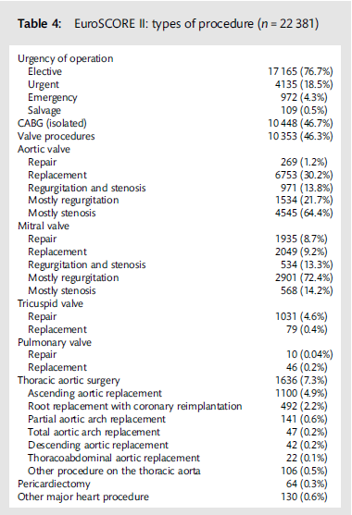
The specificity of the reference class The sparsity increases with the lack of specificity

Slide 11
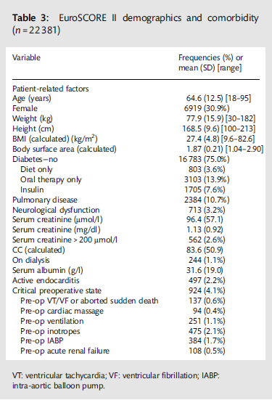
The density of the extremes of the reference class The sparsity increases with the lack of density of the extremes

Slide 12
Actual Patient variability

Slide 13
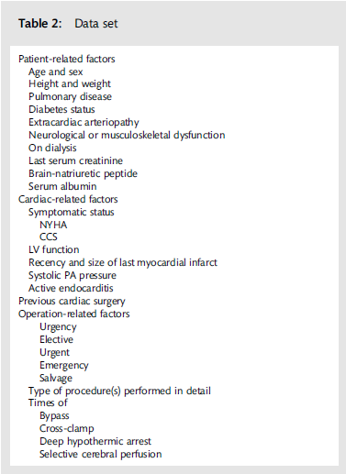
The sparsity of the reference class is decreased by its parsimonious nature
CC glomerular filtration rate

Slide 14
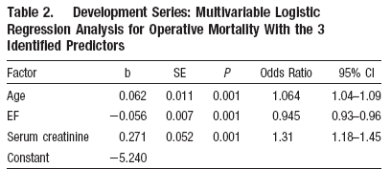
The ACEF score

Slide 15
Primary outcome variable
The primary outcome variable selected was 90 day mortality
The secondary outcome variables selected were hospital and 30 day mortality

Slide 16
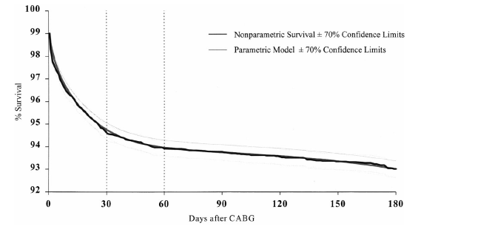
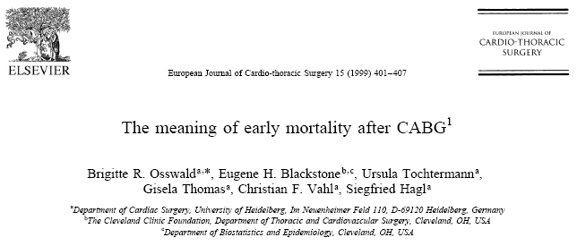
The interval of early risk of dying after CABG,

Slide 17
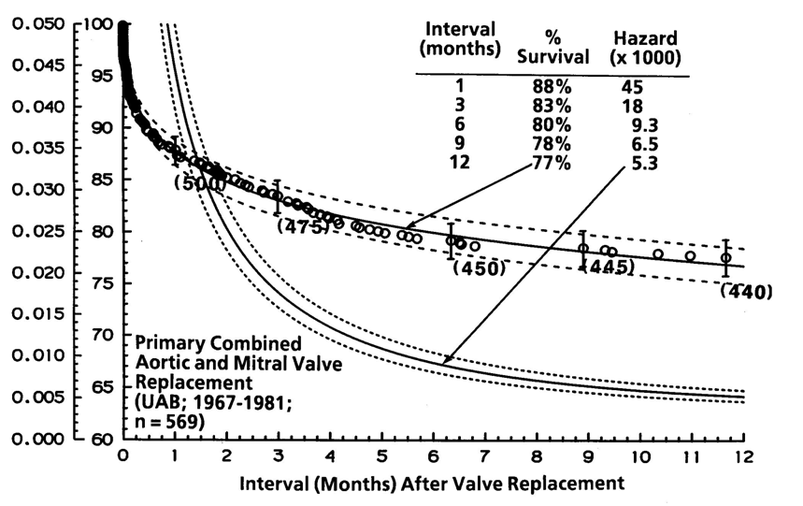

Slide 18
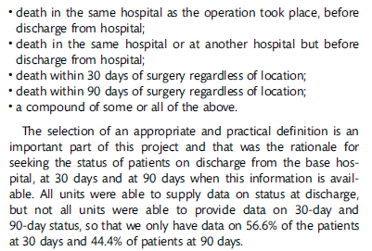
Primary outcome variable
But they have only 56 % of the follow-up complete at 30 days!
But they have only 44 % of the follow-up complete at 90 days!

Slide 19
Primary outcome variable
They then redefine between the different versions of the manuscript the
primary outcome event from the unbiased 90 days to the biased hospital stay!

Slide 20
Follow-up methodologies
Informal methodology
Date of last report
Formal methodologies
Anniversary method
patient contact at anniversary of time 0 (day, wk, yr))
large missing intervals between anniversaries
Common closing date method
define a common closing date and hour first (past or future)
all information is gathered till that common closing date
all posterior information is excluded
No comment made in the whole manuscript about follow-up methodology,
neither about invitations to try to complete the missing follow-up
Notes:
If one has a predefined observation interval, then we will need to find the follow-up information till that specific date.
Many outcome studies observe the follow-up after certain therapies without predefined interval. If that is the issue then the follow-up methodology becomes very important. It is extremely rare to find this essential information under the method section; but in fact all inference building should be based on a correct methodology.
The first possibility is the informal follow-up.
Berkson introduced in 1981 the date of last report method. All information available from the time of initiating the follow-up inquiry until the date of the last report is included in the analysis, even after the return of the study-specific follow-up report. This has the disadvantage that the information is usually at random and seems to give maximum information. A request for follow-up information can be sent to the patient or the medical professional, but this is not mandatory. This method is considered inacceptable today.
The second possibility is the formal follow-up.
In the anniversary method, the patient is contacted at every anniversary (rarely day, week or month; usually year) after time 0. The regular contact with the patient is the core value of this method. It is therefore optimal for studying the time-varying clinical and functional status of the patient. The bias of this method is in the large intervals between the observations and in the censoring at the last anniversary for the living patients. See further to understand “censoring”. This method is acceptable but the limitations should be identified.
In the common closing date method, a closing date is identified first. This can be an arbitrary date (and hour) in the past or in the future. A structured follow-up inquiry is then set up contacting all involved medical professionals and the patient. All information up to the common closing date and hour are included, all later information is ignored.
The researcher will have to guarantee that there are no large intervals without specific information.

Slide 21
Missing follow-up
Top paragraph conflicts completely with bottom paragraph!
Notes:
If one has a predefined observation interval, then we will need to find the follow-up information till that specific date.
Many outcome studies observe the follow-up after certain therapies without predefined interval. If that is the issue then the follow-up methodology becomes very important. It is extremely rare to find this essential information under the method section; but in fact all inference building should be based on a correct methodology.
The first possibility is the informal follow-up.
Berkson introduced in 1981 the date of last report method. All information available from the time of initiating the follow-up inquiry until the date of the last report is included in the analysis, even after the return of the study-specific follow-up report. This has the disadvantage that the information is usually at random and seems to give maximum information. A request for follow-up information can be sent to the patient or the medical professional, but this is not mandatory. This method is considered inacceptable today.
The second possibility is the formal follow-up.
In the anniversary method, the patient is contacted at every anniversary (rarely day, week or month; usually year) after time 0. The regular contact with the patient is the core value of this method. It is therefore optimal for studying the time-varying clinical and functional status of the patient. The bias of this method is in the large intervals between the observations and in the censoring at the last anniversary for the living patients. See further to understand “censoring”. This method is acceptable but the limitations should be identified.
In the common closing date method, a closing date is identified first. This can be an arbitrary date (and hour) in the past or in the future. A structured follow-up inquiry is then set up contacting all involved medical professionals and the patient. All information up to the common closing date and hour are included, all later information is ignored.
The researcher will have to guarantee that there are no large intervals without specific information.

Slide 22
Should we continue to read this manuscript?

Slide 23
Accuracy of Mathematical modelling
Calibration
How well do predicted probabilities agree with actual observed risk.
When the average predicted risk in a subgroup matches the observed risk then there is good calibration.
Hosmer-Lemeshow statistic compares proportions. Imperfect but popular method.
Discrimination
How well can a model separate black from white
If the model identifies a true higher proportion in a cohort it is considered to discriminate well, even if it does not match correctly.
Neglects the random nature of future events if used in predictive modelling.
C-statistic (concordance index),
ROC curve (receiver operating characteristics)
Combination calibration-discrimination
Likelihood statistics, R², Brier score

Slide 24
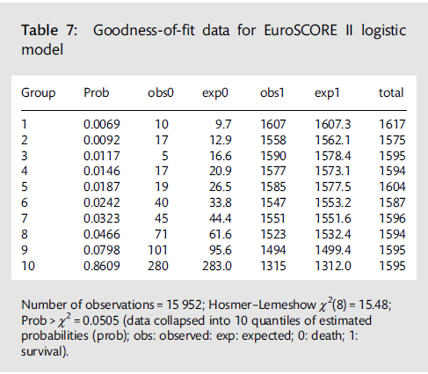
The calibration of the EuroSCORE II
A statistical significant HL is associated with BAD calibration (here 0.05)
but a non-significant test is not associated with good calibration.

Slide 25
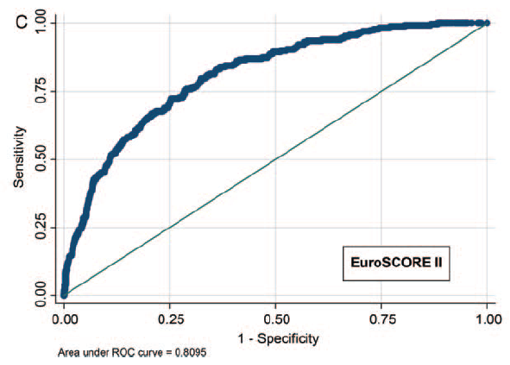
The discrimination of the EuroSCORE II

Slide 26
The discrimination of the EuroSCORE II
So the discrimination improved from 0.789 to 0.809 between EuroSCORE I and II.
This improvement is NOT SIGNIFICANT

Slide 27
ROC analysis
The C-statistic is only based on ranking and therefore not very sensitive.
Other measures are better for model selection.
Examples are: Likelihood statistics, R², Brier score
A test can have a high sensitivity but a low specificity.
The diagnostic likelihood ratio is used to combine these two measures.
Likelihood ratio, positive (LR+) = sensitivity / (1-specificity)
Is an estimate of the relative predictive value of a test
(true positives / false positives)
value > 10 is large and good
value 5-10 is moderate
value < 2 is poor
Likelihood ratio, negative (LR-) = (1-sensitivity) / specificity
value < 0.1 is good
value 0.1 – 0.5 is considered moderate
value > 0.5 is poor

Slide 29
Conclusions
EuroSCORE II
does not score quality of care.
does not score risk of care.
remains having a parsimonious dataset
continues to use nominal data for continuous variables
has added renal dysfunction under a clearance format
has a massive incomplete dataset, inappropriate for any analysis
has improved calibration but the HL test identifies a possible calibration issue.
has not improved its discriminatory power and does not exceed the 0.8 in the prediction of rare events.
can and should not be used for quality control evaluations or comparisons.
cannot be used for differential therapy purposes.

