Slide 1
Dr Lelanie Pretorius
MBChB, MMed (Haemat), PG Dip (Transfusion Medicine)
Dept of Haematology and Cell Biology
Faculty of Health Sciences
University of the Free State
THROMBOELASTOGRAPHY

Slide 2
THROMBOELASTOGRAPHY
What is thromboelastography (TEG)/ thromboelastometry and what does it measure ?
What are the clinical applications of the TEG?

Slide 3
THROMBOELASTOGRAPHY
1948 – First described by Hartert
Complete evaluation of whole blood coagulation
Different philosophy from routine coagulation tests:
    Routine tests
      Isolated stages of coagulation in plasma
    TEG
      A global picture of haemostasis in whole blood

Slide 4
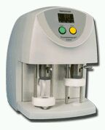
1996 – TEG® became registered trademark of the Haemoscope Corporation

Slide 5
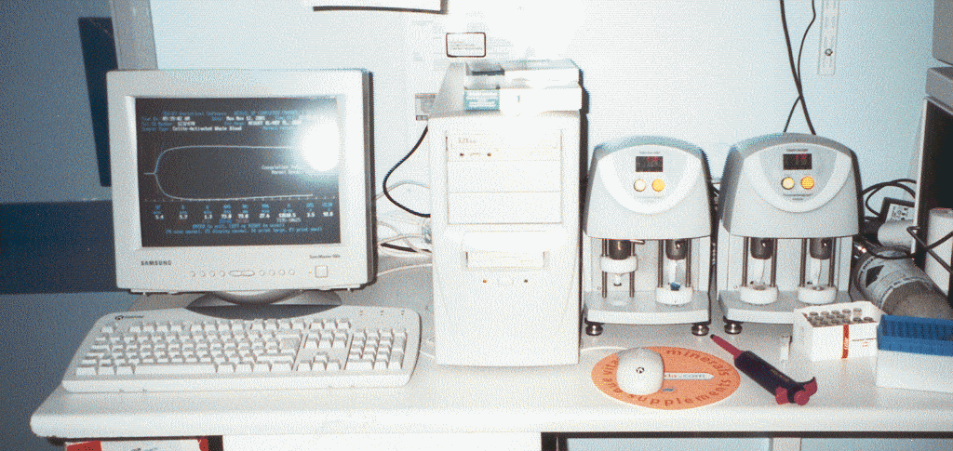
TEG®

Slide 6
What does it measure?
Thromboelastography monitors the thrombodynamic properties of blood as it is induced to clot under a low shear environment resembling sluggish venous flow

Slide 7
What does it measure?
Visco-elastic changes that occur during coagulation
Graphical representation of fibrin polymerization

Slide 8
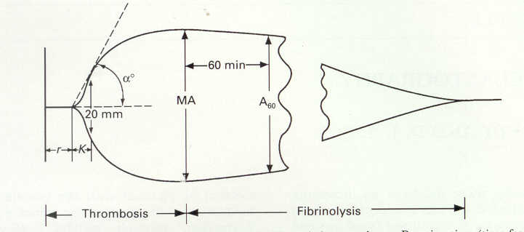
Thromboelastograph

Slide 9
thromboelastography
Clot initiation
Clot formation
Clot stability

Slide 10
TEG: Global process of the coagulation of whole blood
Clot formation
Clotting factors
Clot kinetics
Clotting factors, platelets
Clot strength and
stability
Platelets, Fibrinogen
Clot resolution
Fibrinolysis
= SUM (Platelet function + coagulation proteases and inhibitors + fibrinolytic system)

Slide 11
TEG v CONVENTIONAL TESTS
Global functional assessment of coagulation/fibrinolysis
More in touch with current coagulation concepts
Uses actual cellular surfaces to monitor coagulation
Gives assessment of platelet function
Dynamic testing
Test various parts of coag. cascade, but in isolation
Out of touch with current thoughts on coagulation
May not be an accurate reflection of what actually happens in a patient
Do not assess role of platelets in coagulation
Static testing

Slide 12
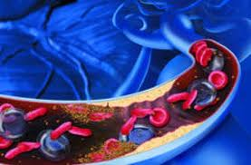
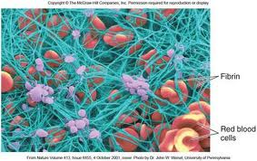
TEG v CONVENTIONAL TESTS
TEG informs how blood
clots and if the clot is
and remains stable
Conventional tests detect when blood clots

Slide 13
THROMBOELASTOGRAPHY
Blood placed in an oscillating cup warmed to 37°C
Pin suspended from torsion wire placed into blood
As blood starts to form clots between the pin and cup, the rotation of the cup is transmitted to the pin
The change in tension is measured electromagnetically producing a trace
Notes:
A blood sample is placed into a cuvette (“cup”) which rotates gently back and forth with a cycle time of 6/min. The non-physiological surface of the cup (+/- added calcium ions) activates coagulation.
A sensor (pin), connected to a torsion wire is inserted into the sample. Clot formation generates a physical connection between the inner surface of the cup and the surface of the sensor. The change of elasticity is detected by an electro-mechanical transducer

Slide 14

Principles of Thrombelastography
Torsion wire
R
K
Pin
α°
Cup
MA
Fibrin
Whole Blood

Slide 15
Normal TEG
K
R
α°
MA
R K Angle MA
2- 8 min 1- 3 min 55 – 78 deg 53 – 69 mm

Slide 16
The “r” time
Represents period of time of latency from start of test to initial fibrin formation.
Reflects main part of TEG’s representation of “standard clotting studies” (PT and PTT).
Normal range 15 -23 min (native blood)
  5 - 7 min (koalin-activated)

Slide 17
What affects the “r” time?
r time ↑ by
  Factor deficiency
  Anti-coagulation (Heparin)
  Severe hypofibrinogenaemia
r time ↓ by
  Hypercoagulability syndromes

Slide 18
Delayed Clot formation
R
K
α°
MA
R K Angle MA
2- 8 min 1- 3 min 55 – 78 deg 53 – 69 mm
13 min 3 min 56 deg 60 mm

Slide 19
Delayed Clot formation
Heparin Effect
Factor deficiency
Treatment: Protamine or FFP

Slide 20
The “k” time
Represents time taken to achieve a certain level of clot strength
Measured from end of r time until an amplitude 20 mm is reached
Normal range 5 - 20 min (native blood)
  1 - 3 min (kaolin-activated)

Slide 21
What affects the “k” time?
k time ↑ by
  Factor deficiency
  Thrombocytopenia
  Platelet dysfunction
  Hypofibrinogenaemia
k time ↓ by
  Hypercoagulability state

Slide 22
Weak Clot formation
K
R
α°
MA
R K Angle MA
2- 8 min 1- 3 min 55 – 78 deg 53 – 69 mm
5 min 6 min 35 deg 42 mm

Slide 23
Weak Clot formation
Treatment:
  FFP,
  platelets
  and possible cryoprecipitate

Slide 24
The “α” angle
Measures the rapidity of fibrin build-up and cross-linking (clot strengthening)
Assesses rate of clot formation
Normal range 22 - 38° (native blood)
  53 - 67° (kaolin-activated)

Slide 25
What affects the “α” angle?
α angle ↑ by
  Hypercoagulability state
α angle ↓ by
  Hypofibrinogenaemia
  Thrombocytopenia

Slide 26
R K Angle MA
2- 8 min 1- 3 min 55 – 78 deg 53 – 69 mm
1min 0.1 min 85 deg 85 mm
R
K
Hypercoagulation
α°
MA

Slide 27
The “maximum amplitude” (MA)
A direct fx of the maximum dynamic properties of fibrin
And platelet binding via GPIIb/IIIa
Represents the ultimate strength of the fibrin clot.
Correlates with platelet function
80% platelets
20% fibrinogen

Slide 28
What affects the maximum amplitude?
MA ↑ by
  Hypercoagulability state
MA ↓ by
  Thrombocytopenia
  Thrombocytopathy
  Hypofibrinogenaemia

Slide 29
Fibrinolysis
LY60 / A60
Measures % decrease in amplitude 60 minutes post-MA (A60)
Gives measure of degree of fibrinolysis
Normal range < 7.5% (native blood)
  < 7.5% (kaolin-activated)
LY30 / A30
30 minute post-MA data

Slide 30
Other measurements of Fibrinolysis
EPL
Represents “computer prediction” of 30 min lysis based on the actual rate of diminution of trace amplitude commencing 30 sec post-MA
Earliest indicator of abnormal lysis
Normal EPL <15%

Slide 31
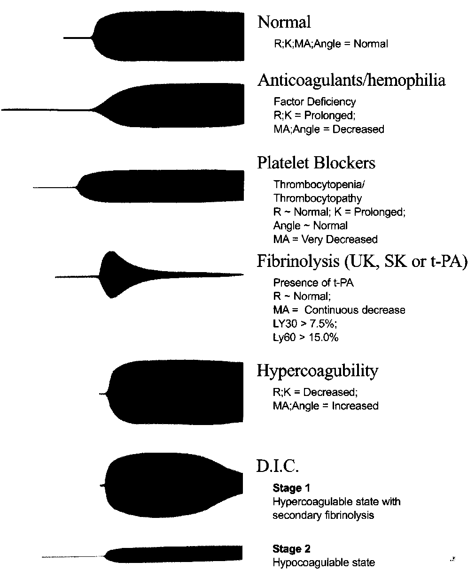

Slide 32
Modified TEG
TEG accelerants / activators
Celite ↑ initial coagulation
Tissue Factor ↑ initial coagulation
Koalin ↑ initial coagulation
Other activators modify initial coagulation
Reopro (abciximab) Block platelet component of coagulation
Arachidonic Acid Activates platelets (Aspirin)
ADP Activates platelets (Plavix®)
Heparinase cups
Reverse residual heparin in sample
Paired plain/heparinase cups allows identification of inadequate heparin reversal or sample contamination

Slide 33
LIMITATIONS
Normal TEG does not exclude defects in the haemostatic process
Surgical bleed will not be detected
Adhesion defect will not be detected
Not sensitive for FVII deficiency
Not effective for monitoring of Warfarin/VKA’s
Standard TEG testing does not disclose increased bleeding risks due to treatment with acetyl salicylic acid or ADP receptor inhibitors as clopidogrel or ticlopidin

Slide 34
limitations
In patients with more complex disturbances of haemostasis, TEG may disclose hypercoagulability
It is then important to bear in mind that TEG is not able to detect changes in the natural anticoagulants, as this is important in the evaluation of thromboembolic complications.

Slide 35
Clinical Value
Clinical management of
  Bleeding and
  Haemostasis
Guide to
  Clotting factor replacement
  Platelet transfusions and
  Anti-Fibrinolytic treatment

Slide 36
Clinical fields
Hepatobiliary surgery
  Monitor haemostasis & guide therapy
  Liver transplant - ↓transfusion requirements
  Assess fibrinolysis and efficacy of anti-fibrinolytic therapy
Cardiac surgery
  ↓transfusion requirements
  Use of specific products
  Assess fibrinolysis and efficacy of anti-fibrinolytic therapy
Trauma – prediction of early transfusion requirements
Obstetrics
  Identify hypercoagulable state ass with Pre-eclampsia
  Identify pt at risk of dangerous bleeding from an epidural
Cardiology: Marker of risk for thrombotic events
  Non-cardiac post-op thrombosis
  Post PCI ischaemic events
  Clopidogrel/aspirin resistance/efficacy

Slide 37
TEG-guided transfusions in complex cardiac surgery
Routine transfusion group
TEG-guided group
52 patients
31/52 (60%) received blood
16/52 (31%) received FFP
15/52 (29%) received Platelets
53 patients
22/53 (42%) received blood
(p=0.06)
4/53 (8%) received FFP
(p=0.002)
7/53 (13%) received Platelets (p=0.05)
Shore-Lesserson et al, Aneth Analg 1999;88:312-9

Slide 38
TEG: Cardiac Algoritm

Slide 39
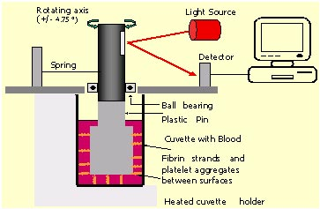
Rotem®

Slide 40
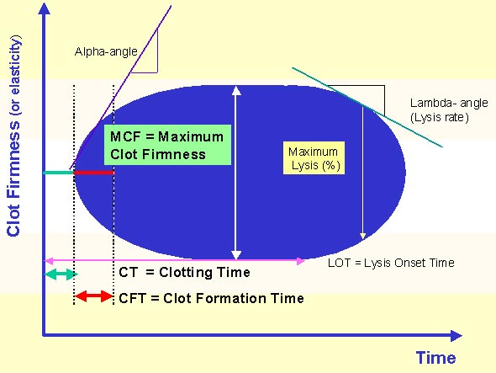
Rotem®

Slide 41
Problems:
Different philosophy: measures global haemostasis and not the different components
Does not allow for batch testing
Poorly validated against laboratory methods
TEG of limited value in primary haemostasis
  not a high shear system;
  VWF and Aspirin have only a weak influence
? Reproducibility and QC
Standardization and reagent optimization

