Slide 1
Pre-Operative Evaluation of a Bleeder
Mrs. M. Jansen van Vuuren
Universitas Academic Hospital Bloemfontein

Slide 2
PRE-OPERATIVE WHY AND HOW?
WHY?
HOW?
ESSENTIAL
KNOWLEDGE

Slide 3
HOW?.....History
General questions
Social/Regular Habits
Occupation
Other diseases
Previous illnesses
Previous operations & Complications
Family history
Current medication

Slide 4
HOW?.....Examination
PHYSICAL
Appearance indication of type of bleeding
Ecchymosis / Petechia/ Bruising/ Cyanosis/ Anemic
Critically ill patient:
History
Jaundice
Anemia
Jugular Venous Distention
Hyper/Hypothyroidism
Auto-immune disease
Infective Endocarditis
Kidney Failure
HIV
Sepsis

Slide 5
HOW?.....Special Investigations
Blood Tests:
Hb & Hct%
Glucose
Albumin
ABG’s
ECG
Urine analysis (Hematuria )
Creatinine Clearance
Rhabdomyolysis
Liver functions (if abnormal, then)
Coagulation Tests:
PTT, PT, INR, vWF
Bleeding time
Thromboelastogram (TEG)
ACT

Slide 6
SURGICAL PROCEDURES RELATED TO BLEEDING TENDENCY
ANY REDO OPERATION
CABG
OPCAB
AORTIC STENOSIS
AORTIC ANEURISMS
CONGENITAL HEART DEFECTS
ADDITIONAL
Patients with:
LIVER DISEASE
RENAL INSUFFICIENCY
HEMATOLOGICAL DISEASE
SEPSIS

Slide 7
PATIENT FACTORS RELATED TO BLEEDING DISORDERS
I THERAPY:
Statins, Aspirin, Warfarin, Plavix, Heparin,
Self Medication
RISK FOR BLEEDING:
Aspirin: Platelets
Warfarin: Clotting factors
Heparin: ATIII
Self Medication: Herbal

Slide 8
PATIENT FACTORS RELATED TO BLEEDING DISORDERS
II THERAPY
Warfarin, Aspirin
Disorders and Syndromes
AvWS (Acquired von Willebrand syndrome)
vWD has variable degrees of severity, so false negative family history is common
Autosomal dominant Disorders: vWD and hereditary hemorrhagic talengectasia.
Autosomal recessive disorders: afibrinogenemia, factor V and factor XIII deficiency.
frequently family history is negative with AR disorders

Slide 9
HISTORY… TYPE OF BLEEDING
Mucus Membrane Bleeding:
Includes: epistaxis, gum bleeding, excessive menstrual bleeding..etc.
DDX: thrombocytopenia, platelet function disorder, vWD
Joint & Deep Muscle Bleeding:
DDX: Hemophilia A or B

Slide 10
HISTORY
The following scenarios are unlikely to be due to a coagulation defect:
Unilateral epistaxis-usually due to a local reason such as cold or nasal congestion.
Post tonsillectomy bleeding-usually surgical reasons.
Bruising in the arms and legs of an active child-usually due to trauma.

Slide 11
HISTORY… REVIEW OF SYSTEMS
Cyanotic Congenital Heart disease
Absorption
Liver Disease
Renal Disease
Uremia
Nephrotic Syndrome

Slide 12
LAB WORK… PETECHIAL RASH & MUCUS MEMBRANE BLEEDING
Von Willebrand Disease:
Deficiency in vWF or defect in its structure (multimeric structure) or activity.
vWF is responsible for adherence of platelets to damaged endothelium.
vWF is a large glycoprotein that is synthesized in megakaryocytes and endothelial cells.
Has several types: Type 1, 2A, 2B, 2N, 2M and type 3

Slide 13
vWD WORK UP
PTT: Can be normal.
Factor VIII level.
vWF level by ELISA or immune electrophoresis (Laurel test).
Blood type.
Multimeric analysis of vWF.
Ristocetin Factor Activity

Slide 14
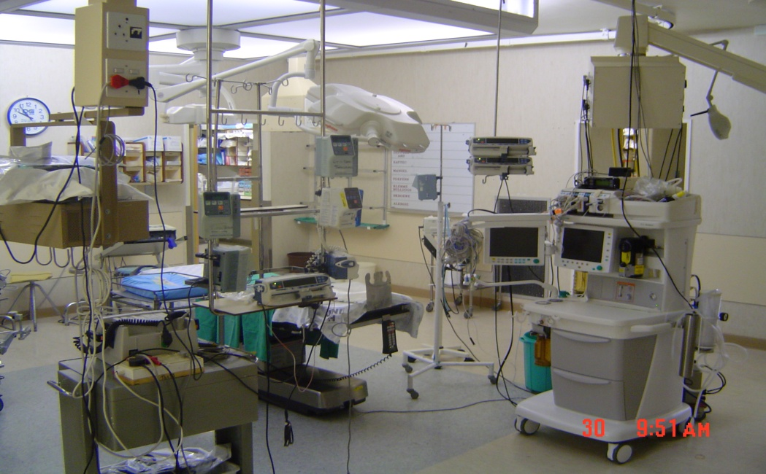
CONCLUSION
“Cardiac surgery is a team sport!”
“There is no other realm of perioperative medicine, in which perfect communicaiton between surgeon, anesthesiologist and perfusionist is of such paramount importance.”
“While once many patients might have been considered ‘too sick’ to undergo cardiac surgery, it is precisely this complex subpopulation that we are being asked more frequently to take care of.”

Slide 15
REFERENCING
Anaesthesiology study guide, Nov 2010, Odendaal CL, Diedericks BJS, Strydom JH
http://www.ncbi.nlm.nih.gov/pmc/articles/PMC301910/
http://www.medicinenet.com/warfaring/article.htm
Fleisher: Anesthesia and Uncommon Diseases, 5th ed. 2005
Thromb Haemost. 2011 Jul;106(1):58-66. Epub 2011 May 5
Fisher GW , Pre to Postop Anesthesia., Dept Anesthesiology, New York.

