Slide 1
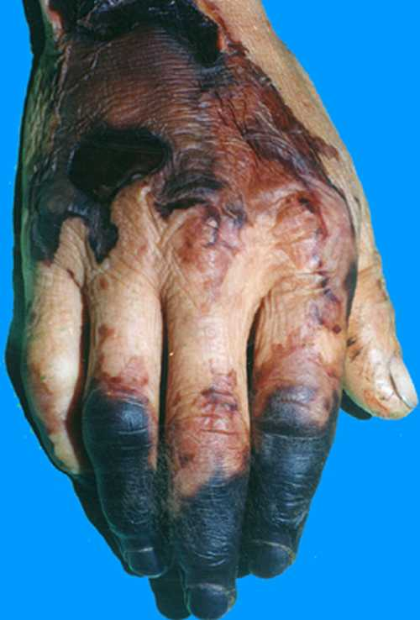
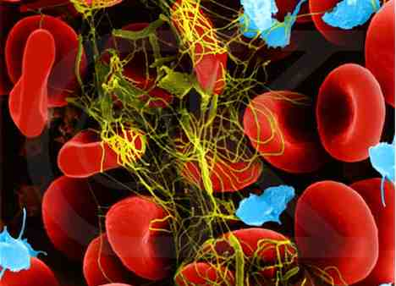
Disseminated intravascular coagulopathy (DIC)

Slide 2
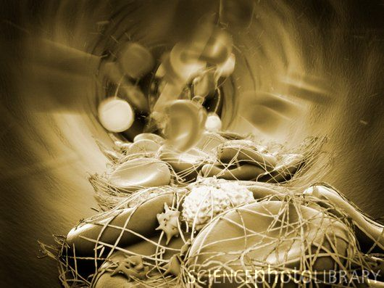
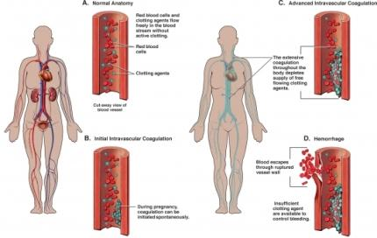
Introduction
What is DIC?

Slide 3
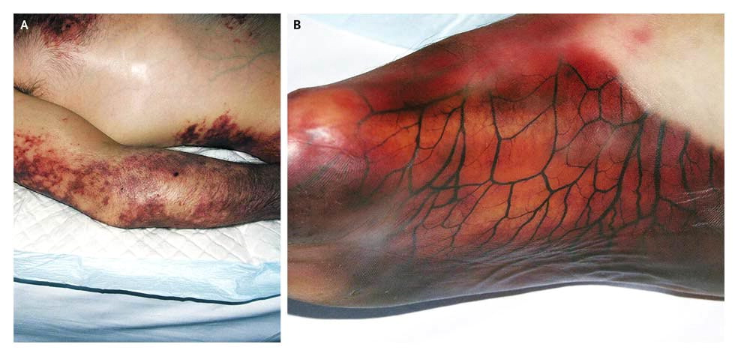
Patient with DIC

Slide 4
Inflammatory Response Syndrome
What is Inflammation?
Insult:
Biologic (microorganism)
Physical (mechanical insult, radiation)
Chemical (poisons, acids)
Metabolic (hypoxia, malnutrition)
Immunologic (autoimmune diseases)
Endogenic disorders of neurohumoral regulation

Slide 5
Systems Responsible for Inflammatory Response
Platelets
Endothelial cells
Complement
Leucocytes
Plasmatic Hemo-coagulation system

Slide 6
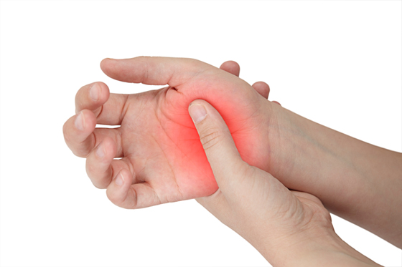
Characteristics of Inflammation
Local Inflammation
Swelling
Redness
Heat
Pain
Dysfunction of
organs involved

Slide 7
Tissue Response to Injury
Kill invading bacteria
Vasodilation
Wound healing

Slide 8
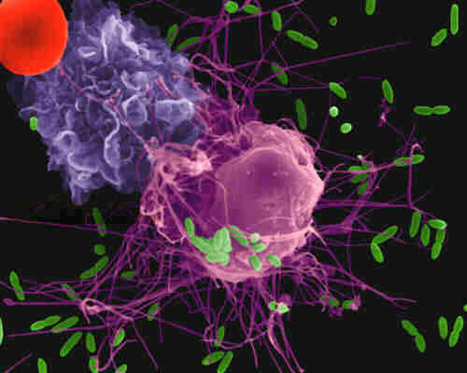
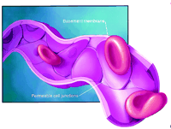
Inflammatory process
Inflammatory chemicals released
Macrophages are activated
Histamine and kinins released
Capillaries dilate

Slide 9
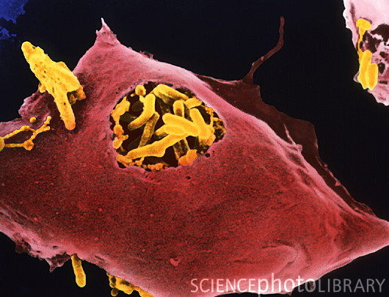
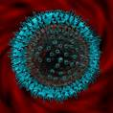
Inflammatory process continued
Invaders destroyed
Phagocytosis
WBC’s produced and released
Lymphocytes produce antibodies
Healing

Slide 10
Systemic Inflammatory Response Syndrome
SIRS
What is SIRS?
Insult:
Hypoxic reperfusion damage
Infection (endotoxin)
Primary mediators (histamin)
Complexes antigen-antibody
Thrombin a plasmin (DIC)
Disorders of microcirculation
Disorders of perfusion
Secondary MODS

Slide 11
Hemostasis

Slide 12
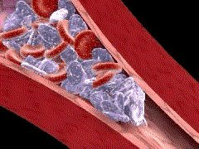
Hemostasis
Step 1: Vasoconstriction.

Slide 13
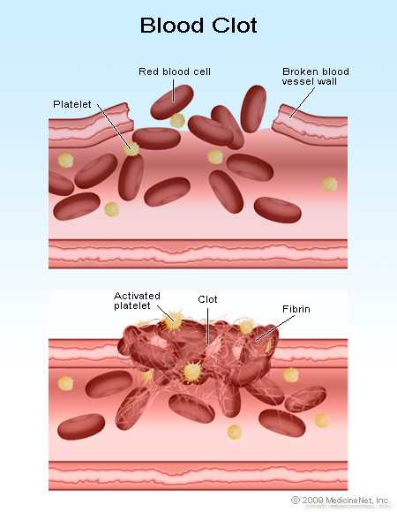
Hemostasis
Step 2: Platelet plug formation.

Slide 14
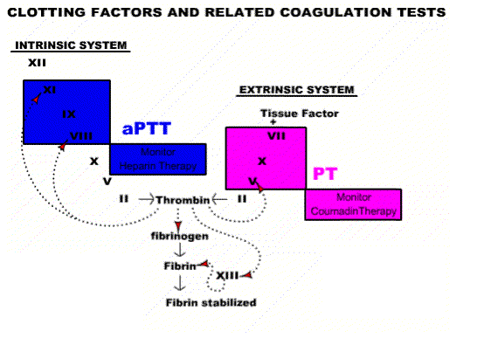
Hemostasis
Step 3: Coagulation
Extrinsic coagulation cascade
Intrinsic coagulation cascade
Clot formation

Slide 15
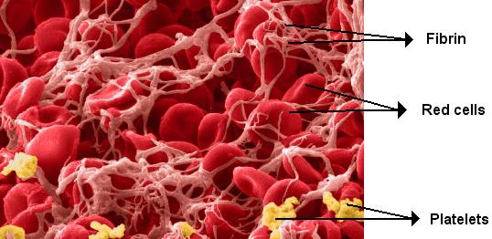
Fibrinolysis
Cascade

Slide 16
Pathophysiology of DIC

Slide 17
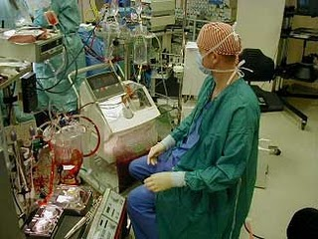
Cardiopulmonary Bypass and DIC

Slide 18
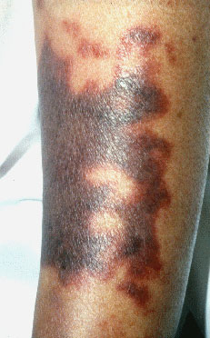
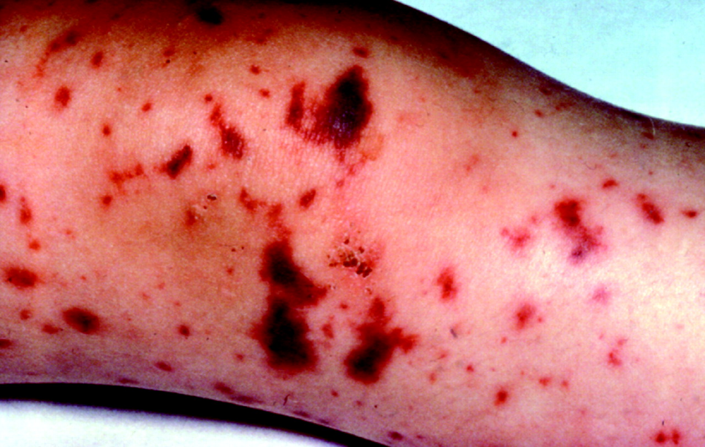
Acute vs. Chronic DIC
Acute DIC – when sudden exposure of blood to procoagulants occurs
Chronic DIC – Compensated state when blood is continuously exposed to small amounts of tissue factor

Slide 19
Causes of DIC

Slide 20
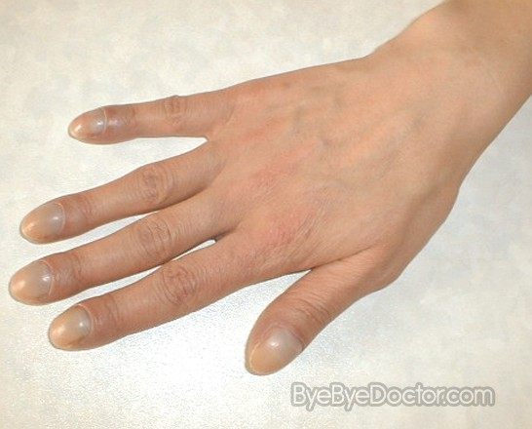
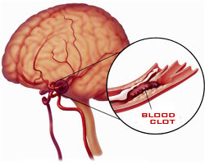
Clinical Manifestations
Hemorrhage
Cerebral thrombus
GI bleeding
Cyanosis

Slide 21
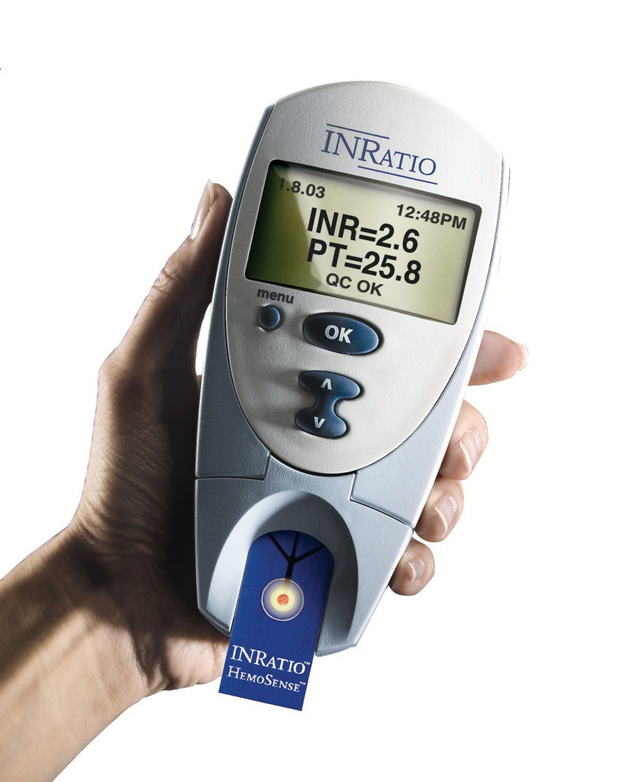
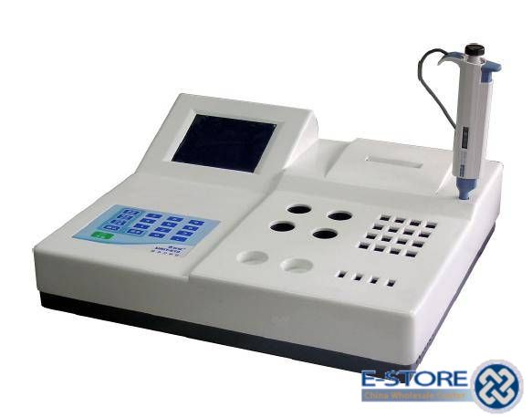
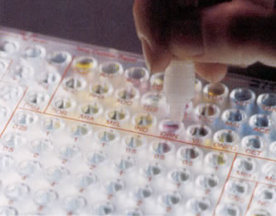
Diagnosis of DIC
Elevated fibrin degredation products
Prolonged prothrombin time
Partial thromboplastin time
Thrombin time
Serum fibrinogen
Thromboelastograph (TEG)
Platelet count
Complete blood count

Slide 22
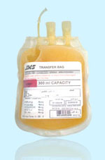
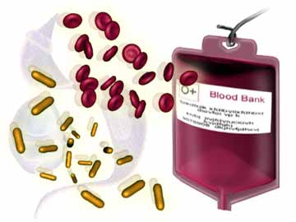
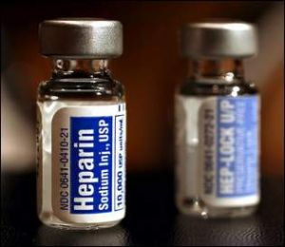
Treatment
Eliminate cause
Heparin therapy
Fluid replacement
Plasma products

Slide 23
Referencing
Ferasatkish R. Naddafnia H. Alavi S. Naseri M. 2007. Diagnosis and treatment of Disseminated Intravascular Coagulation: A case report. Archives of Iranian Medicine;10 (3): 404-408.
Rayatat CS. 2010. Disseminated Intravascular Coagulation: Pathophysiology and Diagnosis. Human Anatomy & Physiology and Renal Disorders.
Kovacova E. Kinova S. Duris I. Remkova A. 2009. General changes in hemostasis in gastric changes. Bratisl Lek Listy; 110 (4).
Janota J. Systemic inflammatory response syndrome – SIRS and Multiple organ dysfunction syndrome – MODS.
Available from: www.lf1.cuni.cz/patf
Accessed [ 10 March 2012 ].
Adib-Conquy M. Cavaillon J. 2009. Compensatory anti-inflammatory reponse syndrome. Available from: www.thrombosis-online.com [Accessed 10 March 2012]
Marieb E. 2007. Human Anatomy and Physiology. Wolters and Kluwer.

