Slide 1

Cardiac ECMO
EACTS/ Hannes Meyer symposium 2012
CJ Jordaan
Dept. Cardiothoracic surgery and
Critical care
University of the Free state
Bloemfontein

Slide 2
First SUCCESFULL case in 1976
  ECMO had several limitations
  Due to poor outcomes (poor indications)
  ECMO had high mortalities worldwide
    High costs involved
    Only few selected centres worldwide persisting
THEN CAME THE REBIRTH OF ECMO

Slide 3

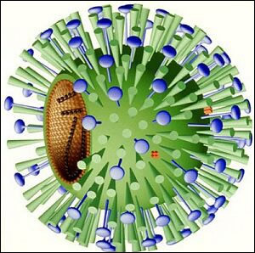


Slide 4
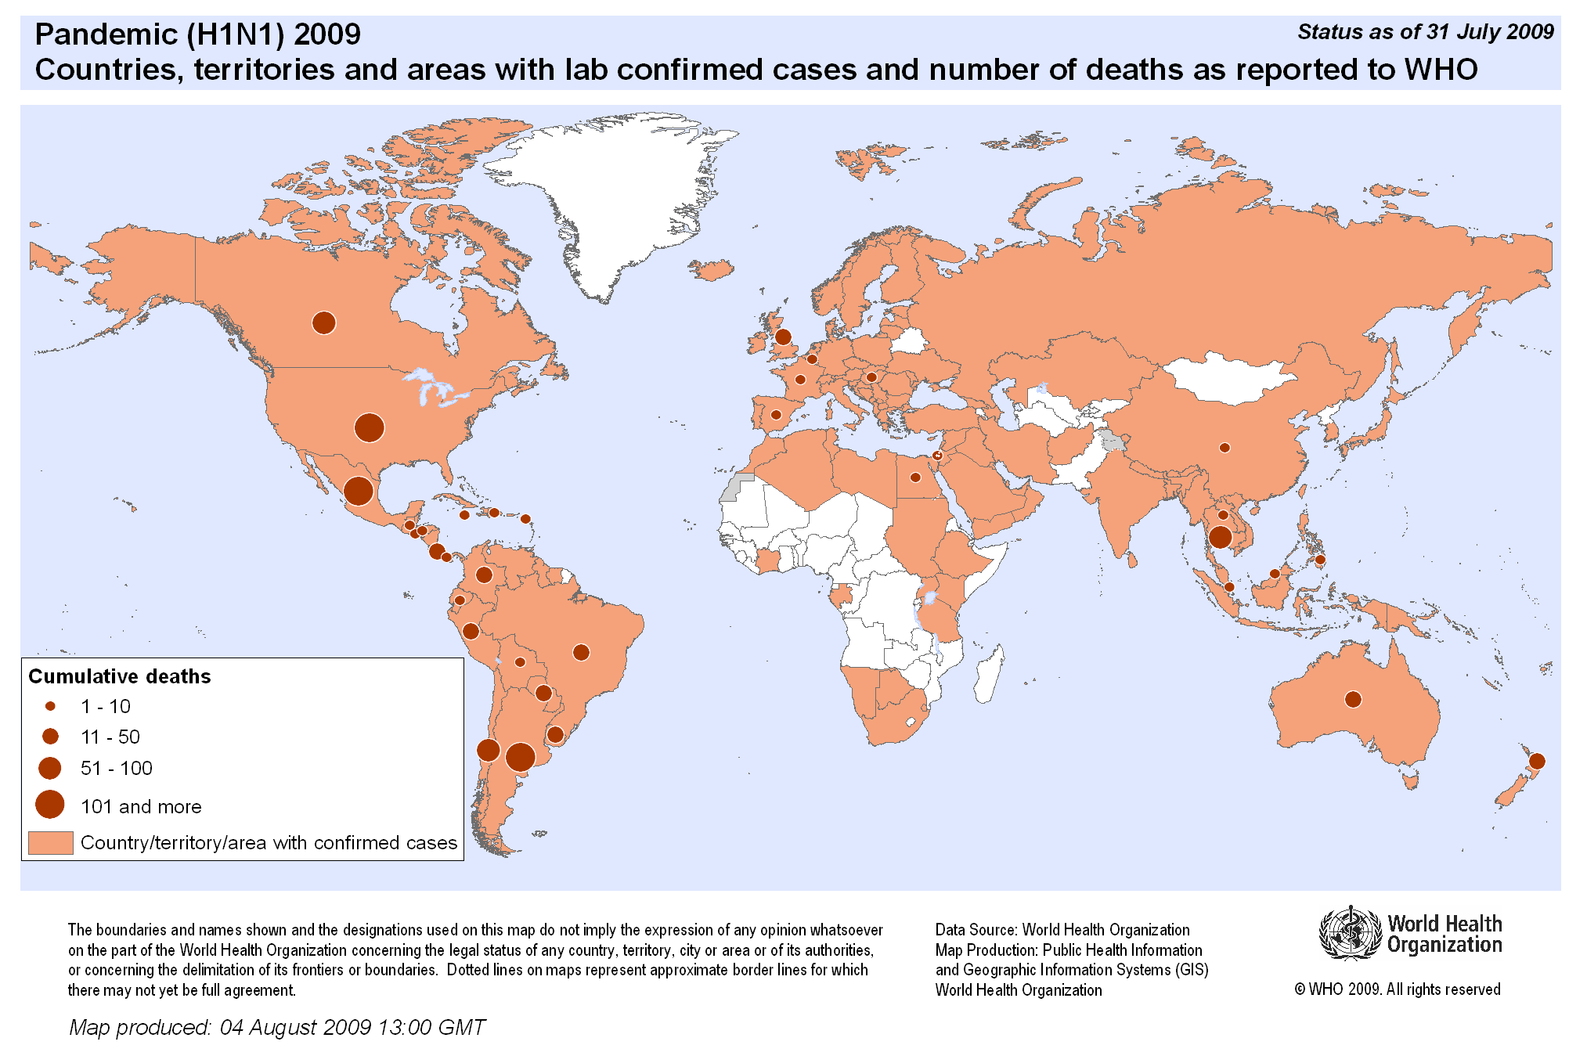
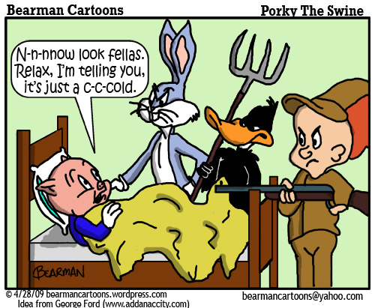
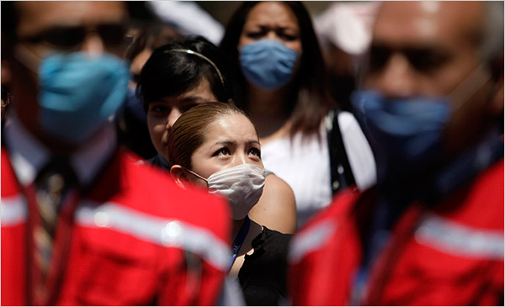

Slide 5
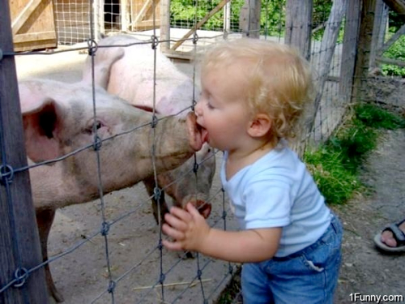
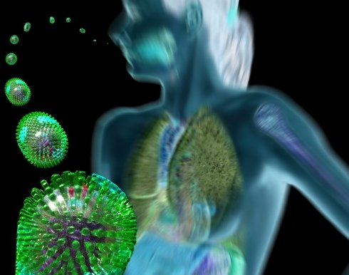
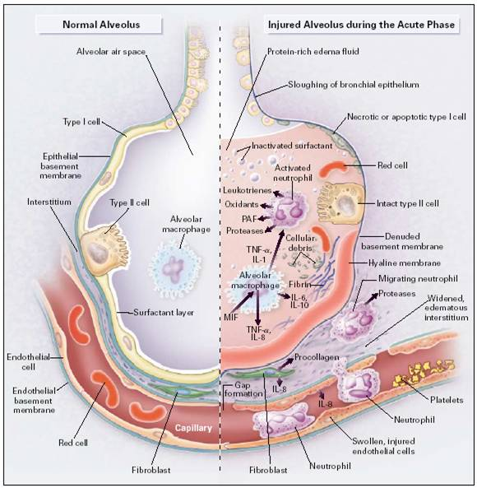

Slide 6
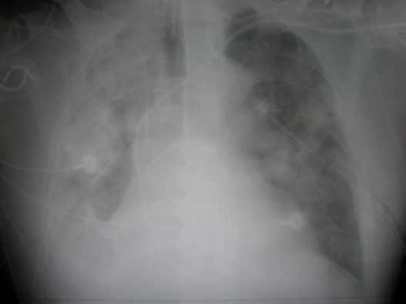
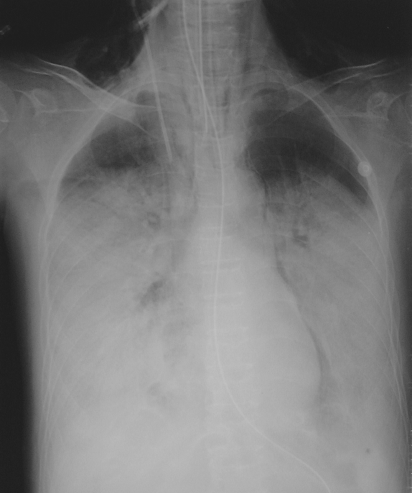
CXR of H1N1…

Slide 7
Who needs ECMO?

Slide 8
Cardiac (V-A) ECMO support: Indications
“Any patient may benefit from ECMO if they have severe respiratory or cardiac failure or both that is refractory to conventional treatment, providing that the underlying disease is ‘potentially reversible’ and there is no absolute contra-indication for support“
‘potentially reversible’ :
Post surgery for congenital heart disease …technically satisfactory repair
Bridge to transplant: Availability of donor organs
ELSO guidelines, 2011

Slide 9
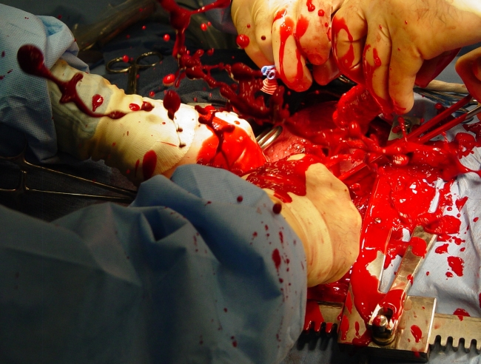
ECMO indications
CARDIAC:
Post cardiotomy
Transient myocardial dysfunction
Transiently increased PVR
Stabilisation of cardiac patients preoperatively
Arrhythmia
Bridge to transplant
Non heart beating organ donation

Slide 10
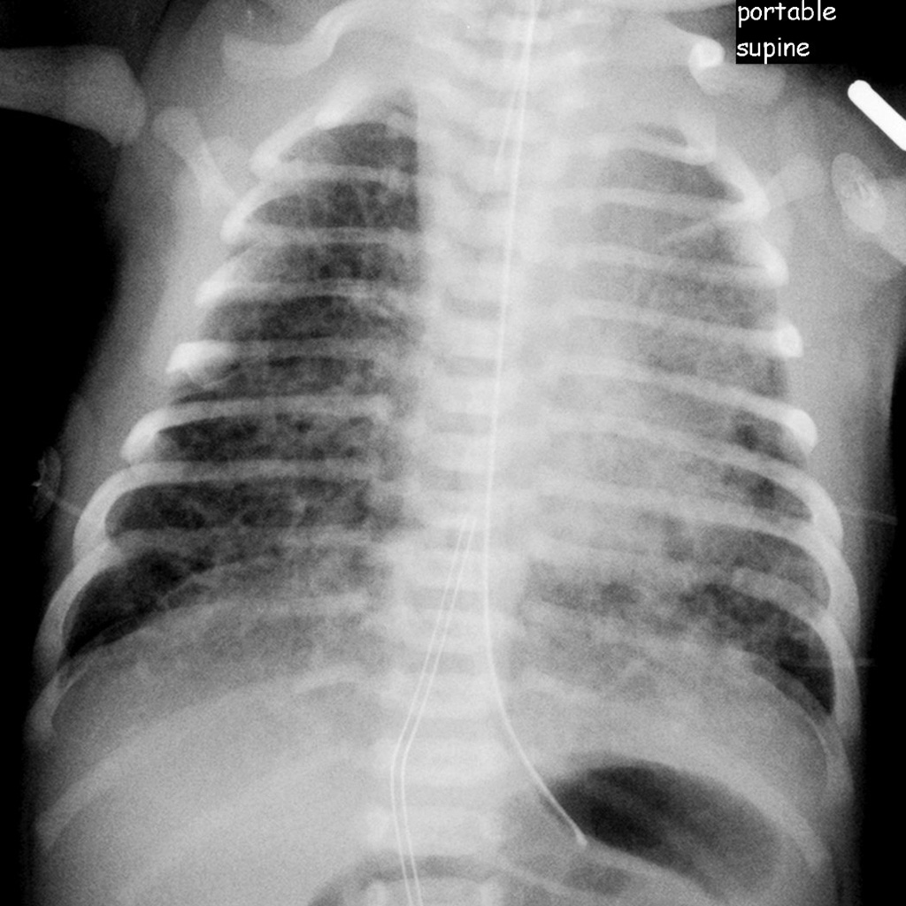
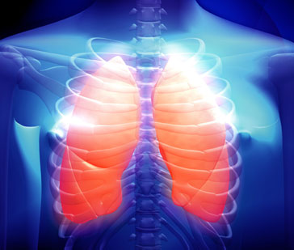
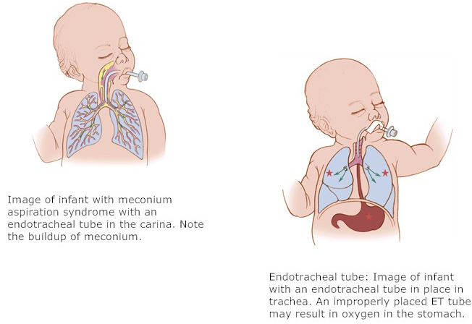
ECMO indications..
Respiratory:
ARDS
Pneumonia
Trauma
Primary graft failure
Paediatric population:
  Meconium aspiration
  Congenital diaphragm herniation
  Cardiac support
  Pulmonary hypertension

Slide 11
Cardiac (V-A) ECMO support: Indications
University of Michigan Criteria
Cardiac index < 2 l/m² per min for 3 h
Metabolic acidosis Base deficit > 5 for 3 h
Blood Pressure Neonate MAP < 40 mm Hg
Infant MAP < 50 mm Hg
Child MAP < 60 mm Hg
Urine < 0.5 ml/hr
After an operation Technically satisfactory repair and
failure to wean off bypass

Slide 12
Cardiac (V-A) ECMO support:
Contra-indications
Actual or possible major brain injury
Prolonged shock Low Blood Pressure
Metabolic acidosis > 5 for 12 h
Oliguria <0.5 ml/h for >12 h
After an operation Technically unsatisfactory repair
Disseminated malignancy
Advanced age
Unwitnessed cardiac arrest
Prolonged resuscitation
Aortic insufficiency

Slide 13
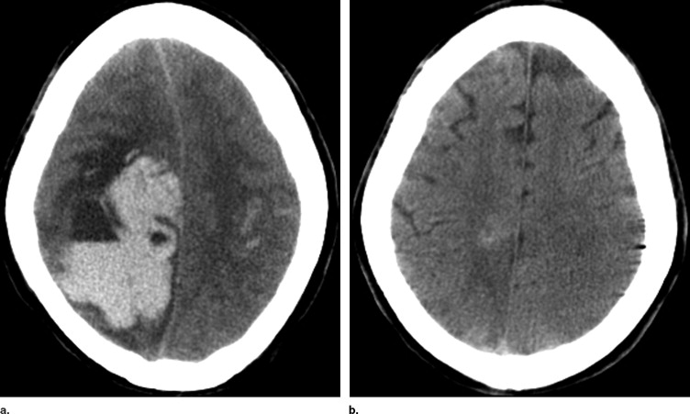
Neonatal criteria.
Gestational age ≥ 34 weeks or
Birth weight ≥ 2000g
No evidence of significant coagulopathy or uncontrolled bleeding
No major intracranial haemorrhage, < grade 2 IVH
Reversible lung disease with length of mechanical ventilation < 10-14 days
No correctable congenital heart disease
No lethal congenital anomalies
No evidence of irreversible
brain damage

Slide 14
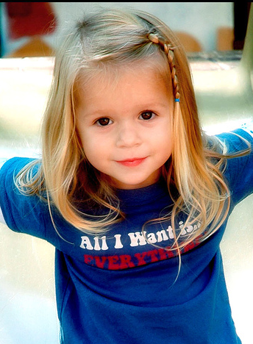
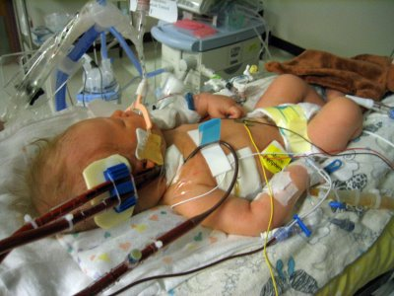

Respiratory criteria:
  AaDO$₂$ > 605-620 mmHg for 4- 12 hours
  Oxygenation index > 35-60 for 1– 6 hours
  PaO₂ < 35- 60 mmHg 2-12 hours
  pH < 7,25 for 2 hours or
  with hypotension
  Acute deterioration

Slide 15
ECMO circuit

Slide 16
Bypass vs ECMO

Slide 17
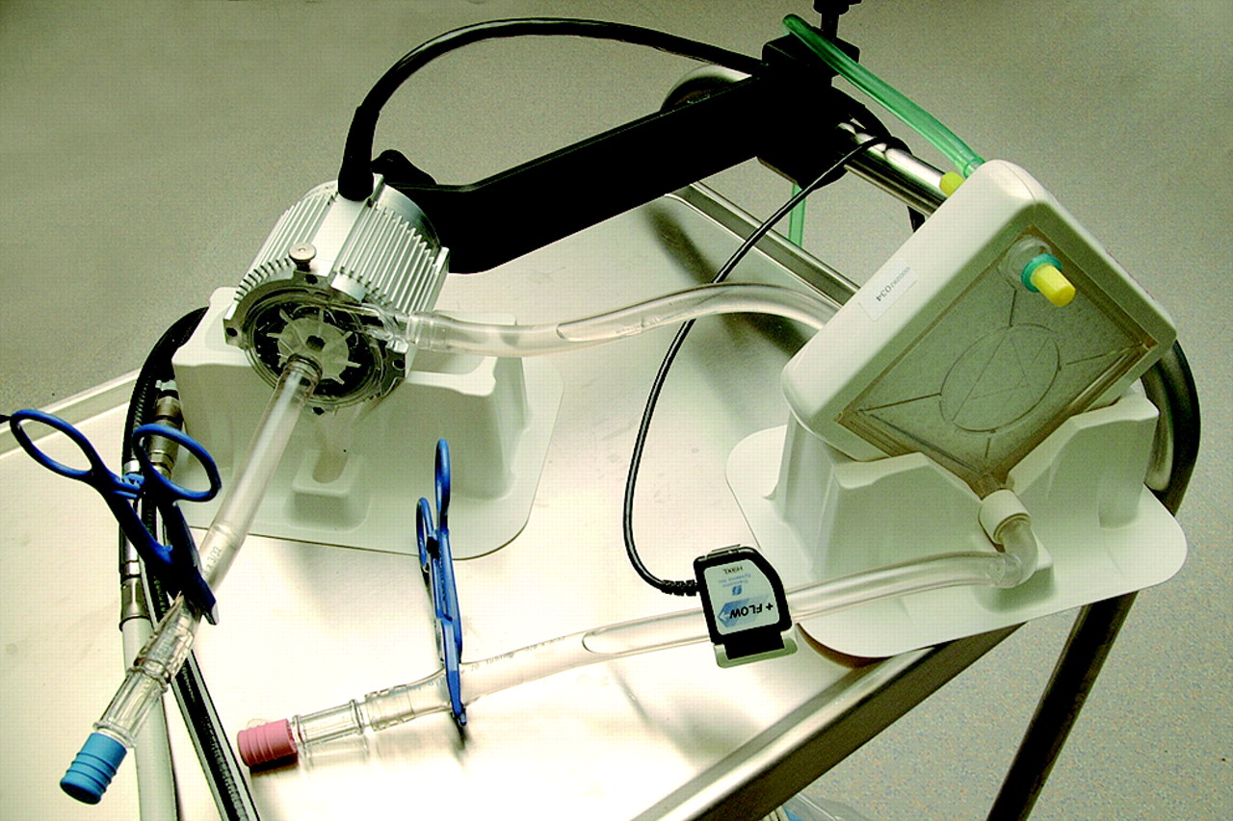
polymethylpentene (PMP)

Slide 18
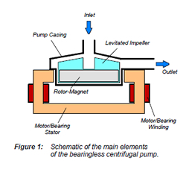
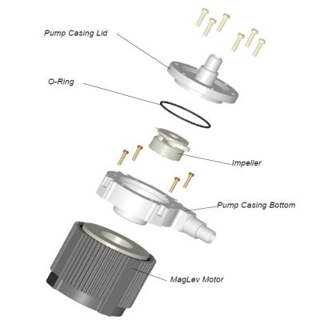
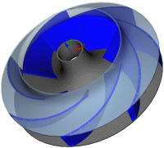
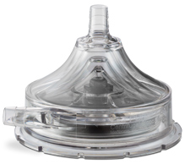
Pump head:
Magnetic levitation of the impeller
No wear resulting in reduced downtime and low maintenance cost
No lubrication required plus the capability of running dry
No particle generation
Wide clearances between the pump casing and impeller, and therefore, no clotting or stopping of the pump
Simple cleaning, sterilization, and exchange of the pump casing and/or impeller
Wide temperature range
Extremely low vibration and noise

Slide 19
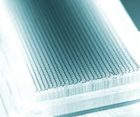
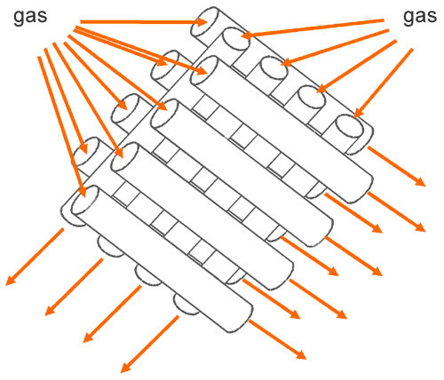
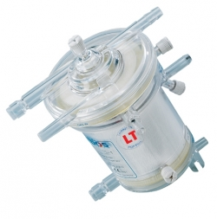
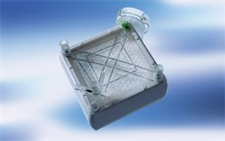
PMP Oxygenators
Diffusion membrane made from polymethylpentene (PMP).
Woven into a complex configuration of hollow fibers.
  low resistance configuration mat arranged in well defined stacks
  maximum blood/gas mixing.
Gas transfer takes place without the direct contact with blood.
PMP membrane surface in contact with blood is treated with a heparin coating to provide a biocompatible and non-thrombogenic surface.
Blood flows over the exterior surface of the device’s fibers

Slide 20
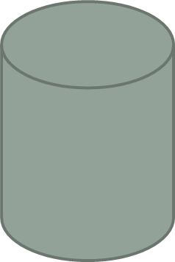
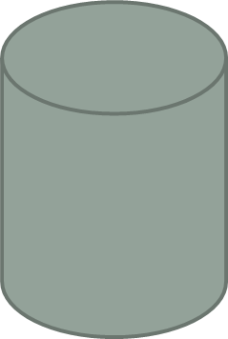


Cannula Design - Physics
Poisseulle’s Law
Flow α Radius⁴ x Pressure
Length
In other words short and fat is best

Slide 21
Management

Slide 22
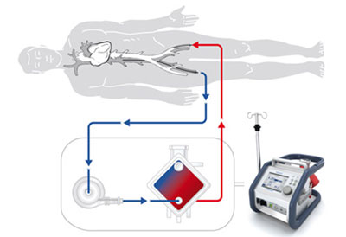
Management
ECMO
  Flow and FiO₂ governs oxygen delivery
  Sweep governs CO₂ clearance
VA flow adjusted by monitoring MVO₂ and lactate
Target value > 75%
  Beware L→ R Shunt

Slide 23
Management
Ventilation
  Low tidal volume ventilation
  Relatively little blood through the lungs
  Coronary perfusion
  Occasionally HFOV
  Nitric only for trial off ECMO
Ventilator settings:
  TV 5-6 ml/kg
  PEEP 5-10 cmH₂0
  PIP 20 cmH₂O
  RR 10 b/m
  FiO₂ <100%

Slide 24
Inotropes
Usually weaned after cannulation
Some background inotropic support beneficial to maintain contractility
IABP may also benefit
Problem with LV distension

Slide 25
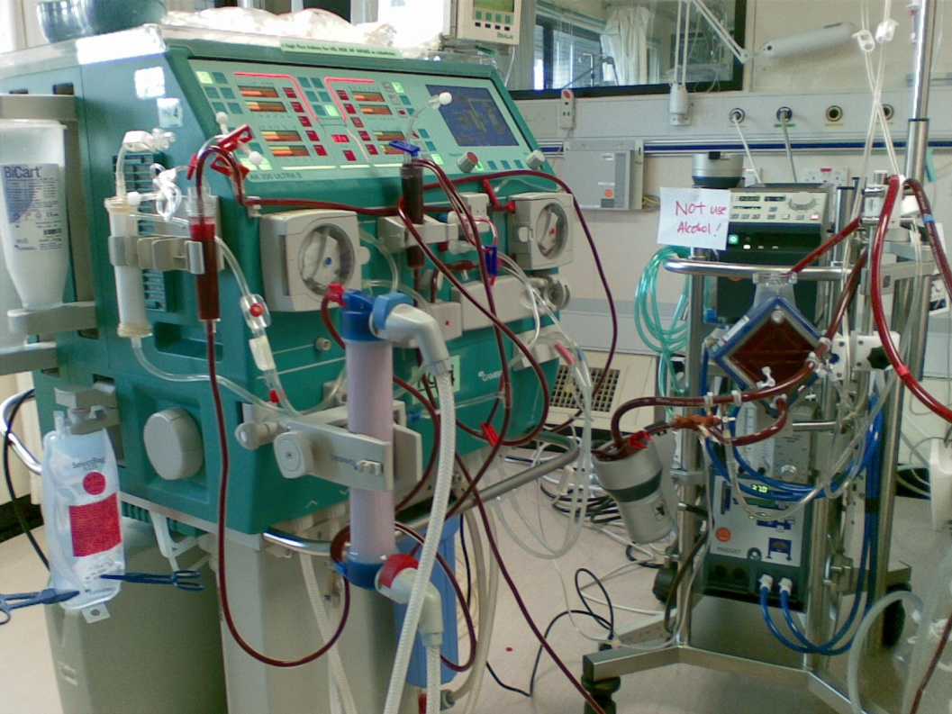
Management
Fluid balance
  Try to keep patient as dry as possible
  Aggressive diuretic therapy
  Early CVVH

Slide 26
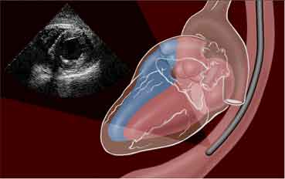
Management
Echocardiography
  Monitor cardiac function
  Distension of heart
  Consider venting or septostomy
Early Cardiac Catheter to aid decisions
Drop in ECMO flow:
  Volume dependent
  Cannula malposition
  Pneumothorax or tamponade
  Increased afterload

Slide 27
ECMO Cannulation

Slide 28
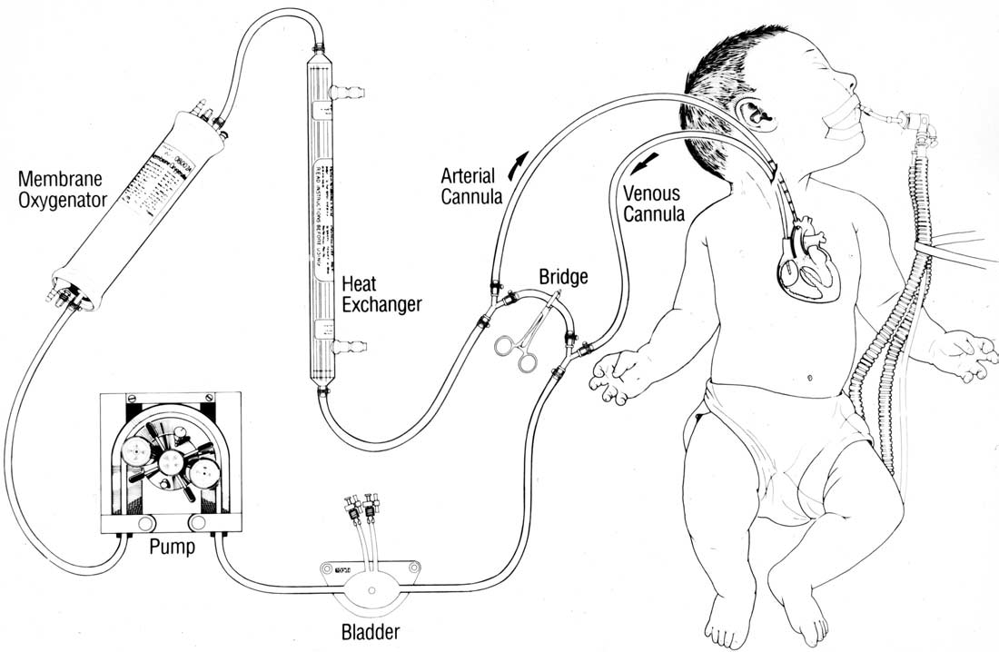
The accurate and secure location of adequately sized cannula is a pre-requisite to successful ECMO
Techniques vary depending
  Mode of ECMO
  Age of patient

Slide 29
Approximate Age | Approximate Weight | Drainage Cannula | Return Cannula
18 months | 15 kg | 17 Fr | 14 Fr
5 years | 25 kg | 21 Fr | 17 Fr
> 16 years | 60 kg | 21 Fr | 21 Fr
> 16 years | 70 kg | 28 Fr | 21 Fr
> 16 years | >100 kg | 2 x 28 Fr | 28 Fr

Slide 30
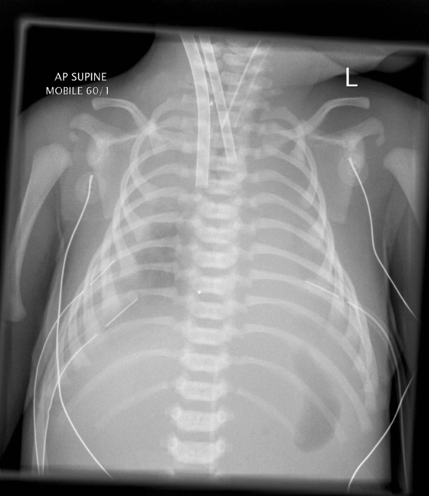
Imaging
Ultrasound
  Guide percutaneous placement
  Sizing of vessel
  Conformation of position
Fluroscopy
  Guidewire and cannula placement

Slide 31
VV Cannulation

Slide 32
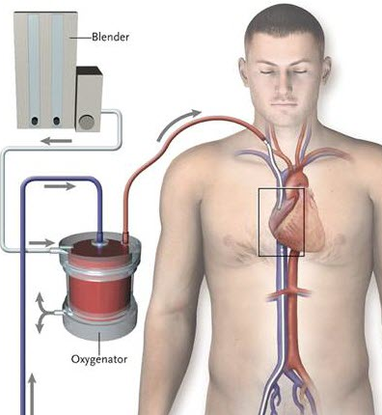
Paediatric and Adults
Percutaneous Technique
Number, size and position of cannula depends on desired flow
Vessels used
  Right internal jugular
  Right femoral
  Left femoral
  Rarely left internal jugular
HEPARIN GIVEN
Guidewire inserted
Progressive dilitation
Cannula inserted and secured

Slide 33
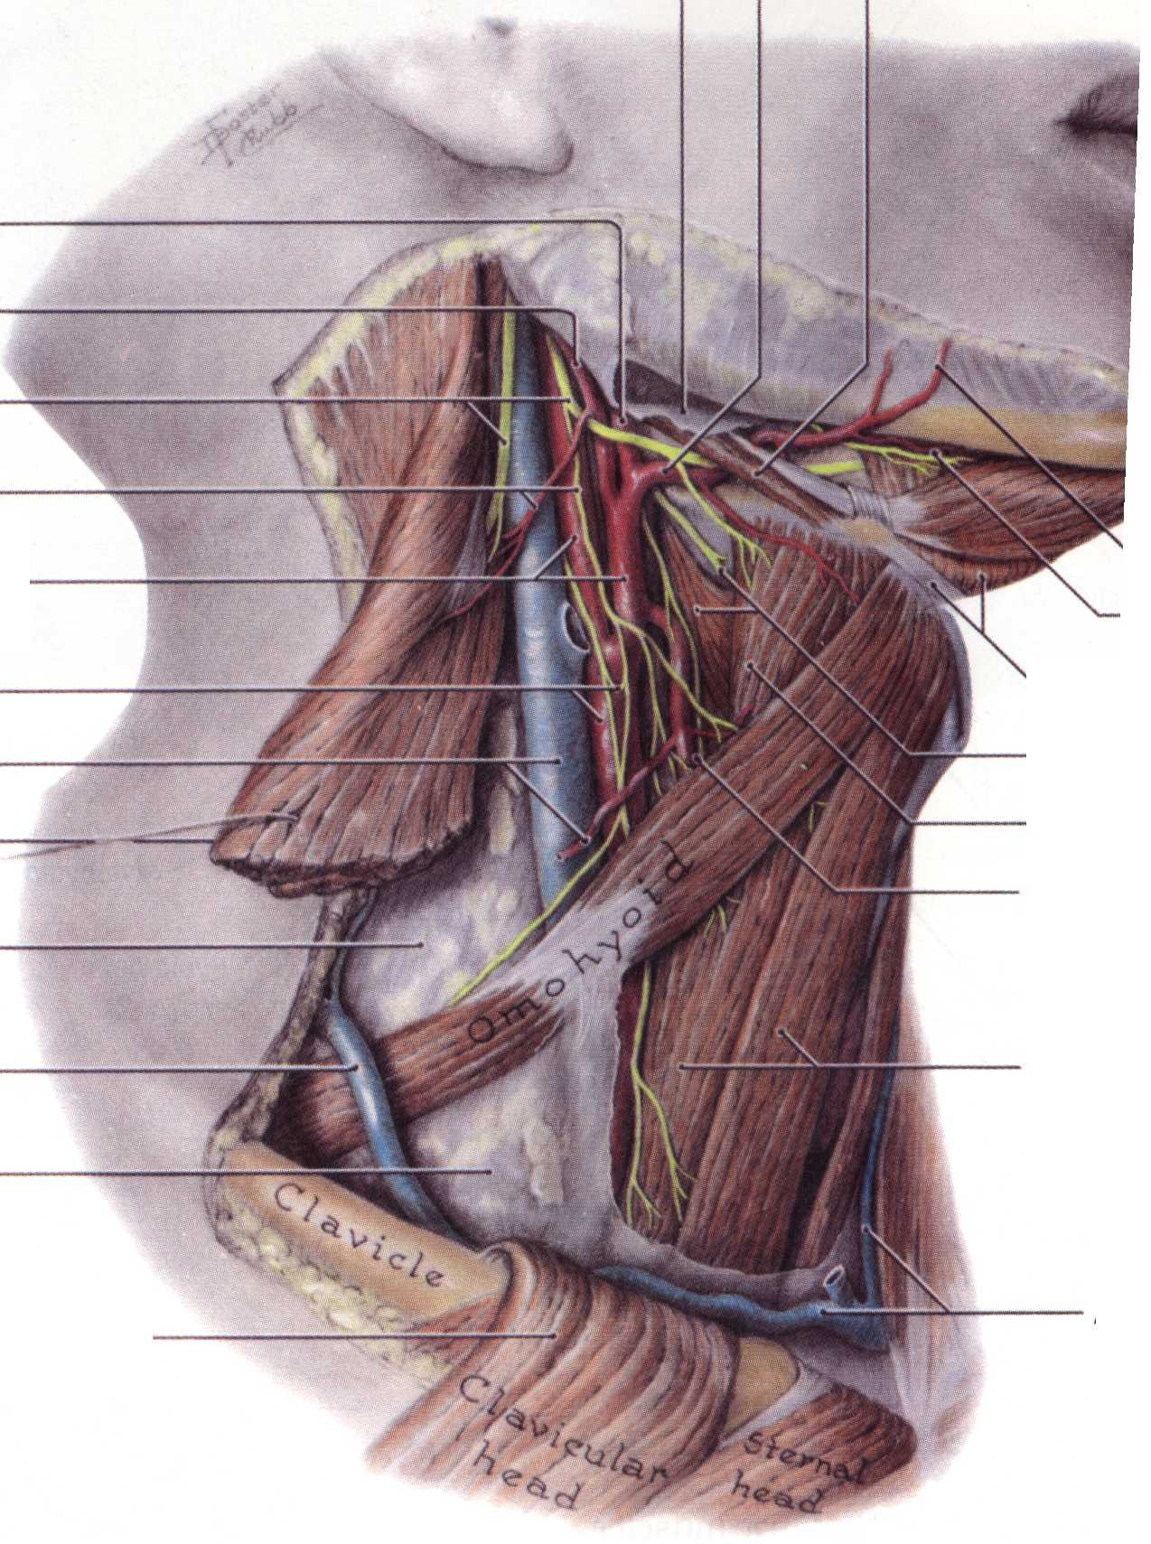
Double lumen cannulation of right internal jugular vein
Patient prepped and draped
Transverse cervical incision
Diathermy to prevent subsequent haemorrhage
Divide platysma
Retract sternomastoid laterally
Division of omohyoid may improve access

Slide 34
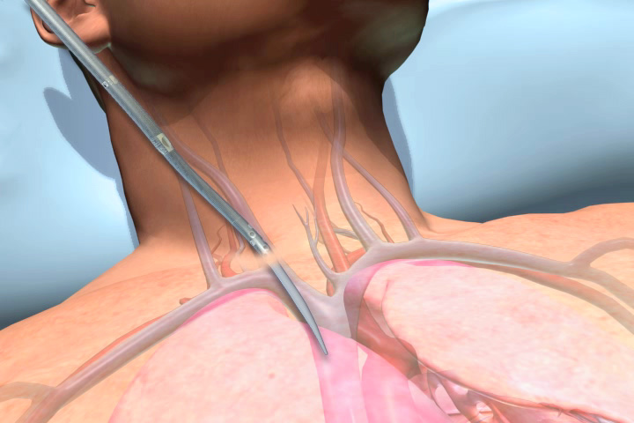

Slide 35
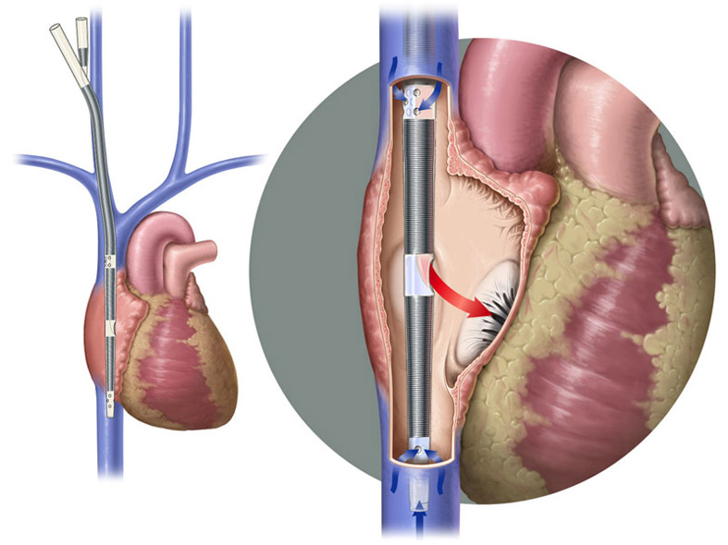

Slide 36
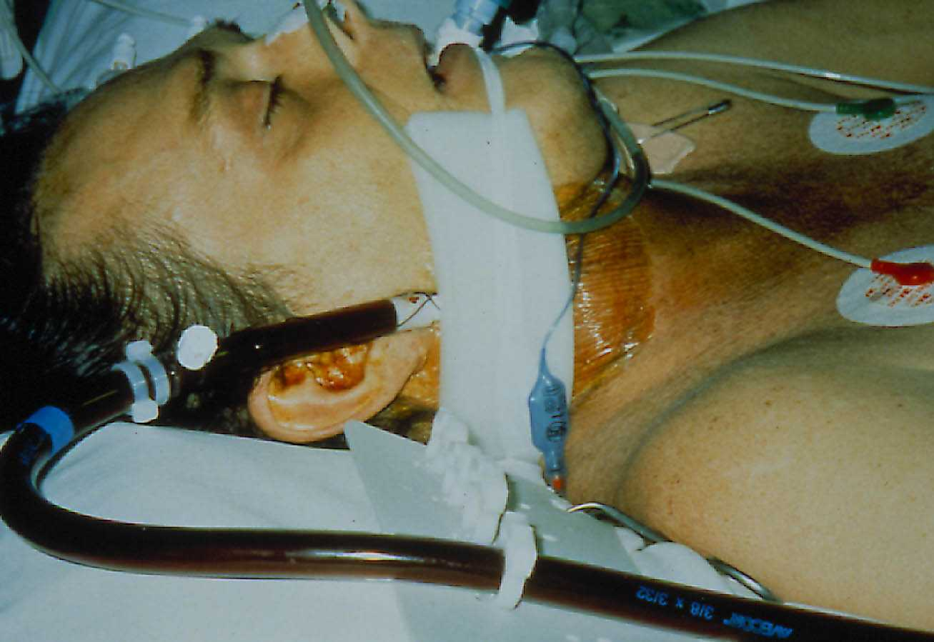

Slide 37
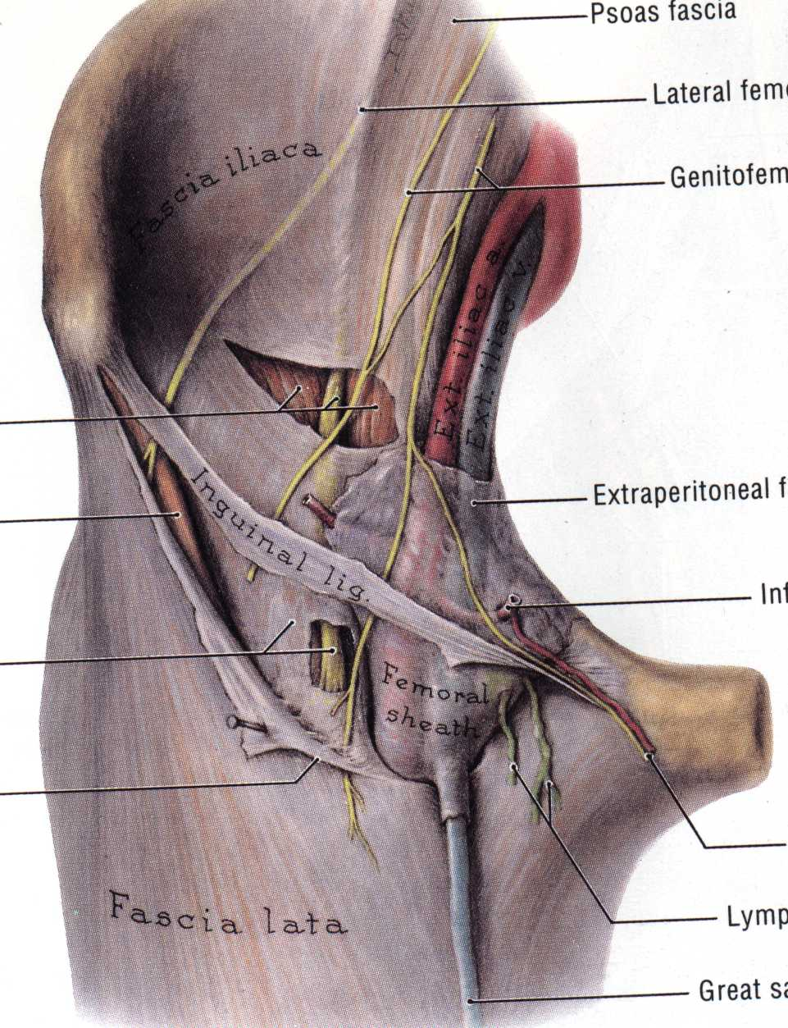

Slide 38
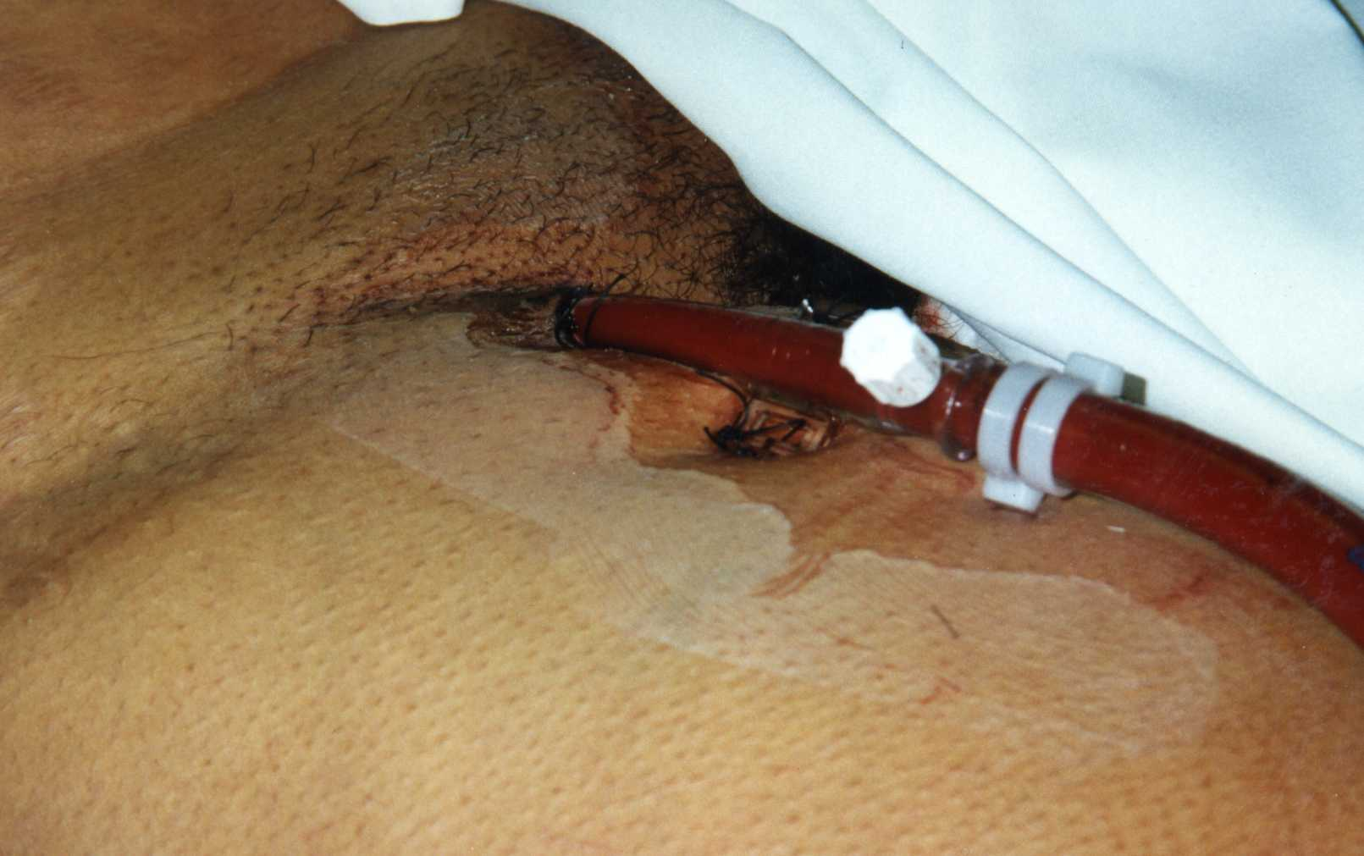

Slide 39
3 Cannula reduce recirculation
Femoral Femoral cannulation may give up to 60% re-circulation
Drainage from neck may decrease cerebral venous hypertension

Slide 40
New cannula – Avalon Elite
Improved handling
Kink and collapse resistant
Reduced re-circulation in sheep to around 2%
Potential for adult VV support through single double lumen cannula
Sizes available
  13, 16, 19, 20, 23, 27 and 31 Fr available

Slide 41
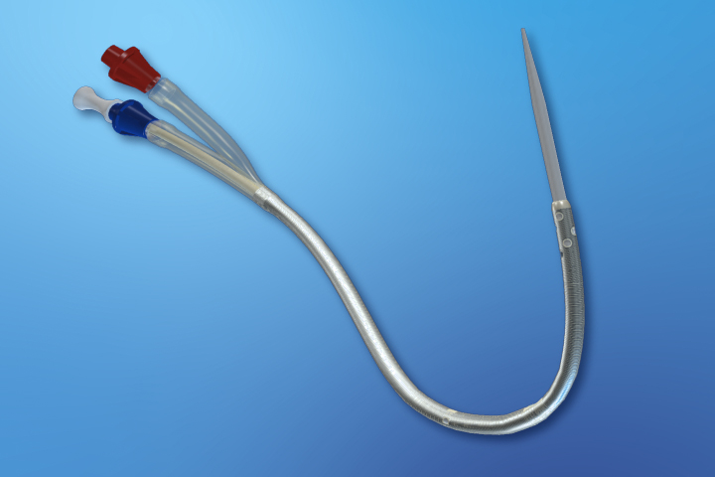

Slide 42
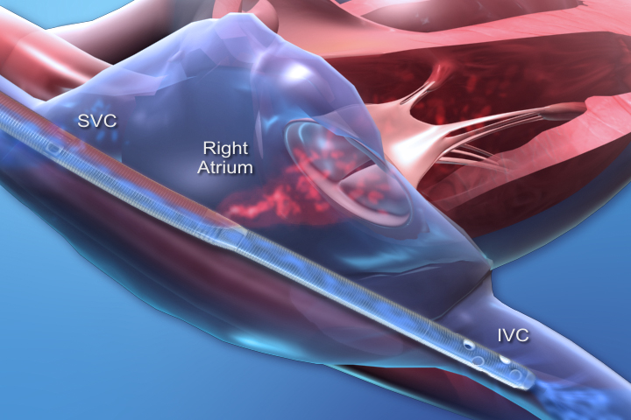

Slide 43
VA Cannulation

Slide 44
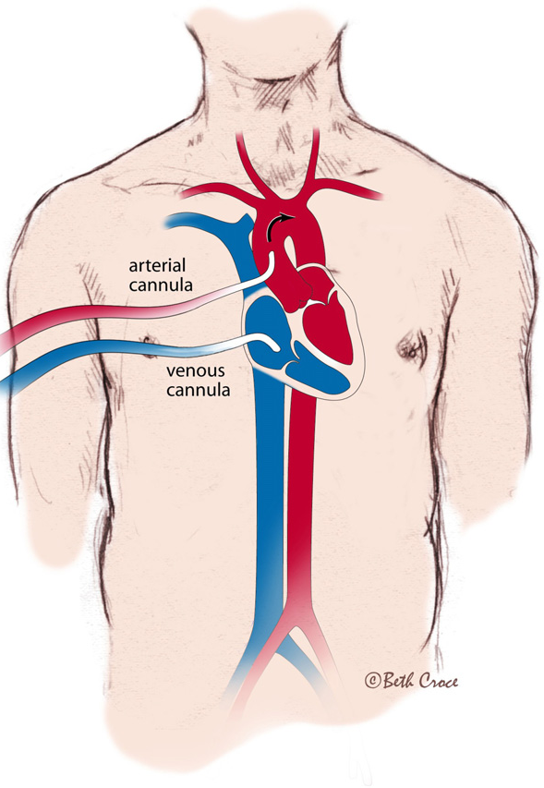
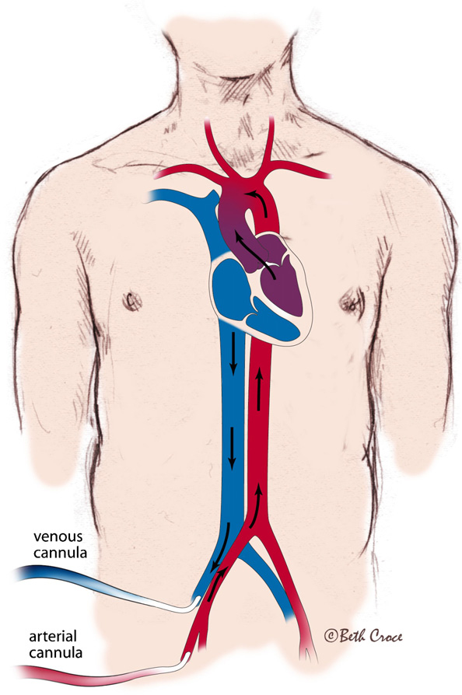
VA Cannulation
Open technique although percutaneous possible
Peripheral or trans-thoracic cannulation
Age and size dependent variation as with VV cannulation
Central ECMO cannulation
Peripheral ECMO cannulation

Slide 45
Carotid and right internal jugular vein exposed
HEPARIN GIVEN
Vessel ligated cranially
Vascular clamp applied proximally
Arrowhead incision
Clamp removed as cannula slipped into vessel
Cannula tied in proximally
Process repeated for venous cannula

Slide 46
Distal perfusion
Important consideration when end arteries cannulated
Small return cannula
Y shaped cannula
Distal cannulation
Vessel sparing cannulation

Slide 47
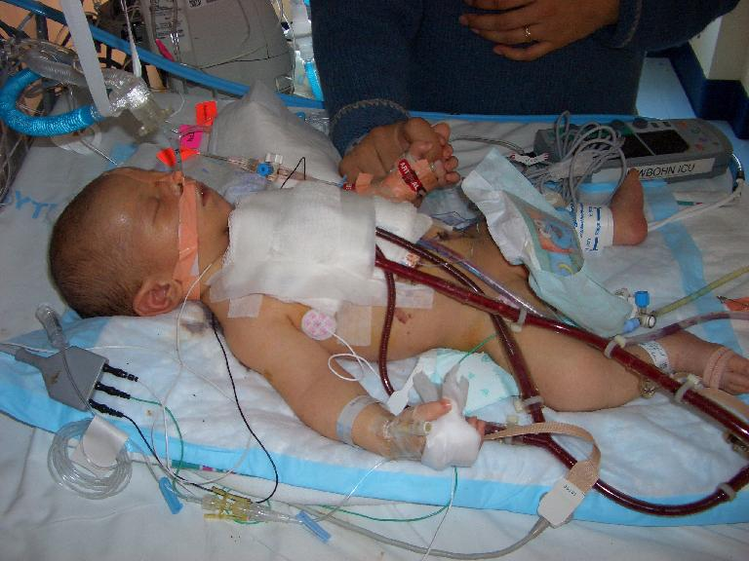
VA Trans-thoracic Cannulation
Often used for failure to wean from bypass
May provide rapid cannulation in ECPR
  Drainage right atrium
  Return aortic root
  Avoids carotid sacrifice

Slide 48
VA Trans-thoracic Cannulation
Advantages
  Requires minimal additional dissection
  Good drainage/return
  Improved cerebral perfusion
  Increased venting options
Disadvantages
  Cannula more likely to dislodge
  Increased bleeding
  Decreased respiratory function with open chest
  Infection risk

Slide 49
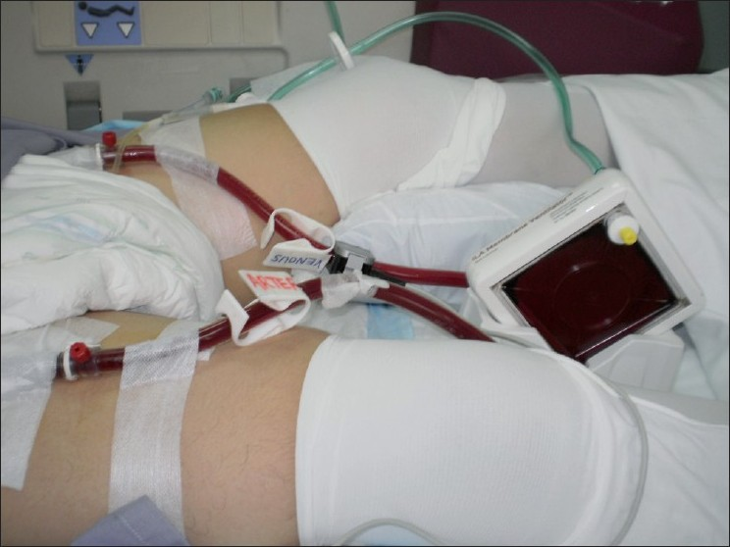
Peripheral VA Cannulation
Femoral vessels too small in non-walkers
Carotids commonly used
Venous drainage from right internal jugular vein or femoral vein
Semi-seldinger technique may reduce local vessel damage aiding decannulation

Slide 50
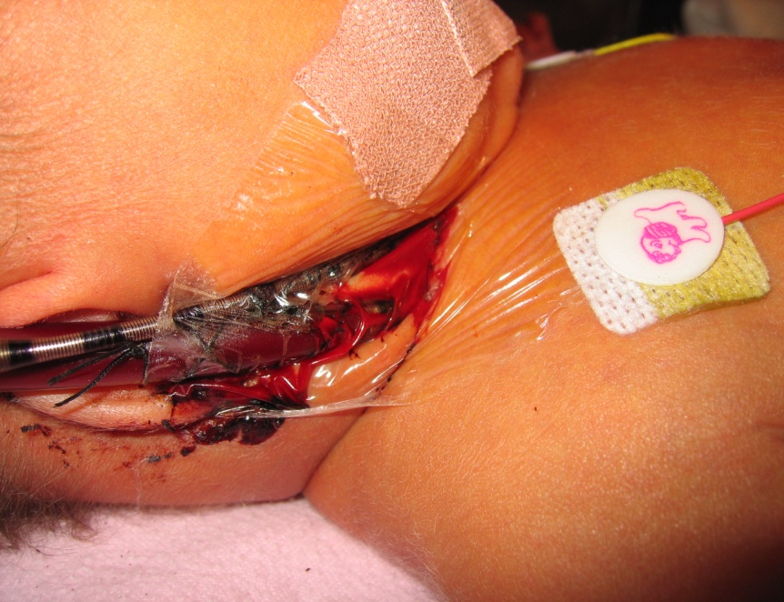
Management
Bleeding
  Be prepared to pack chest and re-explore
  Switch to peripheral cannulation
  Close chest
  Stepwise approach
Dipyramidole
Aspirin
Aprotinine
Antifibrinolytics

Slide 51
Bleeding Protocol
Correct Clotting Parameters
  Platelets >150
  INR < 1.5
  Fibrinogen >2.0
Reduce ACT to 140-160 sec
Commence Aprotonin
Reduce Heparin to 10 iu/kg/hr
Activated factor VII
Stop Heparin

Slide 52
A clinical protocol
Platelets > 150
INR < 1.5
Fibrinogen > 2
ACT 160-180
Patient Bleeding
Effective
Still Bleeding
Effective
OPERATE
APROTININ
Load: 10,000 u/kg
Infusion: 10,000 u/kg/hr
Still Bleeding
yes
Still Bleeding
no
Surgical Treatment Possible ?
HEPARIN

Slide 53
Mobile ECMO

Slide 54
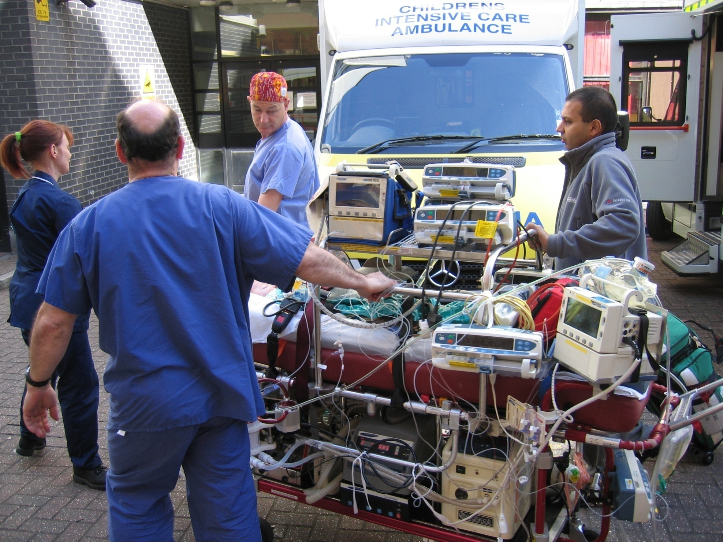

Slide 55
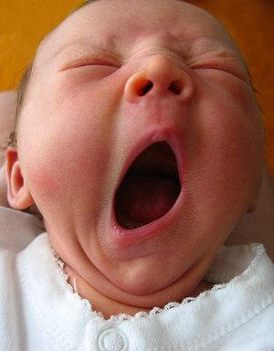

Results

Slide 56
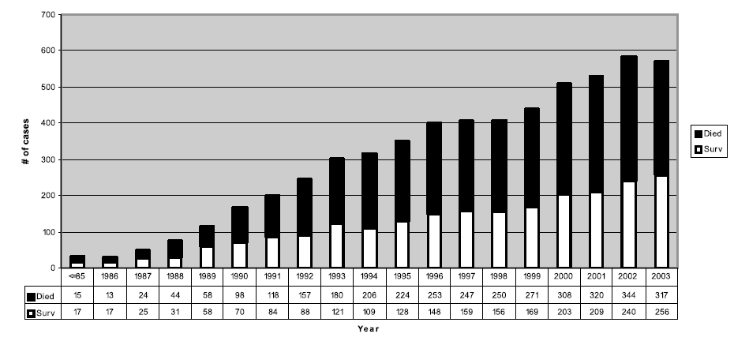
Cardiac ECMO 1986-2003 ELSO Registry Data

Slide 57
Outcome - GOS 1992-2000
‘ECMO after open heart surgery (bivent. physiology) N = 81 .
58% (47 of 81) direct from CPB to ECMO. Hospital survival was 49% (40 of 81);
late deaths in survivors (18%).
Important factors
(i) Initiation of ECMO in theatre (64% vs 29% survival)
(ii) better survival in those with reactive pulmonary hypertension.
(iii) worse outcome: circuit problems, renal support,
residual lesions, duration of ECMO.
Higher survival of patients cannulated in the operating room than in ICU
Chaturvedi et al Heart. 2004

Slide 58
Cardiac ECMO – Glenfield 2001-2006
N ~ 300 ECMO cases; N = 25 with heart disease
ECMO Px for neonatal resp failure ~75% survival at Glenfield
April 2005- 2004- 2003- 2002- 2001-
March 2006 2005 2004 2003 2002
Pre-op 4 3 2 3 2
Post-op 3 2 2 2 2
Survival 4/7 3/5 2/4 2/5 2/4

Slide 59
Cardiac ECMO – Glenfield 2001-2006
PRE- OPERATIVE ECMO N = 4/9 survived
Congenital Mitral Stenosis (1) Died
Neonatal MI (2) Died, 1 survived
Arrythmia (2) Both survived
PA–VSD catheter suite (1) Died
Scimtar Syndrome
ASD / VSD / PDA (1) Died
Viral Cardiomyopathy (2) 1 Died, 1 Tx at GOS

Slide 60
Cardiac ECMO – Glenfield 2001-2006
POST OPERATIVE ECMO N = 10/16 survived
Neonatal TGA (4) 2/4 survived Re RVOT MVR / Transplanted
TVR / TGA (1)
Interrupted Arch (2) 2/2 survived Re-do Rastelli (1) survived
Post Fallot (2) 1/2 survived
AVSD (2) 1/2 survived
Post Fontan (2) Both Died
Double Switch (1) ECMO at BCH
VSD (1) survived

Slide 61
Uni-ventricular hearts
Single centre results
19 patients placed on ECMO
  Median time 112 hours (13-240 hours)
6 VAD
50% of ECMO patients converted to VAD
Survival
  Decannulation 76%
  ITU 56%
  Discharge 44%

Slide 62

Uni-ventricular heart

