Slide 1
Prediction of post operative Lung Volumes and Function
Sidima Sonqishe
Cardiothoracic
Registrar II
University of Pretoria

Slide 2
The Importance:
To make a decision whether patient can tolerate surgery
To predict the occurrence of post operative respiratory complications and Mortality.
To assess the postoperative respiratory disability
Who should be evaluated?
All patients considered for lung reduction surgery, irrespective of age or extent of the lesion

Slide 3
Cause of decrease function and volume
STERNOTOMY:
structural alterations in thoracic chest wall mechanics and decreased blood flow to the intercostal muscles
THORACOTOMY:
10-12% decline in FEV1/FVC
impaired diaphragm activity
restricted chest wall motion
lung parynchyma resection

Slide 4
Spirometry
Simple, Inexpensive, Standardized and readily available
Measures
  FVC: Reflect lung volume
  FEV1: Reflect air flow
  MVV: Muscle strength
  FEV1 being the “Gold Standard” test used for predicting post-op lung function.
Values vary depending on age, height, gender and race

Slide 5
Pulmonary function/volume test
Spirometry
Diffusion Capacity
Arterial Blood Gas Analysis
Ventilation perfusion s (V/Q scan)
Quantitative CT scan
Cardiopulmonary exercise testing

Slide 6
Spirometry: FEV1
Pre-op FEV1 <60% of predicted is the strongest predictor of post-operative complication.
ACCP & BTS Guidelines
FEV1 > 2 L: Tolerate Pneumonectomy
FEV1 > 1-1.5 L: Tolerate lobectomy
Post-op. Pulmonary complication in patients with FEV1<2L was 40% VS 19% for those with FEV1 >2L
(Stephan MK et al. chest 200;118:1263–1270)

Slide 7
Spirometry: FEV1
BTS Guidelines compiled on data from > 2000 patients in 3 large series
Mortality Rate < 5%
FEV1 >1.5L for Lobectomy
FEV1> 2L or >80% predicted for pneumonectomy
(Beckles MA et al., CHEST 2003; 123:105S-114S)

Slide 8
Diffusion Capacity: (DLCO)
Measures amount of C02 taken up by the patient in unit time ( ml.kPa-1.min-1)
Gross estimation of alveolar/ capillary function
Equally significant predictor of post operative complications as for FEV1( actual or % of predicted)
DLCO < 60% predicted: higher mortality
< 80% predicted Higher pulmonary Complications.
DLCO & FEV1 should be viewed as complementary physiological test
(Beckles MA et al., CHEST 2003; 123:105S-114S)

Slide 9
Arterial Blood Gas
PaCO2 >45mmHg doesn’t appear to be an independent predictor of poor outcome.
Pre-op hypoxaemia: O2 Saturation<90% and desaturation >4% with exercise have all been associated with an increased risk of complications.

Slide 10
2 Methods to predict post op Pulmonary function
Basic Segmental Method
  Spirometry – FEV1/FVC
  DLCO
Regional Method

Slide 11
Segment Methods
Postoperative pulmonary function (Ppo) is predicted by:
  calculating the portion of all bronchopulmonary segments (BPS) that will remain after resection,
  then multiplying this portion by the preoperative lung function value.
NOTE: Normally 19 Broncho Pulmonary Segments (BPS) , 10 R & 9 L. Right Lung (3/2/5): 55 % & Left Lung(3/2/4): 45%
PpoFEV1 = preopFEV1 x (remaining segments/19)
(Bolliger and colleagues)
E.g: Right upper lobe lobectomy: 3 segments to be removed in a patient with a pre-op FEV1 of 1,6L which is 80% of predicted normal:
PPO-FEV1 = 1.6L x 16/19 = 1.35L
PPO-FEV1 % = 80% x 16/19 = 67%
The same form of ppo calculation can be used for FEV1, FVC, DLCO. Both actual value and percentage of predicted.

Slide 12
Segment Methods: Pitfalls
Assumes all segments contribute equally
Doesn’t consider:
  Tumor
  Known/ suspected endobronchial obstruction
  Central lung mass
  History of prior lung surgery

Slide 13
Regional method
Quantitative Ventilation/Perfusion (V/Q) scan
Quantitative CT scan

Slide 14
Quantitative Ventilation-Perfusion Scan
Calculates the percentage function of each lung
Readily available with negligible risk
Highly accurate in the prediction of postoperative pulmonary function following resection
Inhaled 133Xe (ventilation) & IV 99Tc (perfusion)
% of radioactivity contributed by each lung correlates with the contribution of the function of that lung

Slide 15
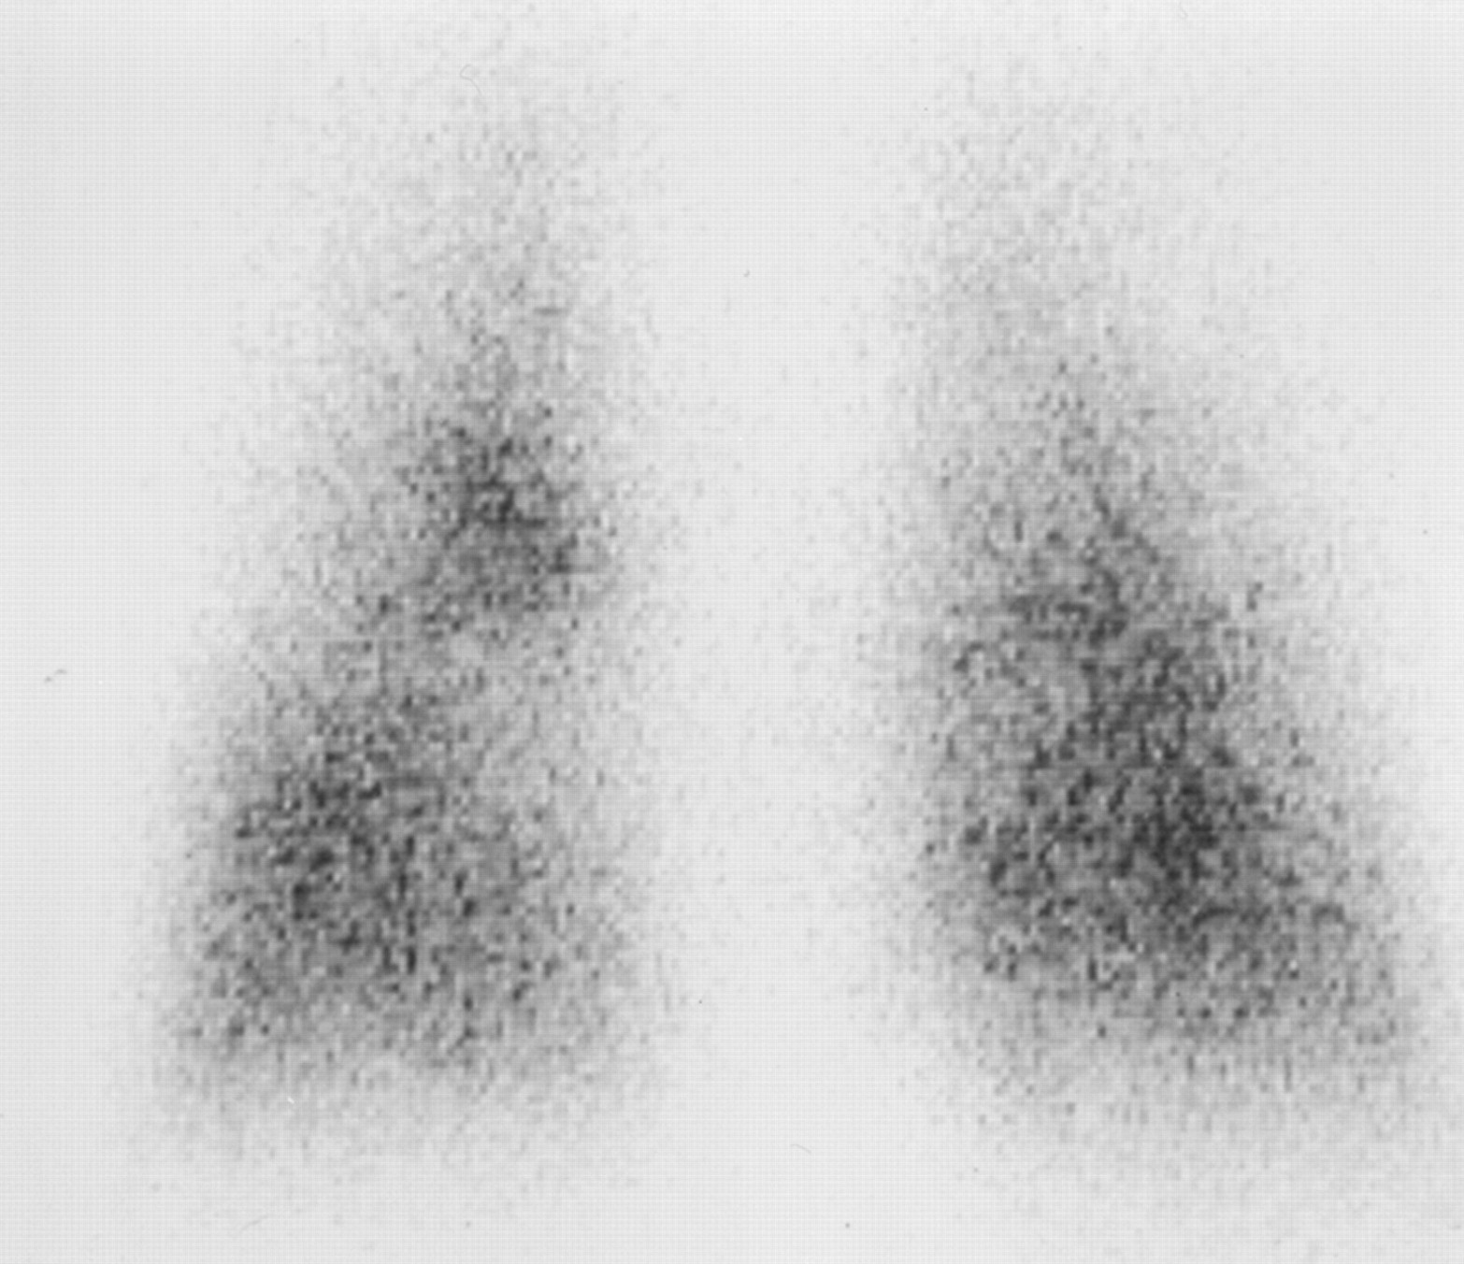

Fractional lung function: V/Q Scan.
Wu M et al. AJR 2002;178:667-672
©2002 by American Roentgen Ray Society
Notes:
—Assessment of fractional lung function by quantitative CT versus perfusion scintigraphy. Preoperative forced expiratory volume in 1 sec (FEV1) in 73-year-old man with chronic dyspnoea with recent haemoptysis for 2 months was 1.21 L. FEV1 after left-sided pneumonectomy was 0.81 L. Loss of FEV1 was 33%, close to prediction by quantitative CT. Perfusion scintigram (posterior image) of left/right lung shows functional distribution was 48% versus 52%. Predicted FEV1 loss was 48%.

Slide 16
V/Q Scan: Calculations
Calculation 1:
PPO FEV1 = Preop.FEV1 X % of radioactivity contributed by non-operated lung
Calculation 2:
Expected loss of function :
Preop.FEV1 X % of function of affected lung
No. of segments in lobe to be resected
X __________________________________
Total No. of segments in the whole lung
Juhl formula
PPO.FEV1 = preop.FEV1 x (1-[SX 5.25]/100)
S=No BPS involved
(JuhlB, Frost B acta anaesthesiol Scand 1975; 49:8-13)

Slide 17
Quantitative CT
The volume of lung with attenuation between -500 and -910 Hounsfield units (H) makes up the estimated functional lung volume.
The Regional functional lung volume (RVF) in the area to be resected is calculated as a portion of the total functional lung volume.
Predicted postoperative lung function has correlated as well as or even better than that calculated by V/Q scan.
Total lung volume and functional lung volume of the lung or lobe to be resected is calculated by multiplying the area of each functionally relevant lung tissue by the slice thickness
Advantage:
Excludes Tumour, post obstructive atelectasis, fibrosis, emphysema
Calculation:
PpoFEV1 = preop.FEV1 x (1-RFV/total functional lung volume).
This is done for each representative slice.

Slide 18
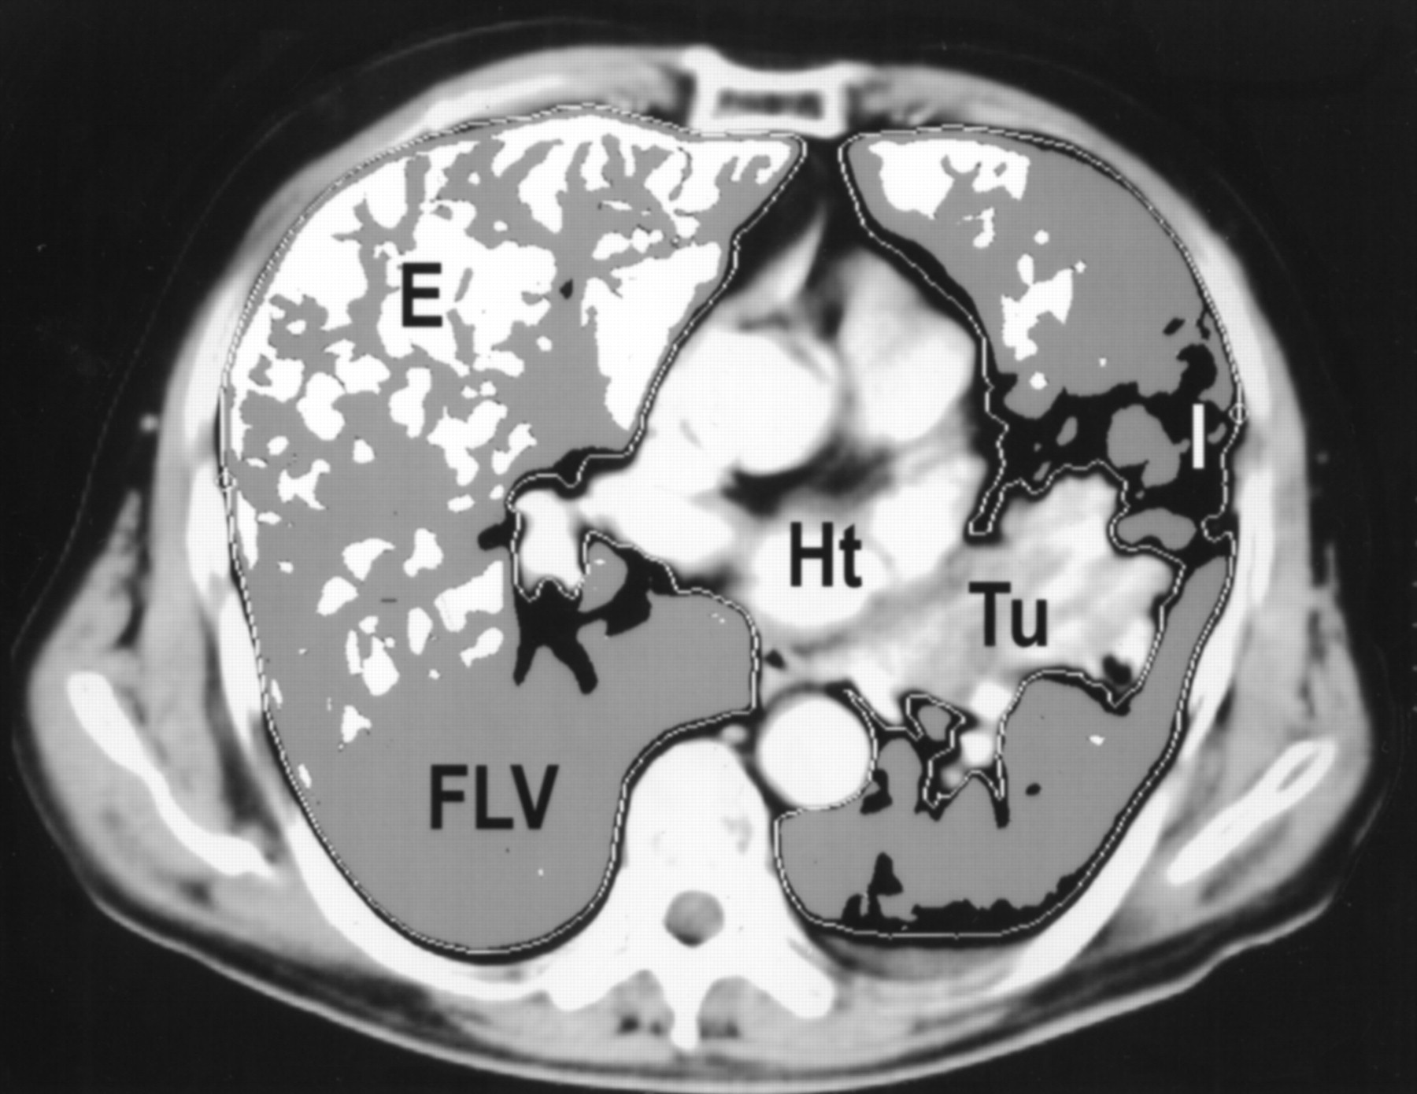
Quantitative CT
Lung parenchyma outlined from mediastinum and chest wall by default range of -200 and -1,024 H (white-line contours).
Tumour (Tu) was also excluded.
After applying dual threshold (-500&-910H, three segments in lung parenchyma were generated.
White area below -910 H denoted emphysema (E), black area above -500 H denoted infiltration and atelectasis (I)
Gray area between -500 and -910 H denoted functional lung volume (FLV). HT = heart.

Slide 19
Predictors of morbidity and mortality post lung reduction surgery
PPO-FEV1 of 0.7-0.8L is advisable after lung resection.
PPO FEV1 < 40% of predicted – 50% mortality
PPOFEV1 > 40% of predicted – 50% mortality
These values are echoed using DLCO as well
The product of pp0.FEV1% and ppo.DLCO% < 1650% = higher mortality
Therefore ppoFEV1 < 40% - further evaluation (CPET)

Slide 20
Exercise Capability
Exercise testing stresses the cardiopulmonary and Oxygen delivery systems, almost accurately indicating cardiopulmonary reserve.
Test includes the number of flight of stairs that can be taken without stopping.
Two more standardised tests can be used:
6 Minute Walk: walking as far as possible in 6 minutes, using a 30m long, flat, straight corridor.
Shuttle Walk Test: patient walks back and forth around 2 markers in increasing speed.
Patients were considered suitable for
  lobectomy: 3 flights of stairs = FEV1 > 1.7L
  Pneumonectomy: 5Flights of stairs = FEV1 > 2L

Slide 21
CPET : VO2max
Measurement of inhaled gases
Oxygen uptake (v02)
Maximal V02 (V02max)
Predicted VO2 = 5.8 x wt(kg) + 151 +10.1(W of workload)
Measures aerobic capacity of the peripheral tissues
VO2 max >1L/min = no mortality
VO2 max < 1L/min = 100% mortality
VO2 max <15mL/kg/min = 100% complication rate
VO2 max 15-20mL/kg/min = 66% complication rate
VO2 max > 20mL/kg/min = 10%

Slide 22
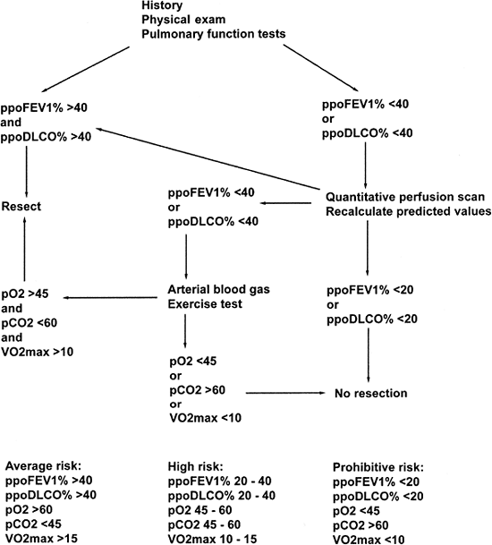
Algorhythm of Assessment:

Slide 23
Discussion

