Slide 1
A Guide to Exams
Prof Anthony Linegar
Hannes Meyer Registrar symposium
July 2015

Slide 2
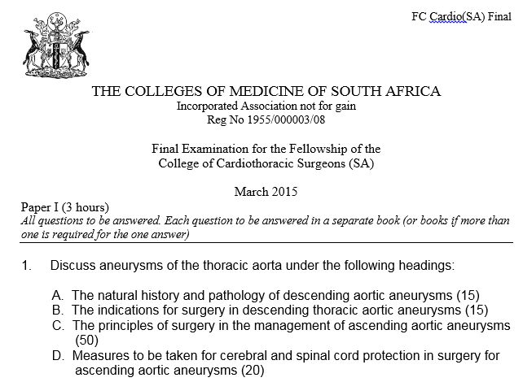

Slide 3
Why do 55% fail the writtens?
Too little theory
Not sticking to the question (Surgical management means just that)
Word count (too few does not give you a chance and too many wastes time)
Most cardiac questions can be anticipated and pre-prepared
Thoracic questions tend to require more evidence of insight into decision making
Differentiate between factual and insight questions
Poor planning in preparational studies, not engaging with subject matter to understand level of debate, insufficient reading.
Must show evidence of insight (principles of surgery, problems to be anticipated, outcome measures, predictors of poor outcome, pros and cons of a specific approach.

Slide 4
Writing style
Hand writing
Logical set out of the answer
Mind map
Stick to the question
Use headings in your answer
Use more bullets and less essay
Cross outs mean it may not be marked
Algorithm; Tabulate; List; Compare; Outcome measures; Predictors of outcome;

Slide 5
Spots (Moet Kennis) Pre-worked answers
Aneurysms
Coronaries
Myocardial protection
Theory of bypass
Valve theory
PE
Rupture oesophagus
Empyema (Chronic)
Major haemoptysis
Inflammatory lung disease
Lung cancer (staging, s/e, neo/adj, palliation)
Oesophagus cancer (staging, s/e, neo/adj, palliation)
Anterior mediastinal mass
Interstitial lung disease

Slide 6
Examples
1. Inflammatory lung disease:
A. Discuss the various surgical options in the operative management of hydatid cysts of the lung. (30)
B. Discuss the management of pulmonary air leaks in patients with pulmonary tuberculosis. (30)
C. Discuss the factors that might predict poor outcomes following lung resection for post tuberculosis destroyed lung. (40)

Slide 7
A. Discuss the various surgical options in the operative management of hydatid cysts of the lung. (30)
The principles are:
A. Removal of the endocyst with its contents.
Management of the cavity (bronchial openings and air leaks, residual space, haemostasis).
Save lung where ever possible.
Discussion points:
1. Pericyst.
2. Hypertonic saline or iodine soaked swabs.
3. Medical therapy and rupture.
4. Capitonnage (atelectasis versus air leaks and empyema).
Problems:
Bilateral cysts – serial surgery; which side 1st
Massive cyst
Radical or conservative surgery
Complicated cyst.
Anaphyllaxis.
Endobronchial rupture

Slide 8
Operative options:
Ennucleate the intact cyst +/- cappitonnage. Ugon 1952. Barrett. Peripheral. 5cm. Popular.
Cystostomy and evacuate the endocyst and contents +/- cappitonnage (Figuera). Recurrence, spill, >5cm.
Pericystectomy and cappitonage. Perez-Fontana technique 1953.
4. Lung resection. A cyst occupying more than 50% of the lobe is considered an indication for lobectomy. Pneumonectomy is rarely needed. Segmental resections or wedge excision is a reasonable option for smaller peripherally situated lesions.

Slide 9
B. Discuss the management of pulmonary air leaks in patients with pulmonary tuberculosis. (30)
Introduction:
Common problem. Mx depends on clinical context.
Spontaneous pneumothorax +/- empyema; TB +/- ; HIV +/- ; Sick +/- ; DRTB +/-
Principles of approach:
Approach 1 aims at closure of air leak
Approach 2 ignores the parenchyma and aims at adequate drainage of the pleural space (temporary or permanent).
Both approaches require Mx of the patient’s underlying morbidities (TB, HIV, nutrition, diabetes, etc)
Management decisions based on a matrix of these variables.
Make a table that will help you make decisions.

Slide 10
C. Discuss the factors that might predict poor outcomes following lung resection for post tuberculosis destroyed lung. (40)
Introduction:
No evidence based publications. Data comes from clinical experience and case series in the literature.
Poor outcomes defined as:
Mortality
Bronchus rupture
Empyema
Bleeding requiring re-opening and large blood Tx
Factors associated with each of these:
Mortality (Major vessel bleed intraop and postop – technique; physiological demise – selection)
Etc…

Slide 11
How to prepare for the exam
Read the theory and the literature (your consultant will guide you as to the controversies)
Prepare answers to key questions (management of haemoptysis, complications of MI, surgery for ischaemic MR)
Practice writing out answers to past papers
Get your consultant to mark these
Prepare long in advance
Make notes as you go and add to them as your develop.

