Slide 1
Surgery in advanced pulmonary arterial hypertension and Eisenmenger’s syndrome
Dr JH Honing

Slide 2
Introduction
➢Significant proportion of CHD population presents with PAH in developing countries
➢Varying surgical outcomes reported in these patients with elevated PVR - response to surgery is often difficult to predict
➢Surgical repair justified if PVR regresses or remains static postoperatively with resulting increase in long-term survival & improvement in quality of life

Slide 3
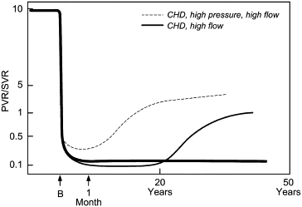
Time course of change in the ratio of pulmonary to systemic vascular resistance with: a. normal pulmonary circulation (thick line); b. with high pressure, high flow congenital cardiac structural lesion (e.g., ventricular septal defect) (dotted line), and c. high flow congenital cardiac lesion (e.g., atrial septal defect) (thin line). B = birth. The thick line depicts the normal pattern of fall in pulmonary vascular resistance.
T.Kulik et al: Pulmonary arterial hypertension associated with congenital heart disease, Prog Pediatr Cardiol (2009)

Slide 4
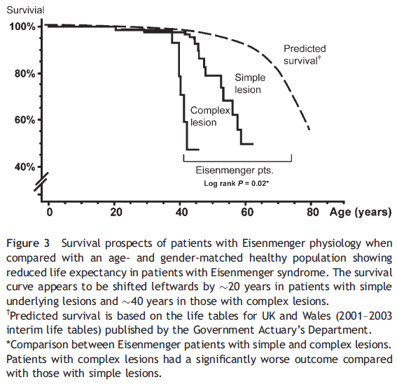
Natural history of Eisenmenger’s syndrome
Diller et all. Presentation, survival, prospects, and predictors of death in Eisenmenger’s syndrome: a combined retrospective and case-control study. European Heart Journal 2006

Slide 5
Eisenmenger’s syndrome
4% of individuals with Congenital heart diseases are reported to have Eisenmenger’s syndrome apposed to 8% previously.
Diller GP et al. Circulation 2007

Slide 6
Predictors of Mortality in PH
Poor NYHA (Class IV) functional status at diagnosis
Poor 6 minute walk results
Elevated right atrial pressure
Higher pulmonary artery pressure
Depressed cardiac output
Absence of response to vasodilators
Age

Slide 7
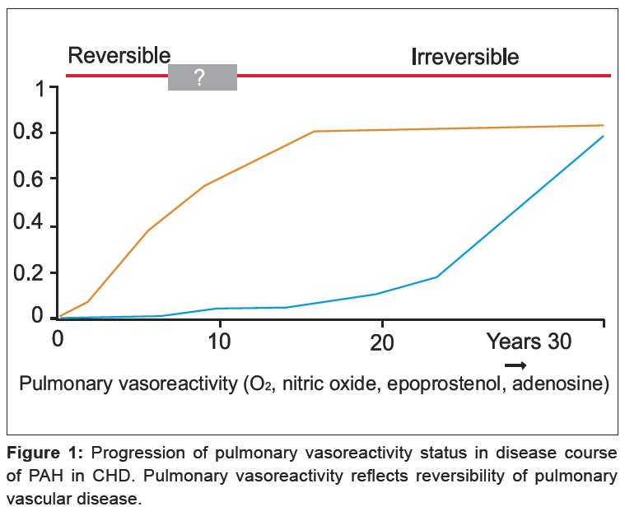
Van Loon et al. PVRI review 2009

Slide 8
Age
Rabinovitch et al. age < 9months
Ikawa et al. Age < 1yr
Few patients age 1-2yrs have severely elevated PVR and they tend to reverse remodel after surgical repair.
Older patients with severely elevated PVR are at risk of sustained pulmonary hypertension or a progressive increase in PVR after repair.
Kulik et al. Progress in Pediatric Cardiology 2009

Slide 9
Acute pulmonary vasoreactivity test and operability.
Hemodynamics:
  Baseline PVR < 6 wood units.m² with resistance ratio of < 0.3 : No vasoreactivity test needed.
  Baseline PVR 6-9 wood units.m² with resistance ratio of 0.3-0.5 : Vasoreactivity tests :
    A decrease of 20% in the index of PVR.
    A decrease of 20% in the ratio of pulmonary to systemic vascular resistance.
    A final PVR index of < 6 wood units.m²
    A final ratio of resistance of < 0.3.
Lopes et al. Cardiol Young 2009

Slide 10
Balloon occlusion pulmonary wedge angiography.
Unreliable in presence of previous pulmonary artery banding or with post-stenotic dilation of the central pulmonary arteries.
Most accurate in children < 2yr
Rabinovich et al. Cardiol young 2009

Slide 11
Lung Biopsy
Right upper lobe – 2x1x1 cm of inflated lung
In any age, the presence of medial hypertrophy and extension of muscle into distal vessels, is always associated with return to normal hemodynamics
Children 6months to 2yrs, loss of vessels and neointimal formation resulted in a 50% chance of regression of elevated pulmonary vascular resistance
Older children with plexiform lesions, persistent and progressive elevation in pulmonary vascular resistance is expected.
Rabinovich et al. Cardiol young 2009

Slide 12
Lung biopsy cont.
Irreversible disease :
  Severe concentric laminar intimal fibrosis, angiomatiod dilated lesions, fibrinoid necrosis and plexiform lesions are considered advanced vascular lesions and irreversible disease.
Pathologist

Slide 13
Long-term outcome of patients operated for large ventricular septal defects with increased pulmonary vascular resistance
Kannan et al, Indian Heart j 2003
Cohort of patients with non-restrictive VSD and PVR > 6 WU.m2
38 patients, age 6 months to 27 years ( Median 7.5 years )
Operated between 1985 and 1996
Pre-op hemodynamic variables:
  PVR 7.6 _+ 1.8 wood’s units
  Qp:Qs 1.9_+ 0.48
  PVR/SVR 0.41 +_ 0.12
Mean follow-up : 8.7yrs
30 patients (80 %) had a good outcome
8 patients (20%) had a poor outcome
  5 immediate post-op deaths, 1 late death
  2 surviving with persistent severe PH

Slide 14
Pulmonary artery banding
Experimental work on rats suggests that the pathologically remodeled pulmonary circulation can undergo reverse remodeling if the PA pressures in reduced.
  O’Blenes et al. J Thorac Cardiovasc Surg 2001
Wagenvoort et al. compared the morphologic changes in lung biopsy specimens of patients with congenital heart disease with a shunt and pulmonary vascular disease before and after banding of the pulmonary arteries. They were able to demonstrate regression of the medial hypertrophy and cellular intimal proliferation.
  Wagenvoort et al. j Thorac Cardiovasc Surg 1984
Batista et al. published a case report in 1997 of a 19yr old patient with severe pulmonary hypertension, ASD and VSD, who responded to PA banding with regression of Pulmonary hypertension.
  Batista et al. Arq Bras Cardiol 1997

Slide 15
Pulmonary artery banding
Khan et al. Congenit Heart Dis. 2006
4 patients with large left-to-right, post-tricuspid valve shunts and hemodynamics unfavorable for conventional surgical therapy were subjected to PAB placement.
2 patients responded with dramatic decrease in PVR.
1 late death presumably related to pulmonary hypertension.

Slide 16
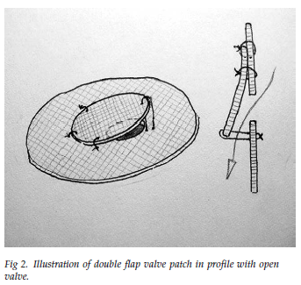
Double flap patch VSD closure
Novick et al.
Fenestrated flap valve double patch closure of VSD in high risk patients.
PVR : 10.5 +-4.9 wood units
Early mortality: 7 of 91 (7.7% )
Late deaths: 7
Post-op echo : 43pts
  Mean PA pressure > 25mmHg : 26 Pts
  ( 8 Pts Right to Left shunt )
  Mean PA pressure < 25mmHg : 17 Pts
Novick et al. Ann Thorac Surg 2005

Slide 17
Advanced pulmonary arterial hypertension therapy.
Repair of ASD with Eisenmenger’s syndrome after long-term Sildenafil therapy.
Kim et al Ann Thorac Surg 2010
  41yr female – Secundum ASD
  NYHA class III and cyanosis ( Sats = 82% )
  PVRI 25 WU.m² with poor response to O₂
  Sildenafil for 2yrs : No cyanosis
  PVRI 12.63
  Partial balloon occlusion
  Surgical repair.
  After 4yrs of Sildenafil – assymptomatic.

Slide 18
Advanced pulmonary arterial hypertension therapy.
Might have the potential to produce a reduction in pulmonary vascular resistance, lowering perioperative risks and possibly widening the range of cases amenable to surgical repair
Dimopoulos et al. International journal of cardiology 2008

Slide 19
The actuarial survival analysis to the surgical and non-surgical therapy regimes for congenital heart disease with severe pulmonary hypertension.
Gan et al. Zhonghua yi xue za zhi.2010
February 1990 to July 2008.
1212 cases (Surgical 915 and non-surgical 297)
Follow-up 97+/-57months
44 late death in surgical group and 65 in non-surgical.
Results : In the 245 propensity score matched pairs, the actuarial survival of the surgical group was significantly higher than that of the non-surgical group when PVR was less than 15WU or Qp/Qs was larger than 1.25(P=0.000 and 0.001), but the actuarial survival between the two groups had no difference when PVR was larger than 15 WU or Qp/Qs was less than 1.25 ( P=0.596 and 0.424 )

Slide 20
Noninvasive markers of irreversibility.
Experimental
Circulating endothelial cells in the peripheral blood was identified as a potential biomarker for irreversibility
Strong association of irreversibility and impaired endothelial cell apoptosis
Smadja et al. Circulation 2009

Slide 21
Transplant surgery
Technology have been available for more than 20 years , but there are some major limitations!
  eg. Lung transplant for Eisenmenger's syndrome have the highest mortality of all lung transplant patients.

Slide 22
Transplant surgery
Patients with Eisenmenger’s syndrome have a better event free survival compared to PAH of other etiologies.
Dimopoulos et al : 5yr survival for patients with Eisenmenger’s syndrome on advanced therapy was 77%
5yr survival for HLT or LT in Eisenmenger's syndrome is 51-54%
Last resort if all other modalities have failed!!

Slide 23
Local experience with PVD in CHD
➢ Cohort of patients with non-restrictive post-TV shunts & PVRI > 6,0 Wood U•m²
16 patients operated between 2001 & 2009:
⬥ age: 1,5 - 23,0 yrs (median 6,4 yrs)
⬥ diagnosis:  VSD (n = 10)
☞ Complete AVSD (n = 4)
☞ PDA (n = 1)
☞ AORPA (n = 1)
➢ 10 patients not offered surgery due to diagnosis of Eisenmenger syn

Slide 24
Local experience (cont)
Pre-op haemodynamic variables:
⬥ mPAp: 69 mmHg (range: 30 - 118)
⬥ PVRI: 6,6 Wood U•m² (range: 6,1 - 69,6)
⬥ Qp:Qs: 1,6 (range: 0,4 - 2,5)
⬥ Rp:Rs: 0,5 (range: 0,2 - 3,1)
⬥ Reversibility of PVR on O₂: 7 patients
Surgical procedures:
⬥ Initial PAB in 3 patients
☞ 1 pt - progression of PVD - debanded
☞ 2 pts - regression of PVD - full correction
⬥ Full correction in 15 patients

Slide 25
Local experience (cont)
Operative mortality: 0%
Major morbidity: 1 x ARF
LOS: ICU & total hospital stay significantly longer than in group without PVD
Follow-up: 25 months (range: 2 - 96):
⬥ no intermediate deaths (1 pt lost to fu)
⬥ 8 pts (54%) - marked regression of PAH & improvement in clinical condition
⬥ 5 pts (33%) - clinical improvement but retained some degree of PAH
⬥ 2 pts (13%) - progression of PAH despite surgery
Notes:
LOS = length of stay

Slide 26
Local experience: Conclusions
Pts operated on with acceptable mortality although resource utilization is increased
Close follow-up of intermediate outcome group required
If post operative PAH progresses patients can be reverted back to Eisenmenger physiology by:
⬥ atrial septectomy
⬥ creation of Potts shunt

Slide 27
Summary
Pulmonary vascular disease secondary to congenital heart disease is a preventable illness, especially if repair is offered to children less than 2yrs of age.
Every effort must be made to identify children with CHD early and appropriate surgical correction offered.

Slide 28
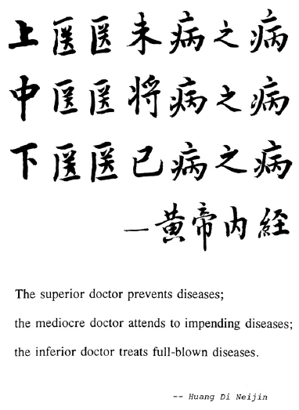

Slide 36
  Atrial Septostomy (AS)
Patients with IPAH and a patent foramen ovale were found to have a survival advantage over those without a patent foramen ovale.
Patients with Eisenmenger’s syndrome caused by a atrial septal defect have a better prognosis than IPAH patients with an intact atrial septum.
Rosenzweig et al. Eisenmenger’s syndrome: Current management. Progress in cardiovascular diseases. Vol 45 No.2 2002

Slide 37
Atrial Septostomy (AS)
Mechanism:
  Intra- atrial right to left shunt decompress the failing right ventricle and increase left ventricular preload, thereby increasing systemic blood flow and improving systemic oxygen transport despite arterial oxygen desaturation.

Slide 38
Atrial Septostomy (AS)
Mortality:
  During or immediately following AS : 13%
  30 day Survival : 82%
Most advanced PAH had the worst outcome
  Markedly elevated pulmonary vascular resistance
  Arterial oxygen saturations < 80% at rest
  Severe right heat failure (Low CO and Raised RAP )
Doyle et al. Surgical Treatment/Interventions for Pulmonary Arterial Hypertension : ACCP Evidence –based clinical practice guidelines. Chest 2004

Slide 39
Atrial Septostomy (AS)
Advantages:
  Improved cardiac output (15%-60%)
  Improved NYHA functional class and 6MW
  Reported success rate for bridging patients to transplant range from 30%-40%
Goal : Palliation, restoration and maintenance of clinical stability until a transplant can be performed.
McLaughlin et al. Expert Consensus Document on Pulmonary Hypertension. JACC Vol 53. No17 ,2009

Slide 40
Atrial Septostomy (AS)
Recommendations:
  In select patients with PAH unresponsive to medical management, AS should be considered.
  Quality of evidence : low
  Net Benefit : Intermediate
  Strength of recommendation : C
  Doyle et al. Surgical Treatment/Interventions for Pulmonary Arterial Hypertension : ACCP Evidence –based clinical practice guidelines. Chest 2004

Slide 41
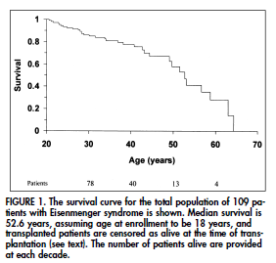
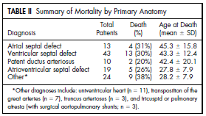
Natural history of Eisenmenger’s syndrome
Warren J. Cantor. Determinants of survival and length of survival in adults with Eisenmenger’s syndrome (Am J Cardiol 1999)
Moet ek die slide gebruik? Ander grafiek eenvoudiger

Slide 42
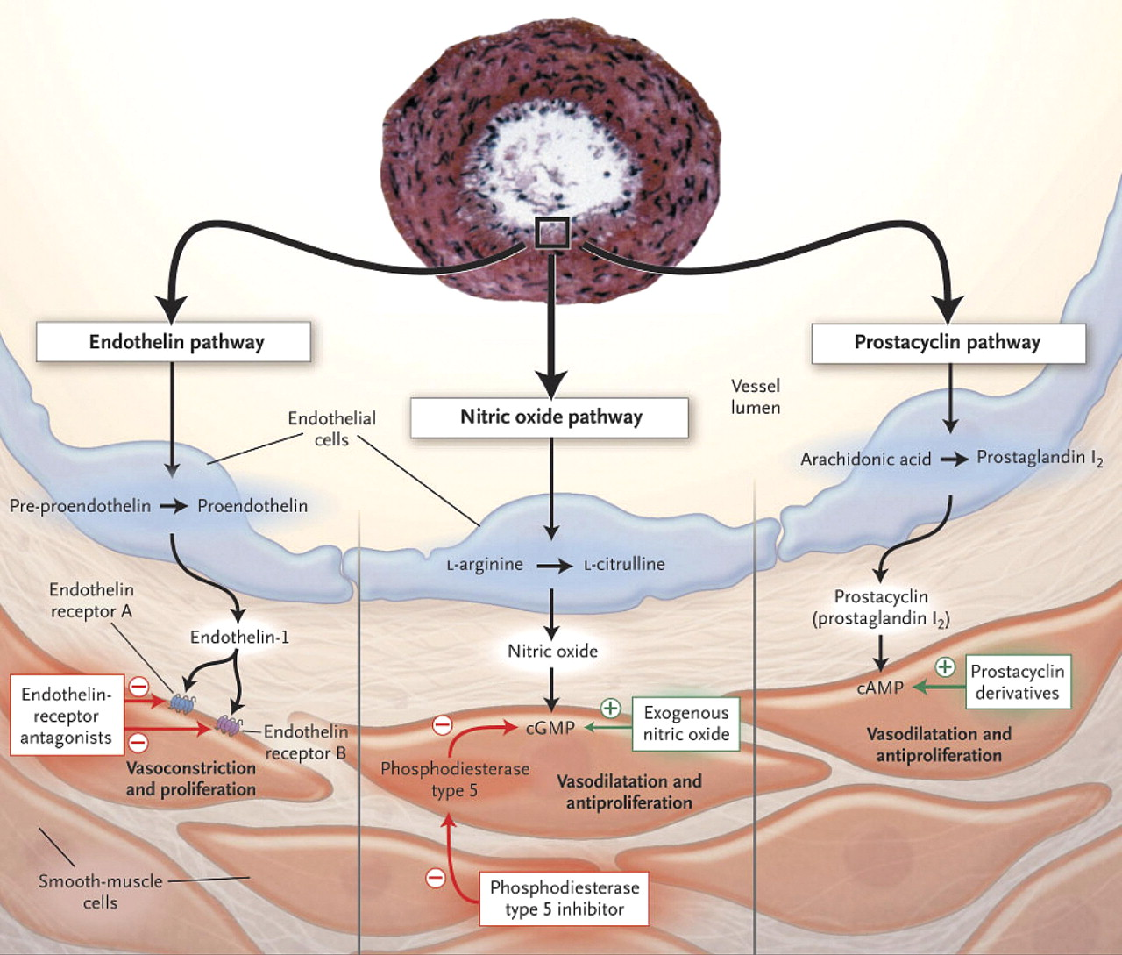
The 3 Pathophysiological Pathways in Pulmonary Arterial Hypertension
Beghetti, M. et al. J Am Coll Cardiol 2009;53:733-740
Copyright ©2009 American College of Cardiology Foundation.

Slide 43
Interventional/Surgical Treatment
Reserved for end-stage disease
Options available :
  Atrial Septostomy (AS).
  Heart-lung or Lung transplantation.
  Other
    RV mechanical assistance.
    PA banding

Slide 44
Pulmonary arterial hypertension
Definition:
  Pulmonary artery pressure > 25mmHg at rest
        OR
  Pulmonary artery pressure > 30mmHg during exercise
  Normal resting cardiac output
  Resting pulmonary vascular resistance above 3 Wood units
  Dimopoulos et al. International journal of Cardiology 2008

Slide 45
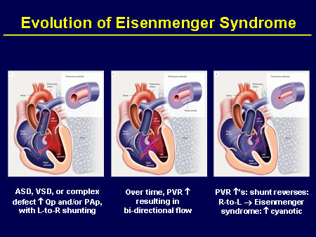
Eisenmenger’s syndrome
Eisenmenger’s syndrome describes the elevation of pulmonary arterial pressure to the systemic level caused by increased pulmonary vascular resistance with reversal or bi-directional shunting through a large intracardiac or extracardiac congenital heart defect.

Slide 46
Introduction
The functional and structural status of the pulmonary vascular bed plays a pivotal role in the presentation and outcome of the child with congenital heart disease
Childhood Eisenmenger’s syndrome is rare in countries with good referral and screening programs
In Papua New Guinea the incidence of pulmonary vascular disease that precluded surgical repair of a shunt was 21%
Kulik et al Progress in Pediatric Cardiology 2009

Slide 47
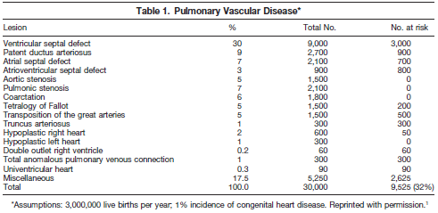
Natural history of Eisenmenger’s syndrome
One third of patients with uncorrected congenital heart disease will die from pulmonary vascular disease.
  Rosenzweig et al . Eisenmenger’s syndrome : Current management. Progress in cardiovascular disease, Vol 45, No. 2. 2002

Slide 48
Irrespective of age, close and consistent follow-up of
patients who undergo surgical or percutaneous closure of
a left-to-right shunt should be strongly considered, as the
natural progression of pulmonary vascular disease is not
known in this patient population, especially in the current
era of advanced PAH therapy.

Slide 49
Right ventricular assist device
Development of Right ventricular failure in a patient with PAH is a grave prognosis prognostic factor.
RVAD used to support acute postoperative right ventricular failure
? Role in PAH with failing ventricle

Slide 50
Corrective cardiac surgery
Valhakes – surgical considerations in ES
CHEST 2010 PAH : global perspective
Evaluating opp Dimopoulos

Slide 51
Transplant surgery
Timing of surgery important.
Indication : Good transplant candidates should be referred when they have an unacceptable response to PAH therapy.

Slide 52
Consider
Clinical characteristics
Age
PVR (PVR/SVR ratio)
Qp:Qs
Vasoreactivity testing
Cardiac morphology
Associated anomalies

Slide 53
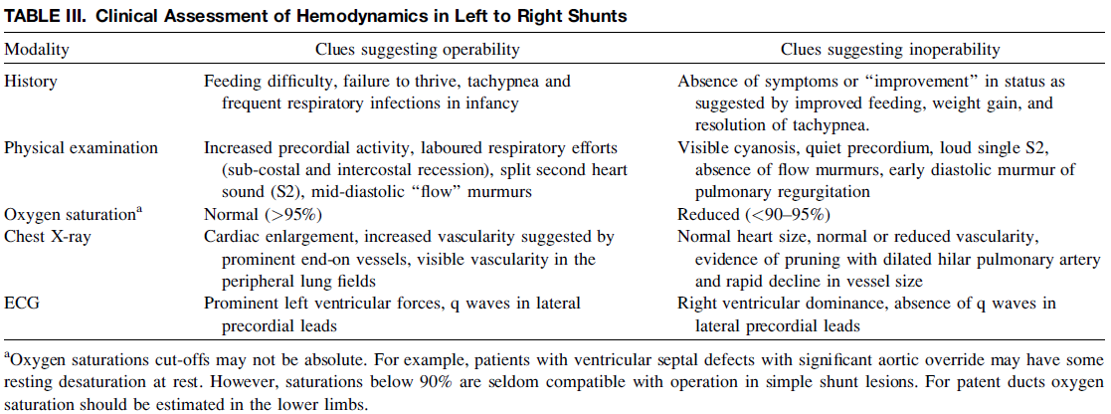
??????????????????????????????????
Viswanathan et al. Catheterization and cardiovascular interventions. 2008

Slide 54
Regression of Obstructive Stage of PAH
@ young age:  < 9 mths (Rabinovitch et al)
⬥ < 1 yr (Ikawa et al)
PA - banding (Wagenvoort et al, Batista et al, Dammonn et al)
⬥ effect limited by degree of cyanosis
induced by R → L shunting
Haemodynamic (pressure) unloading of PA vasculature (experimental) (O’Blenes et al)
Novel stratergies (experimental):
⬥ that reverse sustained vasoconstriction
⬥ that target proliferation and induce apoptosis
⬥ that target inflammation

Slide 55
When is surgery appropriate?
PVR > 7 wood units and age > 5yrs : important risk factors for death on long term follow up.
Few patients age 1-2yrs have severely elevated PVR and they tend to reverse remodel after surgical repair.
Older patients with severely elevated PVR are at risk of sustained pulmonary hypertension or a progressive increase in PVR after repair.
Kulik et al. Progress in Pediatric Cardiology 2009

