Slide 1
The growing epidemic of Adult Congenital Heart Disease
Presenter: Dr M Myburgh
University of the Freestate
Cardiothoracic Surgery Dept.

Slide 2
Introduction
Estimates suggest that the incidence of congenital heart disease is about
7 to 10 per 1000 live births, with moderate to severe forms afflicting 3 per
1000 live births.
Medical and surgical breakthroughs in the care of children born with heart defects have generated a growing population of adult survivors
ADULT CONGENITAL HEART DISEASE

Slide 3
Prevalence
Remarkable advances in diagnostic methods, medical management, interventional techniques, congenital heart surgery and perioperative management have led to a shift in population demographics.

Slide 4
From 1987 to 2005 (Montreal Heart Institute Adult Congenital Center)
>30% reduction in mortality was reported among patients with congenital heart disease
67% mortality reduction in children with complex lesions
More that 85% of children born with heart defects are now expected to survive to adulthood.
Median age at death for simple to moderate defects increased from 60 to 75 years.
Median age at death for severe or complex defects increased from 2 to 23 years

Slide 5
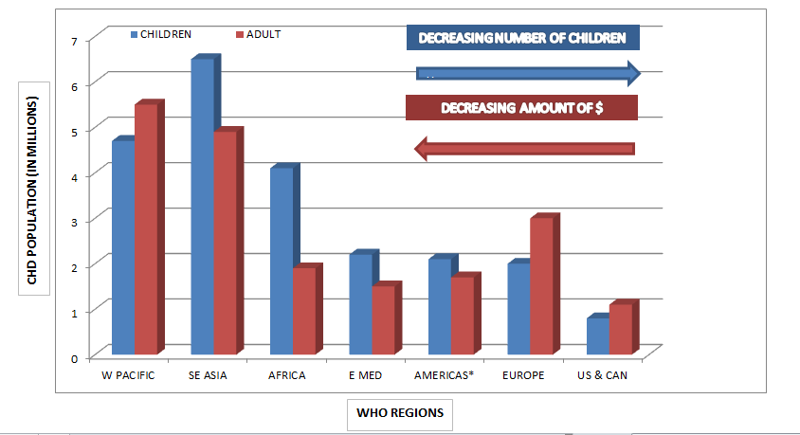
Burden of disease
A Systemic review analyzed data of ten publications on the prevalence of ACHD in
developed countries between 2001 to 2011.
The prevalence rate generally ranged from 1.7-4.1 per 1000 adults, and have steadily
Increased to 6.12 per 1000 adults.

Slide 8
Evolution of ACHD care
Jane Somerville(UK) and Joseph Perloff(US) were the first advocate for specialized ACHD
care.
ACHD represented a small minority of the adult cardiology population.
ACHD vs CAD 1:25
Paediatric Cardiology were managing ACHD, with newly acquired “adult” cardiac diseases
A need for specialized care was established and against this background the first ACHD
Units began to develop in western countries.
Toronto 1959
European 1964

Slide 9
Models of ACHD care
A common model of care advocated the European, Canadian, Australian and USA ACHD
working groups is for adults with CHD to be assessed at least once by a dedicated ACHD
center with inter-professional team-based care.
Several national cardiac societies and the ESC have published recommendations for a
comprehensive ACHD program:
Staff requirements
ACHD cardiologist with advanced specific training
Qualified congenital cardiac surgeon (With specific training in ACHD)
Cardiac anaesthetic service
Interventional cardiologist with ACHD expertise
Interventional electrophysiologist with ACHD expertise
Advanced cardiac imaging specialist
Transition coordinator/Nurse educator/Advanced practice nurse

Slide 10
Institutional requirements
Dedicated ACHD outpatient clinic
24/7 Cardiology emergency service
Adult internal medicine cardiology ward
Intensive care unit
Heart/Lung transplant program
Pulmonary hypertensive program
Multidisciplinary high risk pregnancy program
Genetic counselling
Palliative care
Social work supporting services
Structured transition programs
Dedicated clinical psychology or psychiatric services

Slide 11
Training and education
Competency and subspecialty training
Educational resources
Research development
- APPROACH IS
- NOTE registry

Slide 12
Overview of common issues

Slide 13
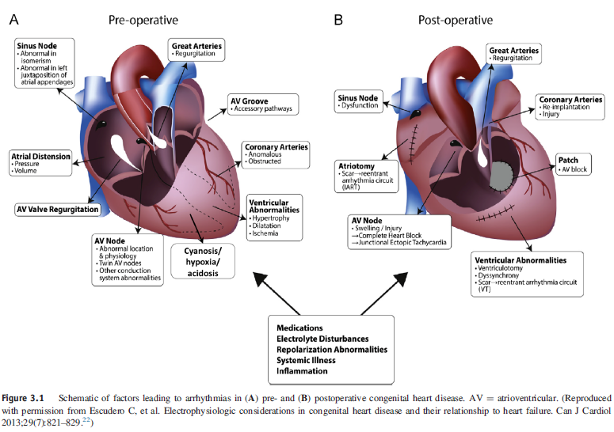
Arrhythmias
Most common long-term complication in ACHD
Leading cause of morbidity and mortality

Slide 15
Heart Failure
Mechanisms : Circulatory overload
Ventricular volume/pressure loading
Inability of a systemic right ventricle or single ventricle to meet metabolic needs
Unequal flow distribution to the lung fields
Variable pulmonary vascular integrity
Abnormal myocardial architecture
Abnormal electrical conduction
Insufficient blood supply
The incidence of systolic dysfunction is highest in those with cyanotic lesions, right systemic
Ventricles or univentricular hearts.
Diastolic dysfunction has a strong correlation with arrhythmias and pulmonary venous
congestion.

Slide 16
Pulmonary Hypertension
Any nonrestrictive systemic to pulmonary communication (Left-to-Right shunt), can produce
pathological changes in the pulmonary arterial bed.
(Clinical group 1)
Left heart failure – Systolic; Diastolic or Valvular
(Clinical group 2)
Chronic thromboembolic pulmonary hypertension
(Clinical group 4)
Prevalence of 4-10% in ACHD

Slide 17
Endocarditis
The incidence of endocarditis (approximately 1.1 per 1000 patient-years) in ACHD is 20-fold
greater than in the general population, with a 12% recurrence rate.
Factors associated with Endocarditis : Type of congenital defect and method of repair
Presence of multiple defects
Male gender
Complications : Systemic embolization
Heart failure
Valvular regurgitation
Appropriate medical management and early surgical intervention have resulted in lower
complication and mortality rates.

Slide 18
Pregnancy
When considered collectively, congenital malformations are the most prevalent form of
heart disease in pregnant women.
Leading cause of maternal morbidity and mortality in developed countries.
Congenital heart disease carries an increased maternal and fetal risk, particularly in the
setting of - Pulmonary hypertension
- Subaortic or subpulmonary ventricular dysfunction
- Left sided valvular obstruction
- Unrepaired aortic coarctation
- Aortic root dilation
Heart failure and arrhythmias are the most common complications
Frequent neonatal adverse outcomes include : Low birth weight
Respiratory complications
Intraventricular cerebral hemorrhage

Slide 19
Challenges of ACHD Surgery
Diversity of anatomo-clinical situations
Multiorgan involvement
Comorbidities
Technical challenges

Slide 20
Anatomo-clinical diversity
Patients with “repaired” malformations
Undergone previous correction that require reoperation.
- RVOT conduits that are outgrown or become stenotic/regurgitant.
- Reoperation for residual lesions
- Reoperation for recurrence
Patients with nonrepaired malformations
Missed diagnoses
- ASD ; Restrictive VSD ; Coarctation ; PAPVC
Complex lesions that underwent palliation
Patients with acquired disease not related to malformation
CABG, Aortic root replacement or Maze procedures for complications
A thorough cardiac evaluation and knowledge of previous procedures are of
critical importance.

Slide 21
Multiorgan involvement
Myocardial involvement
Function is generally impaired : Abnormal ventricular morphology
Ventricular hypertrophy
Longstanding volume or pressure loading
Fibrosis / Scarring
Pulmonary involvement
Almost constant and multifactorial
- Pulmonary Arterial Hypertension (Systemic-to-Pulmonary shunting)
- Pulmonary arterial or venous obstruction (Native or iatrogenic)
- AV malformations
- Chronic thrombo-embolic events
Other organ involvement
Longstanding cardiac malformations have a deleterious effect on several other systems
- Hematological (eg, Polycythemia)
- Renal impairment
- Neurological

Slide 22
Comorbidities
Coronary artery disease should be suspected and assessed in all patients
older than 45 yrs.
The presence of cerebrovascular disease should be evaluated in all patients
with potential risk factors. (Incl: Hypertension ; Diabetes ; Hypercholesterolemia)
Chromosomal or other extracardiac sysndromes might add additional risk to the
baseline profile of these patients.

Slide 23
Technical challenges
Preservation of myocardial function
Limit/Avoid aortic cross clamping
Antegrade and retrograde cardioplegia
Appropriate venting
Topical and systemic cooling
Cardiopulmonary Bypass technique
Well established aortopulmonary collaterals in cyanotic patients
Management - Preoperative occlusion
- Surgical unifocalization
- Deep hypothermic low-flow CPB
Vascular access
Peripheral or central vascular access might be compromised in patients who
have undergone multiple diagnostic or therapeutic procedures
Redo sternotomy
Patients present after multiple sternotomies and thoracotomies.
Assessment of apposing structures is crucial.

Slide 24
Interventional catheterization
Adjunct to surgical treatment : Preoperative (eg, aortopulmonary shunt occlusion)
Intraoperative (eg, Pulmonary artery stenting)
Postoperative (eg, Occlusion of residual shunts)
In certain cases it can eliminate the need for surgery (Pulmonary valve implantation)
Transplantation
Final palliation for a significant number of ACHD patients
Specific considerations : Sensitization from previous transfusions
Fontan - Protein-losing enteropathy
- Pulmonary arteriovenous malformations
Combined multiorgan transplant adds to the complexity of the surgery

Slide 26
Data from UFS (1995-2015)

