Slide 1
Single ventricle Circulation
University of Cape Town
Christiaan Barnard Division of Cardiothoracic Surgery
Groote Schuur Hospital
Red Cross War Memorial Children’s Hospital
Rodgers Manganyi

Slide 2
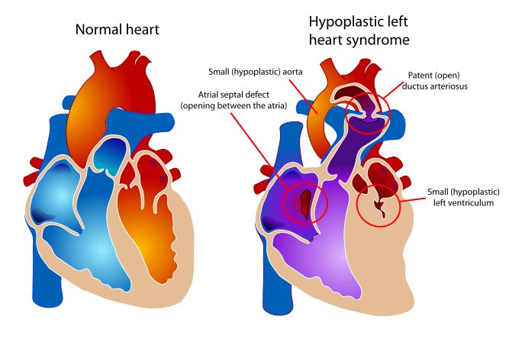
Definition
A heart that lacks two well-developed ventricles
Any cardiac defect that would not allow biventricular repair
It includes those lesions are termed as both
HLHS
HRHS
HLHS
is far more common, and the strategy for palliation of both lesions is similar.

Slide 3
Common anatomic abnormalities
Variations of single RV
Variations of Single LV
Tricuspid atresia
DIRV
Unbalanced ACV defects
PA with intact IVS
Mitral atresia
DORV
HLHS
Aortic Atresia
HLHS
Large VSD ( normal LV)
Unbalanced AVC defects
Shone’s complex

Slide 5
Two ventricles with incorrrectible abnormalities for biventricular repair
Severe TOF with PA
Truncus arteriosus
TAPVR
Ebstein’s Anomaly

Slide 6
HLHS - History
First described in 1952 by Lev as the pathologic complex “hypoplasia of the aortic tract”, included cases of:
Hypoplasia of the aorta and VSD
Hypoplasia of the aorta with aortic stenosis or atresia, with or without mitral stenosis or atresia
In 1958, Noonan and Nadas termed these lesions as “hypoplastic left heart syndrome”.

Slide 7
Epidemiology
Lethal condition prior to 1980
Each year, approximately 1000 infants with HLHS are born in the US.
Prevalence: 1 per 6000-7000 live births.
In pathologic series,
it accounts for 1.4-2.9% of congenital heart disease.
Third most common cause of critical CHD in the newborn.
23% of all neonatal mortality from CHD
Male predominance: 57-70%.
Paul Khairy, MD, PhD et al.Circulation. 2008

Slide 8
Anatomy
Underdevelopment of the left side of the heart
atresia of the aortic or mitral orifice
hypoplasia of the ascending aorta.
The left ventricle may be small and nonfunctional or totally atretic

Slide 9
Anatomy
Pulmonary venous return from LA to RA through a large PFO or ASD
Systemic venous blood mixes with pulmonary venous blood in the RA and RV
RV ejects blood into a large MPA

Slide 10
Anatomy
Blood flow to the coronary and cerebral circulations is retrograde
Usually little or no flow through aortic valve
Postnatal decline in PVR
Renders:
Systemic
Ductal
Coronary
Cerebral vascular beds at risk for hypoperfusion secondary to pulmonary run-off .

Slide 11
Diagnostic tools
Presentation
Qp<Qs
Severe cyanosis
Shock
Qp=Qs
Mild cyanosis
Rather stable
Qp>>Qs
Heart failure
Cardiogenic shock
History
Examination
ECG
Blood gas, pulse Oxymetry
CXR
ECHO
Cardiac cath & Angiography
Cardiac MRI and CT

Slide 12
Treatment
The aim of initial management :
is to optimise Qp and Qs in a manner that provides adequate end organ oxygen delivery without overloading the single ventricle
This balancing act is only temporizing and serves to allow patient to survive to definitive treatment stage

Slide 13
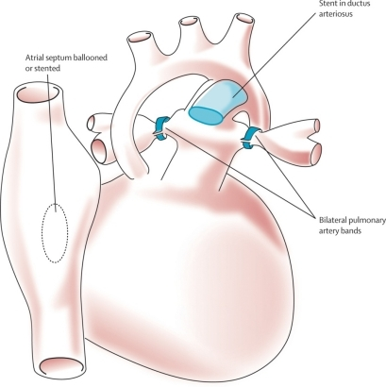
Treatment options
Supportive care
Only option up to 25 years ago
Is still main option of treatment in many countries
Staged reconstruction
Stage I Norwood Procedure
Stage II Bi-directional Glenn or Hemi-Fontan
Stage III Fontan Procedure
Hybrid
Transplant

Slide 14
Goals of Surgery
Unobstructed systemic blood flow
To maximize oxygen delivery and minimize ventricular hypertrophy
Limited pulmonary blood flow
To minimize ventricular volume load and the risk of pulmonary hypertension
Unobstructed pulmonary venous return
To minimize secondary pulmonary artery hypertension
Minimize likelihood of pulmonary artery distortion
Avoid dysrhythmias

Slide 15
Stage I – Norwood palliation
The goal of the Norwood is to:
Stabilize and balance the parallel circuit
Protect the pulmonary vascular bed
Preserve ventricular function
Adequate oxygen delivery allows for the growth necessary for a hemi-fontan or BDG to be performed

Slide 16
Norwood stage 1
Native ascending and transverse aortic arch is incorporated into a neo-aorta
Autologous pulmonary homograft---> create neo-aorta
Neo-aorta attached to proximal pulmonary artery trunk
Neo-aorta provides systemic outflow
Important that the neo-aorta is free of obstruction
Obstruction is poorly tolerated by the single ventricle and is associated with increased interstage mortality

Slide 17
Norwood stage 1
Distal MPA is closed
Pulmonary flow -> restrictive shunt from the right innominate artery to the RPA
Modified BTS

Slide 18
The ventricle has just been through hypothermic cardiopulmonary bypass with myocardial ischemia/arrest
Vascular endothelium of the systemic and pulmonary circulations have also been subjected to bypass and injury
Combined effect is a systemic inflammatory and adrenergic stress response
The ventricle can also shows a low cardiac output syndrome in the first hours to a day post op

Slide 19
Coronary circulation
Single right ventricle coronary blood flow occurs predominantly in diastole
Like an in series LV
When pulmonary flow is supplied by a shunt from a systemic artery, increases in SVR lead to increased pulmonary flow, and increased diastolic pulmonary run-off
This can lead to myocardial ischemia….and sudden death

Slide 20
Stage II – Partial Cavopulmonary Anastomosis
After stage I, there are two problems
Cyanosis
Excessive ventricular volume load
The Fontan addresses both of the above, but must come after an intermediate step

Slide 21
Reasons for a staged repair
The fontan requires low PVR to allow for passive pulmonary flow
PVR does not reach nadir until 6-8 months
Furthermore, following the high Qp:Qs state of pre-norwood, the pulmonary vasculature can be reactive
Which is exacerbated by the stress of bypass
The parallel circulation single ventricle is relatively hypertrophied and dilated secondary to volume overload
A loss of ventricular filling secondary to increases in PVR would lead to critically decreased CO

Slide 22
The solution is a staged procedure that allows for more gradual ventricular unloading and remodeling
Also allows for adjustment of the upper body venous and lymphatic systems to deal with an increase in venous pressure prior to the Fontan
Usually performed around 4-6 months of age

Slide 23
PCPC Pre – Op Evaluation Glenn
Non-invasive
Invasive
Medical History
Physical exam
Blood gasses
CXR
ECHOcardiography
Ventricular function
AV valve function
Aortic outflow
Cardiac Catheterasation
Diagnostic
PVR
TPG
Vessel diameter
Nakata index
McGoon index
Ventricular function
Aortic outflow
Therapeutic Cath
Coarctation
Pulm artery stenosis
MAPCA embolisation

Slide 24
Bidirectional Glenn
The RV/PA or BT shunt is removed
This volume unloads the ventricle
NB in improving outcome in single ventricle palliation
SVC is anastomosed end to side with the RPA
Is more compatible with an extracardiac fontan procedure at a later stage

Slide 25
Stage II Physiology
Half the blood to the heart comes from the IVC, half from the pulmonary veins
Qp:Qs is now 0.5
SaO2 about 75-85%
Infants with bigger heads have higher saturations
Excessive volume load is now eliminated
Ventricle now pumps only Qs
Decreased cavity dimension and increased wall thickness improves tricuspid function

Slide 26
Stage II Physiology
Pulmonary flow can be impaired by
High PVR
Increased atrial pressures
AV valve dysfunction
Ventricular diastolic dysfunction
A low transpulmonary gradient with a good CO is the desired outcome

Slide 27
Post-Op issues
Ventilator management
LCOS
Hypoxemia
Elevated SVC pressures

Slide 28
Stage III - Fontan
The final step in single ventricle palliation
When is the stage II patient ready?
Usually about 6 months following stage II
Increasing growth and activity increases venous return from lower limbs
When the ventricle has remodeled and displays good function on echo
Good AV valve function
Small transpulmonary pressure gradient
Low ventricular end diastolic pressure
Most centers aim for completion between 12-24 months of age

Slide 29
Table 1 Choussat’s ten commandments
Ten Commandments for an ideal Fontan operation result.
Age >4 years
Sinus rhythm
Normal systemic venous return
Normal right atrial volume
Mean pulmonary artery pressure <15 mm Hg
Pulmonary arteriolar resistance <4 Wood units/m2
Pulmonary artery–aorta ratio>0.75
Left-ventricular ejection fraction >0.60
Competent mitral valve
Absence of pulmonary artery distortion
Pediatr Cardiol. 2010 Nov;31(8):1131-4. doi: 10.1007/s00246-010-9811-9. Epub 2010 Oct 20.
Fontan "Ten Commandments" revisited and revised.
Stern HJ.

Slide 30
Stage III - Fontan
Lateral baffle
Blood from IVC directed into RPA via a baffle in the lateral portion of the RA
If the preceding operation was a hemi-fontan, then IVC to RPA continuity is achieved by removing the RA patch

Slide 31
Stage III - Fontan
Extracardiac Fontan
A conduit of PTFE tubing or aortic allograft is placed between IVC and RPA
Advantages
Limited bypass
Atrial arrythmias less common
Disadvantage
Conduit cannot increase in size as pt. grows

Slide 32
Fontan -Fenestration
In both operations, poor ventricular compliance or increased PVR is a concern
Both lead to decreased pulmonary flow, and, possibly, decreased preload
Often a fenestration is left in the baffle or conduit

Slide 33
Fontan Physiology
Qp:Qs is equal
Ventricle supplies Qs
Systemic venous pressure drives Qp
Shunt through fenestration lowers SaO2 slightly
Pulmonary flow is non-pulsatile
Increases pulmonary vascular bed impedance
Decreases capillary recruitment

Slide 34
Fontan Physiology
Flow through pulm vascular bed dependant upon those factors that lend to a low transpulmonary pressure gradient
Good ventricular systolic and diastolic function
AV valve competence
Low PVR
Elevated pulmonary artery pressures leads to higher fluid replacement to maintain high SVC pressures
Third spacing leads to effusions, ascites
Acsites increases required ventilator pressures, decreases renal perfusion

Slide 35
Post-Op concerns
Ventilator management
Minimal PEEP
Low set rate with high PS
LCOS
Anatomic
Pump failure
Increase in PVR
Low Preload
Cyanosis
Atelectasis
Poor Pulm blood flow
Anaemia or LCOS
Arrhythmias
Pace to avoid AV synchrony

Slide 36
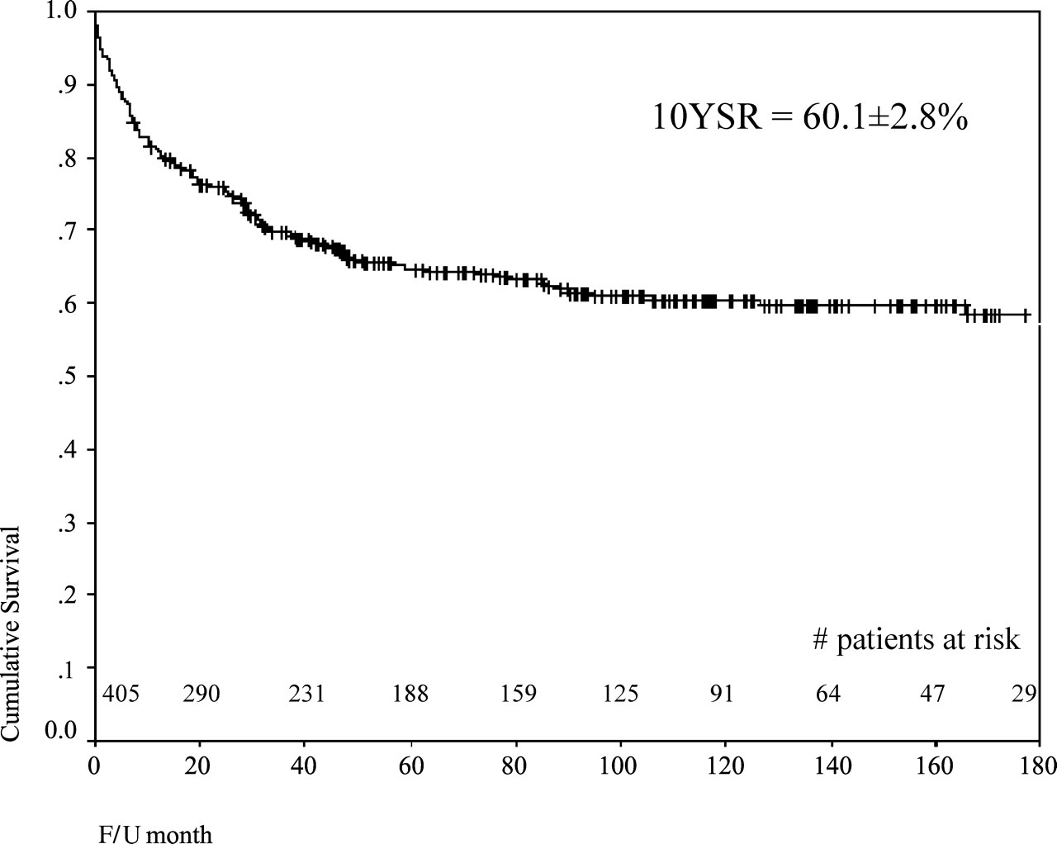
Long-term survival of patients with a functional single ventricle.
Jeong Ryul Lee et al. Eur J Cardiothorac Surg 2003;24:716-722
© 2003 Elsevier B.V.
Notes:
Long-term survival of patients with a functional single ventricle. Starting point of the follow-up duration: from birth.

Slide 37
Medium and long-term outcomes of Fontan operation.
Chungsomprasong P1, Soongswang J, Nana A, Durongpisitkul K, Loahaprasitiporn D, Vijansorn C, Sriyodchartti S.
J Med Assoc Thai. 2011 Mar;94(3):323-30.
Results:
Survival rates were 88.7%, 85.3%, and 83.8% at 1 year, 5 years, and 10 years, respectively
The 10-years survival rates of the patients that underwent lateral tunnel, extracardiac conduit and atriopulmonary connection were 80.7%, 88% and 84.3%, respectively
Conclusion: Cardiac diagnoses were not significantly different in the medium and long-term survival rate of post Fontan patients, freedom from arrhythmia, re-intervention and systemic atrioventricular regurgitation. Types of Fontan operation did not affect long-term survival rate or long-term complications. Mean pulmonary artery pressure of more than 18 mmHg was the only risk factor to the survival rate.

Slide 38
References
Paul Khairy, MD, PhD et al.Circulation. 2008
Chang et al, Pediatric Cardiac Intensive Care, LWW, 1998
Schwartz S et al, Single Ventricle Physiology, Critical Care Clinics 2003;19:393-411
Walker SG, et al, Single Ventricle Physiology – Perioperative implications, Seminars in Ped Surg, 2004, 188-202
Heart Transplantation for Congenital Heart Disease in the First Year of Life
Chinnock RE, Bailey LL - (2011)

