Slide 1
Management of ascending aortic aneurysm
M.MUSONI
REGISTRAR
DEPARTMENT OF CARDIOTHORACIC SURGERY
UNIVERSITY OF WITWATERSRAND
Hannes Meyer Registrar Symposium – 11/7/2015

Slide 2
Overview
Defined arbitrarily as increase of at least 50% in diameter of ascending aorta compared to normal aorta for a particular age , gender and BSA
True aneurysm: all layers of vessel wall
False: localized, contained by adventitia alone or with part of the media
Saccular Vs fusiform

Slide 3
Overview
Epidemiology
Estimated 10/100,000 adults
Thoracic aortic aneurysm Incidence: increased 3x
Clouse WD, Hallett JW Jr, Schaff HV, Gayari MM, Ilstrup DM, Melton LJ 3rdImproved prognosis of thoracic aortic aneurysms: a population-based study JAMA. 1998;280(22):1926.
Ascending aorta | 45%
Descending aorta | 35%
Arch | 10%
thoracoabdominal | 10%
Notes:
Increase in incidence may be due to ageing population, better imaging modalities,

Slide 4
Overview
Etiology
1. Medial degeneration:
Idiopathic
Heritable : Marfans, Loeys Dietz, Ehlers Danlos, Bicuspid aortic valve
2. Inflammatory: Takayasu , Giant cell arteritis, Behcet
3. Infectious: mycotic, syphilitic
4. Chronic dissection
5. Chronic dilation secondary to trauma

Slide 5
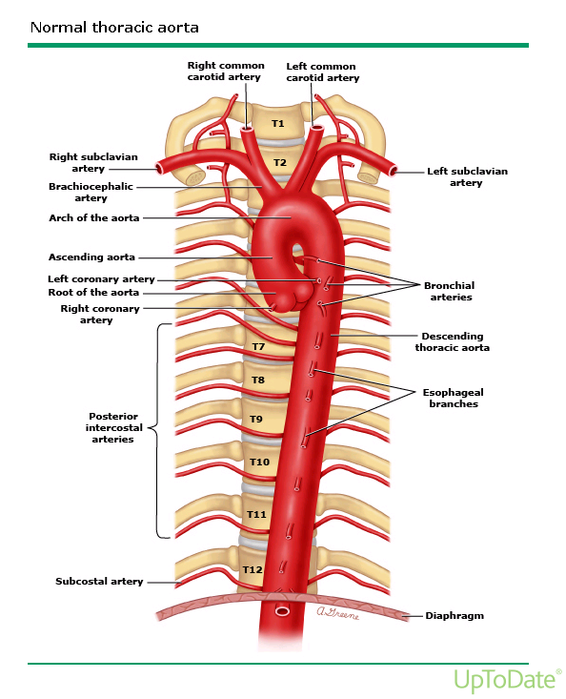
Anatomy
Normal aorta : 4 parts: root, ascending, arch, descending
Composed of 3 layers: intima, media, adventitia
Normal diameter: depends on age, sex, body size, location, method used.
Root: annulus, sinuses, valve, STJ
Ascending AA may extend proximally to annulus and/or distally to innominate artery

Slide 6
Pathophysiology
Biological: - elastic layer fragmentation
- dysfunction of smooth muscle layer
- replacement with cystic mucoid matrix
Mechanical: - cross sectional asymmetry
- reduced compliance
- stress-strain ( LaPlace relationship)
Final common pathway of all etiologies of Ascending AA is pathologic dilation and thinning of the aortic wall
Progression of annular dilation causes AR
Notes:
aorta acts as a physiological reservoir and pump
Principle cause in asc. Ao aneurysm: medial degeneration
Desc aorta is mainly artherosclerosis

Slide 7
Natural history
Progressive incremental dilation: 0.1cm/ yr for aneurysm < 4cm. Increases to 0.4cm/yr as diameter grows
Connective tissue patients present earlier, progress faster, rupture earlier
Elefteriades JA. Natural history of thoracic aortic aneurysms: indications for surgery, and surgical versus nonsurgical risks. Ann Thorac Surg. 2002 Nov. 74(5):S1877-80
Annual risk of | Aortic size(cm)
 | >3.5 | >4 | >5 | >6
death | 5.9% | 4.6% | 4.8% | 10.8%
Rupture/dissection/death | 7.2% | 5.3% | 6.5% | 14.1%
Notes:
Syndromal pt present earlier, progress faster, rupture at smaller diameters
Rate of growth for descending> ascending aorta
Rupture can occur at smaller diameters
Progression in BAV unpredictable

Slide 8
Clinical picture
Symptoms:
- asymptomatic/ incidental finding
-Chest pain: radiating to jaw, acute extension or impeding rupture
Compression symptoms: SVC syndrome, hoarseness
Signs:
- mostly unremarkable, may have wide pulse pressure, diastolic murmur due to AR

Slide 9
Diagnostics
CXR: Convex contour of right superior mediastinum , loss of retrosternal air space, calcified curvilinear boarder,
ECHO:
TTE: root, annulus and valve, LV function, internal diameter
TEE: intraop monitoring,
CT/CTA: size, extent , location, true diameter, image the entire aorta, diameter at multiple levels, IMH, intimal flaps, 3D reconstruction
MRI

Slide 10
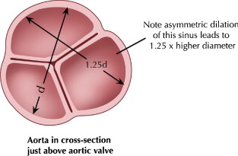
Notes:
Level and obliquity of aorta in the measured segment may give spurious results
Internal Vs external diameter ? True diameter

Slide 11
Decision-making flowchart: ascending aortic aneurysm.

Slide 12
Treatment
Medical:
Indicated in marfans and asymptomatic pt who do not fulfill surgical criteria,
Avoid high intensity exercise
Beta adrenergic blockade
- negative inotropic and chronotropic effect: reduce BP, reduce change in aortic pressure (dP/dT)
Shores J, Berger KR, Murphy EA, Pyeritz RE Progression of aortic dilatation and the benefit of long-term beta-adrenergic blockade in Marfan's syndrome . N Engl J Med. 1994;330(19):1335.
Notes:
Medical therapy brigde to surgical management
Data on β blockers only available for marfans
Experimental data on ARBs , Doxycycline, MMP inhibitors

Slide 13
Treatment
Indications for surgical intervention:
Non elective
New onset dissection/rupture/IMH: immediate repair
Symptomatic (chest pain): urgent surgery
Acute severe CCF 2⁰ to AR: early surgery
Elefteriades JA. Natural history of thoracic aortic aneurysms: indications for surgery, and surgical versus nonsurgical risks. Ann Thorac Surg. 2002 Nov. 74(5)
Notes:
Symptomatic pt considered for urgent surgery regardless of diameter

Slide 14
Treatment
Elective
Sporadic disease: diameter of 5.5-6.0cm, or growth rate 1cm/yr or aortic ratio of 1.5
Connective tissue disorders : diameter 4.5-5.0cm or growth 0.5cm/yr or ratio 1.3-1.4
BAV with functional valve : diameter 5.0-5.5cm or growth 0.5cm/yr
if replacement: diameter 4.5cm, growth 0.5cm or ratio 1.3-1.4
Chronic dissection: diameter 4.5cm or growth 0.5cm/yr or ratio 1.3-1.4
Setting of other cardiac surgery: diameter 5cm or ratio 1.5
Notes:
BAV remains controversial, with some authors recommending replacement of even normal-appearing ascending aortas and others pursuing a more individualized approach.

Slide 15
Treatment
Factors Influencing the Choice of Ascending Aortic Operations
Age and expected survival
Underlying pathology and quality of the aortic wall
Anatomic condition of aortic annulus, valve leaflets, sinuses, sinotubular ridge
Condition of the distal aorta
Risk of anticoagulation
Presence of active annular infection
Ergin MA, Spielvogel D, Apaydin A, et al. Surgical treatment of the dilated ascending aorta: When and how? Ann Thorac Surg 1999;67(6):1834–1839.

Slide 16
Ascending aortic aneurysm surgery
Root replacement
Dilated root
Valve sparing surgery
Normal valve
Composite graft
Homograft
Xenograft
Pulmonary autograft
Diseased valve
Ascending aorta replacement
Dilated aorta
Closed distal anastomosis
Proximal to arch
Open distal anastomosis
Extend to arch

Slide 17
Operative technique
Procedural steps will vary depending on extent of aneurysm, whether aortic valve is normal or needs replacement
Anesthesia and monitoring
CV access, PAC,
A line: preferably right radial
Foley catheter and nasopharyngeal temp probe
TEE:

Slide 18
Replacement of ascending aorta
Aneurysm not involving root and not extending to arch
Arterial cannulation is high in the arch
Cardioprotection: antegrade and retrograde,
LV vent, cool to 28-34⁰C,
Cohn LH, Rizzo RJ, Adams DH et al Reduced mortality and morbidity for ascending aortic aneurysm resection regardless of cause. Ann Thorac Surg 1996;62(2):463–468

Slide 19
Replacement of ascending aorta
Dissection: transect aneurysm at midpoint, resect aneurysmal tissue, leave enough room to do proximal and proximally for anastomosis,
Impregnated dacron graft and 4-0 prolene for anastomosis, Felt may be used to reinforce aorta, start distal anastomosis first
Proximal anastomosis completed after turning off vent to aid deairing
Outcomes: operative mortality 2-5%, late survival 65% at 5yrs, 55% at 7yrs

Slide 20
Root replacement procedures
Valve-sparing root procedures
Ideal candidates: ascending AA, abnormal root, normal or near normal valves ( functional AR)
Controversial in MFS but early outcomes are promising
Conduits: dacron tube graft
Contraindicated: abnormal valves, patient requiring anticoagulation

Slide 21
Root replacement procedures
Valve-sparing root procedures
Outcomes: Yacoub: remodelling Vs David: reimplantation
Low operative mortality for both, higher redo for bleeding in Yacoub (18 vs 3%), lower trend in late AR in David, 17% reoperation at 10yrs in Yacoub
David TE et al. Aortic valve-sparing operations in patients with aneurysms of the aortic root or ascending aorta. Ann Thorac Surg. 2002 Nov. 74(5):S1758-61

Slide 22
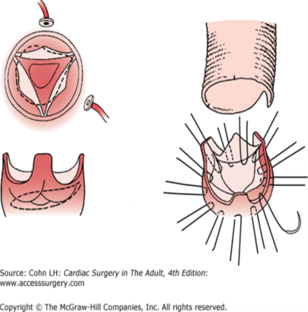
Root replacement procedures

Slide 23
Root replacement procedures
Composite graft
-Ideal candidates: asc AA, root aneurysm, abnormal valve
-Conduit: dacron valved mechanical or hand sewn bioprosthetic valve
Mechanical: <60yrs, no contraindication to anticoagulation,
Bioprosthesis: > 65yrs, contraindication to anticoagulation, female desiring to have child,
Outcomes: in Marfans, operative mortality 1.5% (elective), 11.7% (emergency) , survival at 10 yrs 50-70%
Smith JA, Fann JI, Miller DC et al Surgical management of aortic dissection in patients with the Marfan syndrome. Circulation 1994; 90(5 Pt 2):II235–II242.

Slide 25
Root replacement procedures
Replacement with Aortic homograft
-Ideal candidates: active annular infection+ root dilatation,
-Conduit: cryopreserved aortic homograft
Outcomes: Operative mortality 5.3%, long-term survival (8yr) 80%, long-term freedom from reoperation (8yrs) 10%
El-Hamamsy I, Clark L, Stevens LM, Sarang Z, Melina G, et al: Late outcomes following freestyle versus homograft aortic root replacement results from a prospective randomized trial. J Am Coll Cardiol 2010; 55(4): 368-376

Slide 26
Root replacement procedures
Replacement with Aortic xenograft
Ideal candidate: patient > 60yrs with diseased valve and aortic root aneurysm
Conduit: stent less porcine (freestyle)
Outcomes: Freedom from mod/severe AR at 8yrs was 98.7%, stable EOA for 8yrs, 10 yrs freedom from valve related death 89-96%, freedom from structural deterioration 100%
Bach DS, Kon ND Long-term clinical outcomes 15 years after aortic valve replacement with the Freestyle stentless aortic bioprosthesis. Ann Thorac Surg. 2014 Feb;97(2):544-51.

Slide 27
Root replacement procedures
Pulmonary autograft
Very young patient needing replacement
Controversial in adult,
Conduit: pulmonary autograft
Homograft needed in pulmonary position
Outcomes: Freedom from endocarditis at 13 yrs : 97%, actuarial survival at 10 yrs: 97% , periop mortality <1%
El hamamsy I et al ,Long-term outcomes after autograft versus homograft aortic root replacement in adults with aortic valve disease: a randomised controlled trial. Lancet. 2010 Aug 14;376(9740):524-31.

Slide 28
Other procedures
Reduction aortoplasty +/- wrapping
- Elderly patient unfit for complex surgery
Hybrid and stent graft approaches
- Evidence from large studies on benefit still lacking
May offer option for high risk surgical candidates

Slide 29
Deep hypothermic circulatory arrest
Aneurysm involving the proximal arch requiring open distal anastomosis necessitating DHCA
Simple and gives bloodless field
Circulatory arrest at 18-20⁰C
Safe arrest time 25-30 min
Longer periods have shown worse outcomes,
In addition to basic monitoring: EEG, NIRS, Temp probe at two sites

Slide 30
Deep hypothermic circulatory arrest
Circulatory management: cannulation strategies
Arterial:
central cannulation (arch) stab or Seldinger technique
right axillary artery: through dacron graft
femoral artery: avoid in atheroma of descending aorta
Venous: Dual stage or bicaval in concomitant MV/TR repair or retrograde cerebral perfusion

Slide 31
Deep hypothermic circulatory arrest
Circulatory management: cooling
CPB, head cooling jacket, cool to 12-18⁰C
Cooling to EEG silence preferred over choosing a threshold
Maintain 2-3⁰C gradient between arterial and venous flow - even cooling
22-25⁰C if using Retrograde cerebral perfusion or Selective antegrade cerebral perfusion

Slide 32
Deep hypothermic circulatory arrest
Cerebral protection strategies
Hypothermia, retrograde cerebral perfusion (CP), selective antegrade CP, pharmacological adjuncts
Hypothermia
- Patient cooled to 18-20⁰C
- Safe arrest time 25-30 min
- Bispectral index or jugular venous bulb oxygen saturation monitoring
-Disadvantages: coagulopathy, long CPB time, renal and neurological dysfunction

Slide 33
Deep hypothermic circulatory arrest
Cerebral protection strategies
Retrograde cerebral perfusion
Adjunct to DHCA
Maintain cerebral hypothermia and perfusion, washout of embolic debris,
24F wire reinforced cannula in SVC beyond azygous
Flow rates 200-300 cc/min, perfusate at 12-18⁰C, Trendelenburg position
Pressure in right Internal jugular maintained at 25mmHg

Slide 34
Deep hypothermic circulatory arrest
Cerebral protection strategies
Ante grade selective cerebral perfusion
- Beneficial over RCP if circulatory arrest > 35-45min
- Direct cannulation of head vessels with balloon tipped cannula or right axillary artery cannulation : contralateral ischemia may occur
-Perfusate flow of 10cc/kg/min with pressure of 40-70mmHg at 10-18⁰C
Pharmacological protection
- Barbiturates ? /steroids

Slide 35
Complications
Early:
Bleeding 2.4-11%
Stroke 1.9-5%
Pulmonary dysfunction: ARDS 0.5-1.7%
Myocardial dysfunction: 18-25% requiring support
Periop mortality: 1.7-17.1%
Late:
Late mortality
Reoperation: pseudoaneurysm, progression of disease,
Graft infection: 0.9-6%

Slide 36
Conclusion
Current data shows preemptive surgery on the ascending aorta has much less mortality rate than that in the natural history of rupture, dissection or other aneurysm related death.

Slide 37
Thank you.

