Slide 1
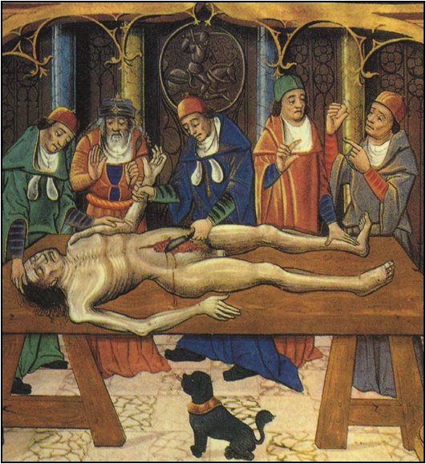
The European Board Examination
2015

Slide 2
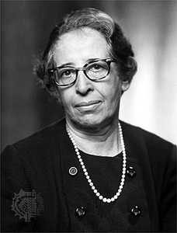
WHICH FACTORS WILL INFLUENCE OUR SURGEONS PRACTICE?
Education has to be situated between the past and the present, the stability and the change, the tradition and the innovation…
Hannah Arendt

Slide 3
WHICH FACTORS WILL INFLUENCE OUR SURGEONS PRACTICE?
USA training: from conventional to new shorter training
EU: diversity of diplomas, time and curriculum to do THE SAME

Slide 4
How is the training going to be ?
Length of training
Name of specialty
Trainees per million
Thoracic Surgery
Cardiac Surgery
Cardio-thoracic Surgery
Thoracic and Cardiovascular Surgery
Vascular Surgery
Cardiovascular Surgery
Surgery of the Heart and Great Vessels

Slide 5
Country | population (million) | institutions | trainees/ 1.000.000
Austria | 8 | 8 | 5
Belgium | 10 | none | none
Czech Republic | 10 | 10 | 8
Denmark | 5 | 5 | 2
France | 60 | 65 | 4
Germany | 83 | 80 | 5
Greece | 11 | 10 | 4
Hungary | 10 | 7 | 2
Italy | 57 | 30 | 4-9
The Netherlands | 16 | 9 | 2
Norway | 4 | 5 | 2
Poland | 38 | 19 | 2
Portugal | 10 | 7 | 2
Spain | 41 | 25 | 2
Sweden | 9 | 8 | 2
Switzerland | 7 | 5 | 3
United Kingdom | 58 | 30 | 3 - 5

Slide 6
Number of residents CTS in 2012
“One resident per 4 million/year”
Spain about 46 million
24
23
12
8
0-6
1985
2001
2002 2012

Slide 7
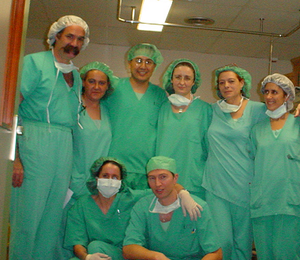
How is the training going to be ?
Men or
Women ?

Slide 8
Men vs women in the Medical School
100%
Barcelona University Medical School
50%
1950
70
90
2002
2012

Slide 9
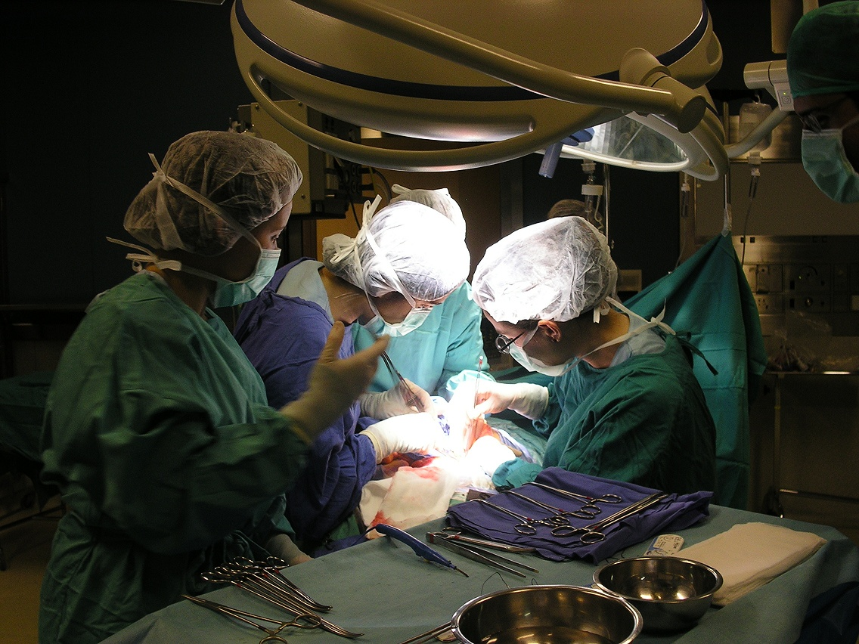
How is the training going to be ?
Massive incorporation of women
Possibilities of dedication
Shifts as an organizational model
Continuity of the intervention
The family and the children

Slide 10
How is the training going to be ?
60
40
20
0
Women Applicants to U.S. Medical Schools
Applications
1st-year entrants
%
D. Cosgrove, MD
60-61
70-71
80-81
90-91
99-00

Slide 11
National Residency Match
N=139
U.S. Graduates 70%
FMG 22%
Unfilled 8%
D. Cosgrove, MD

Slide 12
Medicare Payment Vein Graft x3
4,000
3,200
2,400
1,600
800
Current
Adjusted for ICP
D. Cosgrove, MD
1986
1988
1990
1992
1994
1996
1998
2000
2002

Slide 13
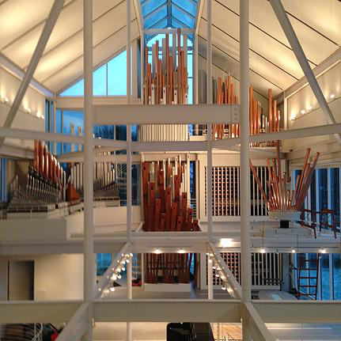
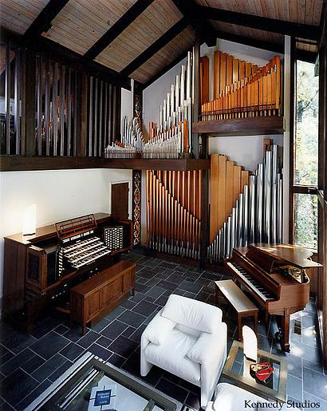
Eugene Blackstone home in Cleveland….

Slide 14
How is the training going to be ?
The EU laws on working hours
Its applicability
The role of private practice vs public
The airplane pilots experience
The responsibility…surgeon or institution
The shifts …
But the number of hours is certainly NOT the issue

Slide 15
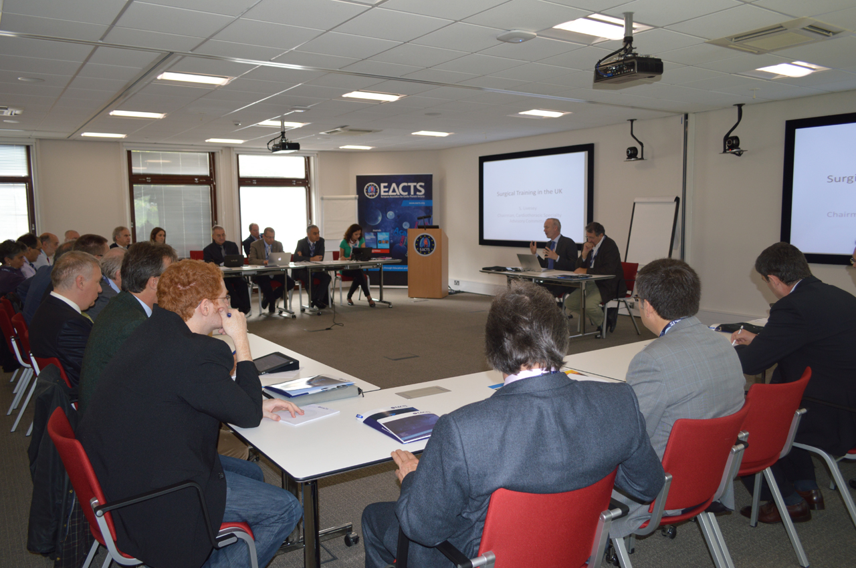
Priorities of EACTS those coming years
Meeting with EU CTS Presidents

Slide 16
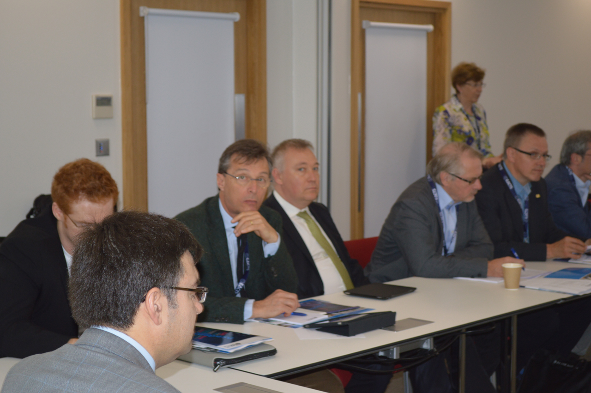
How is the training going to be ?
Meeting with UEMS President
Why UEMS?
Problems among ourselves

Slide 17
The Examination in Cardiothoracic Surgery
WHY ?
An attempt to homogenize the standards in the EU
A secondary goal to upgrade the standards of some (many) countries
Allow for higher mobilisation through Europe
Recognise the training and knowledge/skills of the CT surgeons all over the EU
Exchange of trainees all over the world (USA, EU, Africa, Asia)

Slide 18
The Examination in Cardiothoracic Surgery
The objective is to produce trained cardiothoracic surgeons, who will have the clinical knowledge, the surgical expertise and the professional skills necessary for independent practice in acquired cardiothoracic surgery.

Slide 19
The Examination in Cardiothoracic Surgery
The curriculum, therefore, defines the requirements of a training programme in acquired cardiothoracic surgery. It identifies distinct topics within the specialty and defines the requirements or competences within each of these areas, at each stage of training.

Slide 20
The Examination in Cardiothoracic Surgery
Within each module, the levels of competence are further defined in the following domains:
Knowledge: e.g. basic scientific knowledge; clinical knowledge
Clinical skills: e.g. history, examination, data interpretation, patient management
Technical skills and procedures: e.g. technical procedures, operative management
Professional behaviour and leadership skills: transferable or generic, professional skills, expected of all surgeons

Slide 21
The Examination in Cardiothoracic Surgery
The curriculum also identifies the tools that will be used to assess competence and monitor progress. Cardiothoracic training is now to be seen as competence based rather than, as in the past, determined solely by the number of years in training or by the numbers of procedures performed.
Upon successful completion of the programme the Cardiothoracic Trainee will be able to demonstrate competence in all aspects of the management (including operative management) of Acquired Cardiothoracic Surgery.

Slide 22
The Examination in Cardiothoracic Surgery
HOW and WHEN ?
For the time being, at the EACTS Annual Meeting
In the future, perhaps, independent of EACTS meeting
EACTS as a facilitator of the exam
The examiners: selection and rules. Be soft or rude?
The format:
Knowledge
Understanding and decision making
Skills. Simulators
Personal behaviour and communication abilities

Slide 23
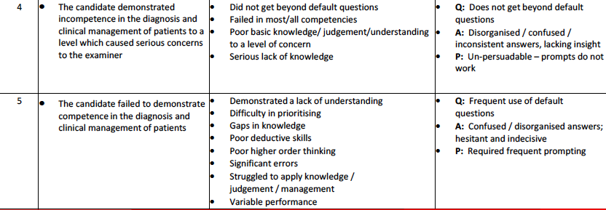

Slide 25
The super man or super woman

Slide 26
The Examination in Cardiothoracic Surgery
Cardiac Surgery is:
Expensive ?
Complex ?
Physically demanding?
Mentally demanding?
Interventional Cardiology!!!
Longest training
(life time)
Stressful
Highest degree of
responsibility
Short productive life (?)
TERRIBLY EXCITING

Slide 27
Interdisciplinary Treatment Taking advantage of Synergy
syn-ergos, συνεργός = 'working together’
Synergy, two or more agents working together to produce a result not obtainable by any of the agents independently

Slide 28
Systems and Cardiac Surgery
Collection of linked individual elements with emerging properties that can not be attributed to each element considered separately.

Slide 29
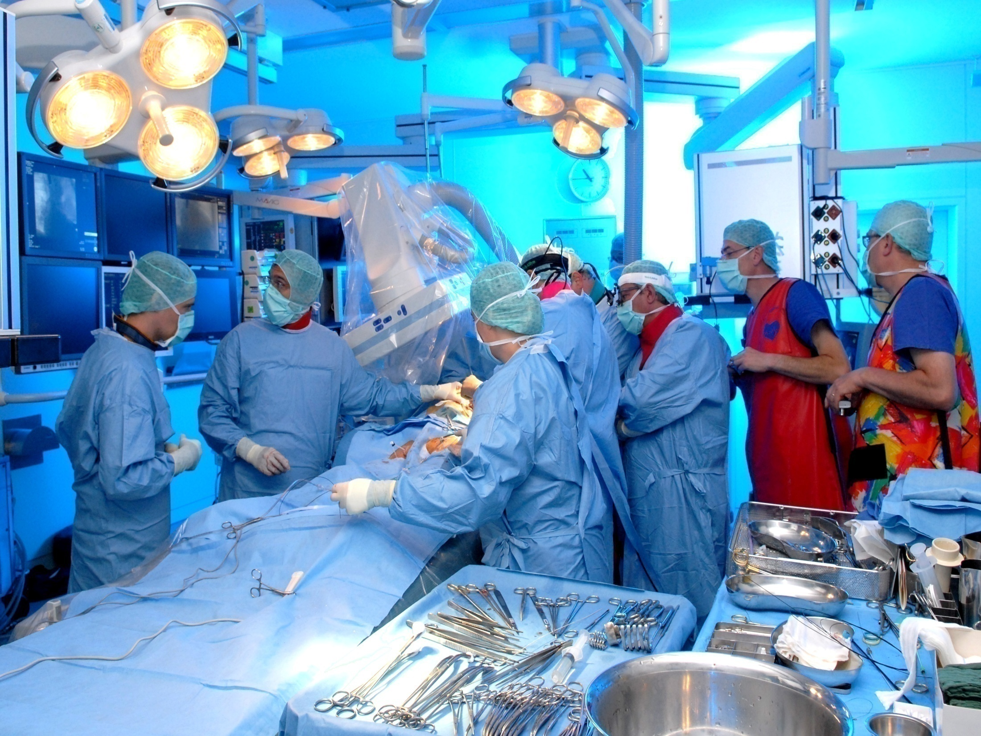
The Team

Slide 30
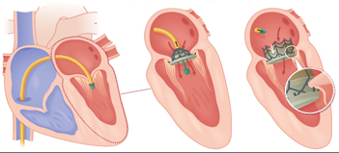
The Examination in Cardiothoracic Surgery
Mitral replacement…you also wish to not do it?

Slide 31
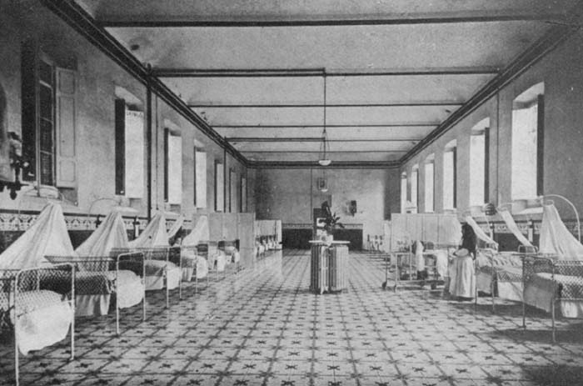
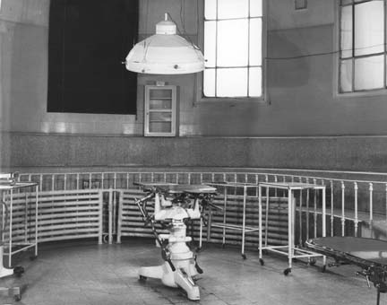
Reductionism: the hospital´s approach
SERVICES OF CARDIOLOGY
AND
CARDIOVASCULAR SURGERY
Department of Medicine
INSTITUTES
OF
CARDIOVASCULAR
DISEASES
Department of Surgery

Slide 33
PATIENT
TECHNIQUES
Cath Labs
Operating Rooms
MYOCARDIAL
REVASCULARIZATION
UNIT
VALVE
THERAPY
UNIT
HEART FAILURE AND
TRANSPLANTATION
UNIT
ARRHYTHMIAS
UNIT

Slide 34
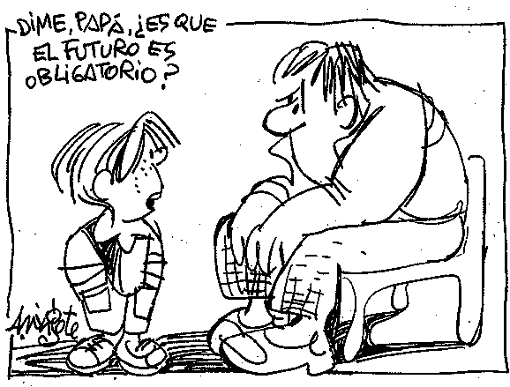
Tell me, dad: Is the
future mandatory?

Slide 35
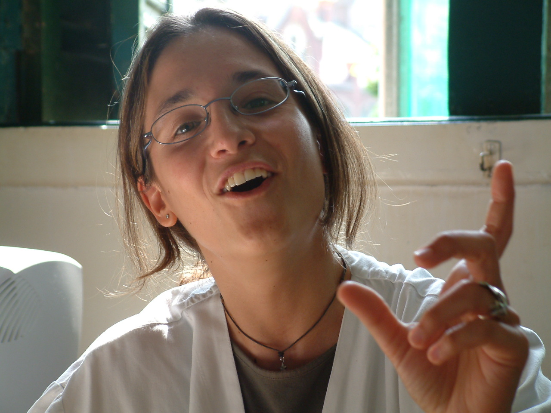
The Examination in Cardiothoracic Surgery
“Our future is in the residents whom we educate “ Irving L. Kron, MD Forty-third Annual Meeting of the Southern Thoracic Surgical Association, Cancun, Mexico, November 1996.

Slide 36
The Examination in Cardiothoracic Surgery
Final Stage
The curriculum for each of the modules is defined (see syllabus). Aims and levels of competence to be attained within each module by the end of this stage are identified.
The list of specialist index conditions is detailed below. All trainees (including those who are developing additional special interests and those who are taking academic pathway) will be required to meet these standards.
The management of critically ill cardiothoracic surgical patients in the pre and post operative periods.
The management of a patient undergoing cardiopulmonary bypass
The management of myocardial protection during cardiac surgery
The management of a patient requiring circulatory support
The assessment and management of patients with coronary heart disease, including elective and emergency presentations. To include competence in both primary and secondary procedures, and where appropriate to include off pump and on pump strategies and arterial revascularisation
The preliminary assessment and initial management of patients with complications of myocardial infarction, including mitral regurgitation, aneurysm and septal defects. To include operative management in appropriate situations. Full competence in operative management of complex cases to be developed in the post CCT period

Slide 37
The Examination in Cardiothoracic Surgery
The assessment and management of patients with valvular heart disease; including both isolated and combined aortic and mitral valve disease.
The assessment and management of patients with combined coronary and valvular heart disease, including operative management.
Full competence in operative management of complex cases including mitral valve repair and secondary procedures to be developed in the post CCT period.
The preliminary assessment and initial management of patients with acute dissection of the ascending aorta. To include operative management in appropriate situations.
Full competence in operative management of complex cases to be developed in the post CCT period
The assessment and management of patients with minor and major cardiothoracic trauma. To include operative management in appropriate situations.
Full competence in the operative management of complex cases including great vessel injury to be developed in the post CCT period

Slide 38
The Examination in Cardiothoracic Surgery
Patient selection and determination of suitability for major thoracic surgery and the pre and postoperative management of a thoracic surgical patient.
The assessment and management of a patient by bronchoscopy including foreign body retrieval
The assessment and management of a patient by mediastinal exploration
Competence in performing appropriate thoracic incisions
The assessment and management of lung cancer, including the scientific basis of staging systems and techniques used in the determination of stage and fitness for surgery
An understanding of the role of surgical treatment in the multidisciplinary management of lung cancer and other intrathoracic malignant diseases, including an appreciation of the principles of other treatment modalities and their outcomes

Slide 39
The Examination in Cardiothoracic Surgery
The assessment and management of patients with pleural disease; including pneumothorax and empyema, and including both VATS and open strategies
The assessment and management of patients with chest wall abnormalities, infections and tumours
The assessment and management of patients disorders of the diaphragm, including trauma to the diaphragm
The assessment and management of patients with emphysematous and bullous lung disease; including surgical management if appropriate and utilising both VATS and open strategies.
Full competence in operative management of complex cases, including lung reduction surgery, to be developed in the post CCT period
The assessment and management of patients with disorders of the pericardium and pericardial cavity; including surgical management if appropriate and utilising both VATS and open strategies
The assessment and management of patients with mediastinal tumours and masses; including surgical management if appropriate and utilising both VATS and open strategies

Slide 40
The Examination in Cardiothoracic Surgery
The assessment and management of patients with disorders of the major airways. Including operative management in suitable cases.
Full competence in operative management of complex cases, including tracheal resection, to be developed in the post CCT period
The curriculum is flexible and can accommodate the needs of trainees following an academic pathway. This is achieved by having individualised learning agreements. It is however acknowledged that academic trainees will need longer training pathways to achieve the essential competencies.

Slide 41
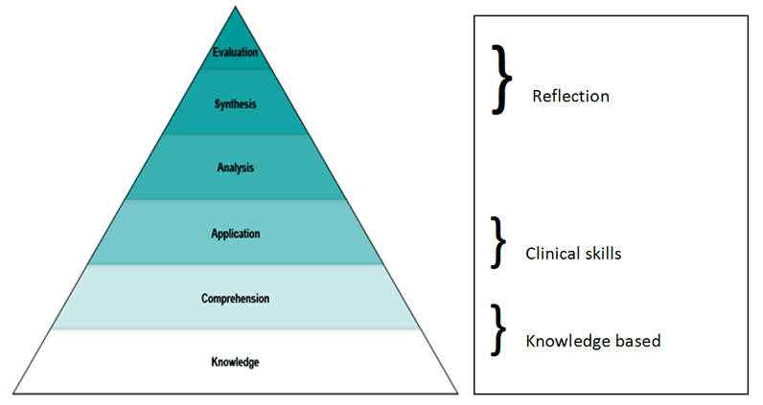
Blooms Taxonomy

