Slide 1

EACTS/ESC GUIDELINES ON CORONARY SURGERY
MARKO TURINA
ZURICH
SWITZERLAND

Slide 2
Modern guidelines are based on prospective randomized studies, which are supposed to be the most exact art of scientific analysis.

Slide 3
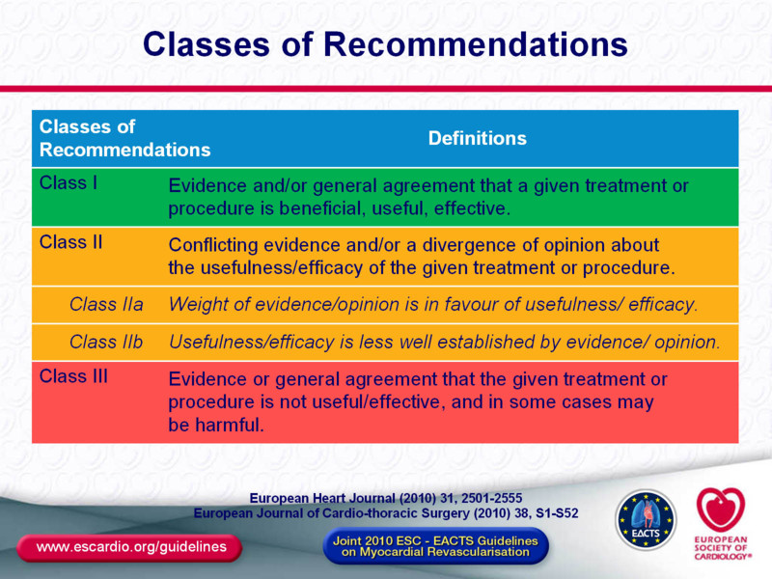

Slide 4
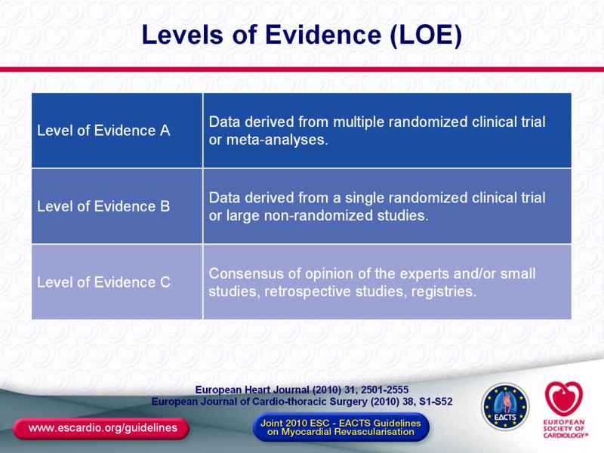

Slide 5
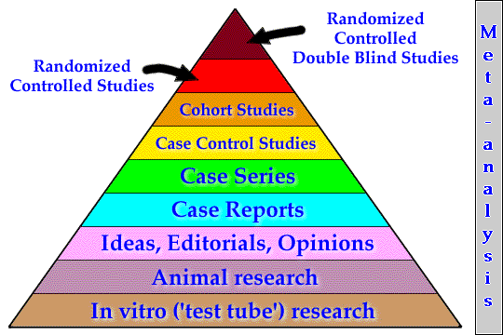
Levels of Evidence
Level A
Level B
Level C
Notes:
5

Slide 6
Major weakness of many randomized CAD treatment trials:
low recruitment
selection bias by primary recruiter, i.e. cardiologist

Slide 7

STUDY ENROLLMENT IN MAJOR RANDOMIZED STUDIES COMPARING
PTCA TO CABG IN THE NINETIES
(91’730 patients screened)
RITA, ERACI, GABI, EAST, CABRI AND BARI trials

Slide 8

RANDOMIZATION IN ARTS TRIAL
(Arterial Revascularization Therapy Study)
University Hospital Zürich, April-December 1997, 986 patients

Slide 9
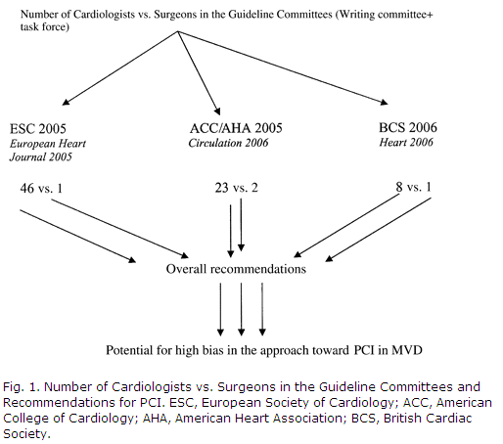
Participation of surgeons in creation of previous guidelines

Slide 10
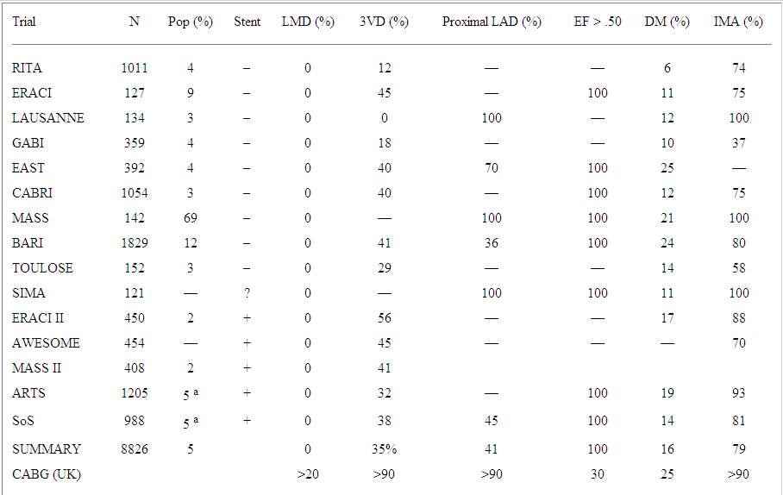
Patients in randomized trials do not reflect the present clinical practice
D.Taggart, Ann Thor Surg 2006

Slide 11
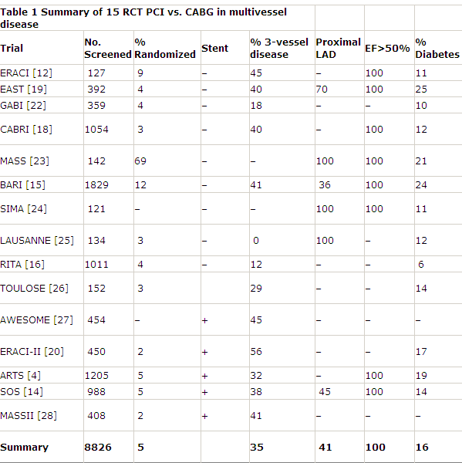
Previous CABG/PCI trials accepted only very low risk patients (e.g. normal LVEF, few diabetics)
Taggart 2006

Slide 12
It has been often observed that patients recruited for trial have better results than those eliminated from the trial because of some exclusion criteria.

Slide 13
NIFEDIPINE IN ACUTE MYOCARDIAL INFARCTION (TRENT TRIAL)
(9292 patients admitted with AMI)

Slide 14
When analyzing a trial, look carefully at “Material and Methods” section: crucial information explaining the results might be found there.

Slide 15
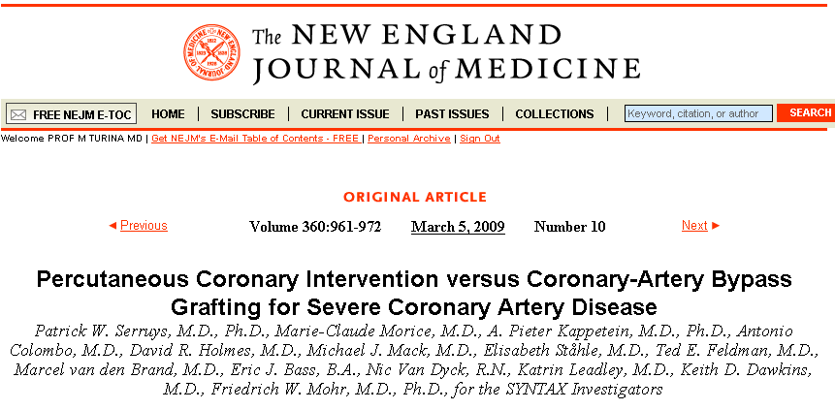
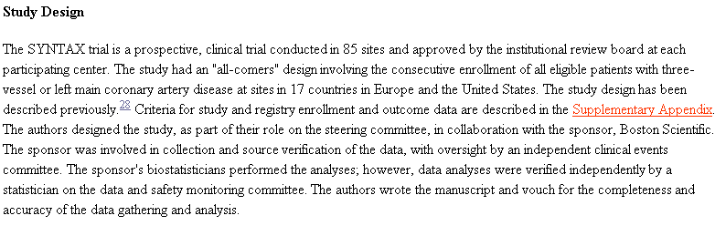

Slide 17
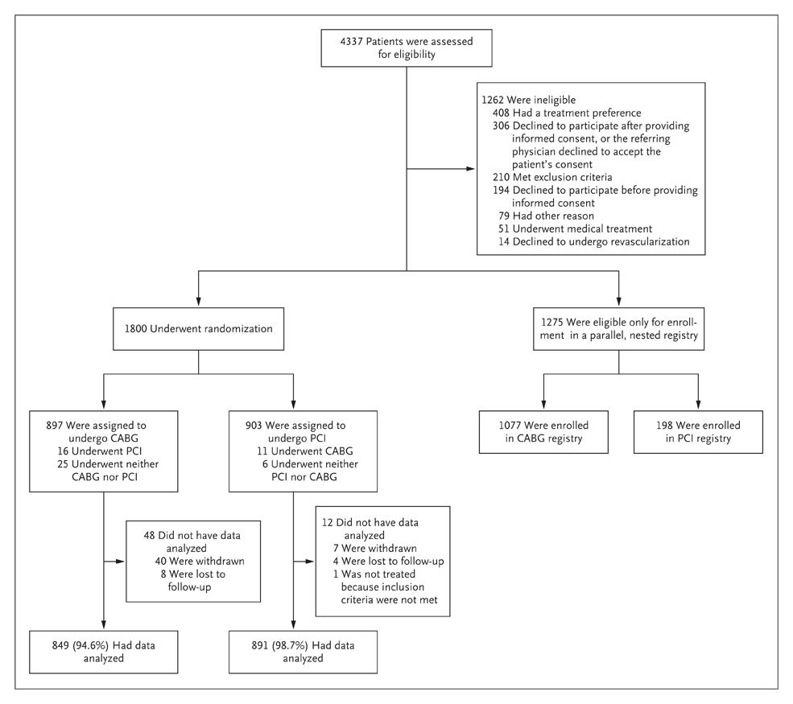

Enrollment and Randomization of Patients with Previously Untreated Three-Vessel or Left Main Coronary Artery Disease in the SYNTAX Trial
2 years, 85 centres:10.6 patients/year
Serruys P et al. N Engl J Med 2009;360:961-972
Notes:
17
Figure 1. Enrollment and Randomization of Patients with Previously Untreated Three-Vessel or Left Main Coronary Artery Disease in the SYNTAX Trial. The trial used an "all-comers" design. Exclusion criteria were previous intervention, acute myocardial infarction, and concomitant surgery. Patients meeting either of the first two exclusion criteria were, according to the trial design, excluded without consultation of the local interventional cardiologist and cardiac surgeon. The need for concomitant surgery was discussed with the local interventional cardiologist and cardiac surgeon. Data for patients who were assigned to one treatment but underwent the other and for those who did not undergo either revascularization procedure were analyzed in an intention-to-treat manner. CABG denotes coronary-artery bypass grafting, and PCI percutaneous coronary intervention.

Slide 18
Average number of patients seen by centres in Syntax trial is less than 11 patients/year! If we accept the fact that “all comers” , i.e. all patients with 3VD and LM entered the trial, these centres should have been closed, according to present standard of PCI and CABG practice, because of insufficient annual volume. They should have never been allowed to conduct a scientific trial.

Slide 19
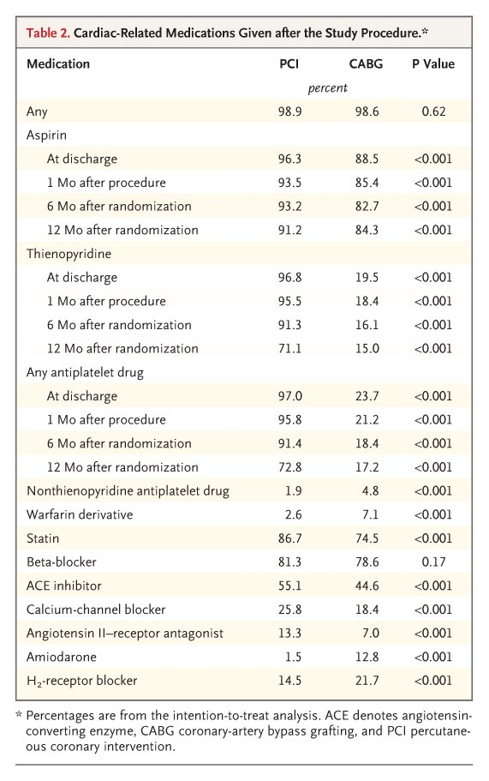
Cardiac-Related Medications Given after the Study Procedure
Serruys P et al. N Engl J Med 2009;360:961-972
Notes:
Table 2. Cardiac-Related Medications Given after the Study Procedure.

Slide 20
A study with radically different drug treatment protocols in the two analyzed groups is statistically invalid.

Slide 21
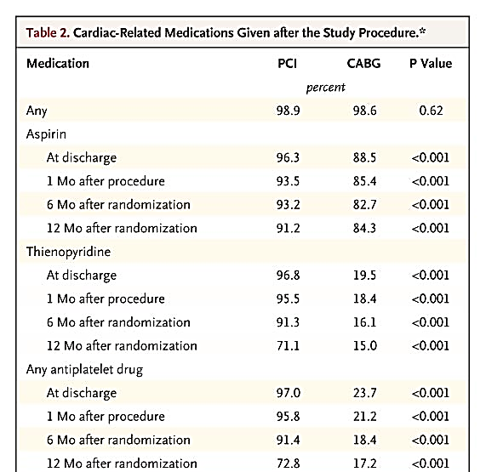

Slide 22
One factor which is disregarded in multi-institutional trails: variable quality of treatment, especially in surgery.
Example: in Excel trial, one participating centre had a CABG mortality of 50 % (4/8 patients) and had to be excluded from trial; but their results still remain in trial analysis!

Slide 24
Beware of industry sponsored trials! Results very often meet the sponsor’s expectations!

Slide 25

Difference in outcome in trials funded by for-profit and not-for-profit sources
JAMA 2006; 295(19):2270-4

Slide 26
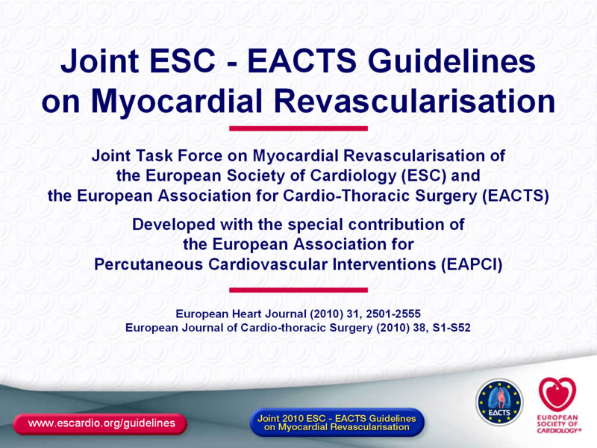

Slide 27
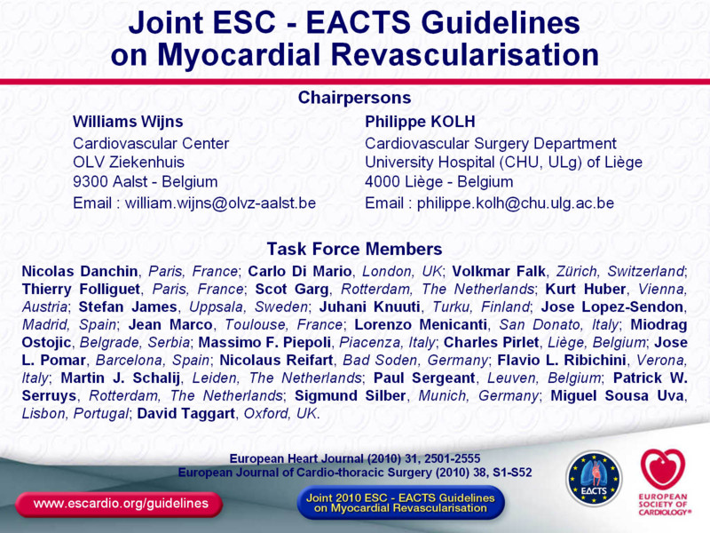

Slide 28
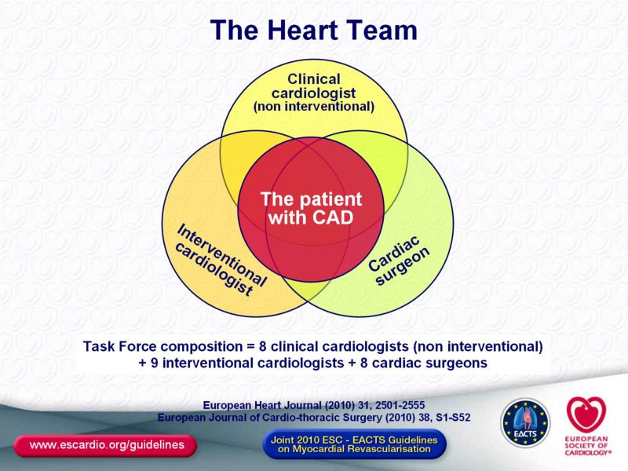

Slide 29
Majority of modern PCIs are carried out during first coronary catheterization, now called “Ad hoc” PCI, where the surgeon naturally cannot be consulted.

Slide 30
Major problem area: “ad hoc” PCI
Routine coronary angiography usually detects significant coronary disease in a half to two thirds of patients.
It is practically impossible to hold heart team session during catheterization: surgeon is not available, no time for extended discussion with the patient.
It is highly objectionable to interrupt the procedure, remove catheters and possibly perform PCI next day: costs, discomfort for the patient, misuse of valuable catheter laboratory time.

Slide 31
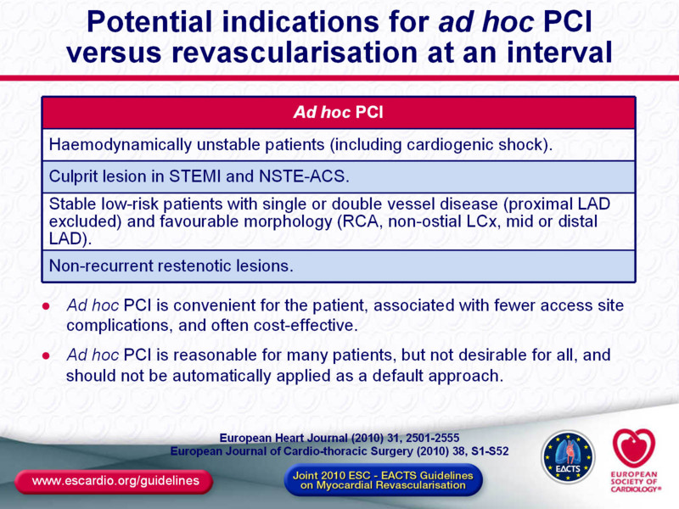

Slide 32
What is the place of medical management of CAD, previously (and in less developed countries even today) considered the mainstay of CAD therapy?

Slide 33
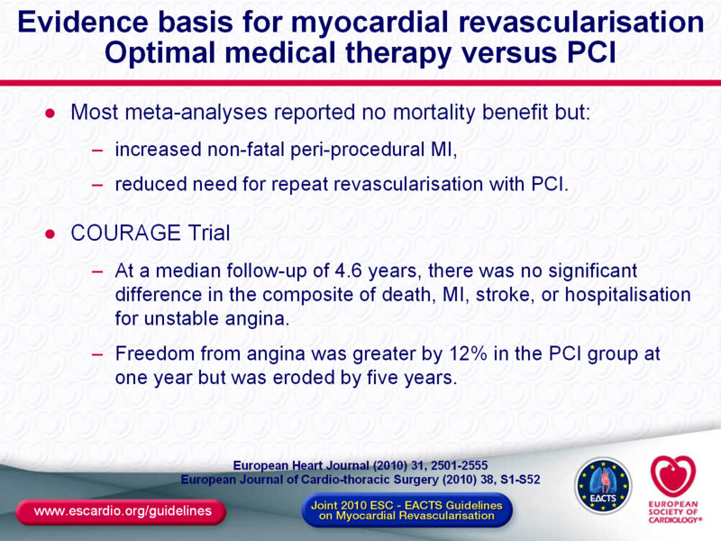

Slide 34
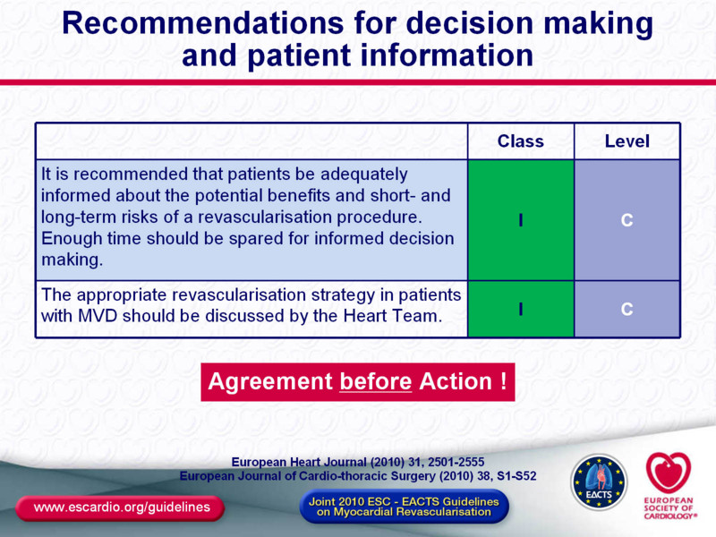

Slide 35
New ESC/EACTS guidelines contain a major surprise: increased importance of CABG vs. PCI in majority of patient categories.

Slide 36
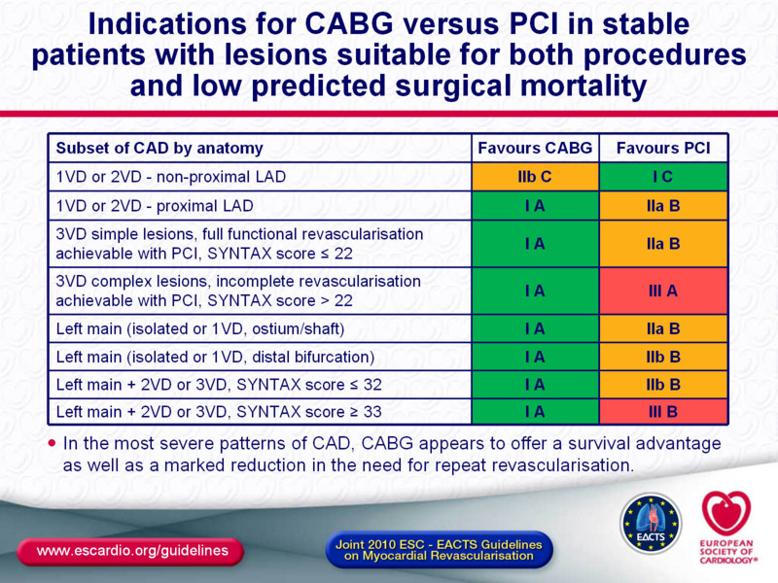

Slide 37
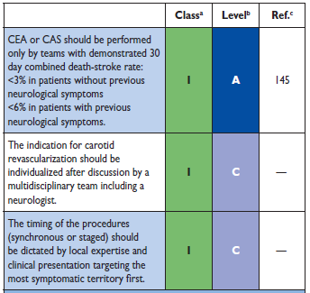
Simultaneous CABG and carotid disease treatment

Slide 38
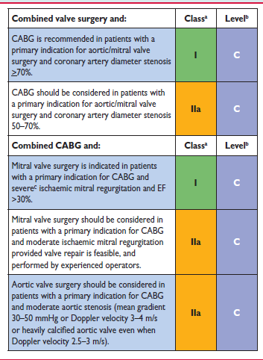
Simultaneous CABG and valve surgery

Slide 39
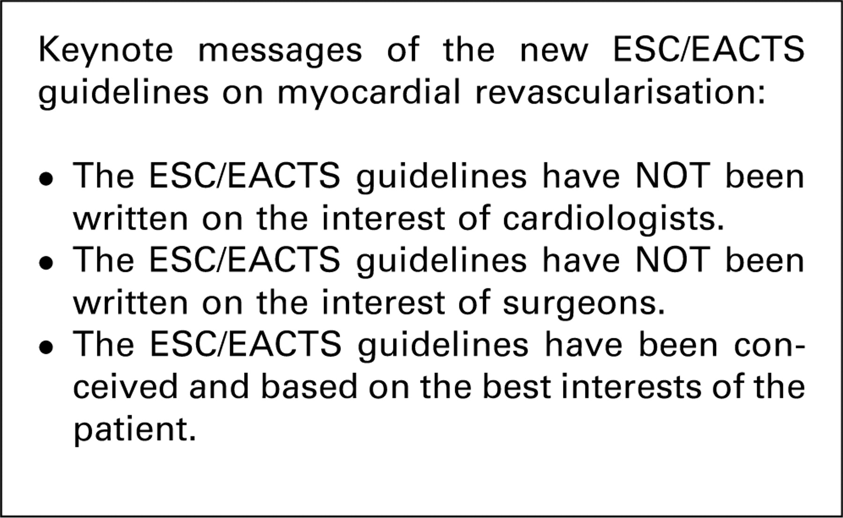

Ribichini F , Taggart D Eur J Cardiothorac Surg 2011;39:619-622
© 2010 European Association for Cardio-Thoracic Surgery

Slide 40
Guidelines are now well known: are they followed?
Strict application of guidelines would massively reduce number of PCIs.
This fact would have major financial impact on many hospitals and on interventionists themselves.
Presently, in many countries there is no evidence that these guidelines are being followed.

Slide 41
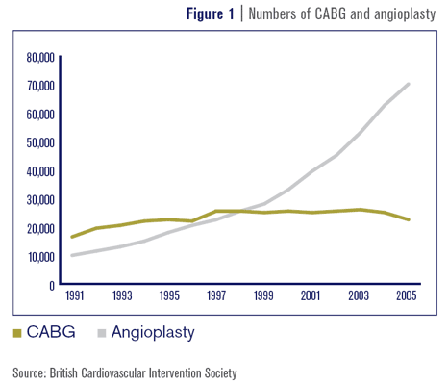
In all highly developed countries, number of PCIs is still increasing and CABGs is going down

Slide 42
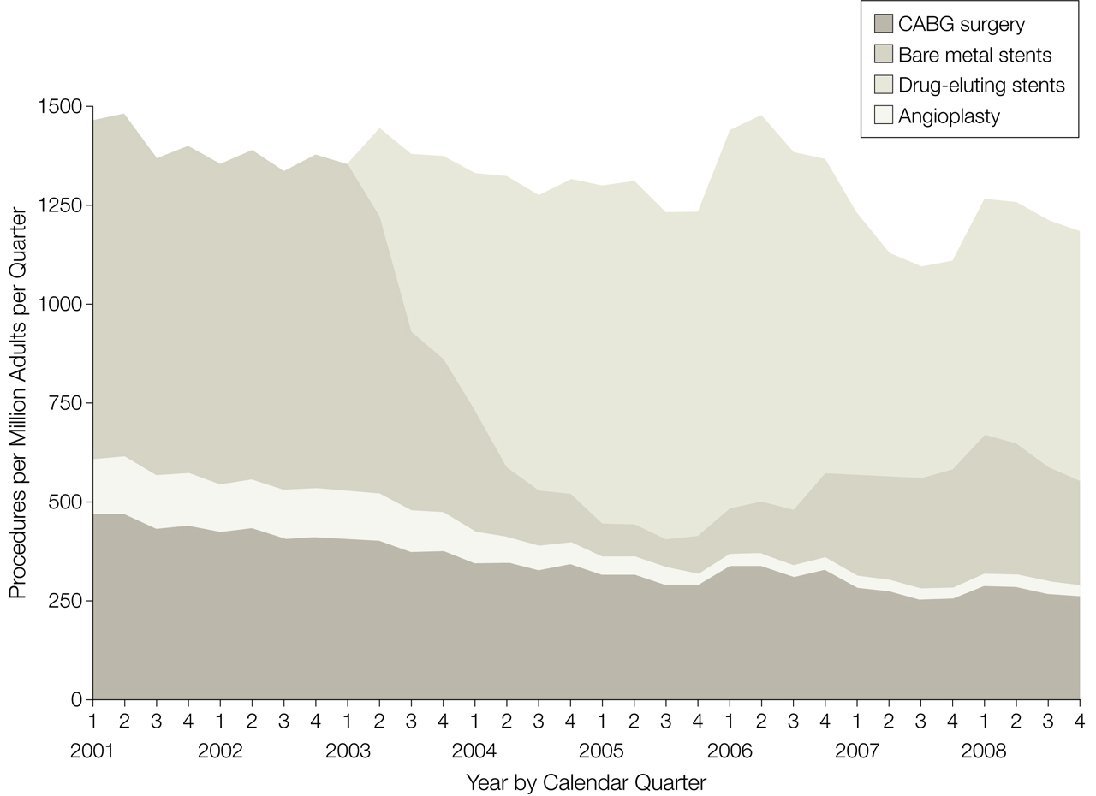

Notes:
CABG indicates coronary artery bypass graft.

Slide 43
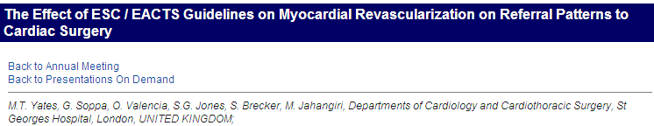

In spite of widely publicized EACTS/ESC guidelines, only a smallest proportion of CAD patients are discussed by a heart team, and large majority receives PCI.

Slide 44
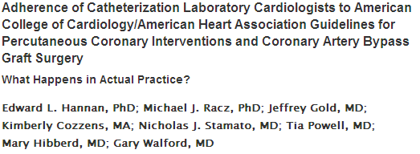


Slide 45
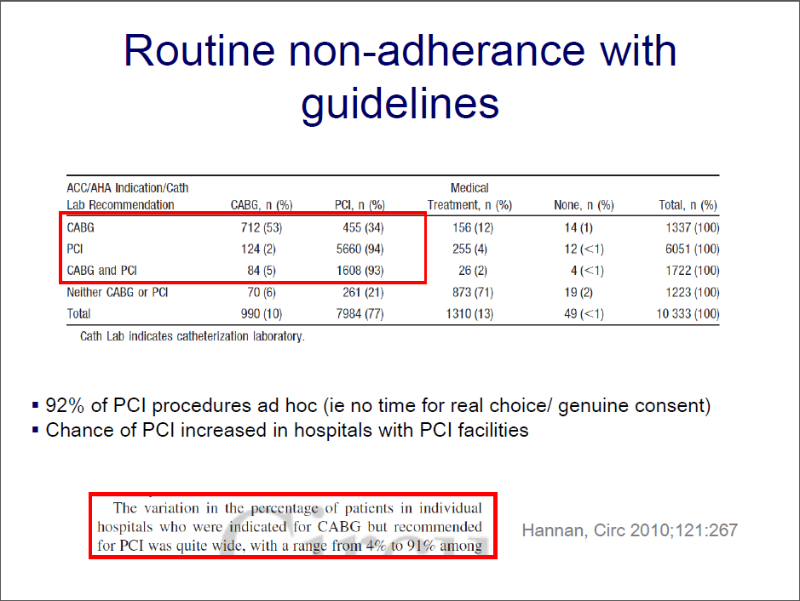

Slide 46
What happens in actual clinical practice in USA?
If patients has an acknowledged indication for CABG, he will get:
PCI in 43 %
CABG in 43 %
Medical treatment in 14 %
Hannan et al, Circulation 2010; 121: 267-275

Slide 47
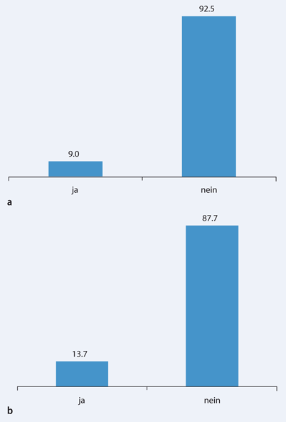


Standard procedure for dealing with an ad hoc PCI established?
Yes
No
Heart team established?
Cremer et al.: Poll of German Cardiosurgical centres, 2011
Cremer et al, 2011

Slide 48
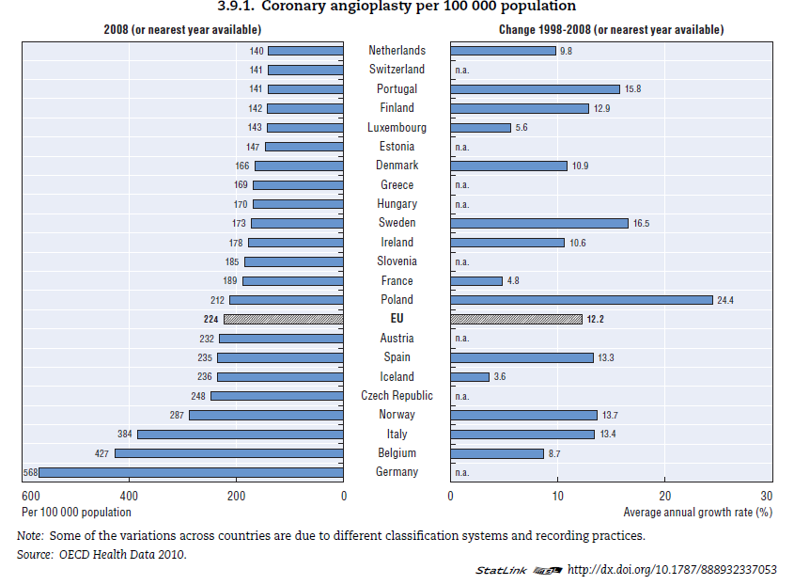
Notes:
CABG indicates coronary artery bypass graft.

Slide 49
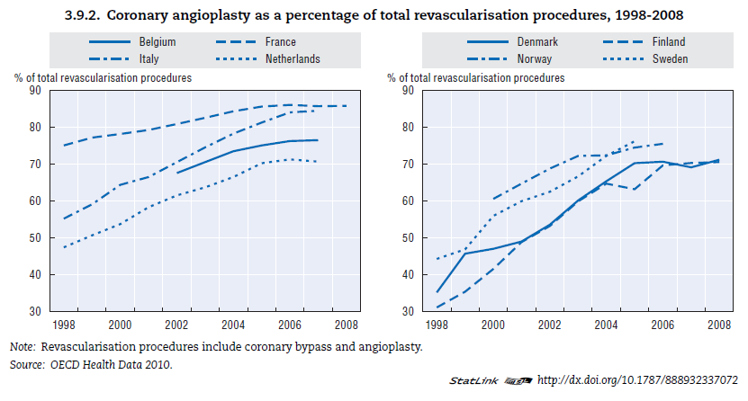
Percentage of PCIs is dependent on financial remuneration
Cardiologists income independent of PCI
Cardiologists paid for PCI
Notes:
CABG indicates coronary artery bypass graft.

Slide 50

Unnecessary stenting in Florida in 2008
Abbott even celebrated the fact that the handy doctor had inserted 30 of the company’s cardiac stents into trusting patients during a single day in August 2008:
“Two days later, an Abbott sales representative spent $2,159 to buy a whole, slow-smoked pig, peach cobbler and other fixings for a barbecue dinner at Dr. Midei’s home.”
“Hospitals can’t bill $12,000 for deciding not to implant a stent, even if that’s the best thing for the patient.”

Slide 51
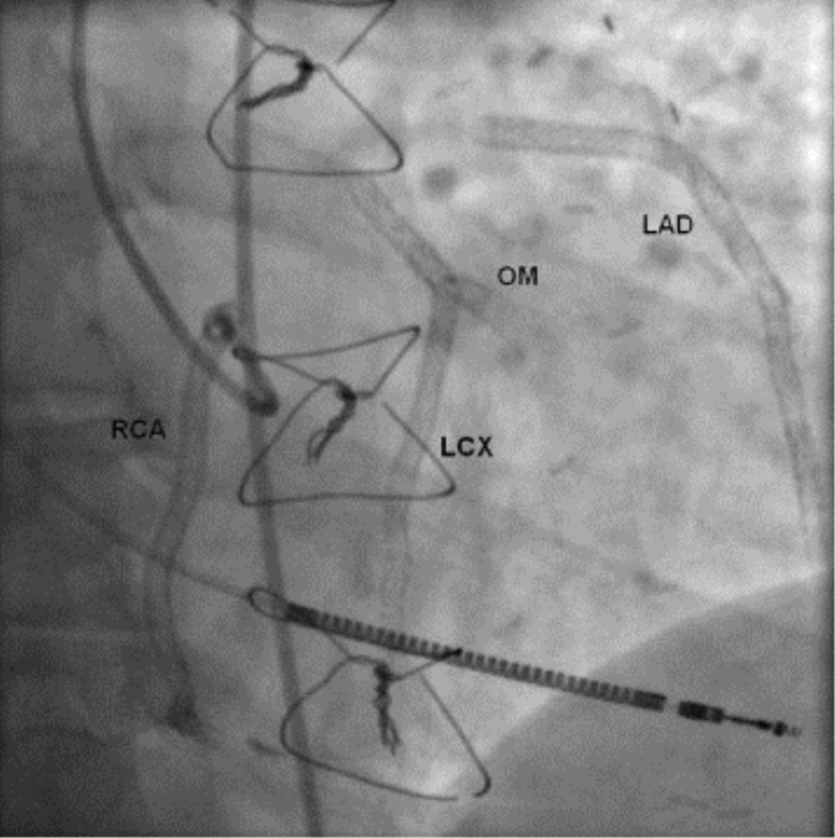
From: A Heart With 67 Stents
J Am Coll Cardiol. 2010;56(19):1605-1605. doi:10.1016/j.jacc.2010.02.077
“Sometimes patients have so many stents that later bypass surgery becomes impossible. That’s called a full metal jacket.”
Date of download:
3/6/2014
Copyright © The American College of Cardiology.
All rights reserved.

Slide 52
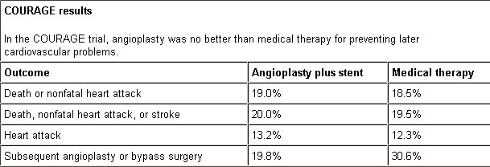
COURAGE Trial
(Clinical Outcomes Utilizing Revascularization and Aggressive Drug Evaluation)
Results after 4.5 years of follow-up

Slide 53
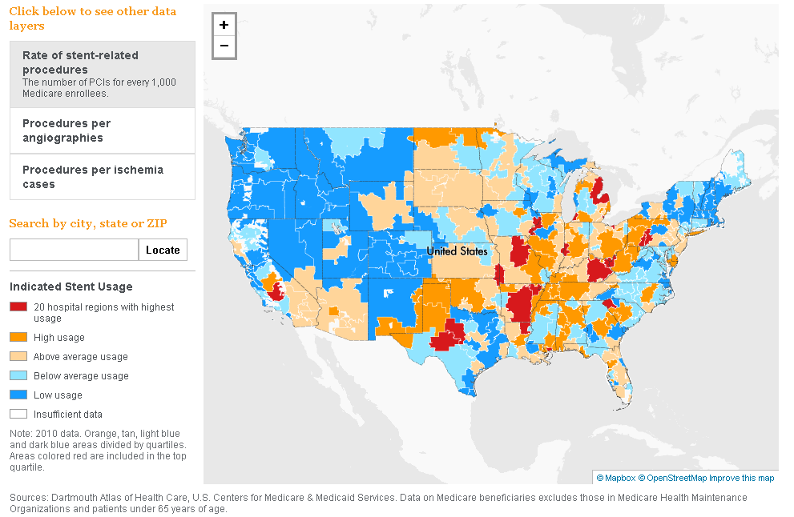
Interactive stent map of USA ….

Slide 54

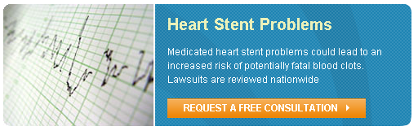
In US, Lawyers are discovering a new profit area: stent lawsuits

Slide 55
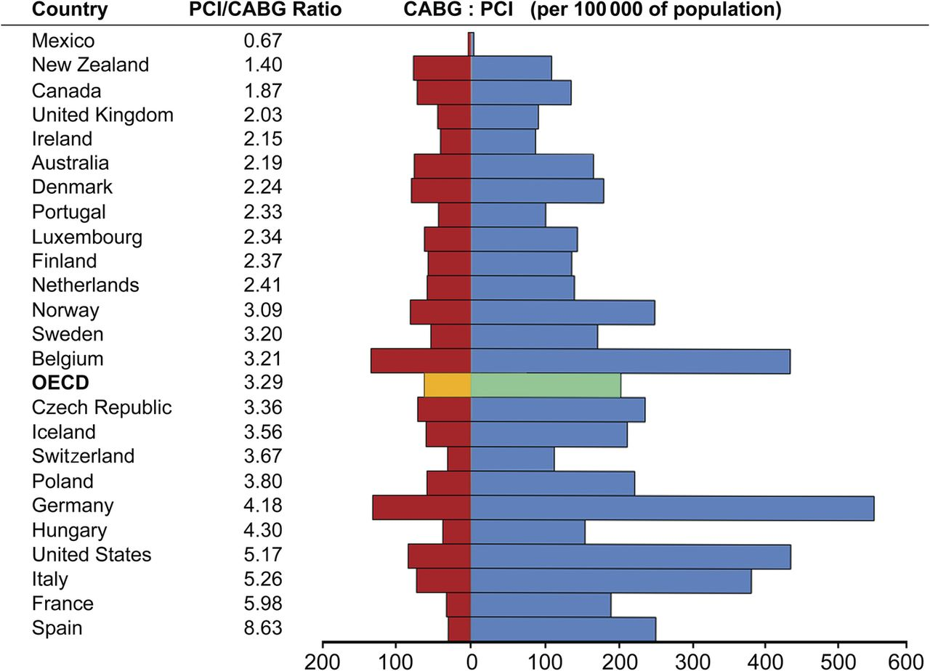

Revascularization procedures performed in countries throughout the Western world.
Head S J et al. Eur Heart J 2013;eurheartj.eht059
Published on behalf of the European Society of Cardiology. All rights reserved. © The Author 2013. For permissions please email: journals.permissions@oup.com
Notes:
Revascularization procedures performed in countries throughout the Western world. Data from the Organisation for Economic Cooperation and Development (OECD) shows a great variety in the number of revascularization procedures per 100 000 inhabitants.¹³ CABG, coronary artery bypass grafting; PCI, percutaneous coronary intervention.

Slide 56
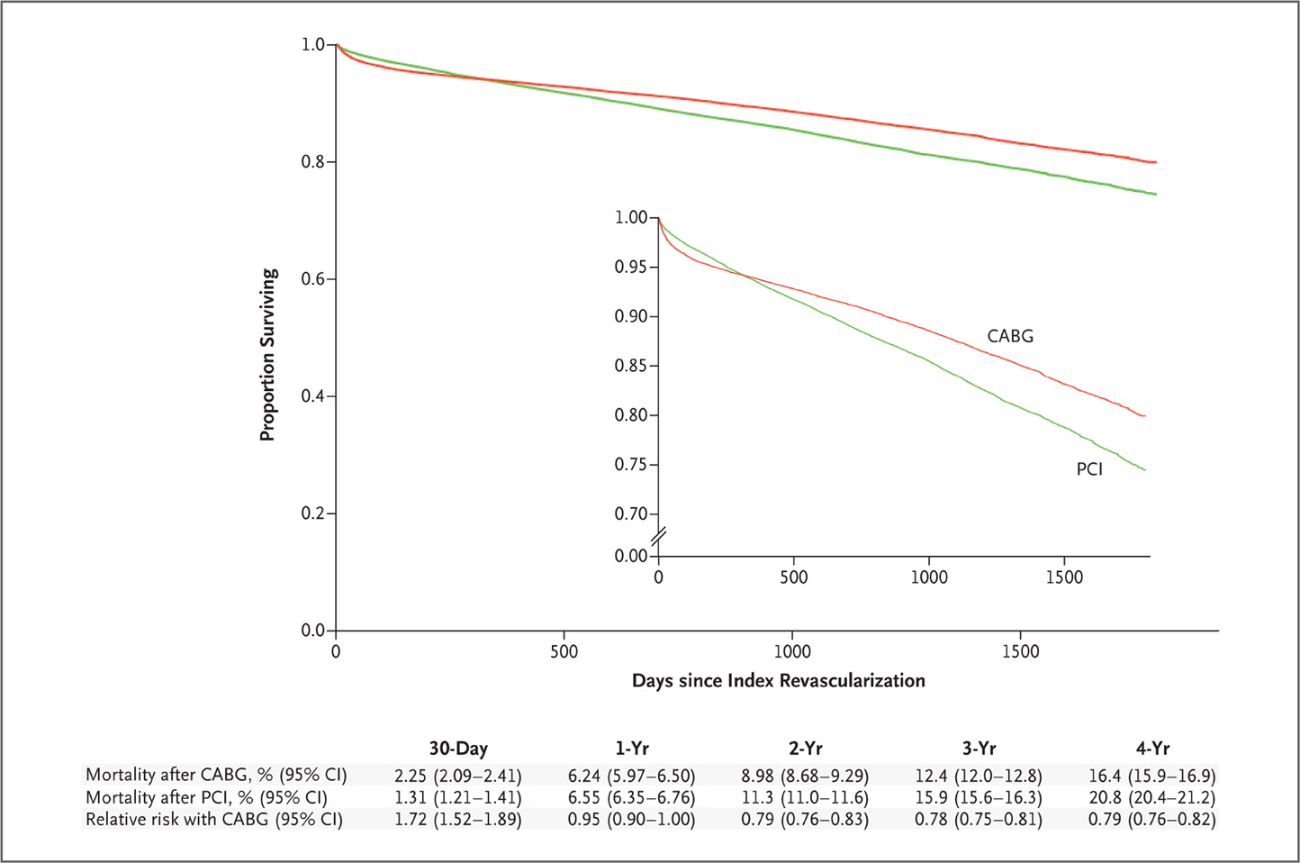

Rates of Survival in the CABG and PCI Populations, from an Analysis Adjusted with the Use of Inverse Probability Weighting.
Analysis of ~ 200’00 patients with CAD
Weintraub WS et al. N Engl J Med 2012;366:1467-1476.
Notes:
Figure 3. Rates of Survival in the CABG and PCI Populations, from an Analysis Adjusted with the Use of Inverse Probability Weighting. Cumulative mortality with CABG and with PCI and the relative risk of CABG as compared with PCI are shown. The inset shows the same data on an enlarged y axis.

Slide 57
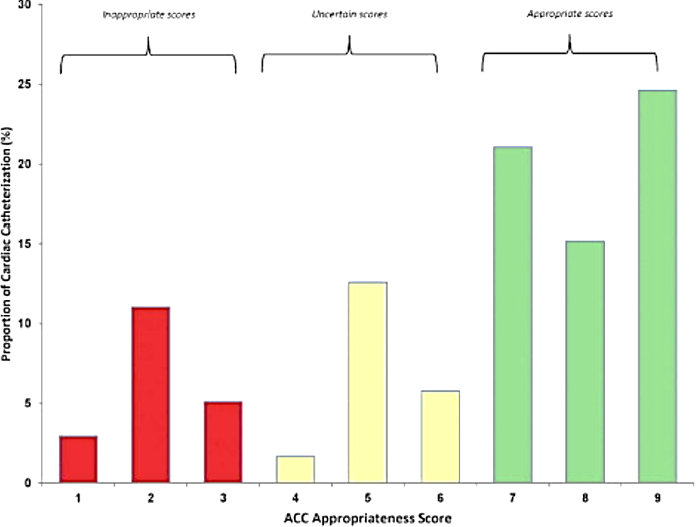
From: Assessing the Association of Appropriateness of Coronary Revascularization and Clinical Outcomes for Patients With Stable Coronary Artery Disease
J Am Coll Cardiol. 2012;():. doi:10.1016/j.jacc.2012.06.056
40 % of all PCIs are inappropriate or uncertain
ACC has recently banished word "inappropriate" in reference to patients who don't need stent implants. Instead, it calls these cases "rarely appropriate." For patients where the use of cardiac stents unclear, ACC has coined the phrase "may be appropriate" to replace "uncertain."
Figure Legend:
Distribution of Appropriateness Score
Distribution of the appropriateness score in patients with stable coronary artery disease undergoing cardiac catheterization. A score of 1 to 3 indicates inappropriate indication, a score of 4 to 6 indicates uncertain indication, and a score of 7 to 9 indicates appropriate indication for coronary revascularization. ACC = American College of Cardiology.
Date of download:
10/23/2012
Copyright © The American College of Cardiology.
All rights reserved.

Slide 58

CABG in Switzerland, 2001 – 2006: 30 % reduction of operative revascularizations, only 20 % are OPCAB
Source: Prof. T.Carrel, Bern

Slide 59
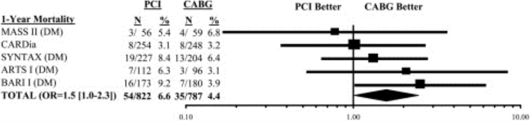
From: 2011 ACCF/AHA/SCAI Guideline for Percutaneous Coronary Intervention: A Report of the American College of Cardiology Foundation/American Heart Association Task Force on Practice Guidelines and the Society for Cardiovascular Angiography and Interventions
J Am Coll Cardiol. 2011;58(24):e44-e122. doi:10.1016/j.jacc.2011.08.007
Figure Legend:
1-Year Mortality After Revascularization for Multivessel Disease and Diabetes Mellitus
An OR of >1 suggests an advantage of CABG over PCI. ARTS I indicates Arterial Revascularization Therapy Study I (185); BARI I, Bypass Angioplasty Revascularization Investigation I (74); CABG, coronary artery bypass graft; CAD, coronary artery disease; CARDia, Coronary Artery Revascularization in Diabetes (186); CI, confidence interval; MASS II, Medicine, Angioplasty, or Surgery Study II (78); OR, odds ratio; PCI, percutaneous coronary intervention; SYNTAX, Synergy between Percutaneous Coronary Intervention with TAXUS and Cardiac Surgery; and W, weighted (76).
Date of download:
5/16/2013
Copyright © The American College of Cardiology.
All rights reserved.

Slide 60
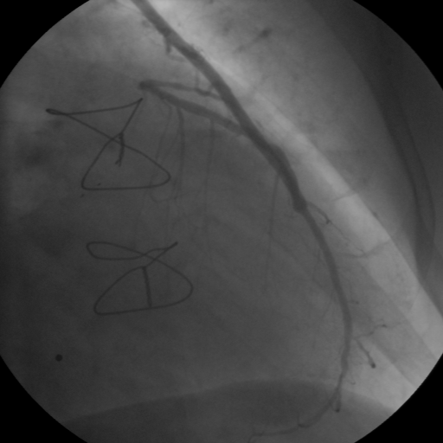
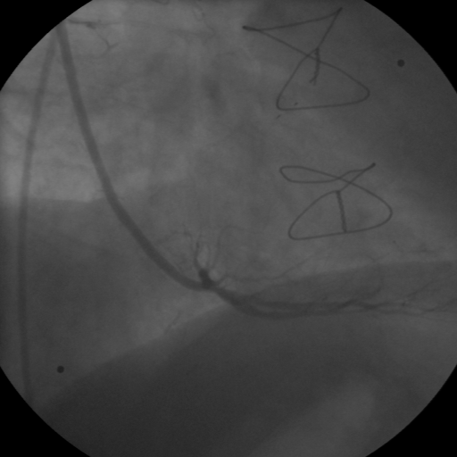
Bilateral IMA grafting: a “permanent” solution

Slide 61
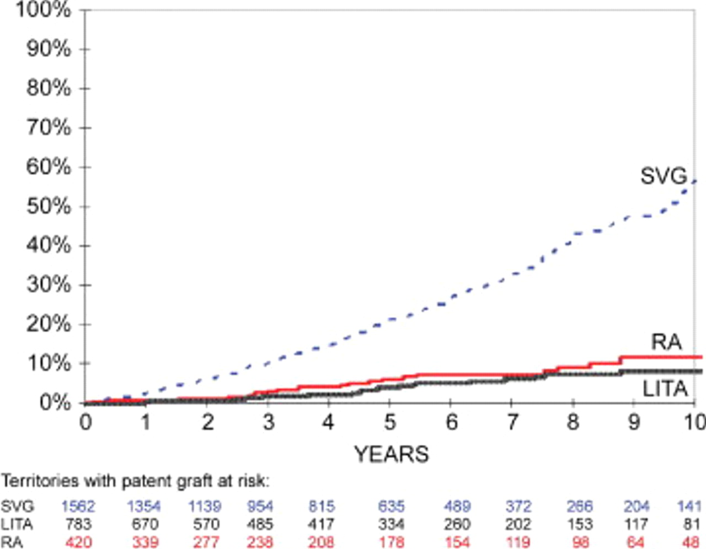

Kaplan-Meier-estimated disease progression rates in all territories with patent conduits
Dimitrova K. R. et al.; Ann Thorac Surg 2012;94:475-481
Copyright ©2012 The Society of Thoracic Surgeons

Slide 62
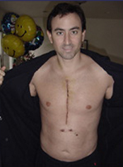
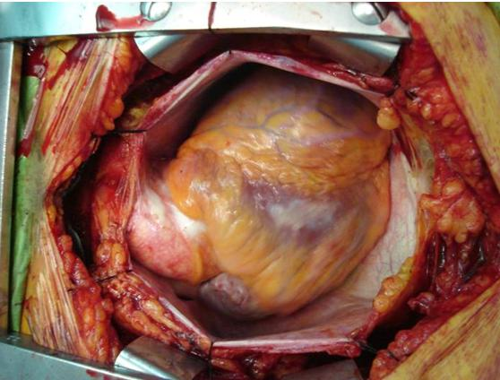
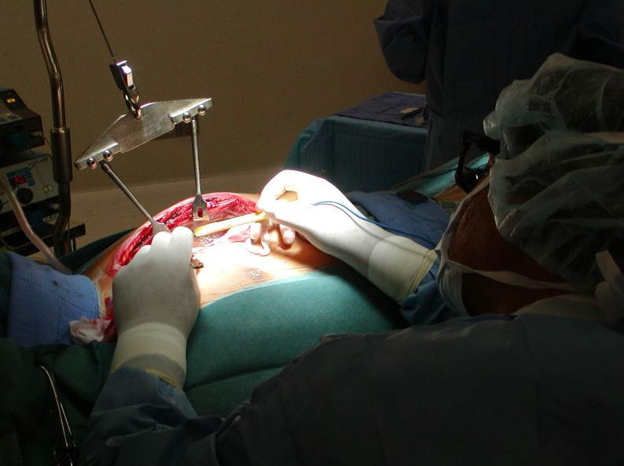
Classic CABG is neither small nor painless procedure

Slide 63

Patient information and consent
When asked, most patients will prefer the less invasive PCI over surgery

Slide 64
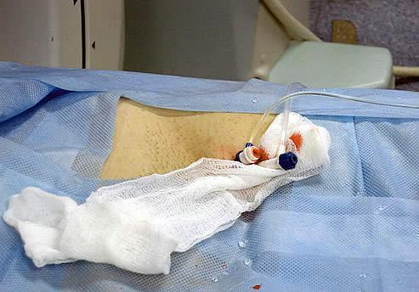
These two punctures are all what PCI needs

Slide 65
It is not a question if invasive cardiologist will replace the coronary surgeon, but only when.
Patrick Serruys, 2004

Slide 66

Iatrogenesis: inadvertent adverse effect or complication resulting from medical treatment or advice.
In coronary artery disease, also known as: “See it, stent it”
Circulation. 2000; 101: e198-e199

Slide 67
Stenting belongs to one of the bleakest chapters in the history of Western medicine. Cardiologists are marching on because the interventional cardiology industry has a cash flow comparable to the GDP of many countries and doesn’t want to lose it.
Nortin Hadler, professor of medicine at the University of North Carolina at Chapel Hill

