Slide 1
Echo LV function Assessment
Alfred Mureko
UCT
23/03/12

Slide 2
LV function
1.Systolic function
2.Diastolic function
Multiple parameters

Slide 3
LV systolic function
Major prognostic factor in cardiac disease
Systematic study through M-mode,2D and doppler flow Investigation
Allows assessment of global and regional LV systolic function
Change in LV geometry between systole and diastole

Slide 4
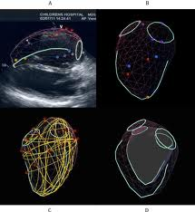
LV systolic function

Slide 5
Parameters in systolic function
Change in diameter
Change in area
Change in volume

Slide 6
Change in diameter
Fraction shortening-FS
M-mode analysis or 2D
LVEDD: 3.5-5.6 cm
LVESD: 2-4 cm
FS=(LVEDD-LVESD)/LVEDD *100
Normal:26-45%

Slide 7
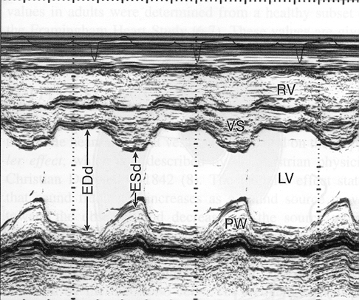

Slide 8
Fraction shortening(FS)
Limitations
LV must contract uniformally to reflect global LV functioning
Caution in conditions that can change cardiac geometry :
segmentally diseased LV
dilated RV
LBBB

Slide 9
Change in Fractional Area
2D echo measurement,
EDA,ESA
EDA-ESA/EDA *100
Normal: greater than 45%
Also affected by conditions affecting cardiac geometry

Slide 10
Change in volume-EF
EF: well accepted useful index of LVF
Interaction: preload,afterload and contractility in determining LV fx
Not a measure of contractility but crude indicator of systolic fx
EF=EDV-ESV/EDV *100
Normal EF:50-80%

Slide 11
Methods of EF calculation
Area-length method
Simpsons Rule
“eye ball”
SV:SV=Flow velocity integral *AVA
Normal:70-140ml/beat

Slide 12
EF in AS
Severity:PG,AVA,flow velocities
PG is a reliable indicator of AS
severity only with good LV function
PG will fall as the LV fx deteriorates in
end-stage disease
AVA is less flow dependant than PG
Dobutamine stress echo
Truly severe AS vs Aortic pseudo-stenosis

Slide 13
EF in MR
LVEF is always overestimated
EF more than 60% is normal
LVID(FS) is a better indicator of LV
function

Slide 14
Systolic function
Regional wall motion
LV segmental analysis
Apical/mid/basal
Hypokinesis,akinesis,dyskinesis,normal
WMSI as powerful as EF in prognosticating patients after MI.

Slide 15
Systolic function
Tissue doppler assessment
Tissue velocity and not blood velocity
Systolic velocity from MV annulus
Good index of global LV function
Velocity>8cm/s: good EF
Velocity<3cm/s: poor EF

Slide 16
Other Parameters in systolic fx
LV wall thickness:6-12mm
>12mm-LVH,independant
prognostic indicator in CVS
disease
Amplitude of IVS
indicator of LV fx

Slide 17
Diastolic function
Ability of the LV to accommodate blood
LV wall relaxation, filling, compliance
Normal LV-EF in CCF should spark suspicion about possible diastolic failure
Generally worsens with age: reversed E:A

Slide 18
Parameters in Diastolic function
Trans-mitral velocities
PWD Pulmonary veins
Tissue Doppler Investigation

Slide 19
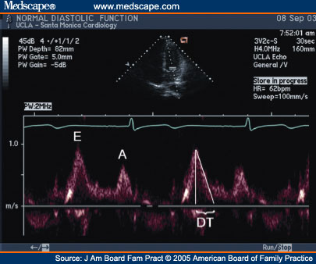
Trans-mitral velocities

Slide 20
Transmitral velocities
E:A ratio: 0.75-1.5
DT: 140-220ms
Diastolic dysfunction:
reversal of E:A ratio, pseudonormalisation
short/prolonged DT
DT:shortened by high LVEDP
prolonged by impaired LV relaxation

Slide 21
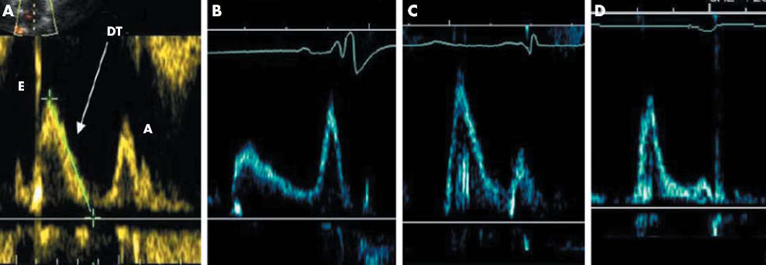
Trans-mitral velocities

Slide 22
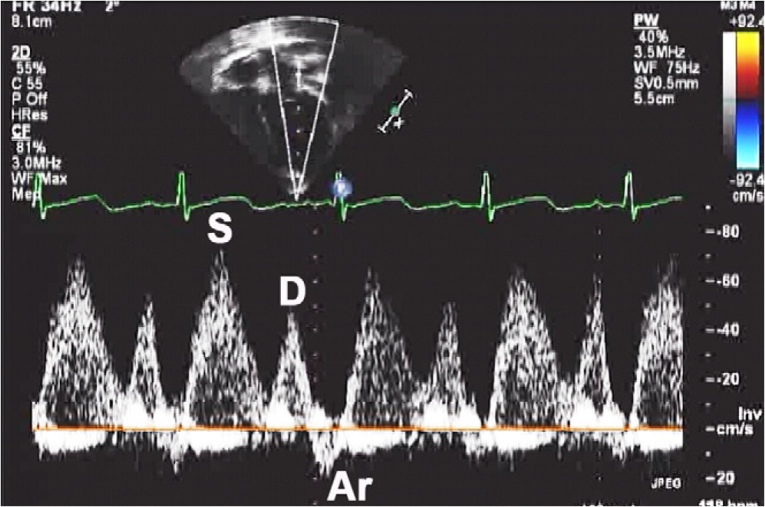
Pulmonary vein PWD

Slide 23
Pulmonary veins PWD
S-wave: antegrade LA inflow
blunted in poor LV relaxation
D-wave: antegrade LA inflow
Ar-wave: retrograde flow into PV
augmented in poor LV compliance

Slide 24
Grading of diastolic dysfx
Normal diastolic fx(normal e:a)
Impaired relaxation(e:a reversal)
Pseudonormalisation(e:a appears normal)
Restrictive filling(e:a more than 2)

Slide 25
Hallmark of diastolic dysfx
Reversal of E:A
Prolonged DT
Augmented Ar-wave on PV PWD

Slide 26
THE END...
I miss the days when apples and blackberries were just fruits...

